Slide 1

Wine Review Analysis
Team 6
Fangqing Wu 001305642
Yangyang Zhang 001342955
Xinzhu Huang 001744806

Slide 2
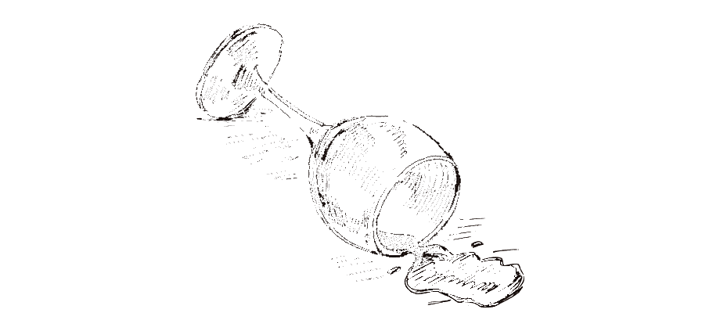
Overview
Dataset used : https://www.kaggle.com/zynicide/wine-reviews
Significant features: points, prices, country, description, title, variety, winery and etc.
This project conducts the wine reviews analysis includes data preprocessing, natural language processing, and machine learning to implements the functions of points prediction and wine recommendation based on user inputs.

Slide 3
Use Cases
Summarized tables generated by spark sql .
[Play Framework] By typing in any description, users can get 10 wine recommendations ordered by points.
[Play Framework] By fill in some features of a certain wine, users can get the predicted point of it.

Slide 4
Methodology
SQL search
Use Spark SQL to generate summarized table
Points Prediction
Use Random Forests Regression with TF-IDF to predict the point based on descriptions
Recommendation
Use KMeans Clustering with feature harsher to generate wine recommendation lists of wines based on other features

Slide 5
Evaluation & Acceptance Criteria
Based on Use Cases:
1. To get summarizations
All Spark SQL should be executed within 5 seconds
2. To get recommendations and point predictions
The accuracy of training models should be higher than 80%
The prediction and recommendation results are under 10 sec.

Slide 6
Workspace
Demo Time
Git Repo Link: https://github.com/fwqfwq/CSYE7200FinalProject_Team6_wine-reviews

Slide 7

Thank you

