Slide 1

Wine Review Analysis
Team 6
Fangqing Wu 001305642
Yangyang Zhang 001342955
Xinzhu Huang 001744806

Slide 2
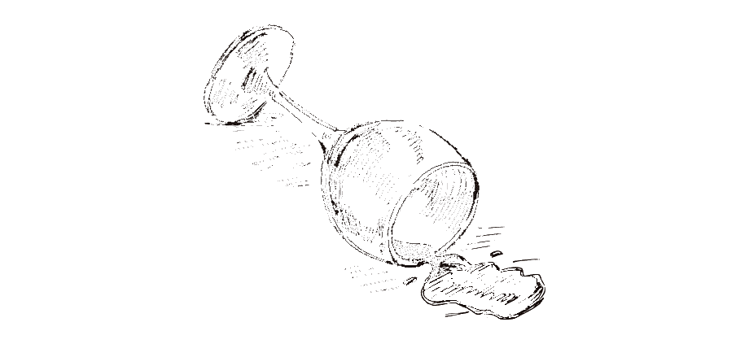
Overview
This project is based on the wine reviews data scraped from WineEnthusiast provided from kaggle, during the week of June 15th, 2017.
The main point would be designed around wine quality analysis and points prediction, wine recommendations based on preference and the trendy wine predictions.

Slide 3
Data sources
Dataset: https://www.kaggle.com/zynicide/wine-reviews
Dataset for wine reviews, contains of three data files:
winemag-data-130k-v2.csv contains 14 columns and 130k rows of wine reviews.
winemag-data_first150k.csv contains 14 columns and 150k rows of wine reviews.
winemag-data-130k-v2.json contains 6919 nodes of wine reviews.
Significant features: points, prices, country, description, title, variety, winery and etc.

Slide 4
Goals
Analyze wine review data to understand the relationship with different wine features and their points
Build predictive models to get similar recommendations from other features, based on single selected wine
Predict the trend of wine, most popular keywords or categories
UI for all the information is comprehensible

Slide 5
Use Cases
Users can get reviews summarizations based on different features.
Users can choose specific wine and get recommendations of similar products, based on description or regions pr prices.
Users can get a scenario of trendy wine, which kind of wine would be popular and would have great feedback.

Slide 6
Methodology
Data Preprocessing & Visualization
Explore and clean the dataset using Spark
Analyze the features and show the diagrams
Spark
Use Spark to build a recommendation system based on users’ preferences
Predictive Models (cont.)
Use KNN, Random Forests and other algorithms to predict the point of wines based on other features
UI Implementation
Use Play framework (and if necessary, with scala.js), users can interact with system to search prefered wine and get predicted wine trend

Slide 7
Progress
Week 1
Define the scope and framework of the project
Explore and visualize data
Week 2
Build models and train data, using Spark SQL
Week 3
Evaluate and optimize model
Build User Interface with Play framework
Week 4
Write report and prepare for presentation

Slide 8
Evaluation & Acceptance Criteria
Based on Use Cases:
1. To get summarizations
Diagrams and ranks should be loaded within 7 seconds
2. To get recommendations
All Spark SQL should be executed within 10 seconds
3. To get trend predictions
The accuracy of training models should be higher than 80%

Slide 9
Workspace
Code Language and Framework:
Spark, Scala, Play Framework
Git Repo Link: https://github.com/fwqfwq/wine-reviews

Slide 10

Thank you

