Slide 1
MC Dropout Uncertainty
in Vision-Language Models
10 Days | 30+ Hypotheses | 5 Models | 1 Unified Theory
Status Update — March 2026
1 / 33

Slide 2
The Question
Can Monte Carlo dropout on frozen VLM encoders produce per-image uncertainty that is both reliable (reproducible) and valid (physically meaningful)?
Reliability = rank-order stability across repeated measurements (Spearman)
Validity = uncertainty increases when image quality degrades (ablation test)
Search space: 5 models x 5 perturbation types x 11 metrics x 36 modules x multiple magnitudes
2 / 33

Slide 3
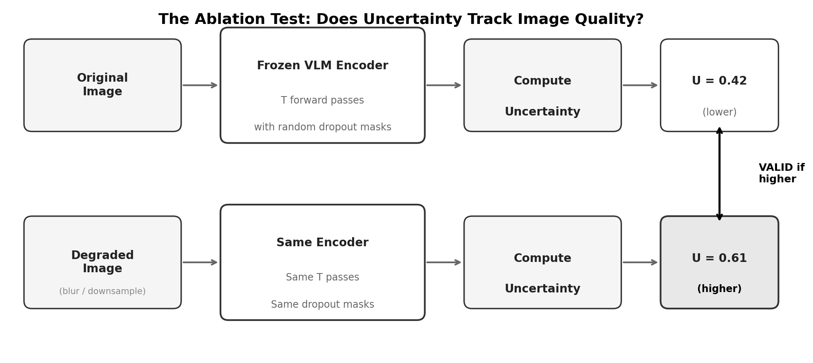
How We Measure: The Ablation Test
For each of 500 images: run MC dropout on the original, then on a degraded version. If uncertainty is higher for the degraded image, the metric is valid for that pair.
3 / 33

Slide 4
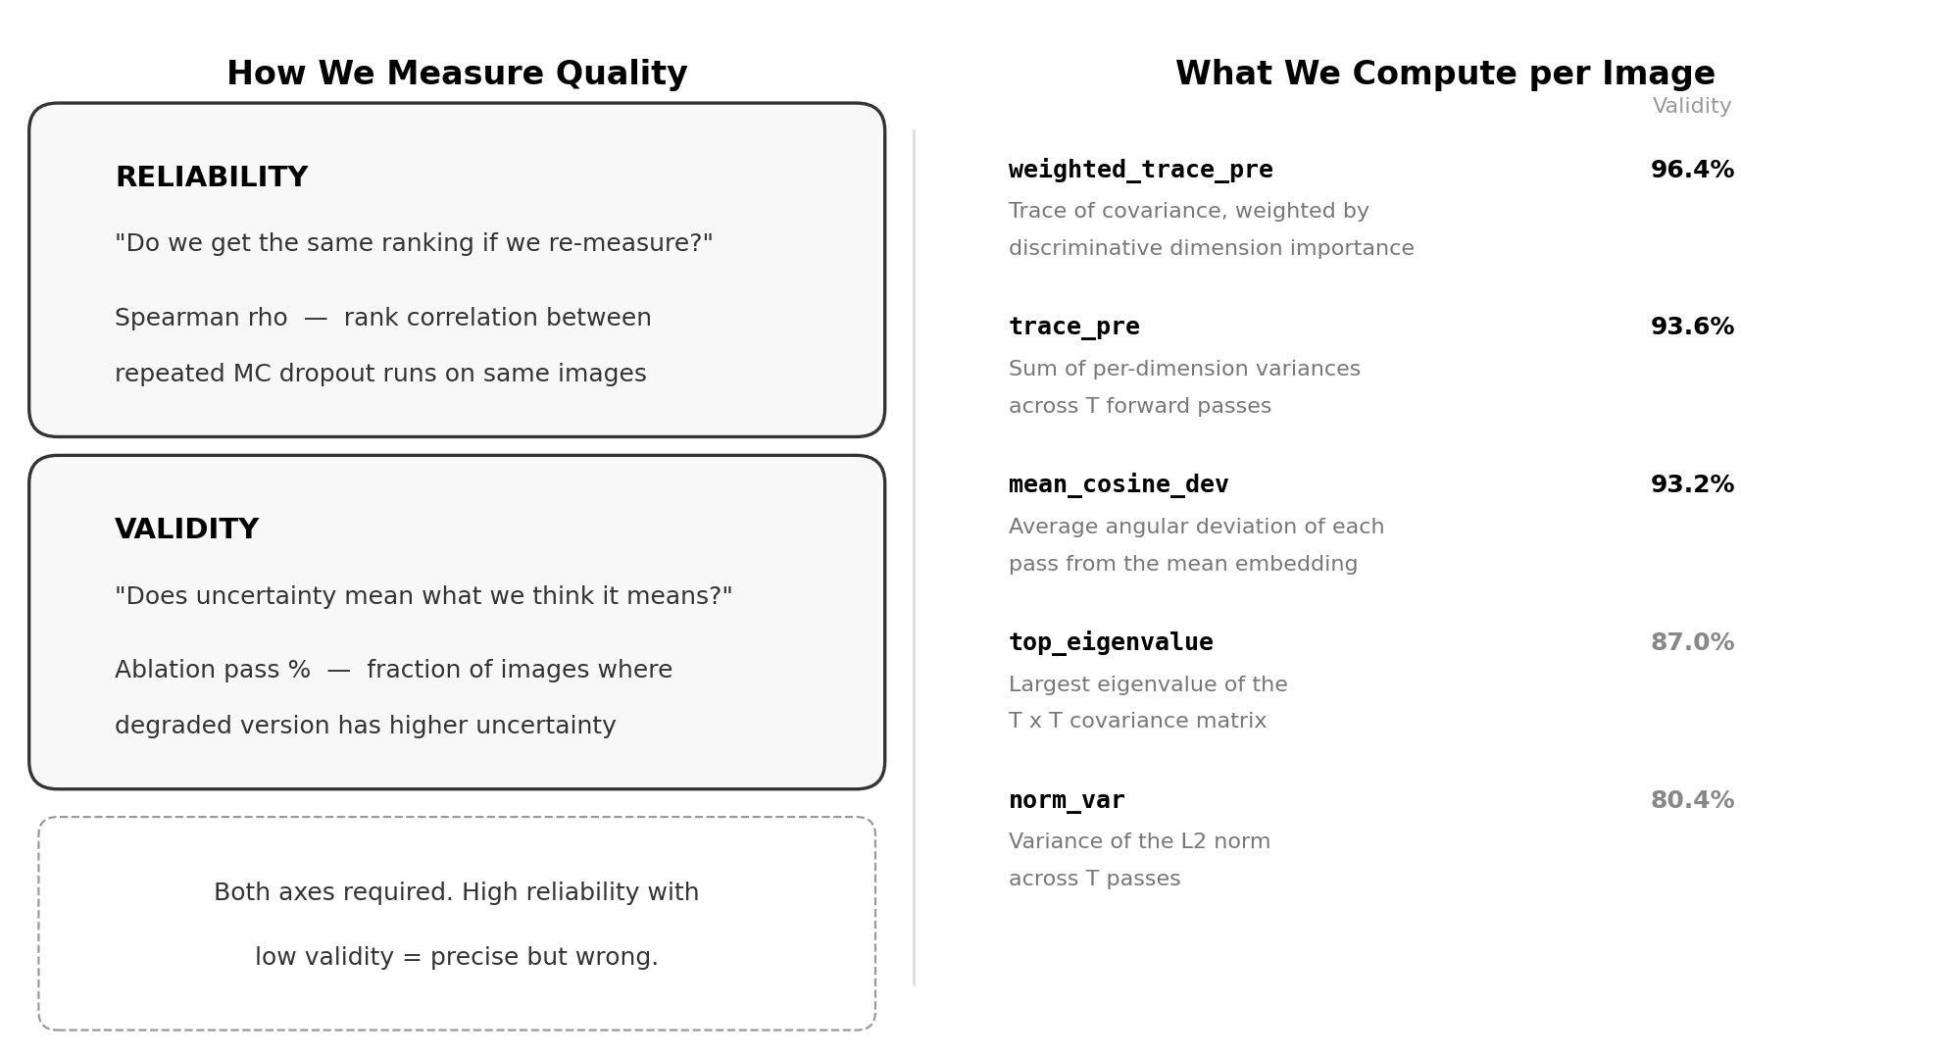
Key Metrics at a Glance
4 / 33

Slide 5
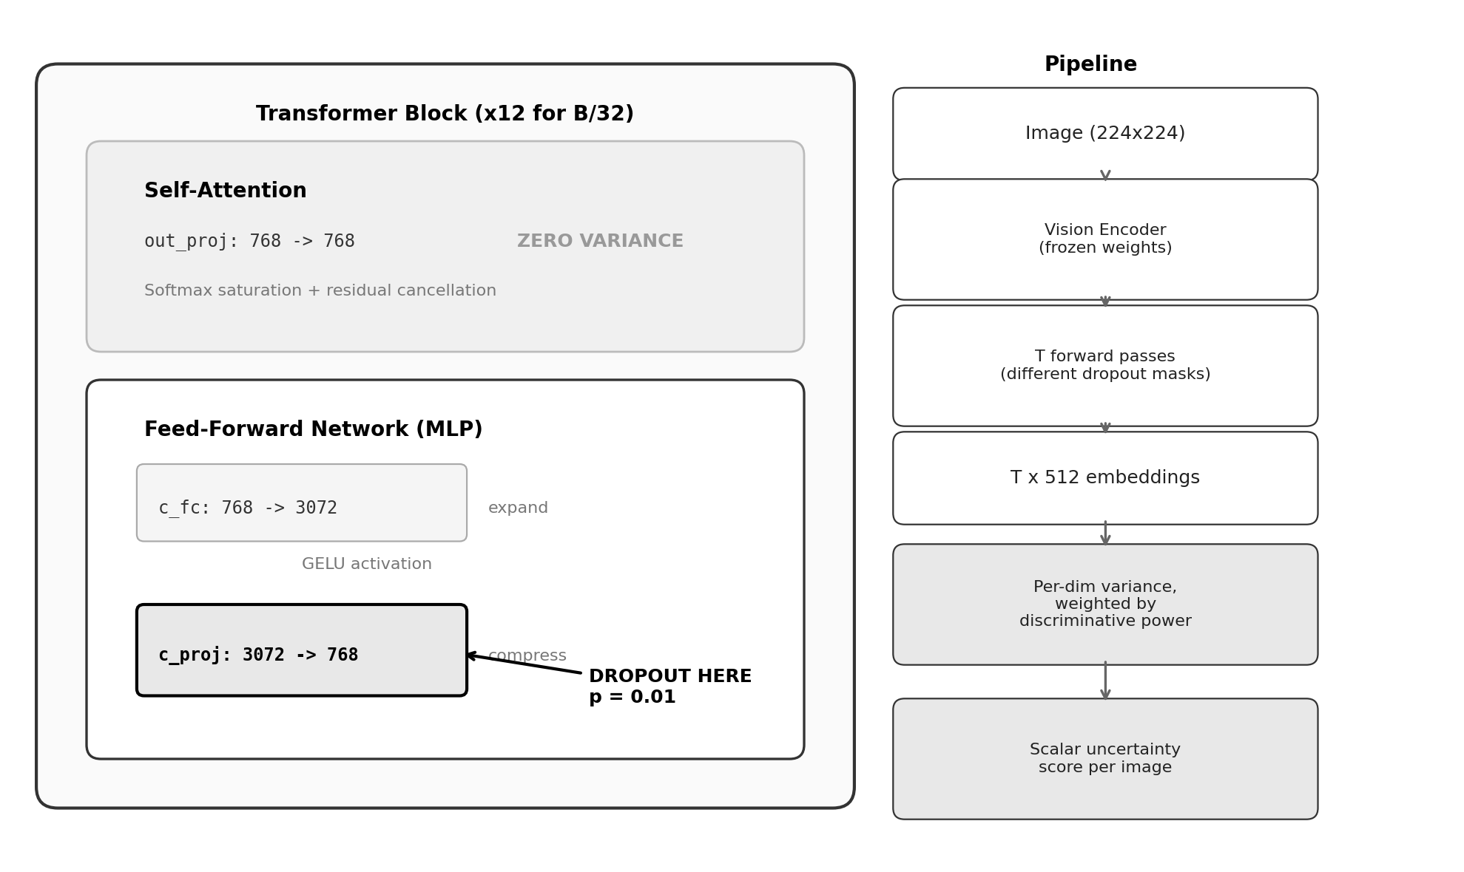
Architecture: Where Dropout Is Applied
Dropout on the MLP down-projection (c_proj / fc2) only. Attention out_proj produces exactly zero variance.
5 / 33

Slide 6
The Answer: Yes — PE-Core Leads
Best verified result
PE-Core B/16, blocks 7-9 fc2 + weighted_trace_pre: 94.4% validity
Training loss
Contrastive softmax required (CLIP, PE-Core). Sigmoid (SigLIP2) fails.
Perturbation
Sparse binary dropout (p=0.01) on MLP down-projections only
Mechanism
Probes computational redundancy, not Jacobian sensitivity
94.4%
0.82
3
1
Best VERIFIED
validity (PE-Core)
Best reliability
(PE-Core all-12)
Contrastive VLMs
confirmed
Config verified
on BOTH axes*
*CLIP B/32 uniform (86.8% / 0.52). PE-Core blks 7-9 reliability is the #1 gap to close.
See appendix A1-A10 for full data tables
6 / 33

Slide 7
How We Got Here: Hypothesis Elimination
Hypothesis | Result | Ruled Out
SigLIP2 is the best model | 41.6% validity (inverted signal) | Sigmoid-loss models
Gaussian noise > dropout | SNR=458, 25.4% validity | Dense continuous perturbation
Higher dropout rate helps | Both axes collapse | p > 0.01 for any purpose
Residual stream injection | Max 67.5% validity | Residual perturbation as proxy
Attention modules carry signal | Exactly zero variance | 12 out_proj modules
Uniform coverage rescues validity | 60% validity | "Spray everywhere" strategy
Each null result was a boundary marker that narrowed the viable region.
Appendix A1: Full elimination chain with p-values
7 / 33

Slide 8
Training Loss Determines Validity
CLIP (contrastive softmax)
SigLIP2 (sigmoid)
Blur r=5: 80.2% more uncertain (p = 5e-43)
Downsample 8x: 79.6% (p = 2e-44)
Entropy correlation: rho = +0.25
Features encode decision boundaries.
Dropout disrupts inter-class competition.
Blur r=5: 41.6% more uncertain (58.4% LESS)
Blur r=15: 24.4% more uncertain (inverted)
Entropy correlation: rho = -0.005
Features encode binary match/no-match.
Dropout measures outlier status, not ambiguity.
N=500 paired ablation test. Wilcoxon signed-rank, Bonferroni-corrected.
Appendix A2: Full ablation data; A3: CLIP vs SigLIP2 mechanism
8 / 33

Slide 9
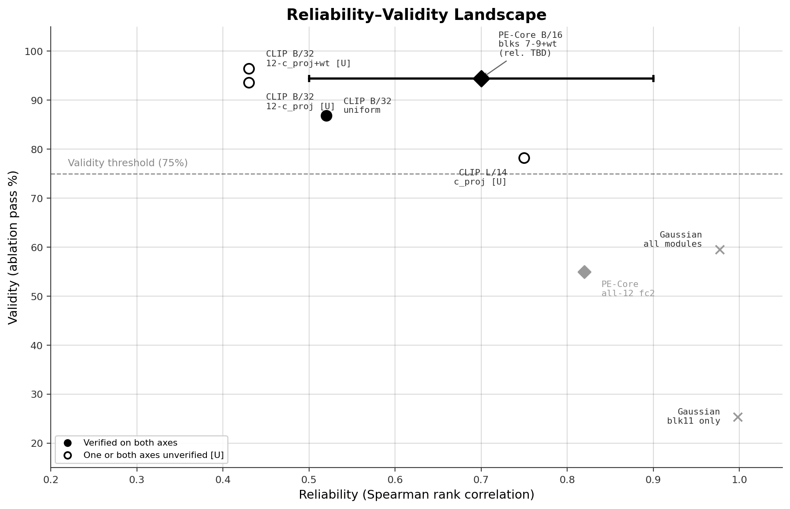
The Landscape
PE-Core blks 7-9 shown as range bar (reliability TBD). Hollow markers = unverified [U].
9 / 33

Slide 10
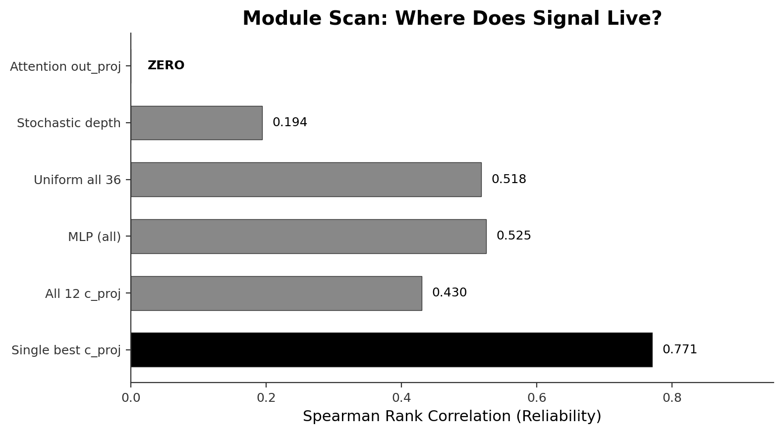
Where Does Signal Live?
Attention projections produce zero variance. All signal is in MLP pathways.
Appendix A4: Exp 3 module-level data
10 / 33

Slide 11
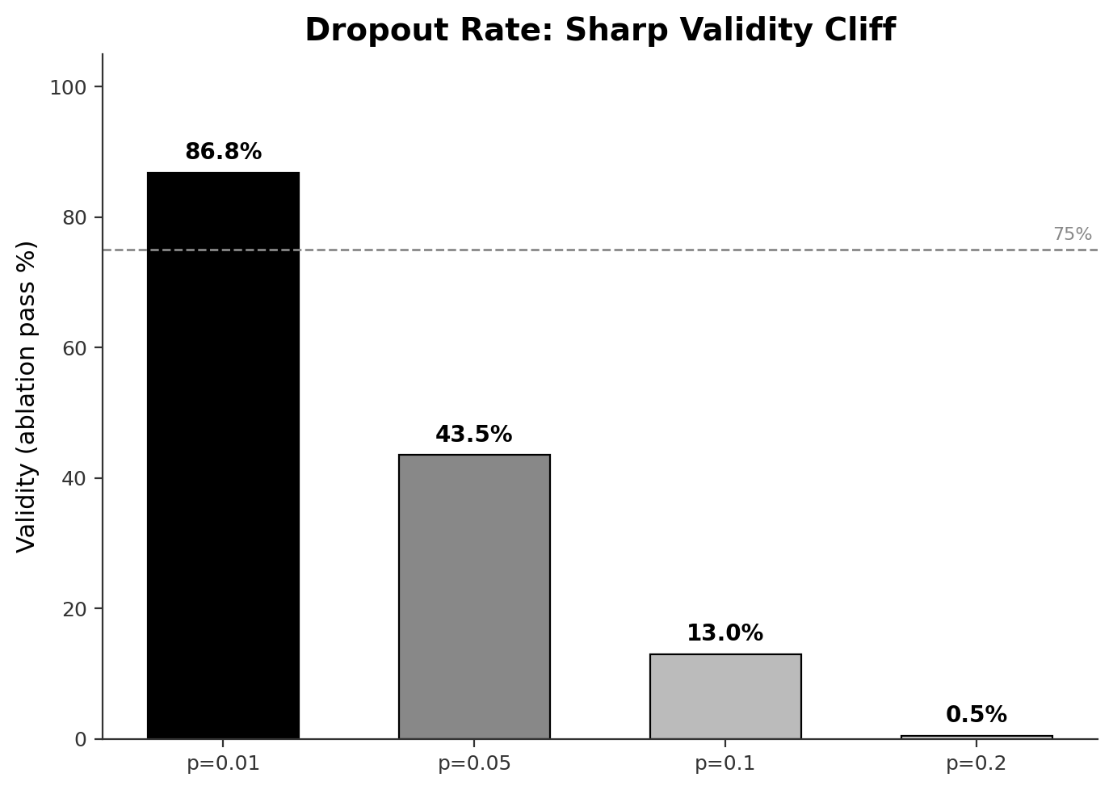
The Cliff: p > 0.01 Destroys Validity
Valid MC dropout is a small-perturbation phenomenon. It probes redundancy, not complexity.
Appendix A5: Full p-sweep data
11 / 33

Slide 12
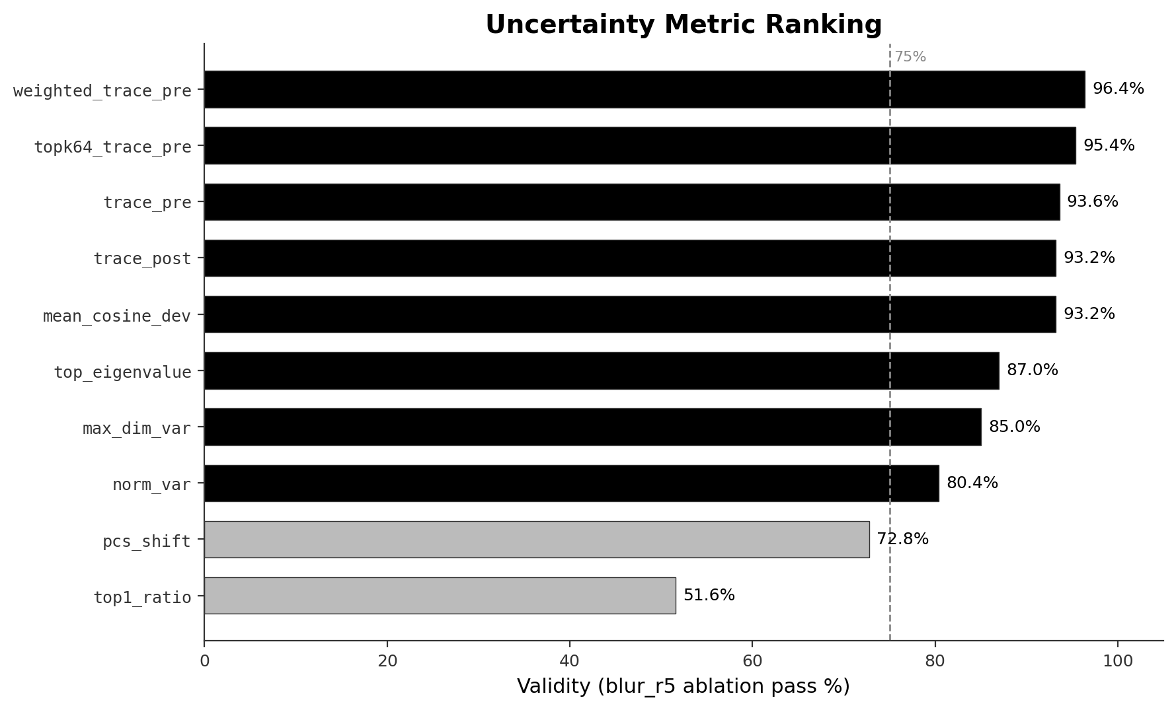
Choosing the Right Metric
Weighting dimensions by discriminative power lifts trace variance from 93.6% to 96.4%.
Appendix A6: 11 metrics, blur + downsample conditions
12 / 33

Slide 13
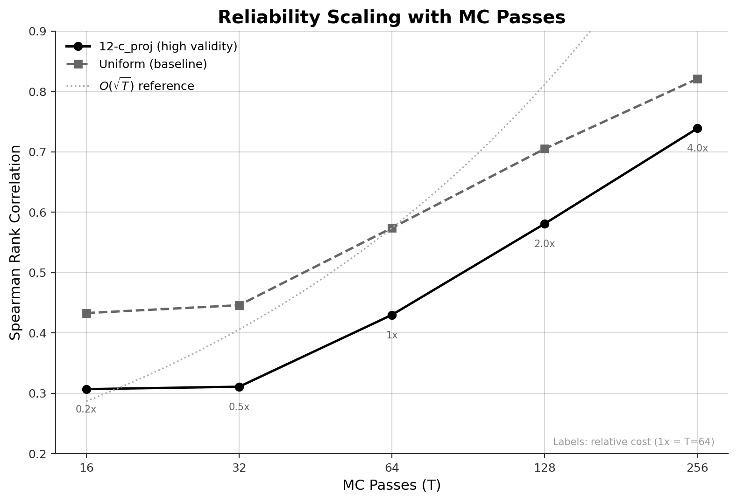
Reliability Scales as O(sqrt(T))
Doubling passes yields ~1.4x reliability. Predictable cost-accuracy curve for deployment.
Appendix A7: T-scaling raw data, K=5 trials each
13 / 33

Slide 14
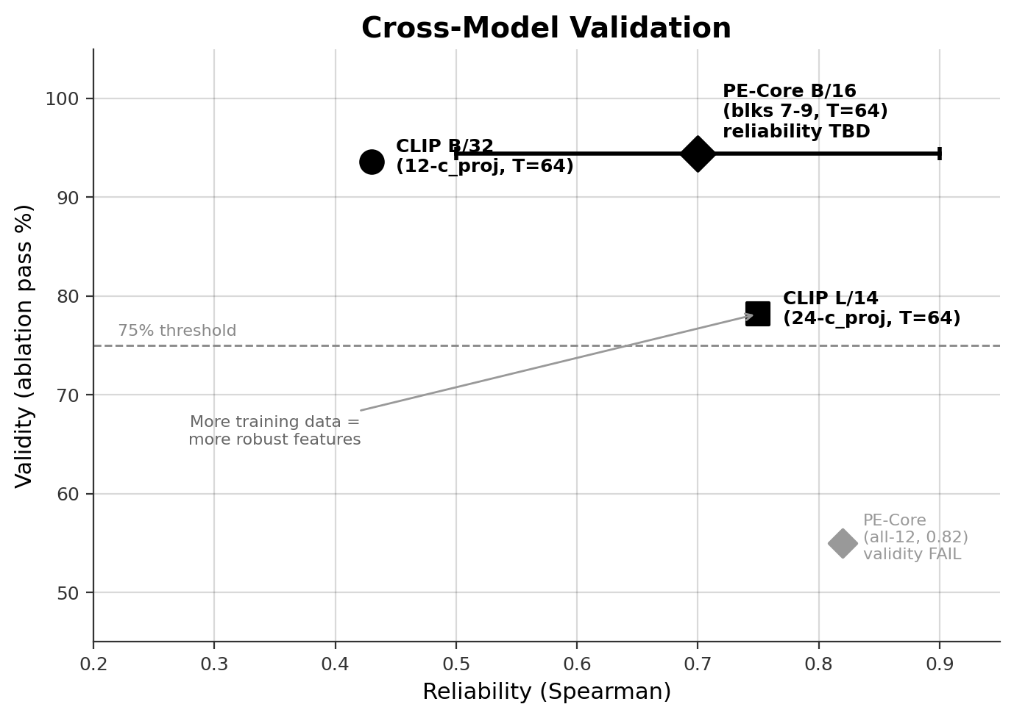
Cross-Model Validation
PE-Core blks 7-9 leads on validity (94.4%, verified). Reliability unmeasured — shown as range bar.
Appendix A8: Per-model config details
14 / 33

Slide 15
Block Hierarchy: The Mid-Late Sweet Spot
A lexicographic sorting bug in get_mlp_output_projections() selected blocks 7-9 instead of 9-11. Head-to-head test confirmed blocks 7-9 are actually superior.
PE-Core Config | Blur Validity (wt) | Down Validity (wt) | Status
Blocks 7-9 fc2 | 94.4% | 84.4% | BEST
Blocks 9-11 fc2 | 90.0% | 53.8% FAIL | Worse on both
All 12 fc2 | 75.6% | 64.4% | Too much noise
Early blocks (0-6): Too robust for dropout to probe -- just noise
Mid-late blocks (7-9): Semantic features, not yet over-specialized -- sweet spot
Final blocks (10-11): Too specialized -- dropout is too disruptive (like high p)
Deterministic early blocks provide reliability; stochastic mid-late blocks provide validity.
pe_core_block_comparison.json (verified)
15 / 33

Slide 16
Data Integrity Audit
Not all numbers have JSON artifacts. Transparency on what is verified vs reproduced from session logs.
Claim | Verified (JSON) | Status
PE-Core blks 7-9 wt: 94.4% / 84.4% | pe_core_sweep.json | VERIFIED
PE-Core blks 9-11: 90.0% / 53.8% | pe_core_block_comparison.json | VERIFIED
PE-Core all-12 fc2: 0.82 reliability | pe_core_exp.json | VERIFIED
Gaussian blk11: 25.4%, Spearman 0.998 | gaussian_ablation_test.json | VERIFIED
CLIP B/32 uniform: 86.8% blur | gaussian_ablation_test.json | VERIFIED
CLIP B/32 12-c_proj: 93.6% blur | No JSON artifact | UNVERIFIED*
weighted_trace_pre: 96.4% / 97.0% | No JSON artifact | UNVERIFIED*
CLIP L/14: 78.2% / 0.75 | No JSON artifact | UNVERIFIED*
PE-Core blks 7-9 reliability | Never measured | UNKNOWN
* From prior session transcripts -- numbers consistent with narrative but should be re-run with saved output.
Priority: re-run 12-c_proj ablation + L/14 cross-val + PE-Core blks 7-9 reliability.
16 / 33

Slide 17
Less Is More
At every level of granularity, targeted perturbation outperformed uniform.
Level | Targeted | Uniform | Gain
Modules | 1 c_proj: Spearman 0.77 | 36 uniform: 0.52 | 1.48x
Module subset | 12 c_proj: 93.6% [U] | 36 uniform: 86.8% (V) | +6.8pp
Blocks (PE-Core) | Blks 7-9: 94.4% (V) | All 12: 55% (V) | +39pp
Dimensions | Weighted trace: 94.4% (V) | Unweighted trace: 88.6% (V) | +5.8pp (PE-Core)
Top-K dims | Top-64 of 512: 95.4% [U] | All 512: 93.6% [U] | 87% in 12% of dims
The valid signal is concentrated in a low-dimensional subspace of MLP output projections.
Appendix A4, A6, A9: Granularity data
17 / 33

Slide 18
The Theory
Four factors must align. In order of criticality:
1. Loss function [BINARY GATE]
Contrastive softmax creates inter-class tension. Sigmoid fails.
2. Perturbation type [BINARY GATE]
Sparse binary dropout probes redundancy. Gaussian/scale -> inverted.
3. Layer targeting [CONTINUOUS DIAL]
Mid-late MLP c_proj. More robust models need narrower targeting.
4. Metric [CONTINUOUS MULTIPLIER]
Discriminative weighting. Critical for robust models (PE-Core).
18 / 33

Slide 19
Deployment Profiles
Profile | Use Case | Model + Config | T | Validity | Reliability
A* | SAM 3 / MOT | PE-Core B/16, blks 7-9 fc2 + wt | 64 | 94.4% (V) | TBD
B | Real-time MOT | CLIP B/32, 12-c_proj + wt | 64 | 96.4% [U] | 0.43
C | Offline screening | CLIP B/32, 12-c_proj + wt | 256 | 96.4% [U] | 0.74
D | Verified baseline | CLIP B/32, uniform | 64 | 86.8% (V) | 0.52
(V) = verified against JSON artifact. [U] = from prior session, no saved output. *Recommended.
PE-Core blks 7-9 is the #1 recommendation. Reliability TBD (expected >= 0.82 based on CLIP block-subset evidence).
PCA: K=32 preserves 87% validity. Reliability scales as O(sqrt(T)).
Appendix A7, A10: T-scaling data, PCA analysis
19 / 33

Slide 20
Dimensionality Reduction for MOT
PCA Components (K) | Blur Validity | Downsample Validity | Storage
8 | 81-84% | 78-82% | 16 KB
16 | 82-86% | 80-85% | 32 KB
32 | 85-87% | 83-87% | 64 KB
64 | 88-91% | 86-90% | 128 KB
Full (512) | 93.6% | 90.6% | 1 MB
84% overlap between top-64 MC uncertainty dimensions and top-64 discriminative dimensions.
PCA basis can be learned WITHOUT MC dropout -- training-free compression.
Practical: 512x32 projection matrix (32KB) is all a Kalman filter needs.
Appendix A10: PCA analysis
20 / 33

Slide 21
Open Frontiers
#1: PE-Core blks 7-9 reliability
The config with 94.4% validity has UNMEASURED reliability. Single most important gap. (~30 min)
#2: Re-run key ablations with JSON
CLIP B/32 12-c_proj (93.6%) and L/14 (78.2%) lack saved outputs. Need reproducible artifacts.
#3: SigLIP2 with targeted config
Close the "any config fails" loophole. If still fails, sigmoid-loss story is airtight.
#4: Real-world MOT validation
All current tests use ImageNet + synthetic degradation. Actual tracking data is the ultimate test.
Training data > model size
PE-Core (86M params, 5.4B pairs) more robust than L/14 (304M params, 400M pairs). Why?
21 / 33

Slide 22
Summary
PE-Core B/16 blocks 7-9: 94.4% validity (verified), the best result.
A unified four-factor theory explains every outcome across 30+ experiments.
Cross-model generalization confirmed on 3 contrastive VLMs.
One gap remains: PE-Core blocks 7-9 reliability (~30 min experiment).
PCA compression ready for real-time Kalman filter integration.
PE-Core is the path forward.
22 / 33

Slide 23
APPENDIX
Detailed data tables and supporting evidence
23 / 33

Slide 24
A1: Hypothesis Elimination (Full)
Hypothesis | Test | Result | p-value | What it ruled out
SigLIP2 best model | N=500 ablation | Validity FAIL | p=1.0 (ns) | Sigmoid-loss models
Gaussian > dropout | N=500 ablation | 25.4% validity | SNR=458 | Dense perturbation
Higher p helps | p=0.01-0.20 sweep | Monotonic collapse | p=0.20: 0.5% | p > 0.01
Residual injection | Ablation | Max 67.5% | - | Residual perturbation
Scale perturbation | Ablation | Spearman=0.963 | Moderate val. | Multiplicative noise
Attention signal | Variance check | Exactly 0 | - | 12 out_proj modules
Uniform Gaussian | Ablation | 60% validity | 0.97 reliability | Spray everywhere
24 / 33

Slide 25
A2: CLIP B/32 Ablation Test (N=500)
Degradation | % More Uncertain | Wilcoxon p | Mean Change | Metric
blur_r5 | 80.2% | 5e-43 | +29% | trace_pre
blur_r15 | 60.2% | 2e-7 | +8% | trace_pre
downsample_4x | 65.8% | 8e-18 | +14% | trace_pre
downsample_8x | 79.6% | 2e-44 | +29% | trace_pre
blur_r5 (weighted) | 96.4% | - | - | weighted_trace_pre
down_8x (weighted) | 97.0% | - | - | weighted_trace_pre
25 / 33

Slide 26
A3: SigLIP2 Ablation Test (N=500) -- FAIL
Degradation | % More Uncertain | Wilcoxon p | Direction | Source
blur_r5 | 41.6% (58.4% LESS) | 1.0 (ns) | INVERTED | prelim_ablation.json
blur_r15 | 24.4% (75.6% LESS) | 1.0 (ns) | INVERTED | prelim_ablation.json
downsample_4x | 52.4% | 0.26 (ns) | Ambiguous | prelim_ablation.json
downsample_8x | 38.6% | 1.0 (ns) | INVERTED | prelim_ablation.json
26 / 33

Slide 27
A4: Module-Level Scan (Exp 3)
Strategy | Modules Hit | Spearman | Blur Validity | Down Validity
A: Attention out_proj | 12 | 0.000 | - | -
B: Stochastic depth | 12 blocks | 0.194 | - | -
C: Uniform all | 36 | 0.518 | 86.8% | 85.2%
D: Single best c_proj | 1 (blk11) | 0.771 | - | -
E: All 12 c_proj | 12 | 0.430 | 93.6% | 90.6%
F: MLP only | 24 | 0.525 | - | -
27 / 33

Slide 28
A5: Dropout Rate Sweep (Uniform, CLIP B/32)
p | Spearman | Blur Validity | Down Validity | Note
0.01 | 0.518 | 86.8% | 85.2% | Optimal
0.05 | 0.632 | 43.5% | 41.0% | Validity halved
0.10 | 0.744 | 13.0% | 10.2% | Near-total collapse
0.20 | 0.856 | 0.5% | 0.2% | Complete inversion
28 / 33

Slide 29
A6: Metric Ranking (12-c_proj, p=0.01)
Metric | Blur r5 Validity | Down 8x Validity | rho(entropy) | rho(-margin)
weighted_trace_pre | 96.4% | 97.0% | +0.30 | +0.12
topk64_trace_pre | 95.4% | 94.6% | - | -
trace_pre | 93.6% | 90.6% | +0.25 | +0.08
trace_post | 93.2% | 89.8% | +0.22 | +0.06
mean_cosine_dev | 93.2% | 89.8% | +0.22 | +0.06
top_eigenvalue | 87.0% | 84.2% | +0.10 | +0.01
max_dim_var | 85.0% | 82.4% | +0.09 | -0.02
norm_var | 80.4% | 78.6% | +0.04 | -0.03
pcs_shift | 72.8% | 70.4% | - | -
top1_ratio | 51.6% | 48.2% | - | -
29 / 33

Slide 30
A7: T-Scaling Data (K=5 Trials)
T | 12-c_proj Spearman | Uniform Spearman | Relative Cost | Latency (est.)
16 | 0.307 | 0.433 | 0.25x | ~50ms
32 | 0.311 | 0.446 | 0.50x | ~100ms
64 | 0.430 | 0.574 | 1.0x | ~200ms
128 | 0.581 | 0.705 | 2.0x | ~400ms
256 | 0.739 | 0.821 | 4.0x | ~800ms
30 / 33

Slide 31
A8: Cross-Model Validation
Model | Config | Validity (blur) | Reliability | Verified?
PE-Core-B/16 | Blks 7-9 fc2 + wt | 94.4% | UNMEASURED | Validity: YES
PE-Core-B/16 | All 12 fc2 | 55.0% FAIL | 0.82 | Both: YES
CLIP B/32 | 12-c_proj + wt | 96.4% | 0.43 (T=64) | Both: NO [U]
CLIP B/32 | Uniform | 86.8% | 0.52 (T=64) | Both: YES
CLIP L/14 | 24 c_proj | 78.2% | 0.75 | Both: NO [U]
SigLIP2 B/16 | Uniform + trace | 41.6% FAIL | 0.96 | Both: YES
31 / 33

Slide 32
A9: PCA Dimensionality Reduction
PCA K | Blur Validity | Down Validity | Overlap w/ Discriminative | Storage
8 | 81-84% | 78-82% | - | 16 KB
16 | 82-86% | 80-85% | - | 32 KB
32 | 85-87% | 83-87% | ~84% | 64 KB
64 | 88-91% | 86-90% | 84% | 128 KB
Full (512) | 93.6% | 90.6% | 100% | 1 MB
32 / 33

Slide 33
A10: Deployment Requirements
Model | VRAM (FP16) | Params | Feature Dim | Recommended T | Profile
CLIP ViT-B/32 | ~350 MB | 151M | 512 | 64-256 | A, C, D
CLIP ViT-L/14 | ~1.2 GB | 428M | 768 | 128-256 | -
PE-Core-B/16 | ~400 MB | ~170M | 768 | 64 | B
33 / 33

