Slide 1
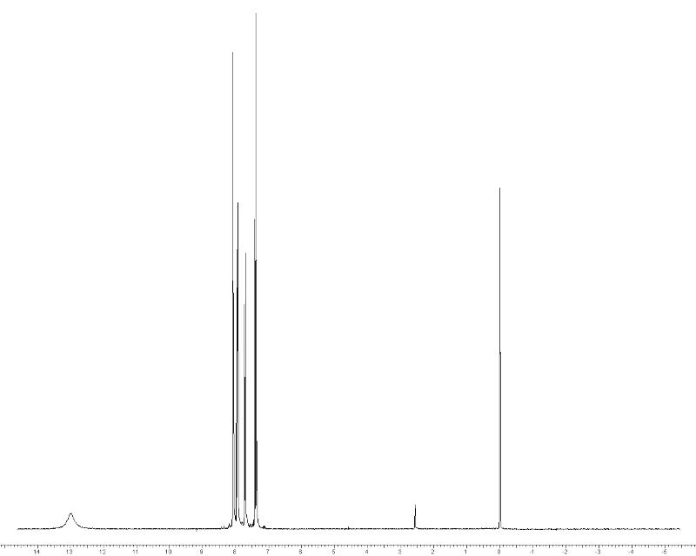
CAS Number:
[585-76-2]
t, 1 H
s, 1 H
d, 1 H
d, 1 H
Trace
solvent
bs, 1 H

Slide 2
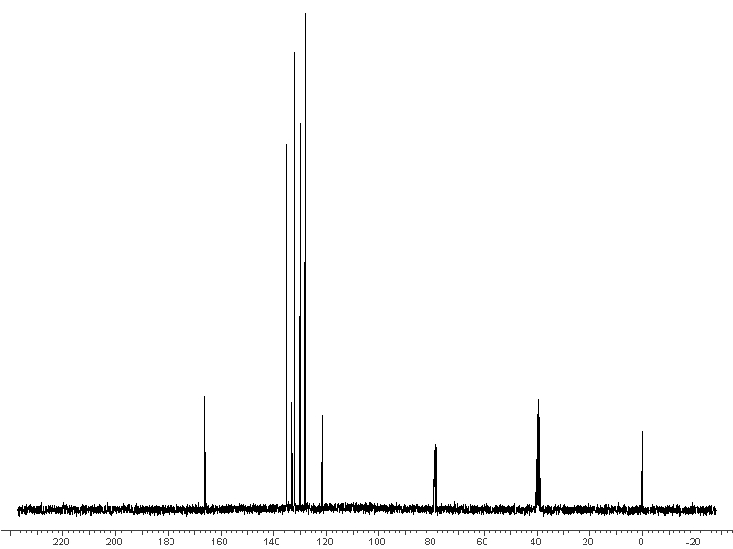
DMSO
CDCl₃

Slide 3
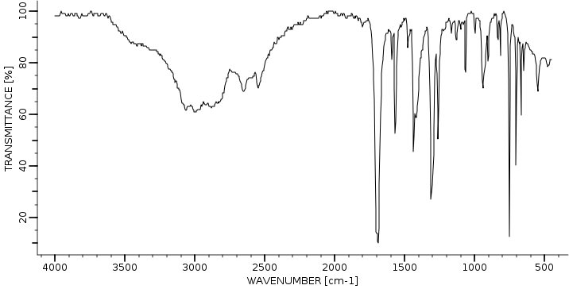

Slide 4
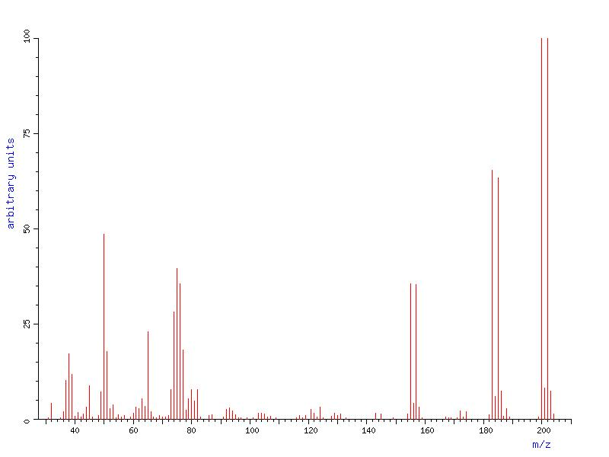

Slide 5
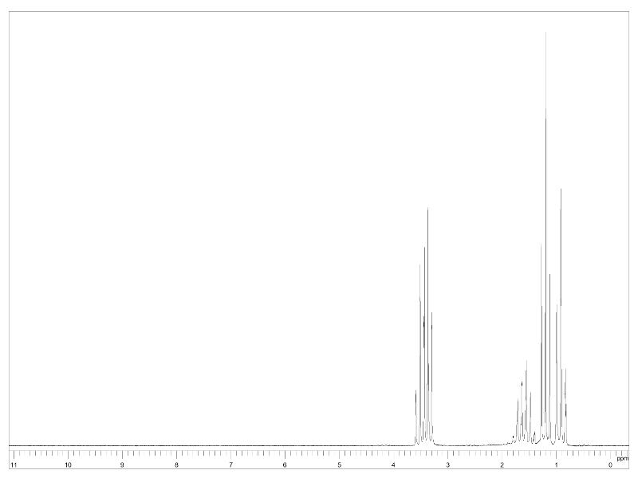
[628-32-0]
t, 3 H
t, 3 H
m, 4 H
h, 2 H

Slide 6
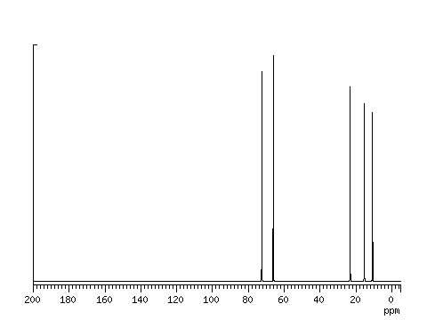

Slide 7
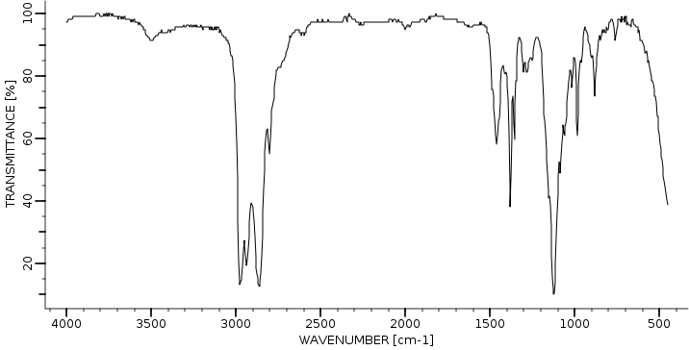

Slide 8
