Slide 1
Chapter 3
Water and Life

Slide 2
Overview: The Molecule That Supports All of Life
Water is the biological medium on Earth
All living organisms require water more than any other substance
Most cells are surrounded by water, and cells themselves are about 70–95% water
The abundance of water is the main reason the Earth is habitable
© 2011 Pearson Education, Inc.

Slide 3
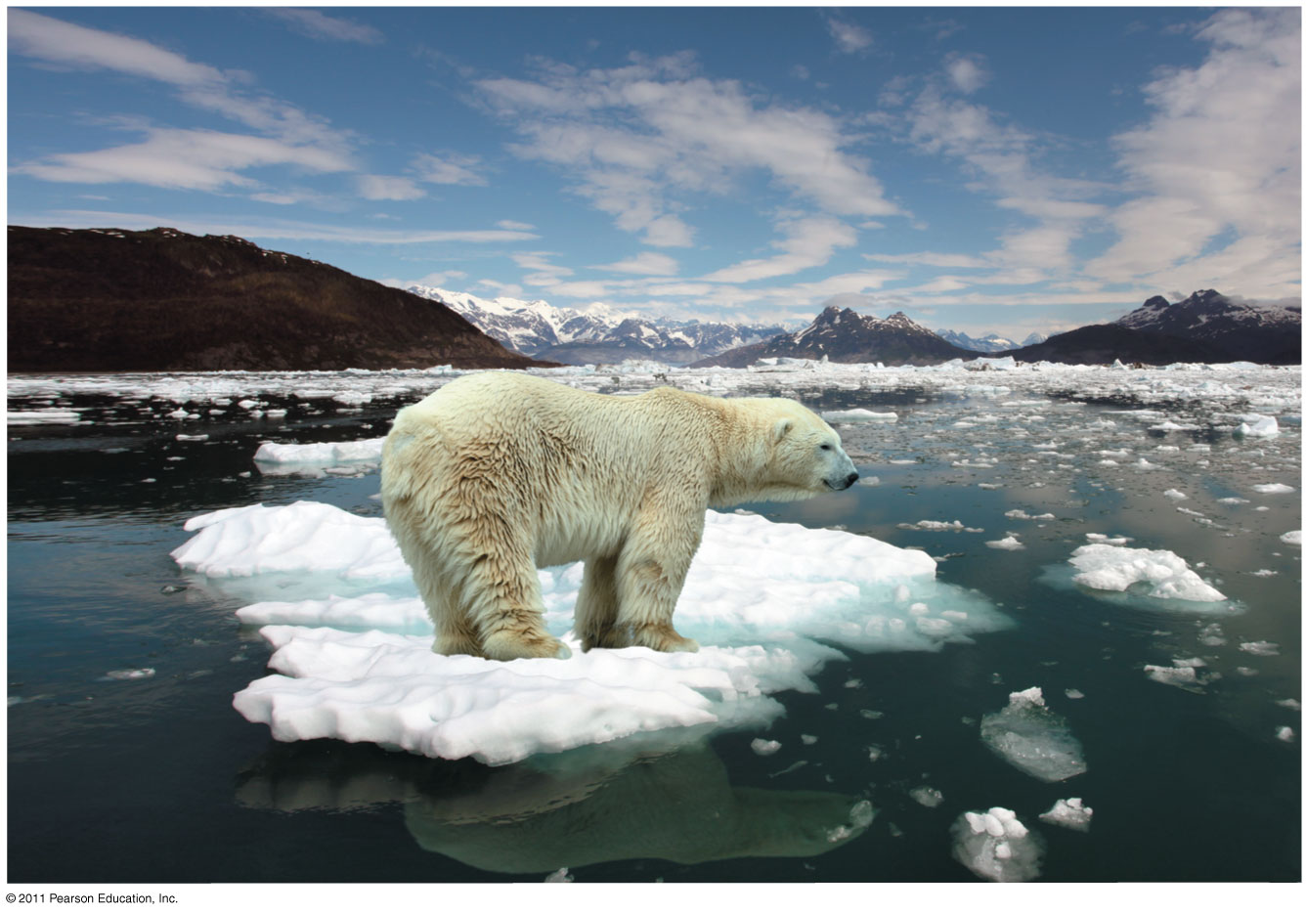
Figure 3.1
Notes:
Figure 3.1 How does the habitat of a polar bear depend on the chemistry of water?

Slide 4

Concept 3.1: Polar covalent bonds in water molecules result in hydrogen bonding
The water molecule is a polar molecule: the opposite ends have opposite charges
Polarity allows water molecules to form hydrogen bonds with each other
Animation: Water Structure
© 2011 Pearson Education, Inc.

Slide 5
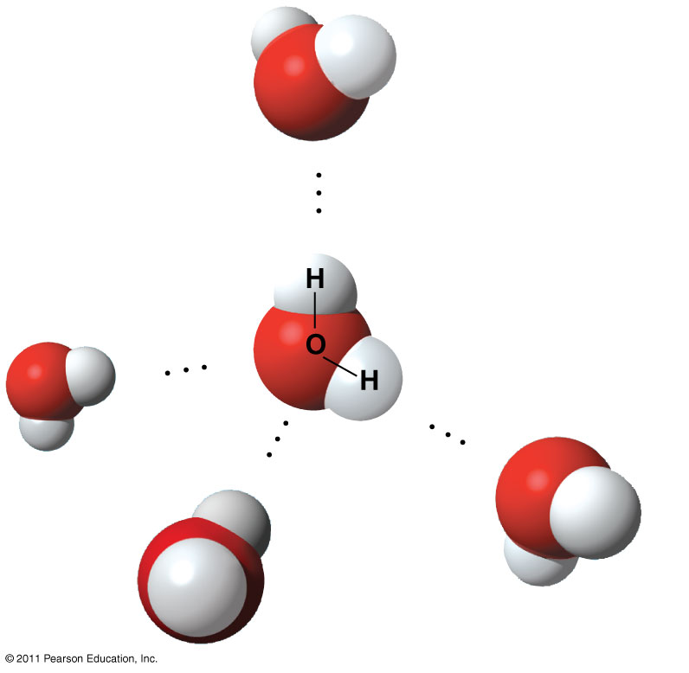
Figure 3.2
δ
−
Hydrogen
bond
δ
+
Polar covalent
bonds
δ
+
δ
−
δ
−
δ
+
+
δ
−
δ
Notes:
Figure 3.2 Hydrogen bonds between water molecules.

Slide 6
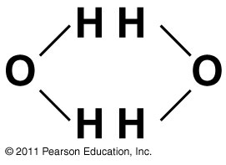
Figure 3.UN01
Notes:
Figure 3.UN01 Concept Check 3.1, question 2

Slide 7
Concept 3.2: Four emergent properties of water contribute to Earth’s suitability for life
Four of water’s properties that facilitate an environment for life are
  Cohesive behavior
  Ability to moderate temperature
  Expansion upon freezing
  Versatility as a solvent
© 2011 Pearson Education, Inc.

Slide 8
Cohesion of Water Molecules
Collectively, hydrogen bonds hold water molecules together, a phenomenon called cohesion
Cohesion helps the transport of water against gravity in plants
Adhesion is an attraction between different substances, for example, between water and plant cell walls
Animation: Water Transport
© 2011 Pearson Education, Inc.

Slide 9
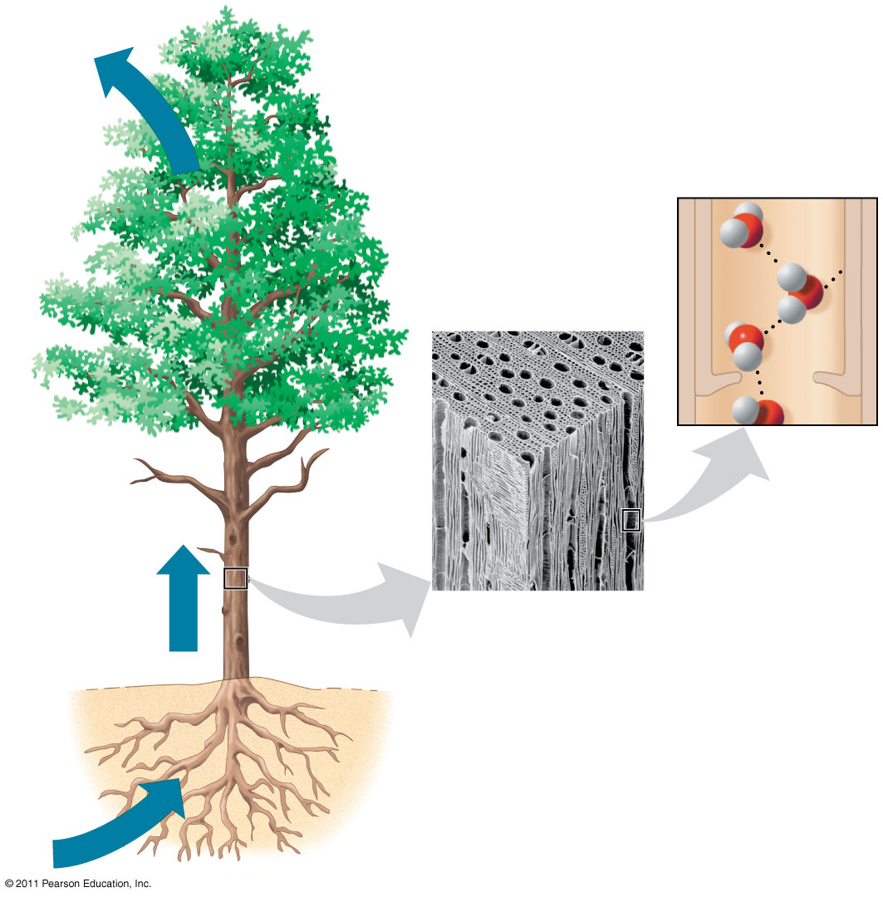
Figure 3.3
Adhesion
Two types of
water-conducting
cells
Cohesion
Direction
of water
movement
300 μm
Notes:
Figure 3.3 Water transport in plants.

Slide 10
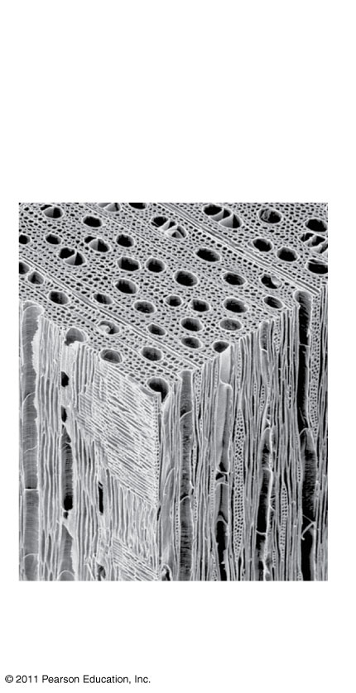
Figure 3.3a
Two types of
water-conducting
cells
300 μm
Notes:
Figure 3.3 Water transport in plants.

Slide 11
Surface tension is a measure of how hard it is to break the surface of a liquid
Surface tension is related to cohesion
© 2011 Pearson Education, Inc.

Slide 12
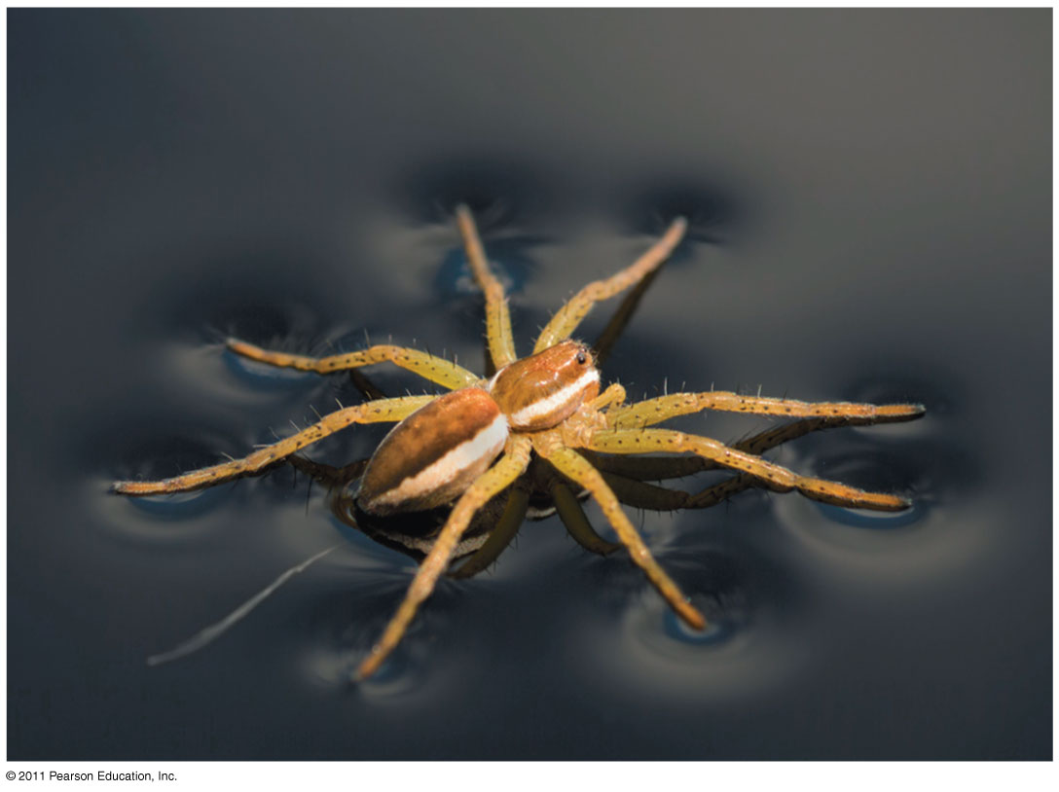
Figure 3.4
Notes:
Figure 3.4 Walking on water.

Slide 13
Moderation of Temperature by Water
Water absorbs heat from warmer air and releases stored heat to cooler air
Water can absorb or release a large amount of heat with only a slight change in its own temperature
© 2011 Pearson Education, Inc.

Slide 14
Heat and Temperature
Kinetic energy is the energy of motion
Heat is a measure of the total amount of kinetic energy due to molecular motion
Temperature measures the intensity of heat due to the average kinetic energy of molecules
© 2011 Pearson Education, Inc.

Slide 15
The Celsius scale is a measure of temperature using Celsius degrees (°C)
A calorie (cal) is the amount of heat required to raise the temperature of 1 g of water by 1°C
The “calories” on food packages are actually kilocalories (kcal), where 1 kcal = 1,000 cal
The joule (J) is another unit of energy where
1 J = 0.239 cal, or 1 cal = 4.184 J
© 2011 Pearson Education, Inc.

Slide 16
Water’s High Specific Heat
The specific heat of a substance is the amount of heat that must be absorbed or lost for 1 g of that substance to change its temperature by 1ºC
The specific heat of water is 1 cal/g/ºC
Water resists changing its temperature because of its high specific heat
© 2011 Pearson Education, Inc.

Slide 17
Water’s high specific heat can be traced to hydrogen bonding
  Heat is absorbed when hydrogen bonds break
  Heat is released when hydrogen bonds form
The high specific heat of water minimizes temperature fluctuations to within limits that permit life
© 2011 Pearson Education, Inc.

Slide 18
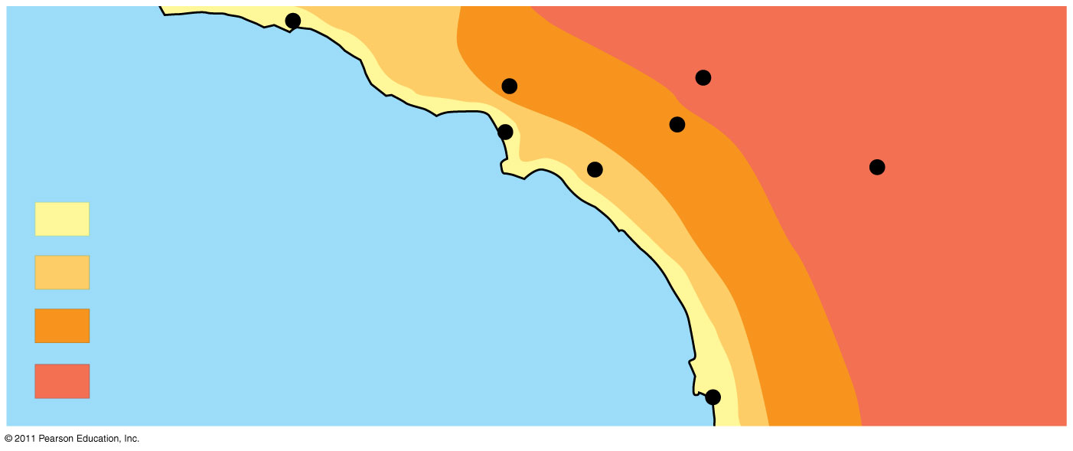
Figure 3.5
Burbank
90°
San Bernardino
100°
Santa Barbara 73°
Los Angeles
(Airport) 75°
Riverside 96°
Santa Ana
84°
Palm Springs
106°
70s (°F)
80s
Pacific Ocean 68°
90s
100s
San Diego 72°
40 miles
Notes:
Figure 3.5 Effect of a large body of water on climate.

Slide 19
Evaporative Cooling
Evaporation is transformation of a substance from liquid to gas
Heat of vaporization is the heat a liquid must absorb for 1 g to be converted to gas
As a liquid evaporates, its remaining surface cools, a process called evaporative cooling
Evaporative cooling of water helps stabilize temperatures in organisms and bodies of water
© 2011 Pearson Education, Inc.

Slide 20
Floating of Ice on Liquid Water
Ice floats in liquid water because hydrogen bonds in ice are more “ordered,” making ice less dense
Water reaches its greatest density at 4°C
If ice sank, all bodies of water would eventually freeze solid, making life impossible on Earth
© 2011 Pearson Education, Inc.

Slide 21
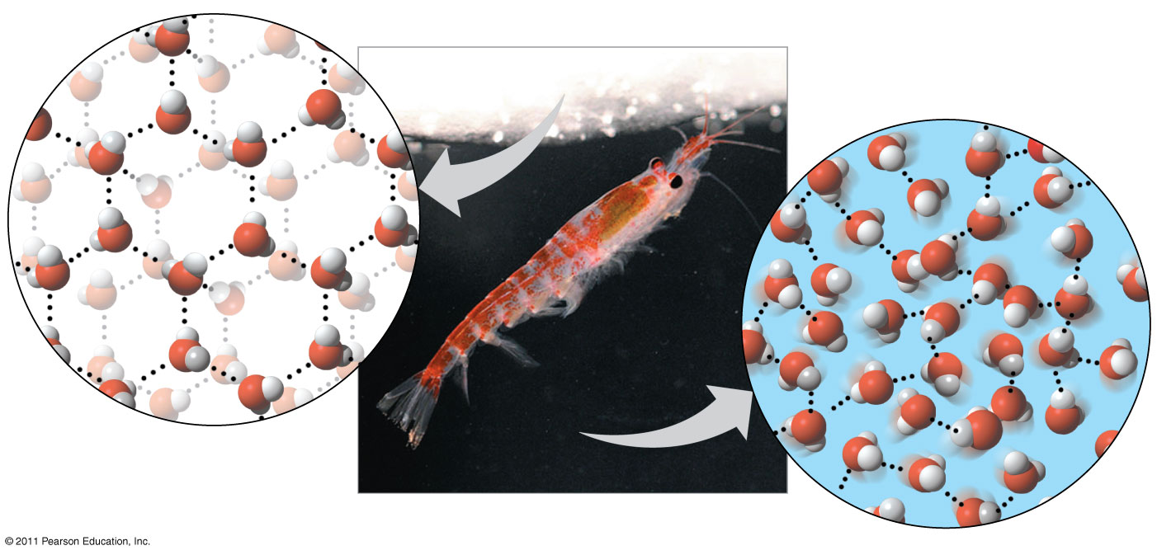
Figure 3.6
Hydrogen bond
Liquid water:
Hydrogen bonds
break and re-form
Ice:
Hydrogen bonds
are stable
Notes:
Figure 3.6 Ice: crystalline structure and floating barrier.

Slide 22
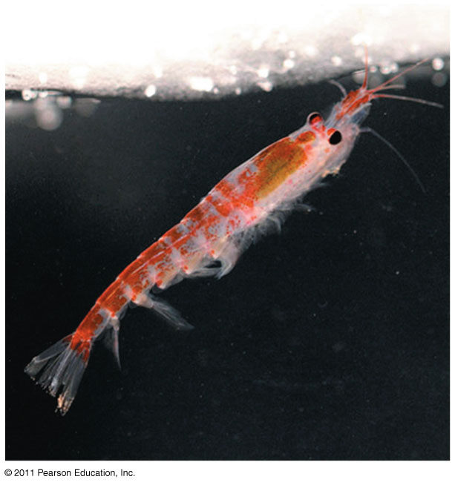
Figure 3.6a
Notes:
Figure 3.6 Ice: crystalline structure and floating barrier.

Slide 23
Water: The Solvent of Life
A solution is a liquid that is a homogeneous mixture of substances
A solvent is the dissolving agent of a solution
The solute is the substance that is dissolved
An aqueous solution is one in which water is the solvent
© 2011 Pearson Education, Inc.

Slide 24
Water is a versatile solvent due to its polarity, which allows it to form hydrogen bonds easily
When an ionic compound is dissolved in water, each ion is surrounded by a sphere of water molecules called a hydration shell
© 2011 Pearson Education, Inc.

Slide 25
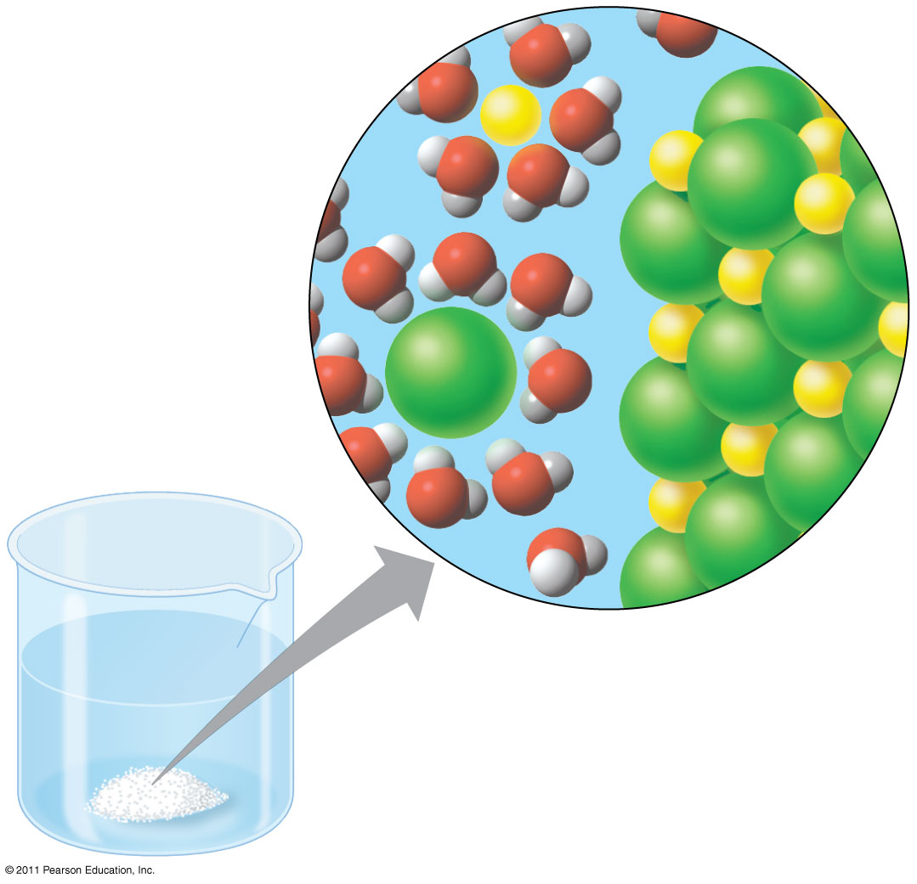
Figure 3.7
−
Na⁺
⁺
−
⁺
−
−
⁺
−
Na⁺
−
⁺
⁺
Cl⁻
Cl⁻
−
−
⁺
⁺
−
⁺
−
−
Notes:
Figure 3.7 Table salt dissolving in water.

Slide 26
Water can also dissolve compounds made of nonionic polar molecules
Even large polar molecules such as proteins can dissolve in water if they have ionic and polar regions
© 2011 Pearson Education, Inc.

Slide 27
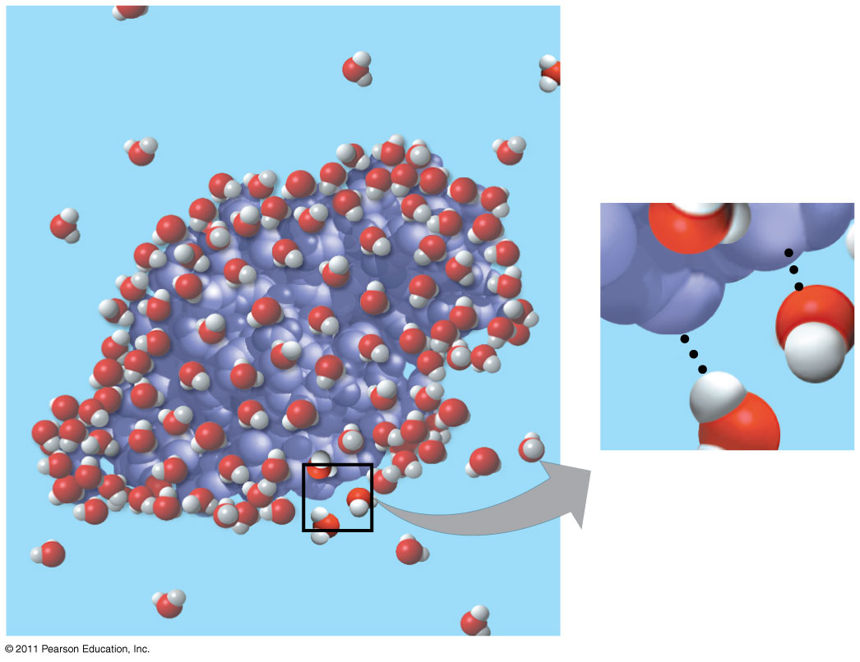
Figure 3.8
δ
+
δ
−
δ
−
δ
+
Notes:
Figure 3.8 A water-soluble protein.

Slide 28
Hydrophilic and Hydrophobic Substances
A hydrophilic substance is one that has an affinity for water
A hydrophobic substance is one that does not have an affinity for water
Oil molecules are hydrophobic because they have relatively nonpolar bonds
A colloid is a stable suspension of fine particles in a liquid
© 2011 Pearson Education, Inc.

Slide 29
Solute Concentration in Aqueous Solutions
Most biochemical reactions occur in water
Chemical reactions depend on collisions of molecules and therefore on the concentration of solutes in an aqueous solution
© 2011 Pearson Education, Inc.

Slide 30
Molecular mass is the sum of all masses of all atoms in a molecule
Numbers of molecules are usually measured in moles, where 1 mole (mol) = 6.02 x 10²³ molecules
Avogadro’s number and the unit dalton were defined such that 6.02 x 10²³ daltons = 1 g
Molarity (M) is the number of moles of solute per liter of solution
© 2011 Pearson Education, Inc.

Slide 31
Possible Evolution of Life on Other Planets with Water
The remarkable properties of water support life on Earth in many ways
Astrobiologists seeking life on other planets are concentrating their search on planets with water
To date, more than 200 planets have been found outside our solar system; one or two of them contain water
In our solar system, Mars has been found to have water
© 2011 Pearson Education, Inc.

Slide 32
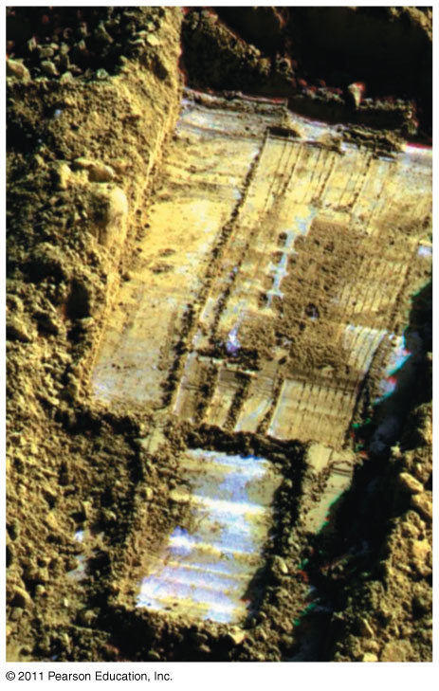
Figure 3.9
Notes:
Figure 3.9 Subsurface ice and morning frost on Mars.

Slide 33
Concept 3.3: Acidic and basic conditions affect living organisms
A hydrogen atom in a hydrogen bond between two water molecules can shift from one to the other
  The hydrogen atom leaves its electron behind and is transferred as a proton, or hydrogen ion (H⁺)
  The molecule with the extra proton is now a hydronium ion (H₃O⁺), though it is often represented as H⁺
  The molecule that lost the proton is now a hydroxide ion (OH–)
© 2011 Pearson Education, Inc.

Slide 34
Water is in a state of dynamic equilibrium in which water molecules dissociate at the same rate at which they are being reformed
© 2011 Pearson Education, Inc.

Slide 35
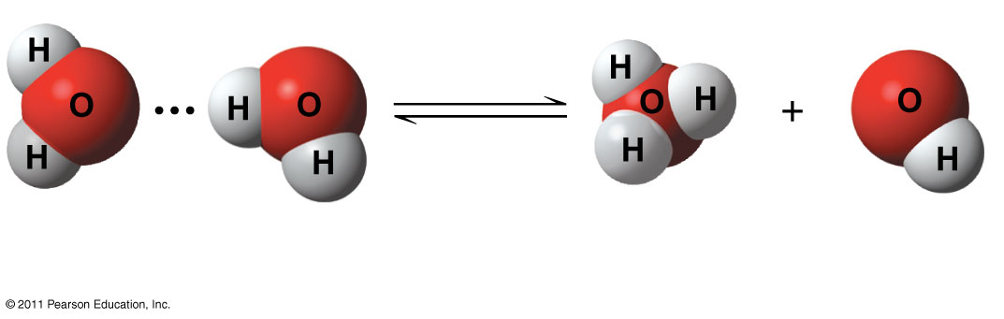
Figure 3.UN02
+
−
2 H₂O
Hydronium
ion (H₃O⁺)
Hydroxide
ion (OH⁻)
Notes:
Figure 3.UN02 In-text figure, p. 53

Slide 36
Though statistically rare, the dissociation of water molecules has a great effect on organisms
Changes in concentrations of H⁺ and OH– can drastically affect the chemistry of a cell
© 2011 Pearson Education, Inc.

Slide 37
Concentrations of H⁺ and OH– are equal in pure water
Adding certain solutes, called acids and bases, modifies the concentrations of H⁺ and OH–
Biologists use something called the pH scale to describe whether a solution is acidic or basic (the opposite of acidic)
© 2011 Pearson Education, Inc.

Slide 38
Acids and Bases
An acid is any substance that increases the H⁺ concentration of a solution
A base is any substance that reduces the H⁺ concentration of a solution
© 2011 Pearson Education, Inc.

Slide 39
The pH Scale
In any aqueous solution at 25°C the product of H⁺ and OH– is constant and can be written as
The pH of a solution is defined by the negative logarithm of H⁺ concentration, written as
For a neutral aqueous solution
[H⁺][OH–] = 10^{–14}
pH = –log [H⁺]
[H⁺] is 10^{–7} = –(–7) = 7
© 2011 Pearson Education, Inc.

Slide 40
Acidic solutions have pH values less than 7
Basic solutions have pH values greater than 7
Most biological fluids have pH values in the range of 6 to 8
© 2011 Pearson Education, Inc.

Slide 41
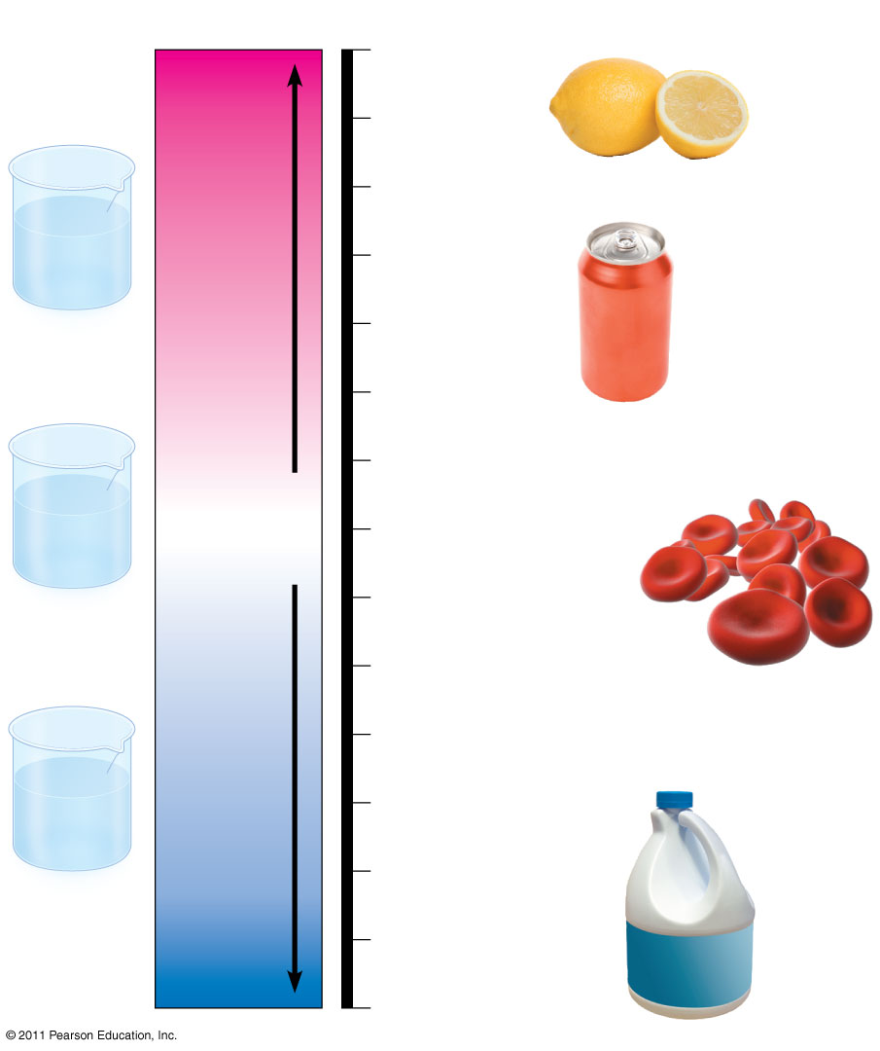
Figure 3.10
pH Scale
0
1
Battery acid
2
Gastric juice, lemon juice
H⁺
H⁺
H⁺
OH⁻
H⁺
Increasingly Acidic
[H⁺] > [OH⁻]
3
Vinegar, wine,
cola
OH⁻
H⁺
H⁺
H⁺
H⁺
4
Acidic
solution
Tomato juice
Beer
5
Black coffee
Rainwater
6
Urine
OH⁻
OH⁻
Neutral
[H⁺] = [OH⁻]
Saliva
H⁺
H⁺
OH⁻
7
Pure water
OH⁻
OH⁻
H⁺
Human blood, tears
H⁺
H⁺
8
Neutral
solution
Seawater
Inside of small intestine
9
Increasingly Basic
[H⁺] < [OH⁻]
10
OH⁻
Milk of magnesia
OH⁻
11
OH⁻
H⁺
OH⁻
Household ammonia
OH⁻
H⁺
OH⁻
OH⁻
12
Basic
solution
13
Household
bleach
Oven cleaner
14
Notes:
Figure 3.10 The pH scale and pH values of some aqueous solutions.

Slide 42
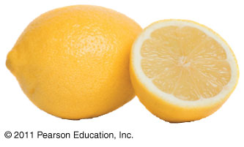
Figure 3.10a
Notes:
Figure 3.10 The pH scale and pH values of some aqueous solutions.

Slide 43
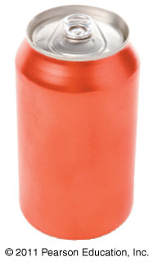
Figure 3.10b
Notes:
Figure 3.10 The pH scale and pH values of some aqueous solutions.

Slide 44
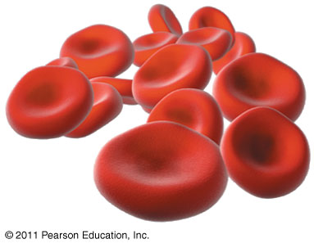
Figure 3.10c
Notes:
Figure 3.10 The pH scale and pH values of some aqueous solutions.

Slide 45
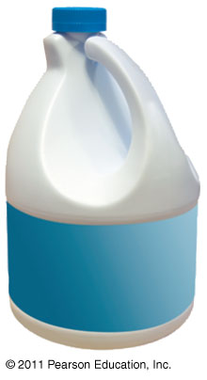
Figure 3.10d
Notes:
Figure 3.10 The pH scale and pH values of some aqueous solutions.

Slide 46
Buffers
The internal pH of most living cells must remain close to pH 7
Buffers are substances that minimize changes in concentrations of H⁺ and OH– in a solution
Most buffers consist of an acid-base pair that reversibly combines with H⁺
© 2011 Pearson Education, Inc.

Slide 47
Acidification: A Threat to Water Quality
Human activities such as burning fossil fuels threaten water quality
CO₂ is the main product of fossil fuel combustion
About 25% of human-generated CO₂ is absorbed by the oceans
CO2 dissolved in sea water forms carbonic acid; this process is called ocean acidification
© 2011 Pearson Education, Inc.

Slide 48
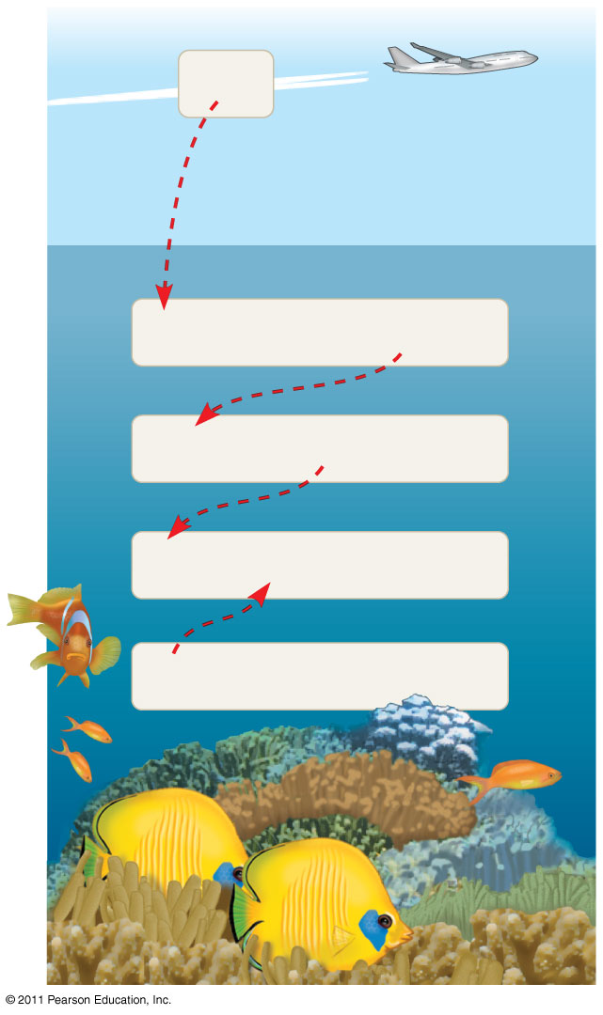
Figure 3.11
CO₂
CO₂ + H₂O
H₂CO₃
H₂CO₃
H⁺ + HCO₃⁻
H⁺ + CO₃²⁻
HCO₃⁻
CO₃²⁻ +
Ca²⁺
CaCO₃
Notes:
Figure 3.11 Atmospheric CO₂ from human activities and its fate in the ocean.

Slide 49
As seawater acidifies, H⁺ ions combine with carbonate ions to produce bicarbonate
Carbonate is required for calcification (production of calcium carbonate) by many marine organism, including reef-building corals
© 2011 Pearson Education, Inc.

Slide 50
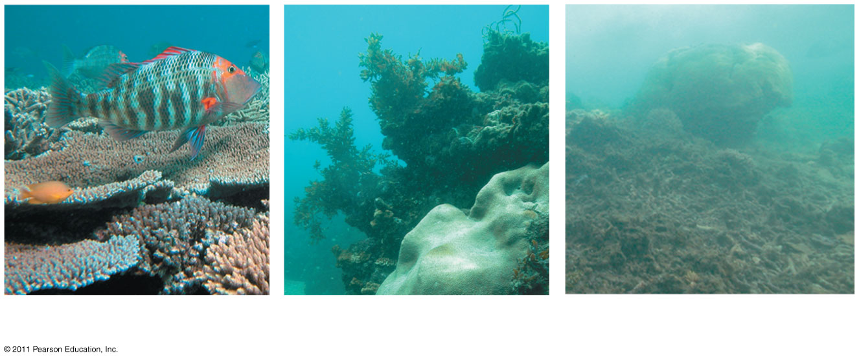
Figure 3.12
(a)
(b)
(c)
Notes:
Figure 3.12 IMPACT: The Threat of Ocean Acidification to Coral Reef Ecosystems

Slide 51
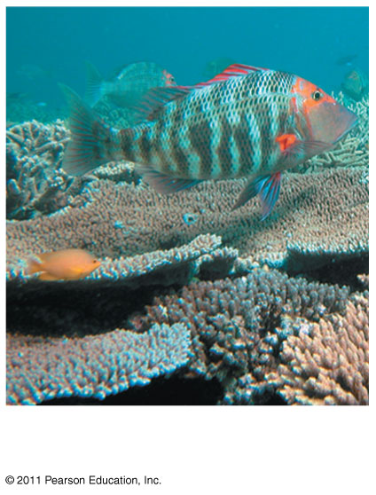
Figure 3.12a
(a)
Notes:
Figure 3.12 IMPACT: The Threat of Ocean Acidification to Coral Reef Ecosystems

Slide 52
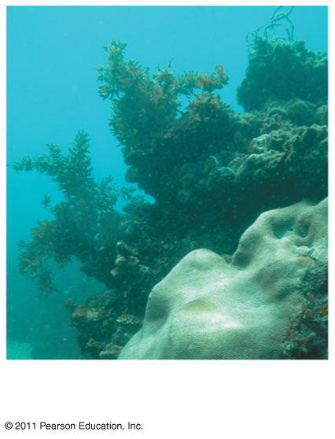
Figure 3.12b
(b)
Notes:
Figure 3.12 IMPACT: The Threat of Ocean Acidification to Coral Reef Ecosystems

Slide 53
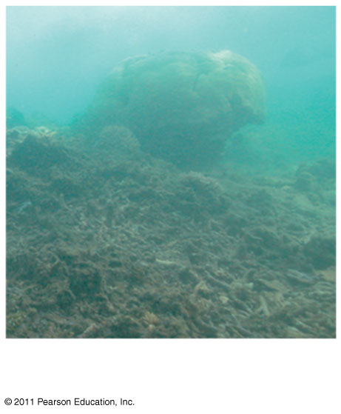
Figure 3.12c
(c)
Notes:
Figure 3.12 IMPACT: The Threat of Ocean Acidification to Coral Reef Ecosystems

Slide 54
The burning of fossil fuels is also a major source of sulfur oxides and nitrogen oxides
These compounds react with water in the air to form strong acids that fall in rain or snow
Acid precipitation is rain, fog, or snow with a ph lower than 5.2
Acid precipitation damages life in lakes and streams and changes soil chemistry on land
© 2011 Pearson Education, Inc.

Slide 55
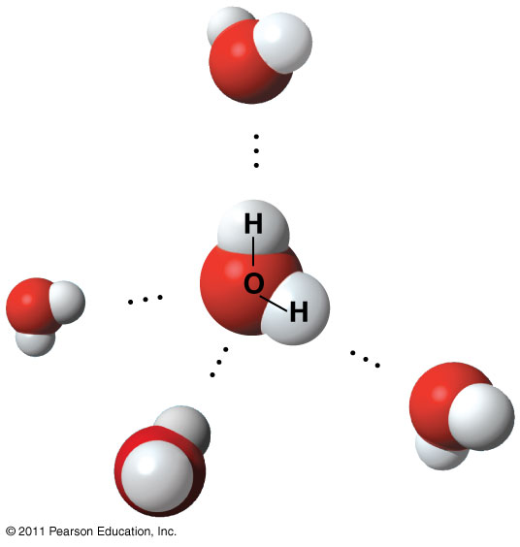
Figure 3.UN03
δ
−
δ
⁺
δ
δ
−
⁺
δ
−
δ
⁺
δ
δ
−
⁺
Notes:
Figure 3.UN03 Summary figure, Concept 3.1

Slide 56
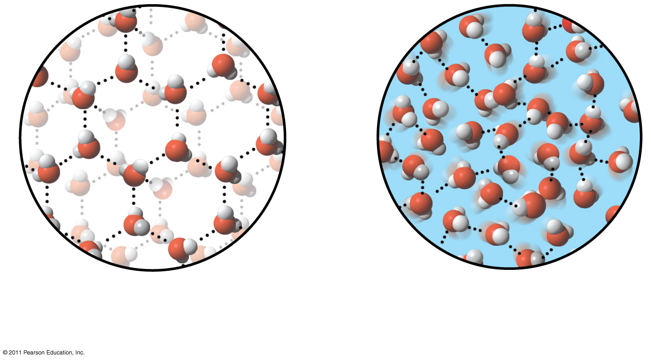
Figure 3.UN04
Ice: stable hydrogen bonds
Liquid water: transient
hydrogen bonds
Notes:
Figure 3.UN04 Summary figure, Concept 3.2

Slide 57
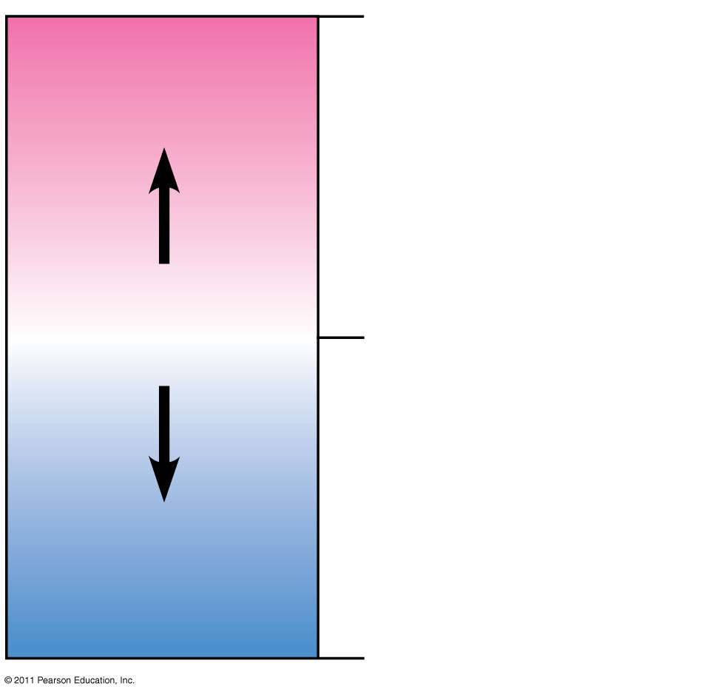
Figure 3.UN05
0
Acidic
[H⁺] > [OH⁻]
Acids donate H⁺ in
aqueous solutions.
Neutral
[H⁺] = [OH⁻]
7
Bases donate OH⁻
or accept H⁺ in
aqueous solutions
Basic
[H⁺] < [OH⁻]
14
Notes:
Figure 3.UN05 Summary figure, Concept 3.3

Slide 58
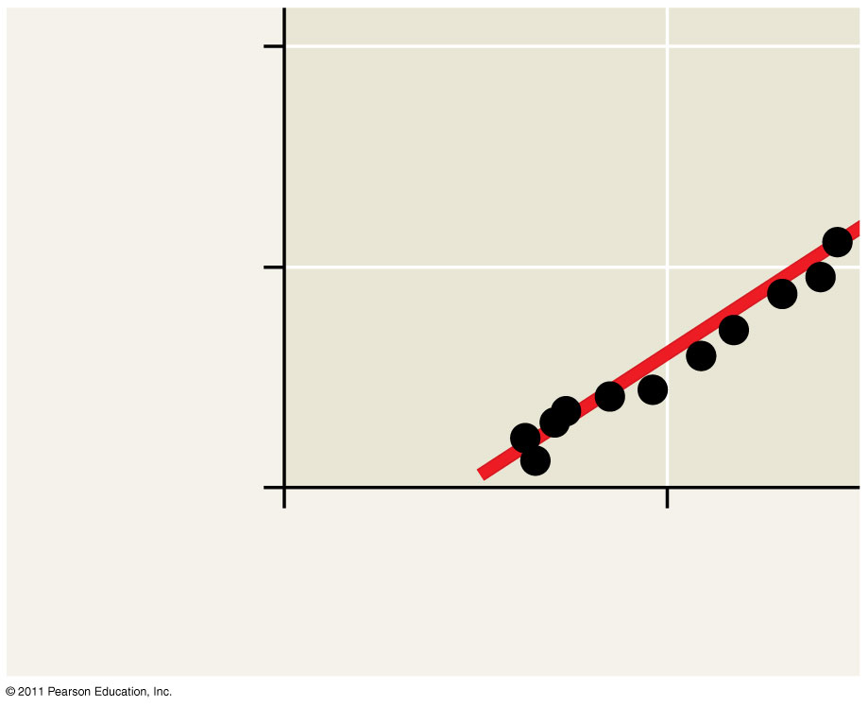
Figure 3.UN06
40
Calcification rate
(mmol CaCO₃/m² • day)
20
0
200
250
[CO₃²⁻] (μmol/kg)
Notes:
Figure 3.UN06 Test Your Understanding, question 14

Slide 59
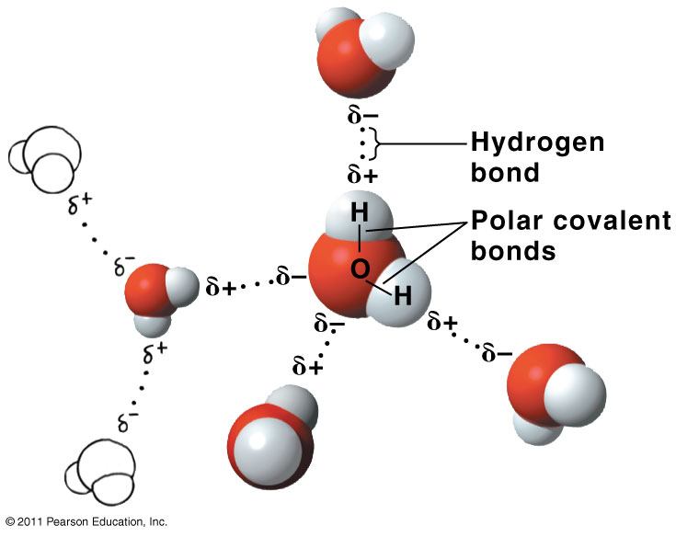
Figure 3.UN07
Notes:
Figure 3.UN07 Appendix A: answer to Figure 3.2 legend question

Slide 60
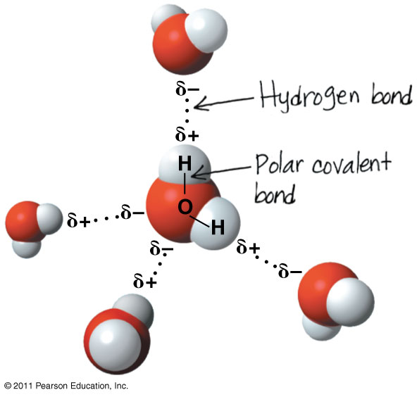
Figure 3.UN08
Notes:
Figure 3.UN08 Appendix A: answer to Summary of Concept 3.1 Draw It question

Slide 61
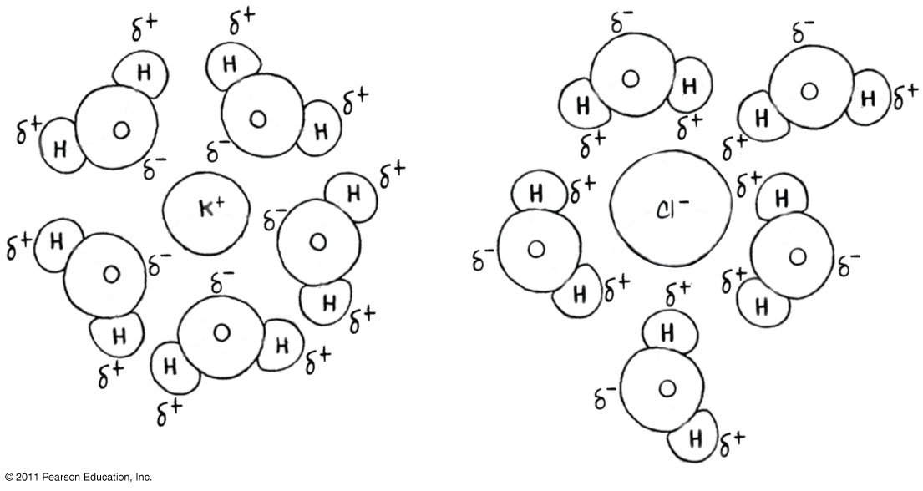
Figure 3.UN09
Notes:
Figure 3.UN09 Appendix A: answer to Test Your Understanding, question 9

