Slide 1
Chapter 10
Organohalides

Slide 2
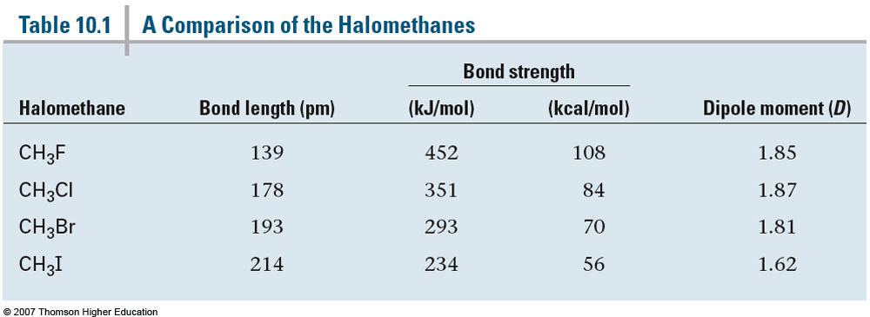
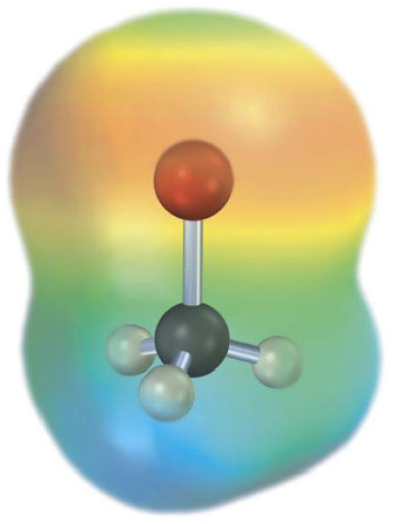
Section 10.2 Structure of Alkyl Halides
Due to the high bond polarity alkyl halides act as good electrophiles
Reactivity increases as the electronegativity of the halide increases

Slide 3
Section 10.3 Preparing Alkyl Halides from Alkanes: Radical Halogenation
Simple alkyl halides can be provided via a radical chain-reaction pathway with Cl₂ or Br₂ and light (hν)
Not very useful to the lack of control over the reaction and can lead to di-, tri-, and tetra-substituted products
Occurs via a three step mechanism:
Initiation
Propagation
Termination

Slide 4
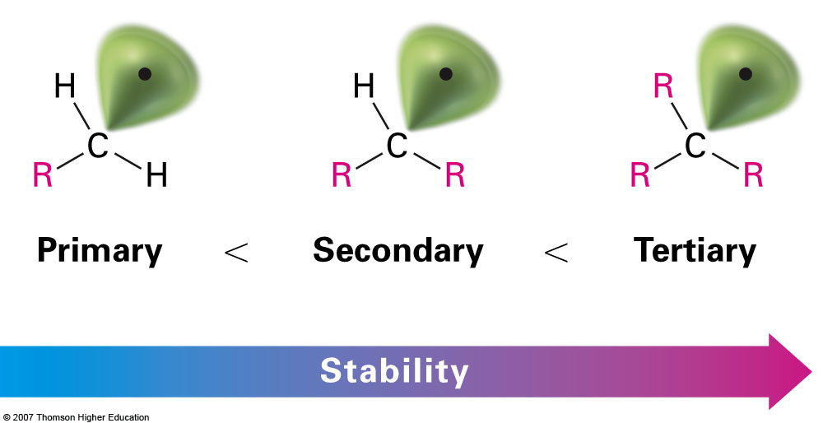
Order of Reactivity
Tertiary hydrogens are removed much more quickly because the resulting radical is more stabilized compared to a primary or secondary carbon
This can be seen by drawing an energy diagram for the process

Slide 5
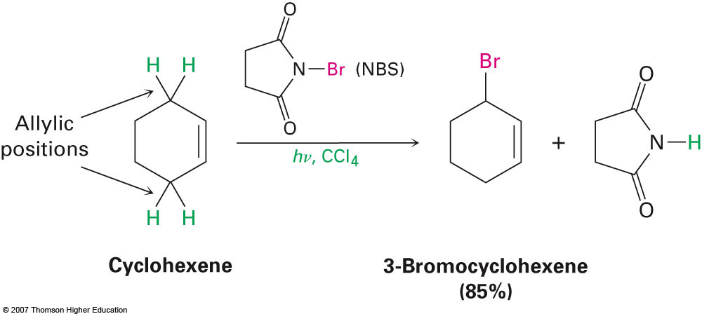
Section 10.4 Preparing Alkyl Halides from Alkenes: Allylic Bromination
We have already seen reactions involving the bromination of alkenes where the double bond is actually broken to form either mono- or di-bromides
Allylic bromination involves the reaction of alkenes with NBS where the double bond remains intact:

Slide 6
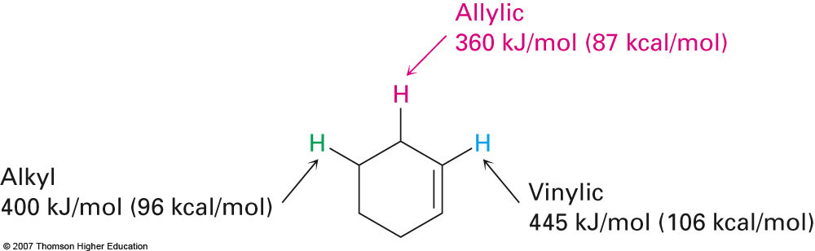
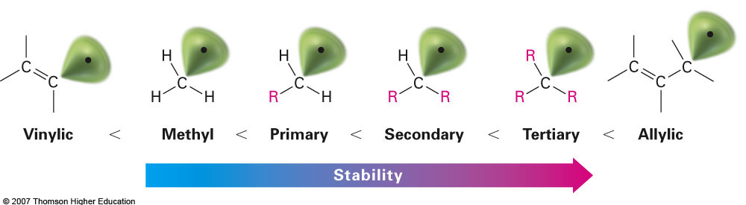
Allylic vs. Vinylic Positions

Slide 7
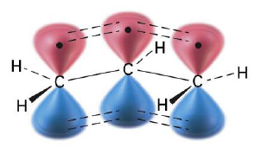
Section 10.5 Stability of the Allyl Radical: Resonance Revisited
The radical that is initially formed in free radical halogenation occupies a p orbital and essentially extends the π system allowing for resonance structures to be drawn
π-system extended over three carbons instead of two
While resonance forms impart stability it also creates problems when attempting to use it in organic synthesis
Example: 4,4-Dimethylcyclohexene

Slide 8
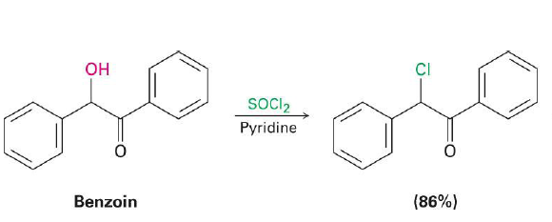
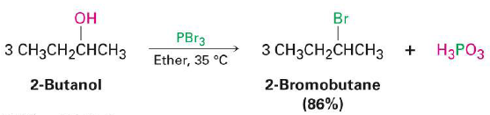
Section 10.6 Preparing Alkyl Halides from Alcohols
Easiest method involves treating the alcohol precursor with HX to produce the alkyl halide
Works well with tertiary alcohols but reaction is significant slower with primary and secondary (alternative methods work better for these alcohols)

Slide 9
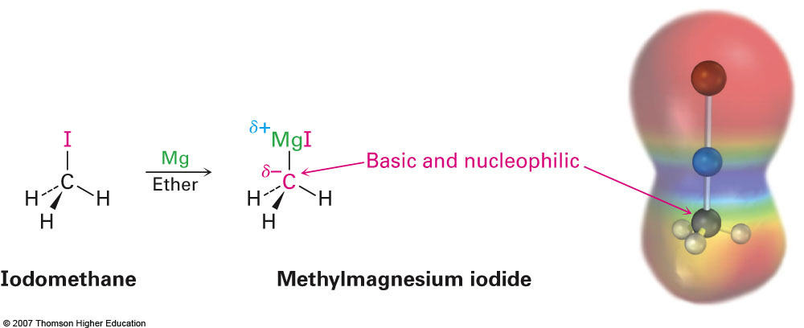
Section 10.7 Reactions of Alkyl Halides: Grignard Reagents
Alkyl halides will react with elemental magnesium to produce a Grignard reagent
The first example of an organometallic compound which contains a C—M bond
The more polarized the C—X bond the greater reactivity towards Mg
(Fluorides rarely react)

Slide 10
Reactions with Grignard Reagents
We will look at many more reactions involving Grignards later, but for now we will only discuss how they can be used to convert alkyl halides to alkanes
Not a very useful reaction but can eliminate halogens if necessary
Grignard Reagent

Slide 11
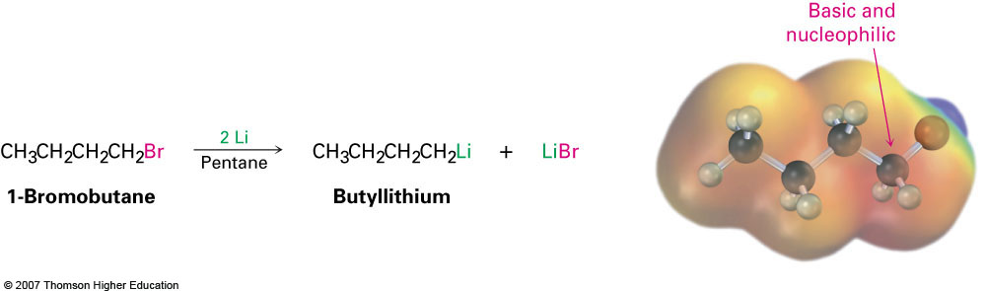
Section 10.8 Organometallic Coupling Reactions
Additional organometallic reagents can be prepared from alkyl halides with various uses
Alkyllithium reagents
Organocuprates (Gilman reagents)
Alkyllithium reagents are prepared by adding two equivalents of lithium metal to an alkyl halide:
Although nucleophilic, it is most commonly used as a base

Slide 12
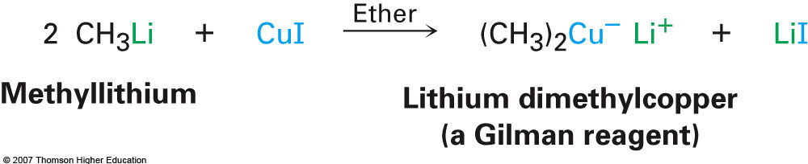

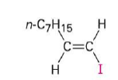

Gilman Reagents
Gilman reagents are prepared from two equivalents of an alkyllithium and copper (I) iodide:
Can be used on any halide whatsoever:
Alkyl
Vinyl
Aryl
Alkyl
Vinyl
Aryls

