Slide 1
Chapter 11
Reactions of Alkyl Halides: Nucleophilic Substitutions and Eliminations

Slide 2
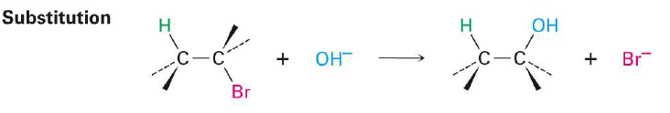
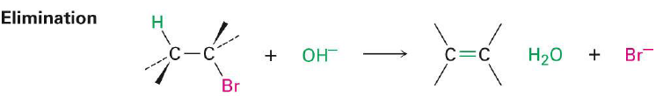
Substitution vs. Elimination
Substitution reactions involve the substitution of one nucleophile for another
Simply exchanges functional groups
Elimination involves the removal of the original functional group
Results in the formation of a double bond

Slide 3
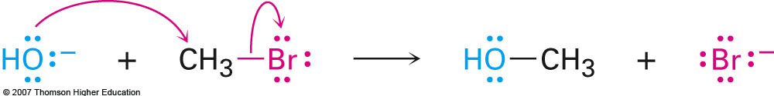
Section 11.2 The S_{N}² Reaction
Example:
Characteristics:
Proceeds with 2nd order kinetics (bimolecular reaction)
Always involves stereochemical inversion at the site of attack
R enantiomer would become S and vice versa
Transition state involves a planarized carbon center as seen on next slide

Slide 4
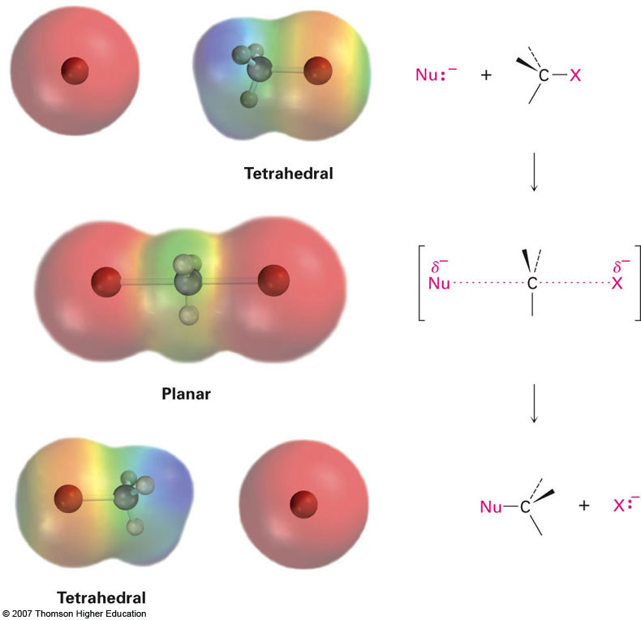
S_{N}² Transition State
Planarized carbon T.S.
Inversion of Stereochemistry

Slide 5
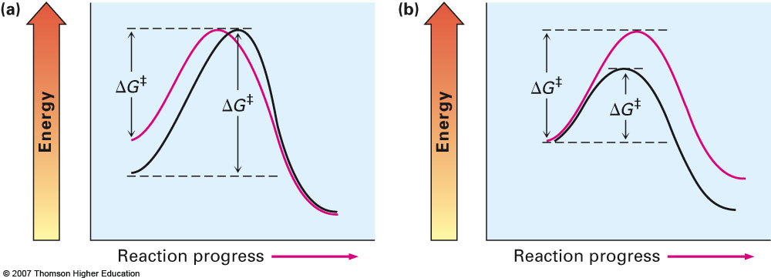
Section 11.3 Characteristics of the S_{N}² Reaction
Recall that reaction kinetics are determined primarily by the energy of the transition state (ΔG‡)
Lowering of this energy results in an increase in reaction rate
There are several variables that effect this transition state energy which we will investigate
Red line represents faster rxn
Red line represents slower rxn

Slide 6
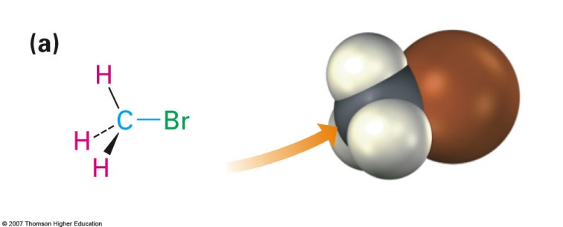
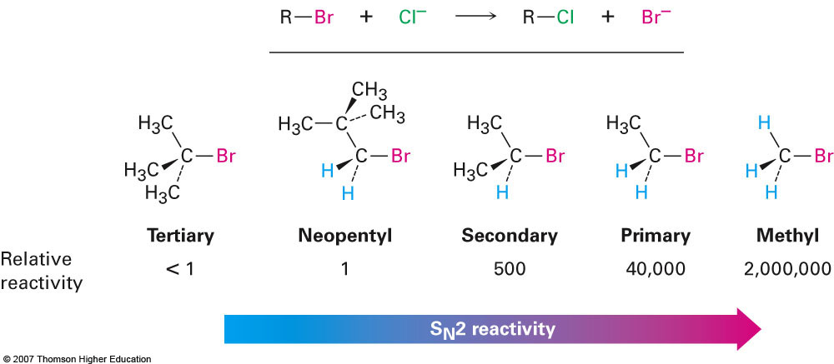
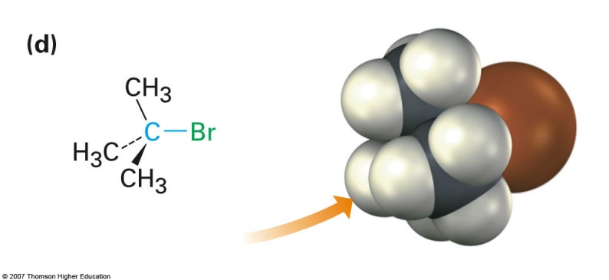
The Substrate (Starting Material)
Steric interactions play a huge role in the kinetics of the S_{N}² reaction
A hindered reaction site will react very slowly (or not at all)
S_{N}² reactions really only occur at unhindered sites (methyl, 1°, possibly 2°)

Slide 7
The Nucleophile
Since the nucleophile is the second species necessary for the bimolecular reaction it plays an important role as well
Although the descriptor nucleophilicity is a difficult one to interpret, some guidelines can be used when comparing nucleophiles:
Nucleophilicity roughly parallels basicity
Nucleophilicity usually increases going down a group on the periodic table
Less electronegative = more nucleophilic
Negatively charged nucleophiles are usually more reactive than neutral ones

Slide 8
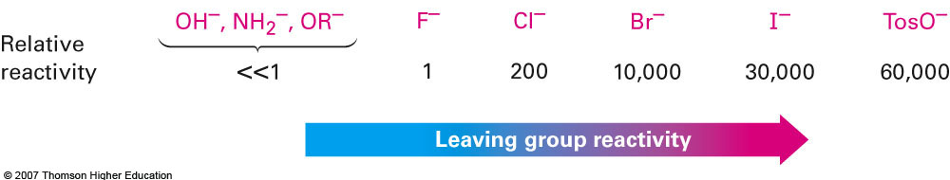
The Leaving Group
The leaving group in the S_{N}² reaction is important when considering the stabilization of the intermediate
A better stabilized negative charge on the leaving group leads to a lowering of energy and an increase in reaction rate
Interesting examples involve converting the –OH group into a better leaving group
--- Reactions involving SOCl₂, PBr₃, and Tosylates

Slide 9
The Solvent
Nonpolar Solvents
Polar solvents
Hexane
CCl₄
Benzene
Toluene
NO DIPOLE MOMENT
Protic (Capable of H-bonding)
Water
Methanol (CH₃OH)
Ethanol (C₂H₅OH)
Acetic acid
Aprotic (No H-bonding)
Acetone
DMSO
Ether
THF
CH₂Cl₂

Slide 10
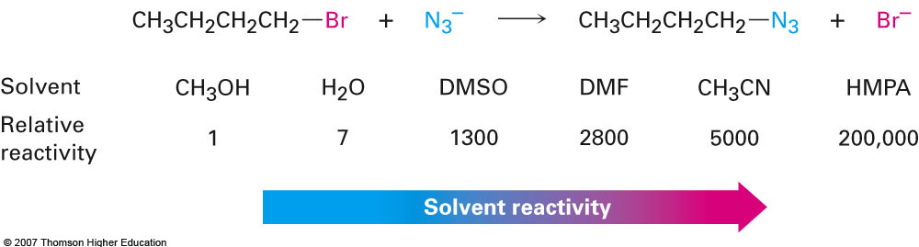
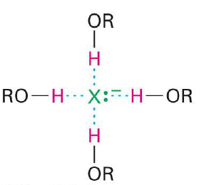
Solvent Effects on Reaction Rate
For the S_{N}² reaction polar aprotic solvents work best because they help solvate the cation which leaves the negatively charged nucleophile free to react with electrophile
Polar protic solvents can H-bond to the negatively charged nucleophile and lower its nucleophilicity

Slide 11
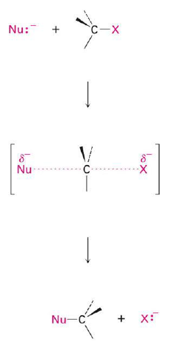
Important Characteristic of S_{N}² Reaction
What’s important to remember regarding the S_{N}² mechanism is that it is a sterespecific reaction
If the starting material is enantiomerically pure, then the product will be as well; however, it will proceed with an inversion of stereochemistry
R will become S and vice versa
You can think of it as opening an umbrella too far

Slide 12
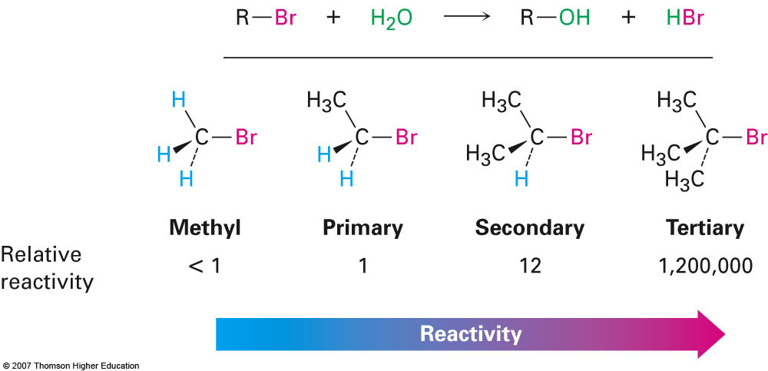
Section 11.4 The S_{N}¹ Reaction
As can be seen from the name, this mechanism is a unimolecular mechanism and the rate of reactivity below sheds light on how the reaction actually proceeds
Order of reactivity is opposite of that expected for S_{N}²

Slide 13
Energy Associated with S_{N}¹ Reaction
First order process where nucleophile doesn’t even affect reaction kinetics
Let’s take a look at the reaction between tert-butyl bromide and water
Hydrolysis reaction
Too sterically hindered to occur via S_{N}² mechanism

Slide 14
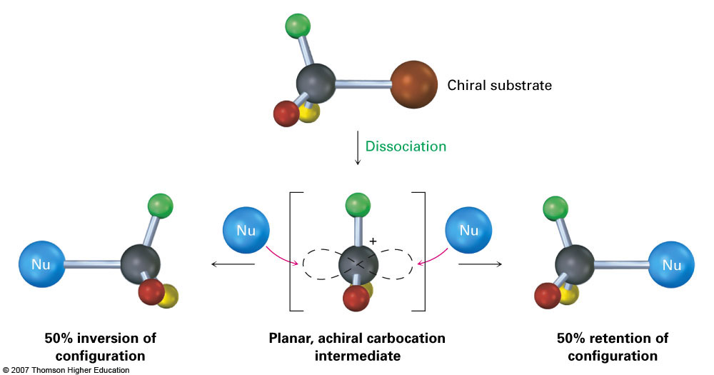
Effects on Stereochemistry
Because the S_{N}¹ reaction is a two step process involving a trigonal planar intermediate chirality is lost and racemization of the product is observed

Slide 15
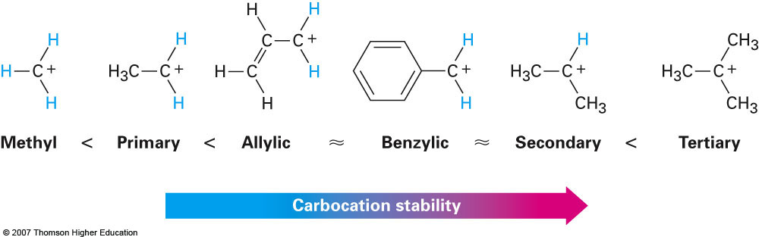
Section 11.5 Characteristics of the S_{N}¹ Reaction
The factors that affected the S_{N}² reaction also affect the S_{N}¹ reaction
For each variable it is very important to consider how it will affect the stability (energy) of the carbocation intermediate that is formed.
When considering the substrate you have to consider how it can stabilize this intermediate

Slide 16
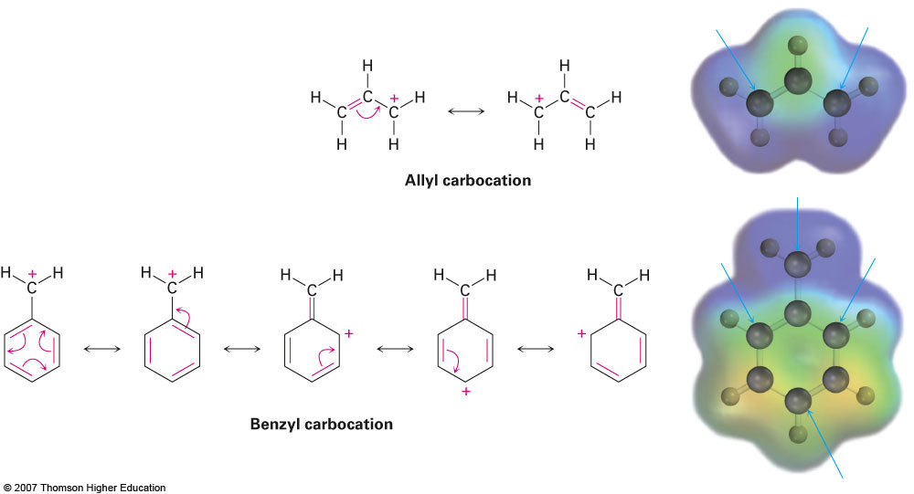
Benzylic Carbocations
Almost like a special case of the allylic carbocation
Unusually stable due to charge stabilization through resonance

Slide 17
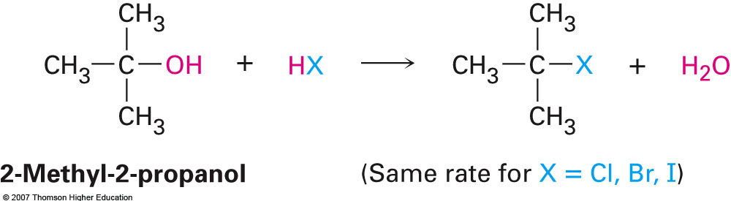
The Leaving Group and Nucleophile
The order of reactivity regarding the leaving group is exactly the same as that for the S_{N}² reaction and for the exact same reason
Because the nucleophile does not appear in the rate law for the reaction it will have absolutely no bearing on the reaction kinetics
Rate of formation of carbocation intermediate is the only determining factor

Slide 18
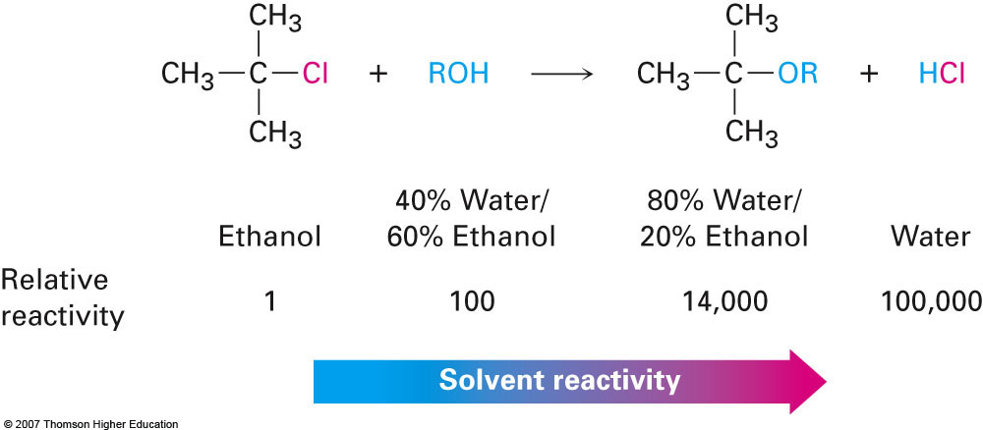
Solvent Effects
The reason for the solvent effect for an S_{N}¹ reaction is different from that for an S_{N}² reaction.
S_{N}² protic solvents slow the reaction down due to lowering of the nucleophile’s nucleophilicity
S_{N}¹ protic solvents enhance the reaction because they stabilize the carbocation intermediate

Slide 19
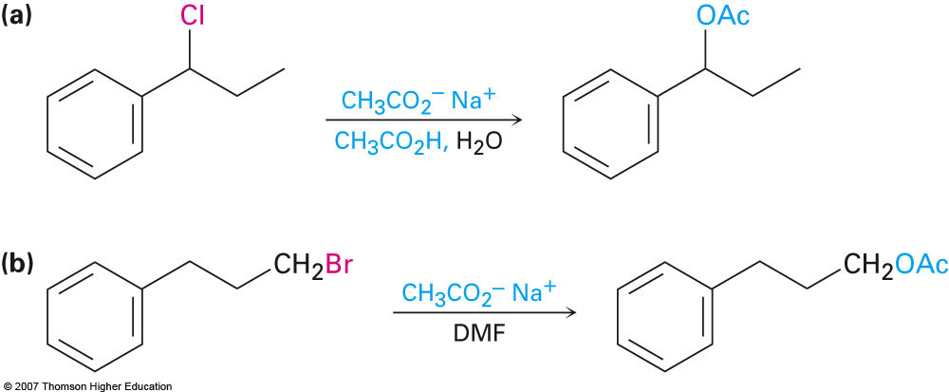
Examples
Which mechanism is most likely for the examples shown below?

Slide 20
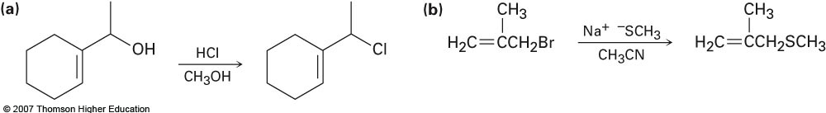
Examples
S_{N}¹ or S_{N}²?

Slide 21
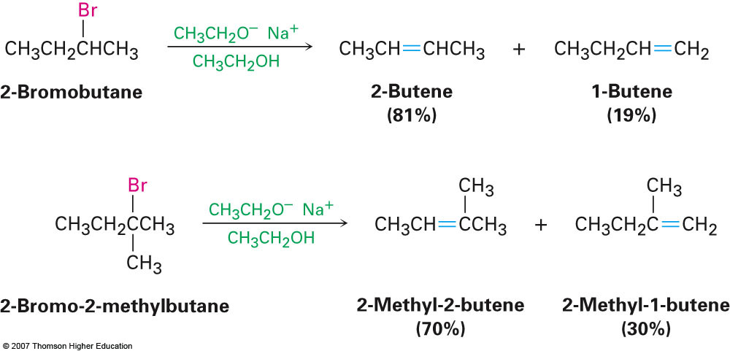
Section 11.7 Elimination Reactions of Alkyl Halides: Zaitsev’s Rule
Substitution reactions always result in one product
If the reaction occurs at all then typically only one product will form
For elimination reactions mixtures of products often occur
According to Zaitsev’s rule the most stable (i.e. most substituted) double bond will form in an elimination reaction

Slide 22
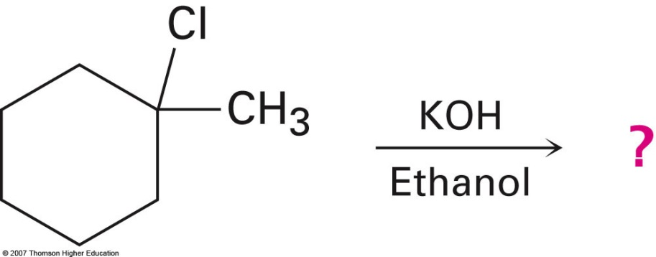
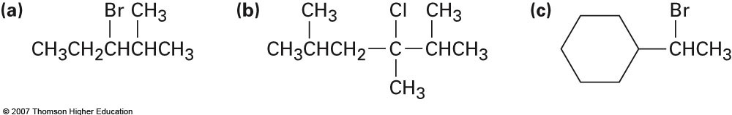
Example
What product would you expect from the following elimination reactions?

Slide 23
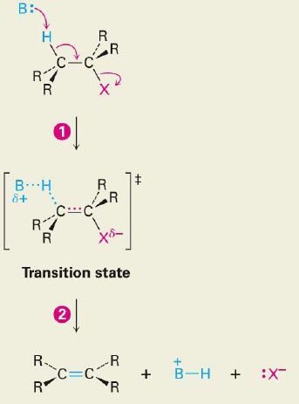
Section 11.8 The E2 Reaction
An analogous reaction to the S_{N}² reaction
Rate = k[Substrate][Base]
Base = Strong base such as hydroxide or alkoxide (e.g. CH₃O⁻)
Occurs with periplanar geometry which ends up dictating the stereochemistry of the resulting alkene product

Slide 24
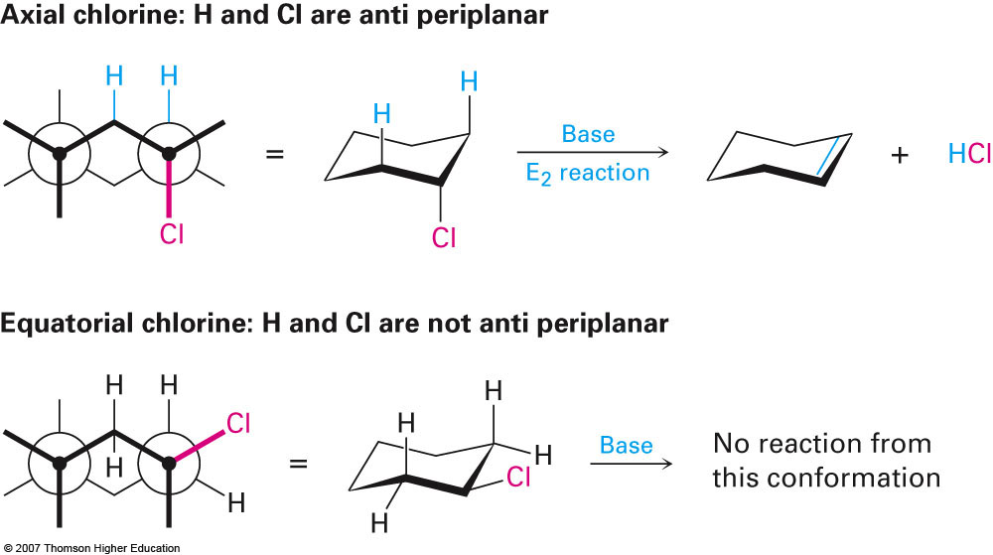
Section 11.9 The E2 Reaction and Cyclohexane Conformation
The requirement for anti periplanar geometry is actually more important than Zaitsev’s rule
Because the molecular is constrained due to the ring, only when the hydrogen and the leaving group are diaxial to each will reaction occur:

Slide 25
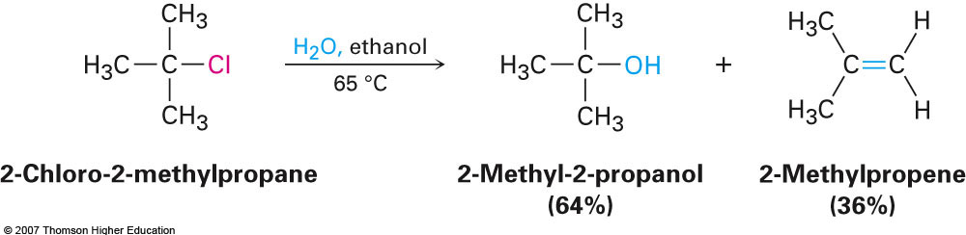
Section 11.10 The E1 Reaction
First step of the E1 reaction is exactly the same as the first step in an S_{N}¹ reaction
Formation of a carbocation
Because the same conditions as S_{N}¹ are preferred for E1 a mixture of the two products is often obtained:

