Slide 1
Chapter 12
Structure Determination: Mass Spectrometry and Infrared Spectroscopy

Slide 2
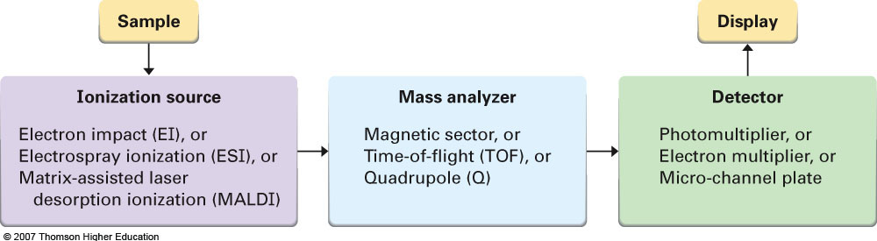
Section 12.1 Mass Spectrometry of Small Molecules
Mass spectroscopy is essentially a technique which provides one main piece of information: the molecular weight of a compound
There are multiple techniques using the same basic principles depending on sample composition:

Slide 3
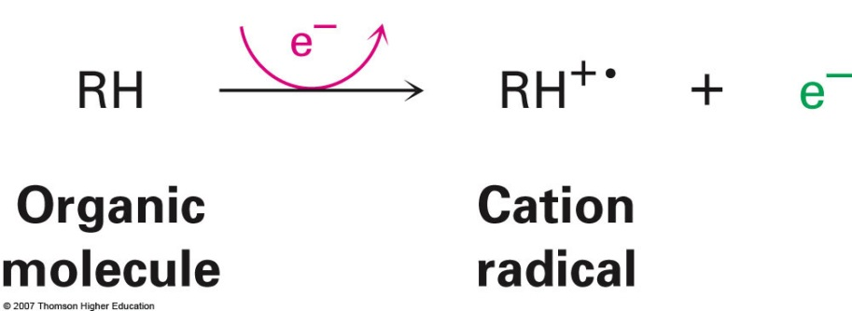
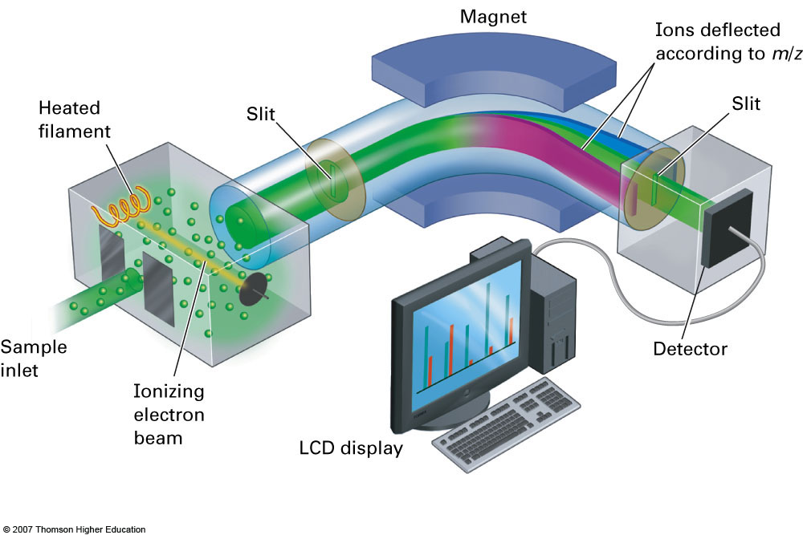
Ionization
Mass spectrometers are only capable of analyzing charged particles; therefore, ionization of the sample must occur first

Slide 4
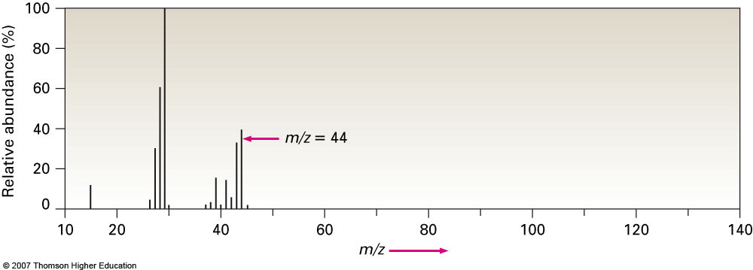
Mass Spectrum
The ionized particles are deflected within the magnetic field according to both their charge and their mass
The mass spectrum which the software generates is typically presented in the form of a bar graph and depicts all of the mass to charge (m/z) ratios for all fragments produced.

Slide 5
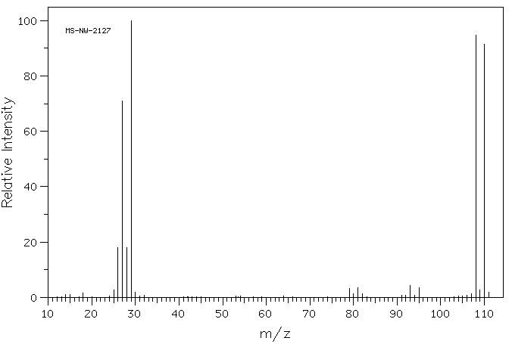
Mass Spectra of Bromine Containing Compounds

Slide 6
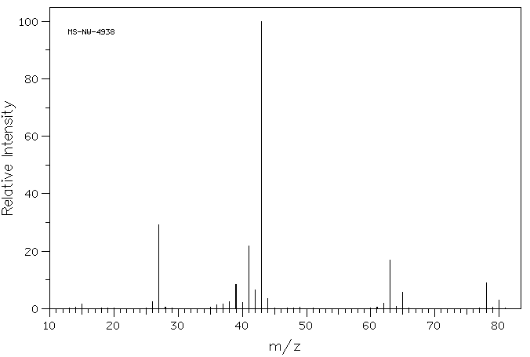
Mass Spectra of Chlorine Containing Compounds

Slide 7

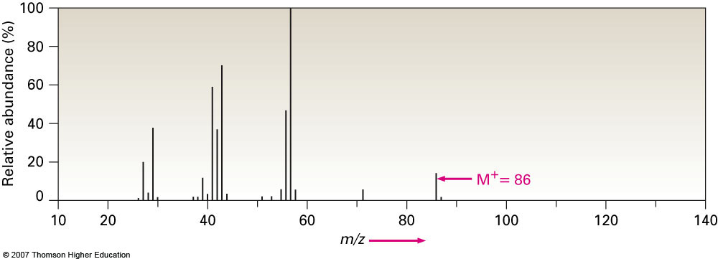
Section 12.2 Interpreting Mass Spectra
It is possible to determine the structure of some organic compounds using its mass spectrum alone; however we will only be interested in some basic information:
Parent Peak
Molecular Ion Peak (M⁺)
Contributions from other Isotopes
Hexane
Parent Peak (% abundance =100)

Slide 8
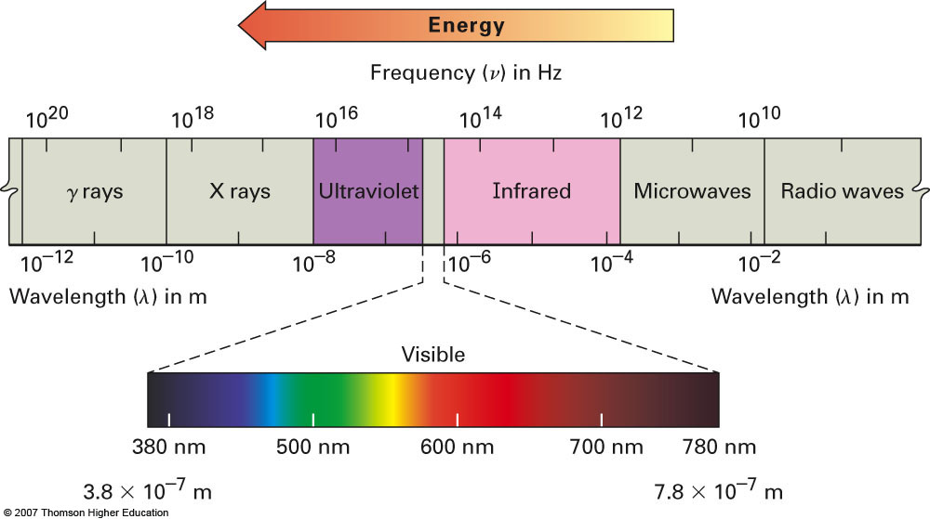
Section 12.5 Spectroscopy and the Electromagnetic Spectrum

Slide 9
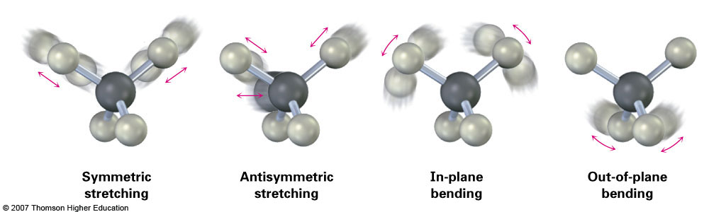
Section 12.6 Infrared Spectroscopy
Infrared spectroscopy relies on the different vibrational modes possible for different compounds
You can think of the chemical bonds as being springs and the constant excitation and emission of energy occurs in the IR region
Particularly useful for identifying functional groups present within a molecule

Slide 10
Section 12.7 Interpreting Infrared Spectra
IR spectra are typically most useful for identifying what types of functional groups are present within a molecule
The functional groups can be identified because we can identify the stretching from individual bonds
We will analyze five different regions of an IR spectrum to obtain functional group information:
~3500 cm⁻¹ ( O—H / N—H bond)
~3010 cm⁻¹ ( unsaturated C—H bond)
~2950 cm⁻¹ ( saturated C—H bond)
~1700 cm⁻¹ ( carbonyl group, C=O)
~1250-1000 cm⁻¹ ( C—O single bond)

Slide 11
Functional Groups to be Aware Of
These are the functional groups we will discuss in class through various examples and for which you are responsible:
Standard alkane/alkene/alkyne
Alcohols
Amines
Carbonyl containing compounds
Aldehydes
Ketones
Esters
Carboxylic acids

Slide 12
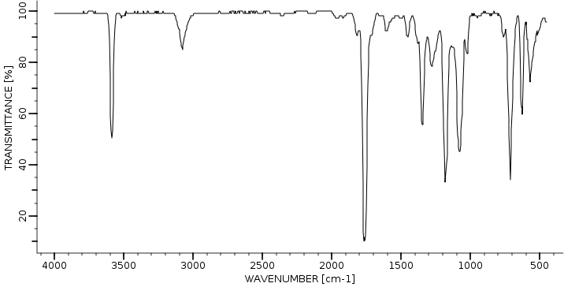
Example #1
Identify the functional groups present in the following IR spectrum:

Slide 13
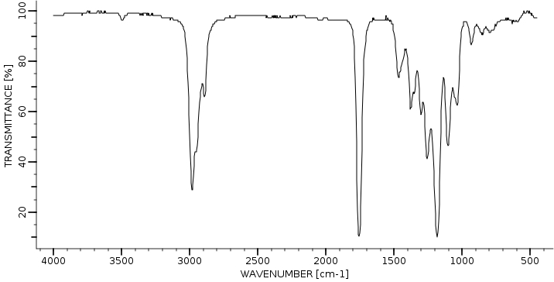
Example #2
Identify the functional groups present in the following IR spectrum:

