Slide 1
Chapter 13
Structure Determination: Nuclear Magnetic Resonance Spectroscopy

Slide 2
Section 13.1 Nuclear Magnetic Resonance Spectroscopy
Out of the four different techniques discussed in this unit, NMR spectroscopy probably provides the most information
Provides information on the H and C environments in a compound
Not all nuclei are NMR active
Those with nuclear spin = ½ are the most important
Most elements have NMR active isotopes; however, isotopic abundance can render them useless

Slide 3
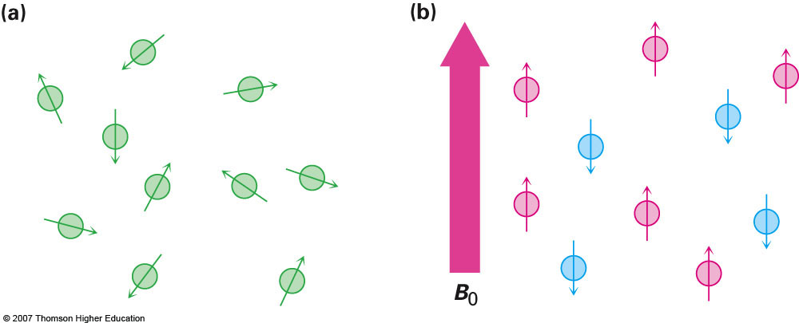
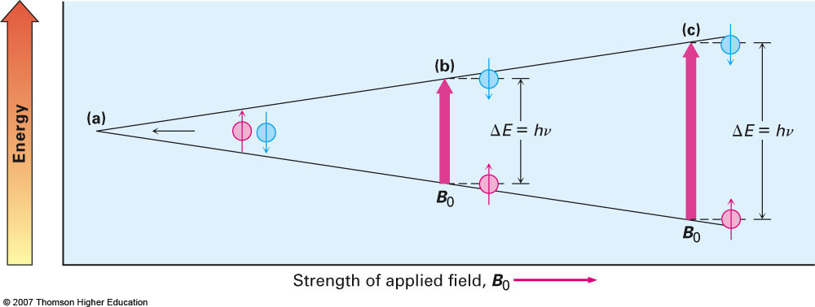
Principle Behind NMR
Spin of nuclei is random unless an external magnetic field is applied to the sample
The stronger the applied field the greater the energy difference between spin states:

Slide 4
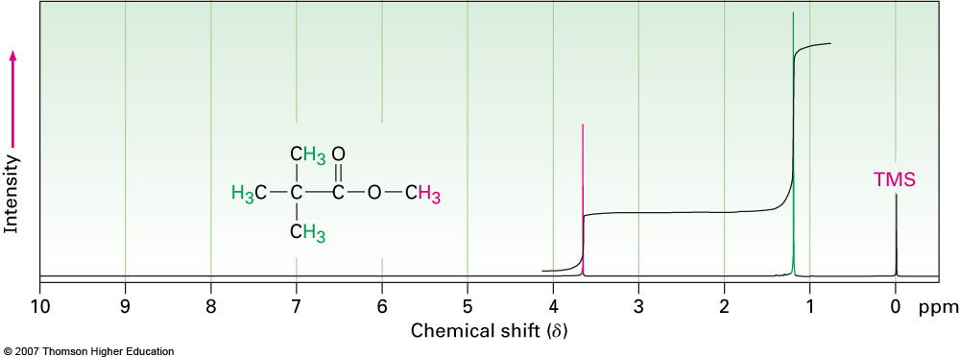
The Nature of NMR Absorptions
Based on what we’ve discussed thus far, there would be nothing to distinguish the nuclei and there would be no point to NMR spectroscopy
However, around each of the nuclei are electrons and it is the nature of the electronic environment that distinguishes the nuclei
B_{effective} = B_{applied} – B_{local}

Slide 5
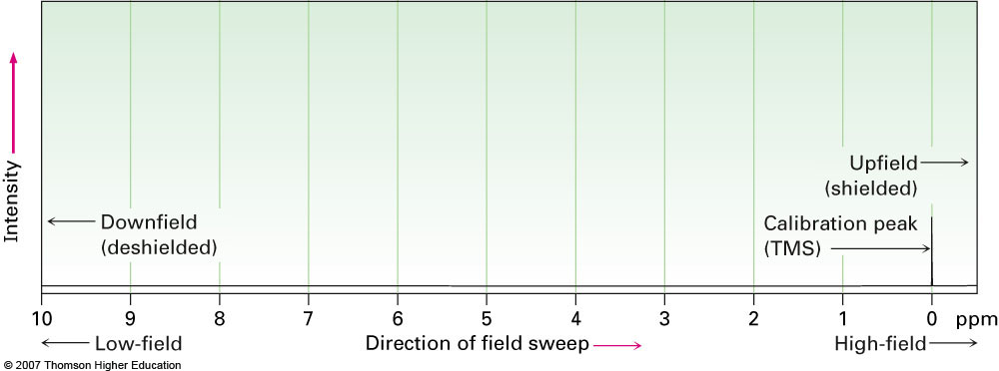
Section 13.3 Chemical Shifts
NMR spectra are always referenced to an internal standard (typically tetramethylsilane) and peaks are always measured in ppm

Slide 6
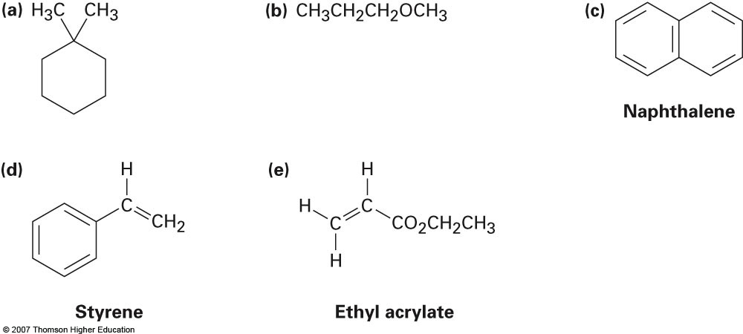
Section 13.8 ¹H NMR Spectroscopy and Proton Equivalence
Proton NMR can become quite complex when considering enantiomers or diastereomers (or compounds with even more chiral centers)
We will only look at relatively simple compounds to determine if their hydrogens are equivalent or not
How many resonances (peaks) would you expect in the ¹H NMR spectra for the following compounds:

Slide 7
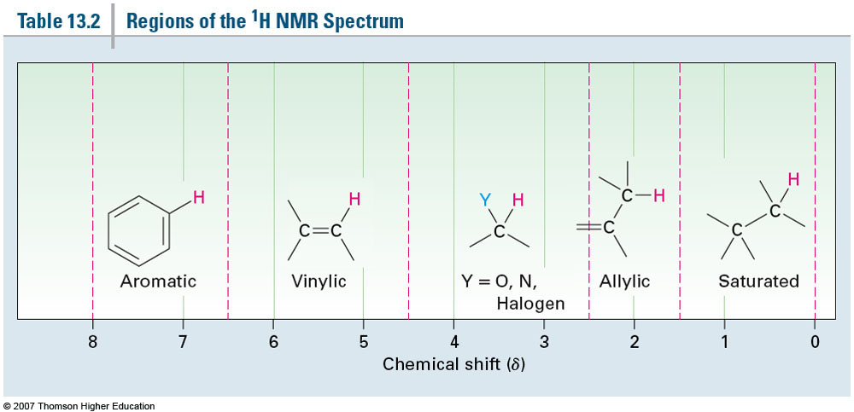
Section 13.9 Chemical Shifts in ¹H NMR Spectroscopy
Most protons will fall in the range of 0-10 ppm
Carboxylic acid protons (if seen at all) will typically be around 12 ppm)
Strongly shielded nuclei will be found on the right while deshielded will be found on the left

Slide 8
Section 13.10 Integration of ¹H NMR Absorptions: Proton Counting
Let’s examine the spectrum of methyl 2,2-dimethylpropanoate shown below
Two types of peaks observed; however, the peaks are not the same size
By integrating the peak area we can determine the relative numbers of the different types of protons in a molecule

Slide 9
Section 13.11 Spin—Spin Splitting in ¹H NMR Spectra
When considering one chemical environment (one set of chemically equivalent protons) you have to remember that they are affected by adjacent protons
The electrons around these protons set up a tiny magnetic field of their own which splits the expected peak into a multiplet
The number of peaks expected can be predicted using the n + 1 rule
Ex: bromoethane

Slide 10
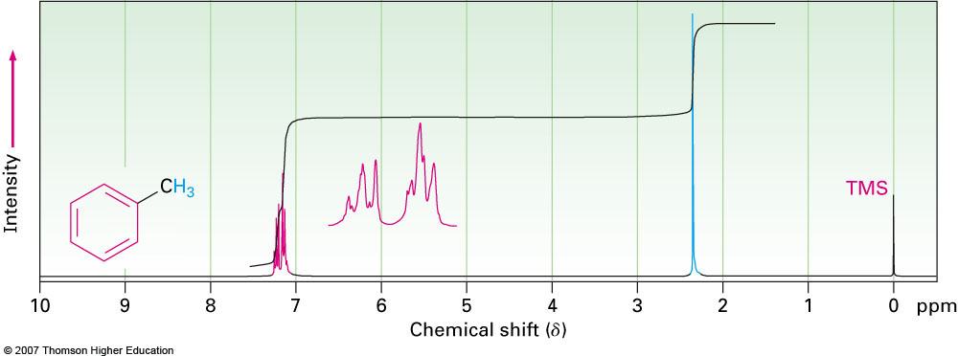
Section 13.12 More Complex Spin—Spin Splitting Patterns
On some occasions the peaks corresponding to individual chemical environments overlap each other because the degree of shielding is very similar between them
Leads to peaks that can’t be identified as simple doublets, triplets, quartets, etc.

Slide 11
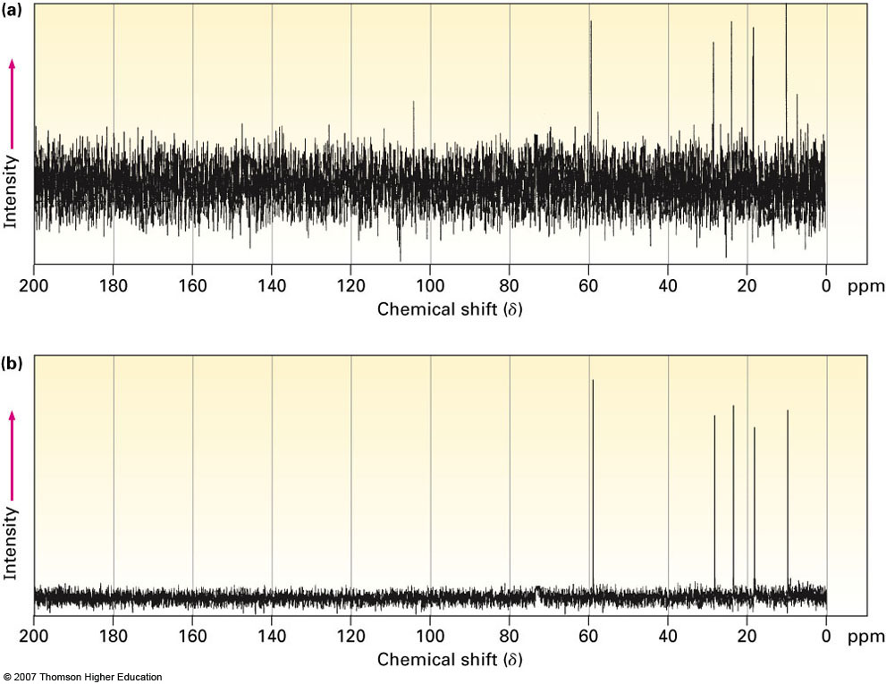
Section 13.4 ¹³C NMR Spectroscopy: Signal Averaging and FT-NMR
The natural abundance of the C-13 isotope is very small compared to the abundance of protium (H-1)
This means that many scans are necessary in order to reduce the signal to noise ratio to an acceptable level

Slide 12
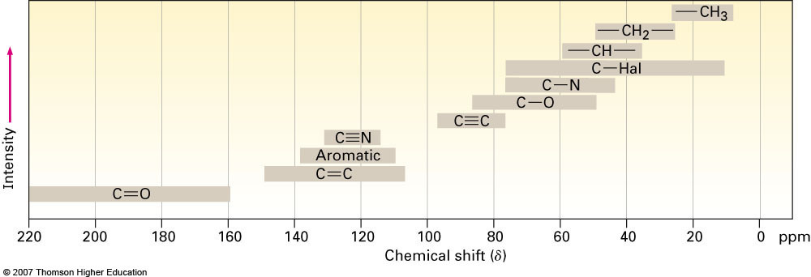
Section 13.5 Characteristics of ¹³C NMR Spectroscopy
Same exact theory as that for ¹H NMR only this time we tell the instrument to look for ¹³C nuclei
¹³C spectra are always decoupled from other carbons as well as protons which eliminates overly complicated spectra
¹³C spectrum essentially gives us a carbon map for all unique chemical environments within a molecule

Slide 13
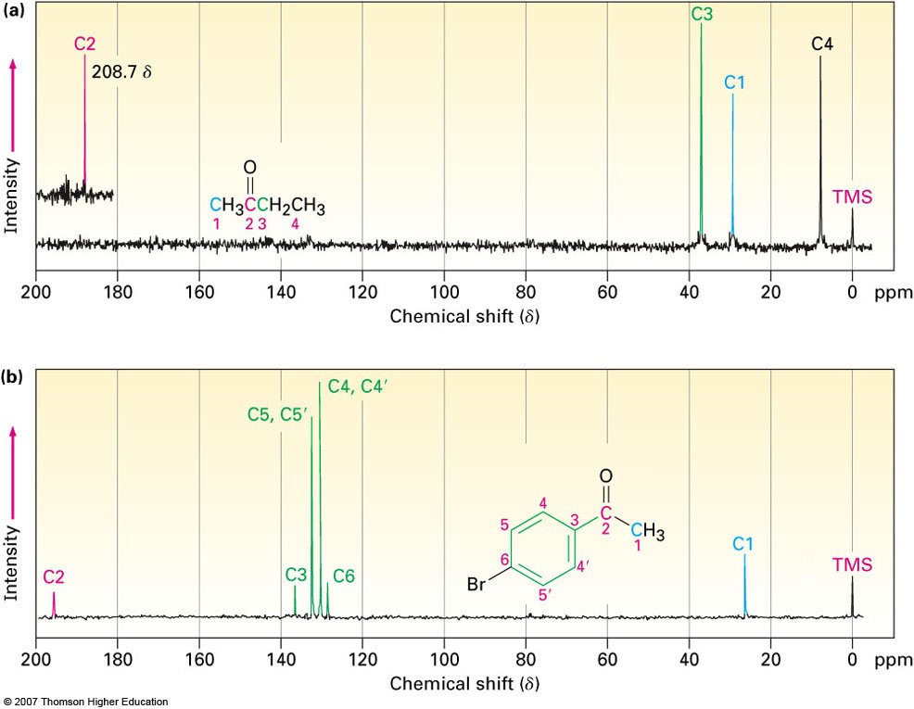
Examples

