Slide 1
Chapter 15
Benzene and Aromaticity

Slide 2
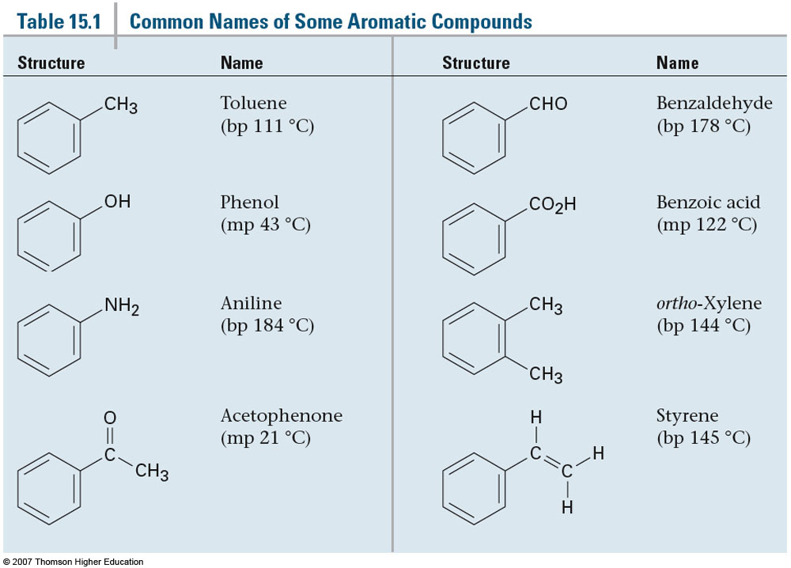
Section 15.1 Sources and Names of Aromatic Compounds
Common names for aromatic compounds:

Slide 3
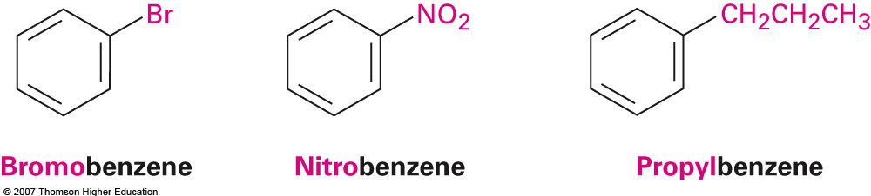
Monosubstituted Benzenes
Monosubstituted benzenes are named similar to other organic molecules
-benzene is used as the suffix

Slide 4
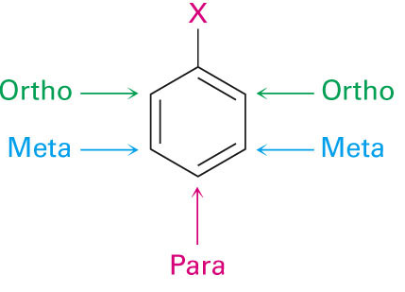
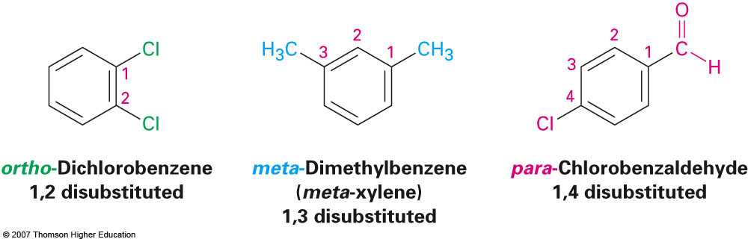
Disubstituted Benzenes
Instead of using numbers for substituent positions for disubstituted benzenes, the prefixes ortho-, meta-, and para- are used
ortho = 1,2 positions
meta = 1,3 positions
para = 1,4 positions

Slide 5
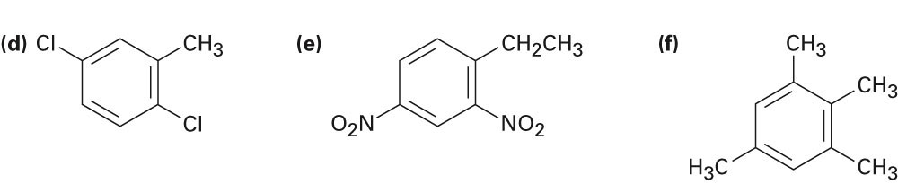
Higher Substitutions
Substituents are numbered as follows:
A point of attachment is chosen (position 1) and substituents are numbered such that the second substituent (alphabetically) has the lowest number possible
If this remains ambiguous then ensure that the third position has the lowest number followed by fourth, etc.

Slide 6
Additional Examples
Draw structures for the following:
p-Bromochlorobenzene
m-Bromotoluene
1-Chloro-3,5-dimethylbenzene

Slide 7
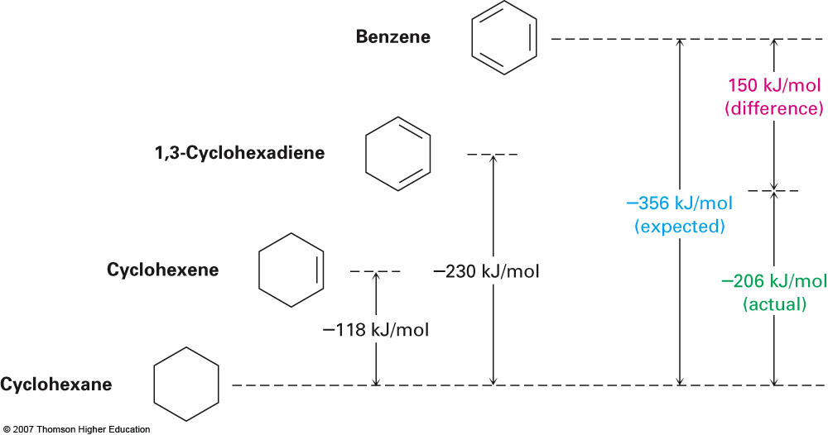
Section 15.2 Structure and Stability of Benzene: Molecular Orbital Theory
Heats of Hydrogenation Analysis:

Slide 8
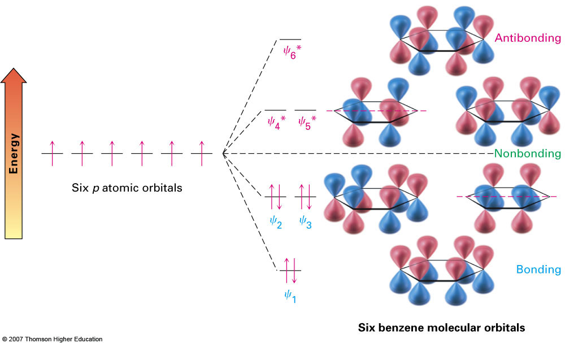
Aromaticity from a Molecular Orbital Viewpoint

Slide 9
Section 15.3 Aromaticity and the Hückel 4n+2 Rule
Requirements for aromaticity:
Cyclic
Conjugated (Uninterrupted π-system)
Planar
4n + 2 π electrons
Molecules with 4n electrons are referred to as antiaromatic
Ex: Cyclobutadiene

Slide 10
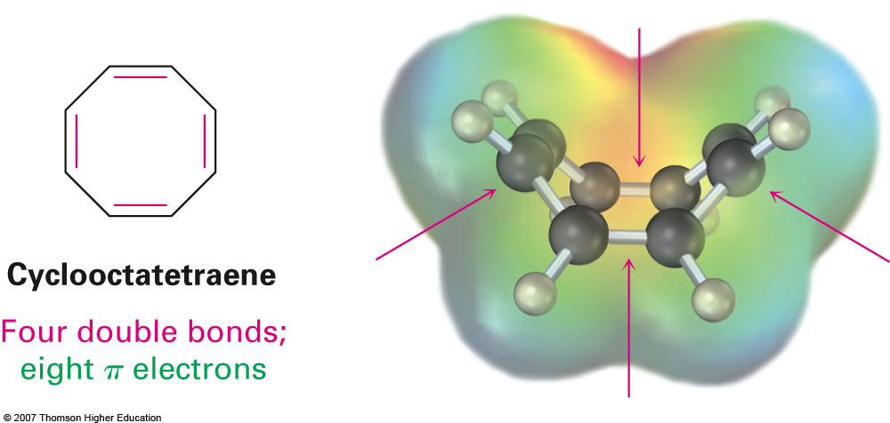
Cyclooctatetraene
Before aromaticity was fully understood it was believed that the only requirements for stability were a cyclic structure with an uninterrupted π-system
Therefore cyclooctatetraene was predicted to be unusually stable similar to benzene

Slide 11
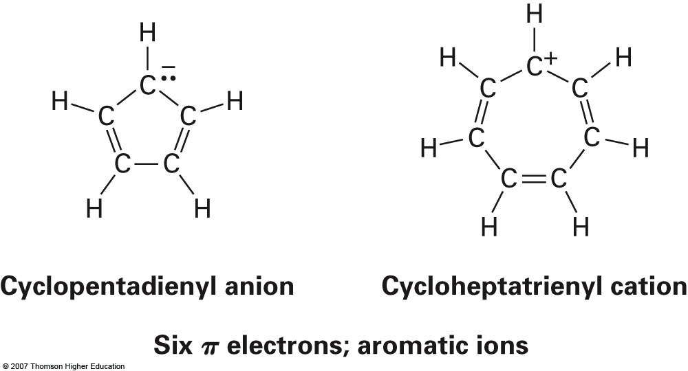
Section 15.4 Aromatic Ions
The criteria for aromaticity are not limited to neutral molecules.
Can be expanded to include ions that fulfill the Huckel 4n + 2 criteria and planarity

Slide 12
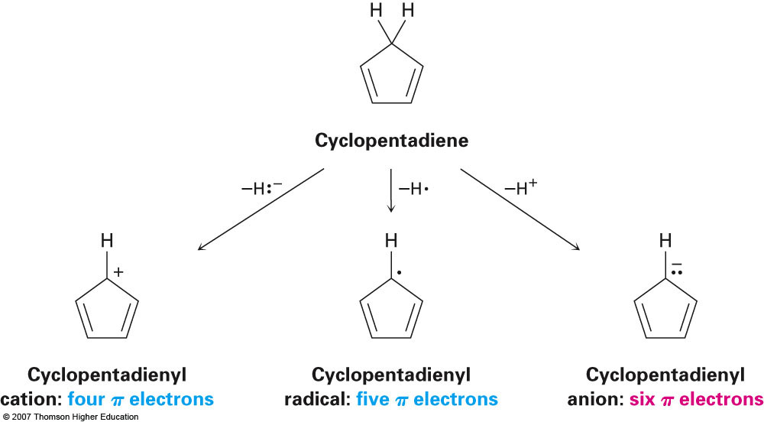
Generating Aromatic Ions from Neutral Compounds

Slide 13
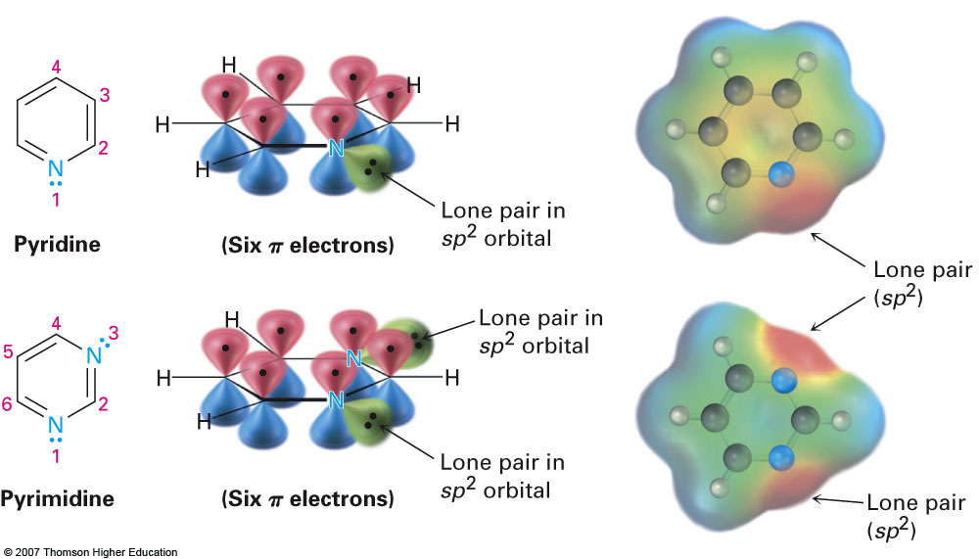
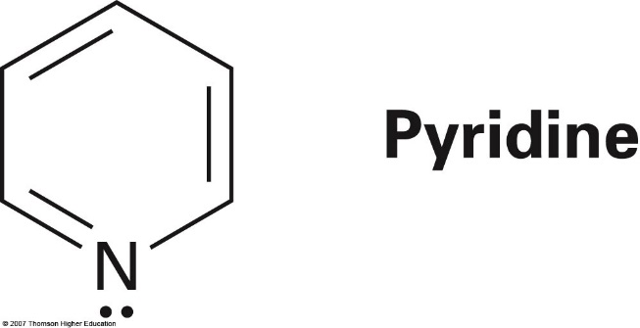
Section 15.5 Aromatic Heterocycles: Pyridine and Pyrrole
Not only do aromatic compounds not have to be neutral, they can also be comprised of elements other than simply carbon and hydrogen
They can include heterocyclic molecules
Ex: Pyridine and Pyrrole

Slide 14
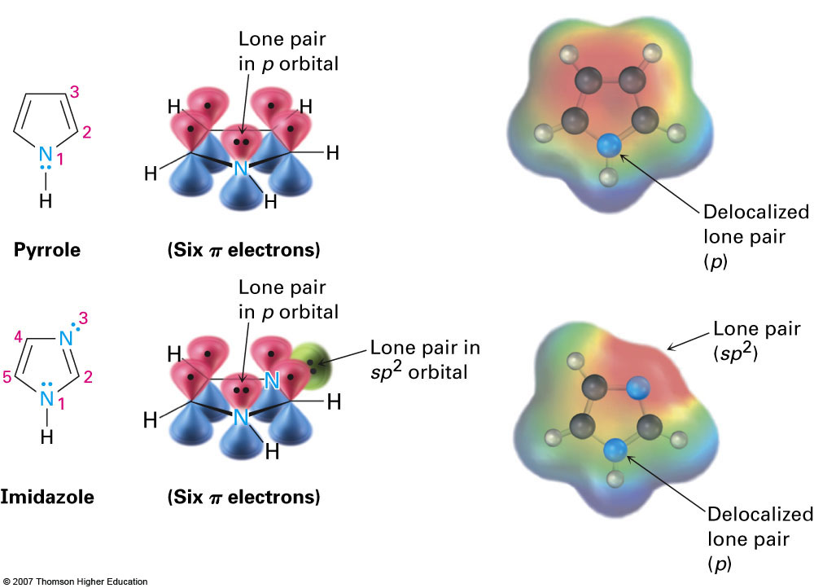
Pyrrole

Slide 15
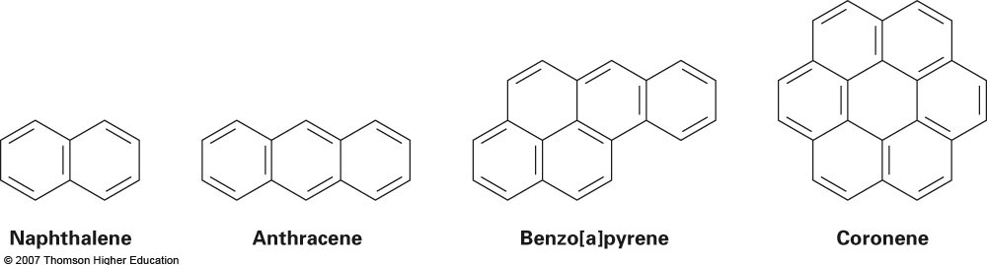
Examples of Polycyclic Aromatic Compounds

