Slide 1
Chapter 16
Chemistry of Benzene: Electrophilic Aromatic Substitution

Slide 2
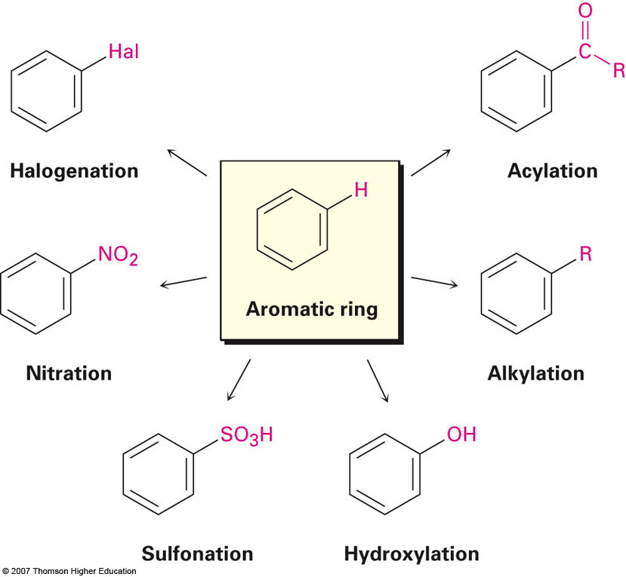
Overview of Reactions

Slide 3
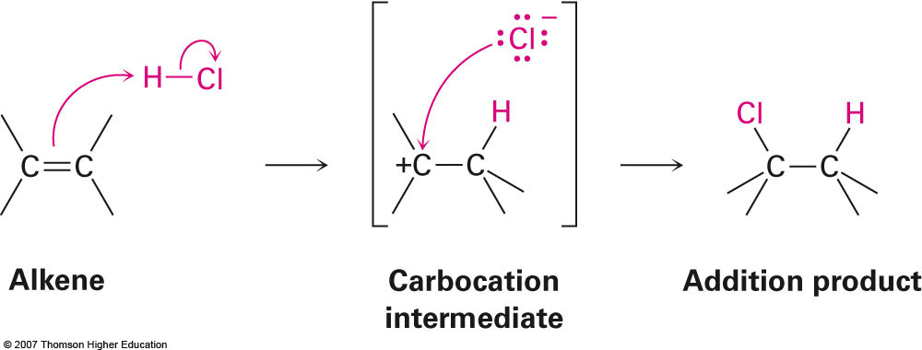
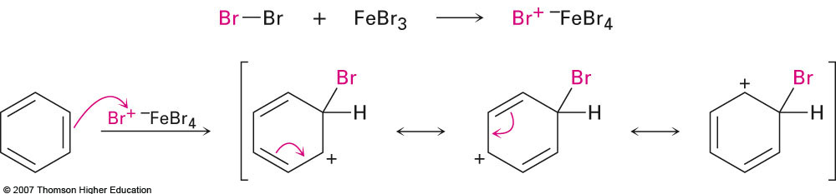
Section 16.1 Electrophilic Aromatic Substitution Reactions: Bromination
When comparing alkene bromination to aromatic bromination there are two notable differences:
Aromatic bromination requires the use of a catalyst
ΔG‡ is too high
Aromatic bromination gives a substitution product as opposed to an addition product

Slide 4
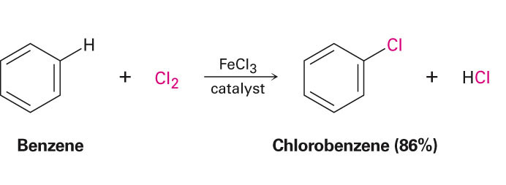
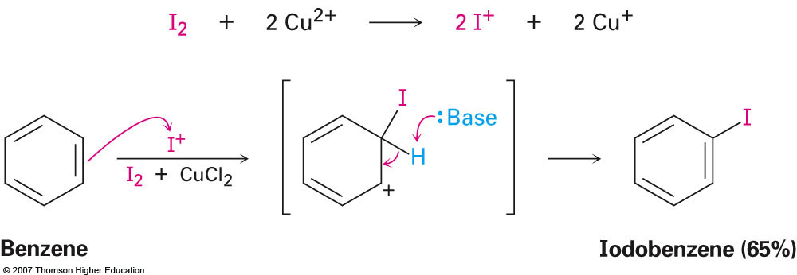
Section 16.2 Other Aromatic Substitutions
Chlorination
Iodination
Reagent: Cl₂
Catalyst: FeCl₃
Reagent: I₂
Catalyst: Cu²⁺

Slide 5
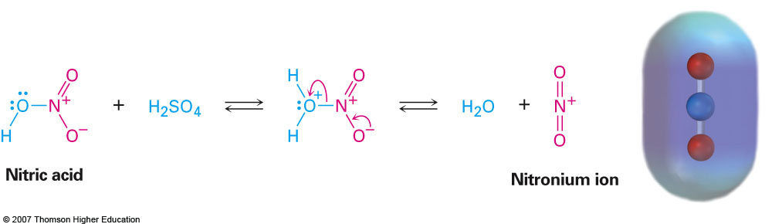
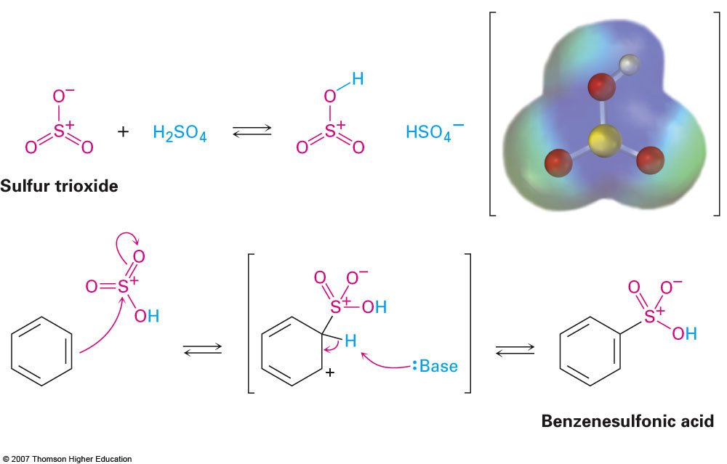
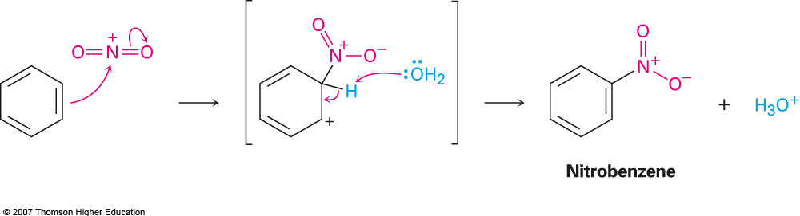
Other Aromatic Substitutions (cont.)
Nitration
Sulfonylation
Reagent: HNO₃
Catalyst: H₂SO₄
Reagent: SO₃
Catalyst: H₂SO₄

Slide 6
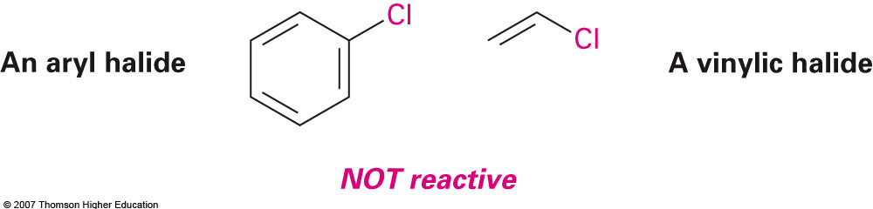
Section 16.3 Alkylation and Acylation of Aromatic Rings: The Friedel—Crafts Reaction
Can be thought of as analogous to aromatic halogenation:
Only alkyl halides are reactive
Reaction will not proceed with aromatic or vinyl halides
Instead of adding a halogen we are adding the “alkyl” portion of an alkyl halide.

Slide 7
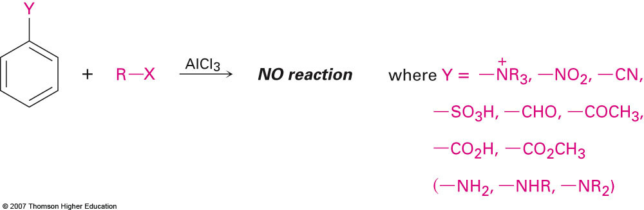
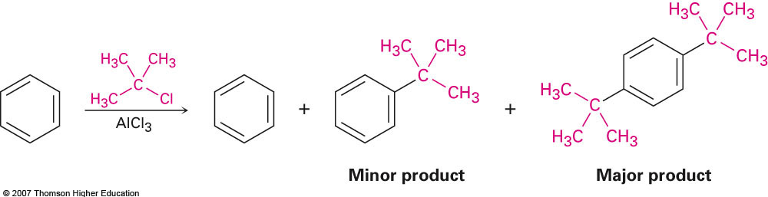
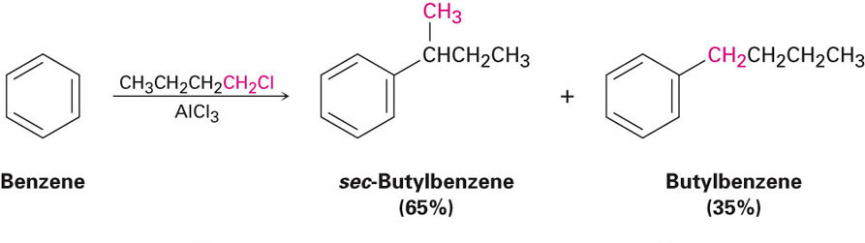
Limitations to Friedel—Crafts Alkylations
The aromatic ring cannot contain electron withdrawing substituents:
The reaction often leads to multiple substitutions (polyalkylation):
Because carbocation intermediates are involved the carbocations could potentially rearrange:

Slide 8
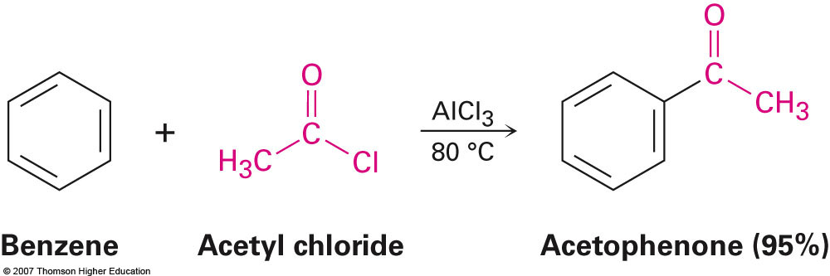
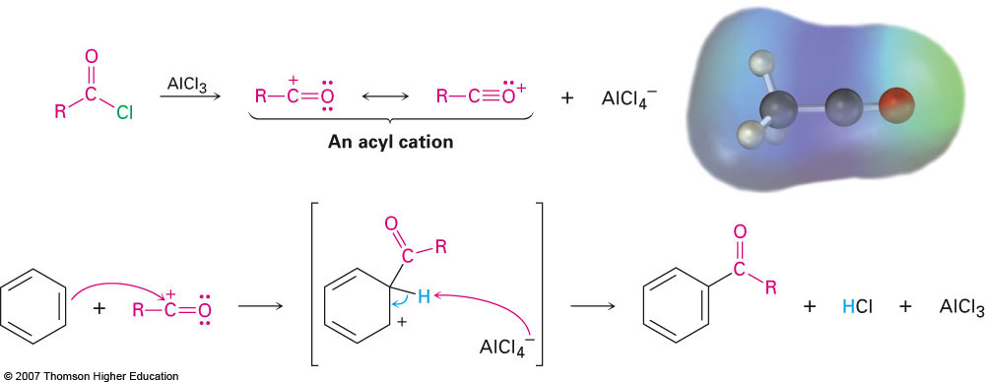
Friedel—Crafts Acylation
Involves the addition of an acyl group by using an acid chloride and the appropriate catalyst

Slide 9
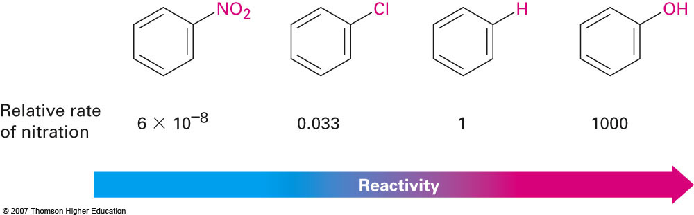
Section 16.4 Substituent Effects in Substituted Aromatic Rings
Substituents on an aromatic rings affect the reactivity in two main ways:
They affect the rate of reaction
They affect the orientation (regiochemistry) of the reaction

Slide 10
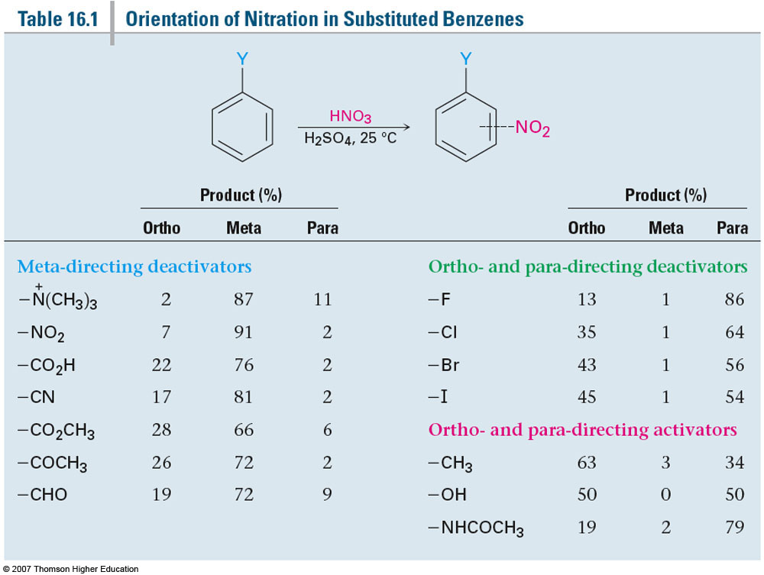
Substituent Effects on Orientation of Reactions
Substituents are grouped based on both how they affect the rate of reaction as well as how they force a reaction to proceed with a certain orientation

Slide 11
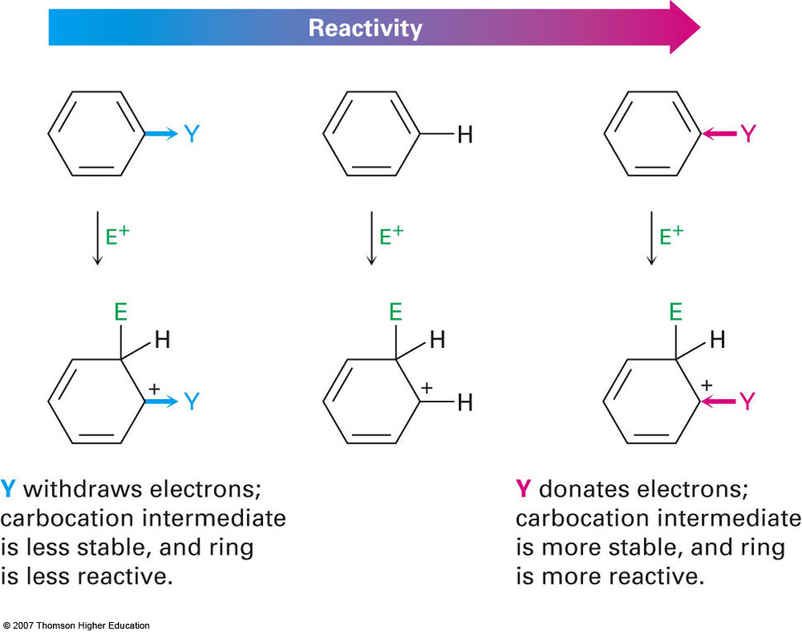
Section 16.5 An Explanation of Substituent Effects
Activation and deactivation of aromatic rings
Simply put, activating groups donate electrons to the ring and vice versa

Slide 12
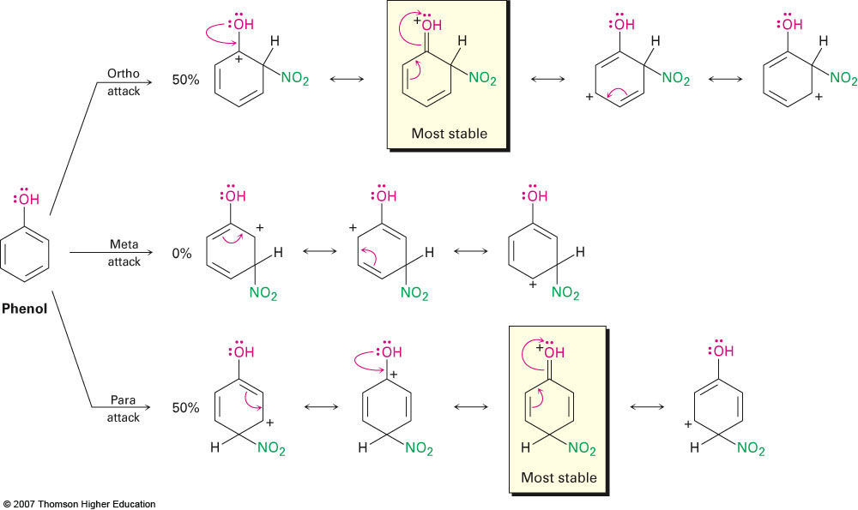
Ortho/Para Directing Activators
Electron donating substituents direct to the ortho- and para- positions because these are the only positions where the charge can be delocalized onto the electron donating group itself

Slide 13
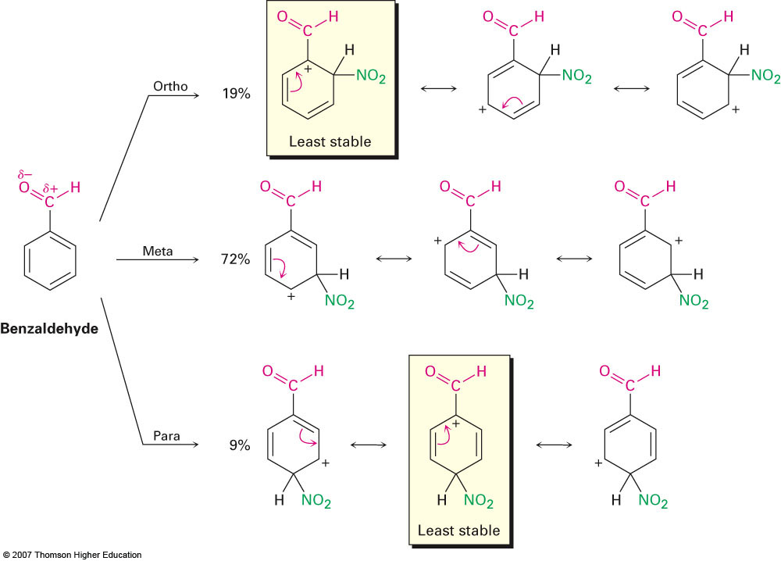
Meta Directing Activators
Electron withdrawing substituents direct to the meta position due to the fact that NO resonance structure leaves a positive charge on the carbon attached to the electron withdrawing group

Slide 14
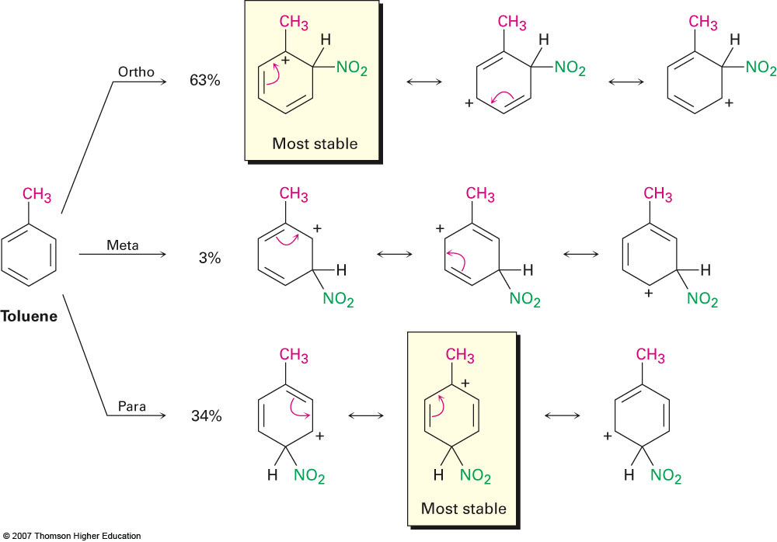
Ortho/Para Directing Alkyl Groups
Alkyl groups direct to the ortho and para positions due to the fact that the most stable resonance structures have the carbocation on the carbon directly attached to the alkyl group
Most stable due to the slight electron donating ability of alkyl groups

Slide 15
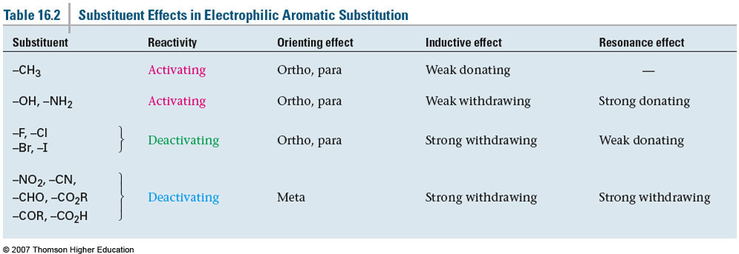
Summary of Substituent Effects

Slide 16
Section 16.6 Trisubstituted Benzenes: Additivity of Effects
If the two groups direct to the same position(s) then all is well and the American way of life remains unthreatened
Ex: Bromination of p-Nitrotoluene
If the two groups direct to different positions then the more powerful donating group determines the substitution
Ex: Nitration of p-Methylphenol
Substitution between two groups that are meta-disubstituted is often problematic due to steric hindrance.
Chlorination of m-Chlorotoluene

Slide 17
Section 16.9 Oxidation of Aromatic Compounds
Oxidation of alkyl side chains on an aromatic ring can be accomplished by using strong oxidizing agents such as KMnO₄ and Na₂Cr₂O₇
No benzylic hydrogens to oxidize

Slide 18
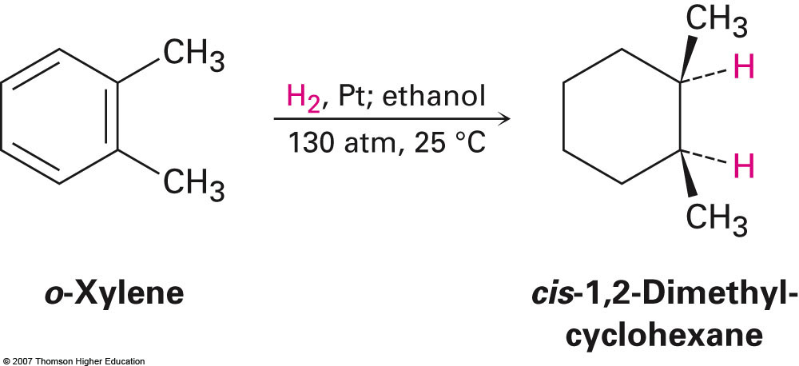
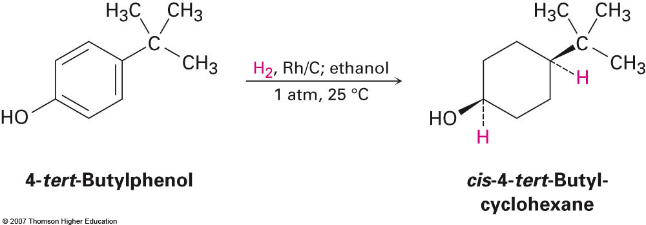
Section 16.10 Reduction of Aromatic Compounds
Catalytic hydrogenation of aromatic rings can only be accomplished under extreme conditions or really expensive catalysts
Not very useful reactions typically
Extremely high pressure
Extremely expensive rhodium catalyst

Slide 19
Reduction of Aryl Nitro Groups
Nitro groups can be easily reduced under mild conditions to produce the corresponding aryl amine
Catalytic Hydrogenation
Reduction via Tin and HCl

Slide 20
Fun, Yummy Synthesis and Synthesis Strategies
Show how the following compounds could be synthesized from benzene:

Slide 21
Trisubstituted Benzenes

