Slide 1
Chapter 1
Structure and Bonding

Slide 2
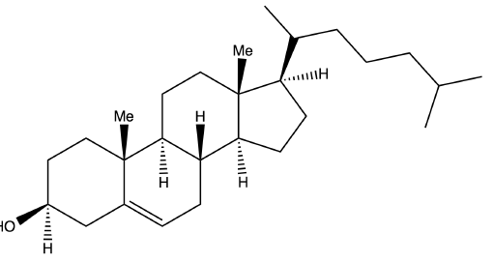
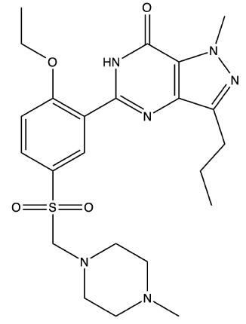
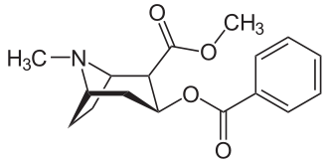
Cholesterol
Viagra
Cocaine

Slide 3
Introduction
The field of organic chemistry dates back to the mid 1700’s
Torbern Bergman first distinguished between “inorganic” material and “organic” material
First organic molecule to be synthesized was urea (CH₄N₂O)
To put it simply, Organic Chemistry is the study of carbon based compounds
Carbon is special primarily because of the fact that it can form incredibly extensive, stable molecules

Slide 4
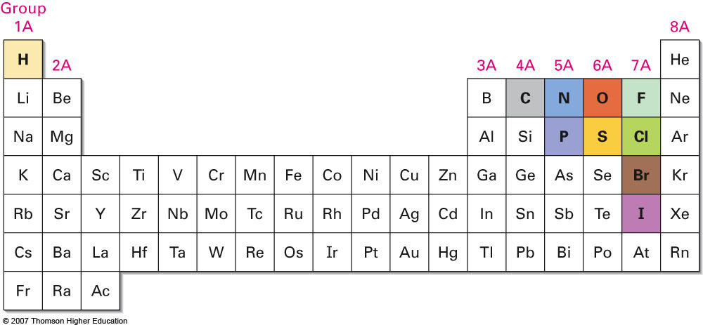
Elements Commonly Found in Organic Chemistry

Slide 5
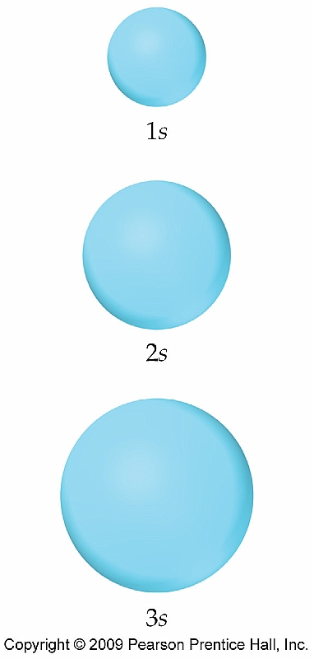
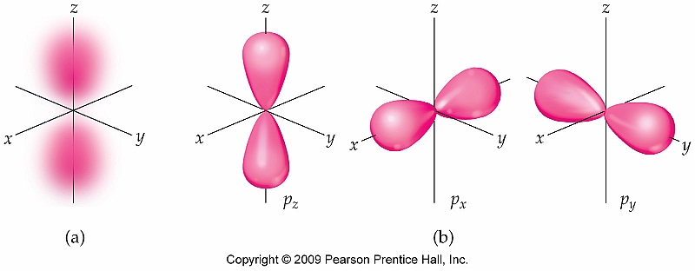
Section 1.2 Atomic Structure: Orbitals
n = 0 (no node)
n = 1 (1 node)

Slide 6
An Up Close Look at p Orbitals
Nodes (Zero Electron Density)
-- Become very important later when discussing reactivity

Slide 7
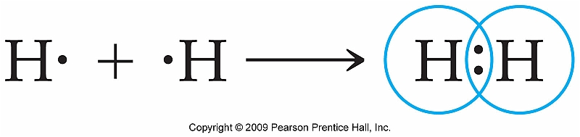
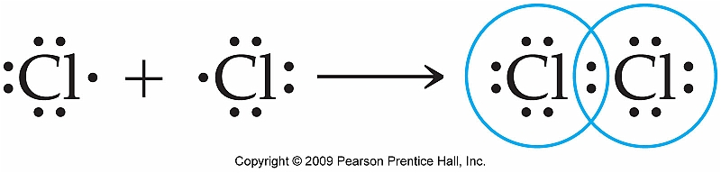
Section 1.5: Covalent Bonds
Covalent bonds in covalent compounds are often represented by Lewis dot structures:

Slide 8
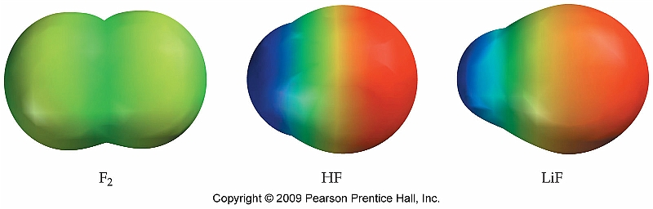
Polar Covalent vs. Nonpolar Covalent
Arrangement of electrons within a bond determines bond polarity.
Evenly arranged = nonpolar
Uneven arrangement = polar bond

Slide 9
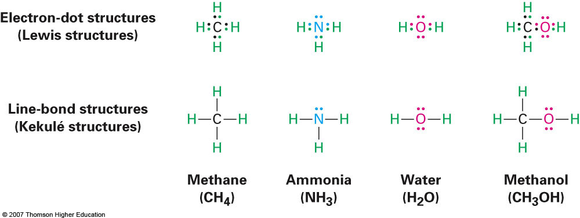
Kekulé Structures vs. Lewis Dot Structures
What you have previously known as Lewis Dot Structures are technically known as Kekulé structures or line-bond structures.
Much simpler and easier to draw
Show two types of electron pairs
Bonding
Nonbonding (lone pairs)

Slide 10
Lewis Dot Structure Review
Draw Lewis (Kekule) structures for each of the single central atom molecules below:
NH₃
CH₄
HF
H₂O
CO₃²⁻
Simple organic molecules with and without multiple central atoms
Ethylene (H₂CCH₂)
Formaldehyde (H₂CO)
Acetonitrile (H₃CCN)

Slide 11
Formal Charge Review
Assign formal charges to the most stable structure of the compounds below:
SOCl₂
CO₃²⁻
Assign formal charges to the organic compounds shown below:

Slide 12
VSEPR Theory Review
Compound | # of Electron Domains | Lewis Dot Structure | Geometry | Bond Angle
BeH₂
BH₃
CH₄
NH₃
H₂O

Slide 13
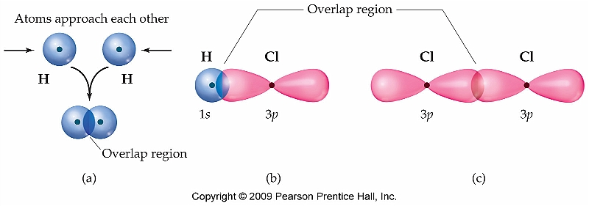
Section 1.6: Valence Bond Theory and Molecular Orbital Theory
To gain a greater understanding of the bonding in organic molecules two additional bonding models must be considered
Valence Bond Theory (Review)
Molecular Orbital Theory (Most Up-to-Date Model)

Slide 14
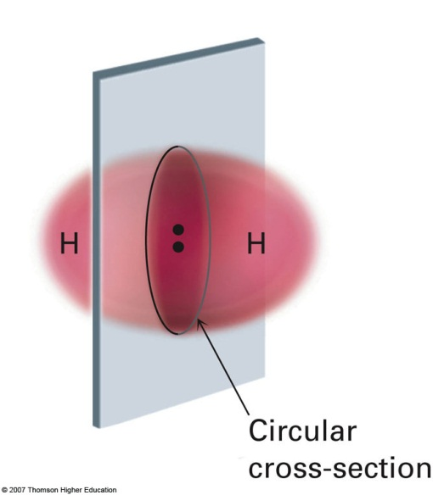
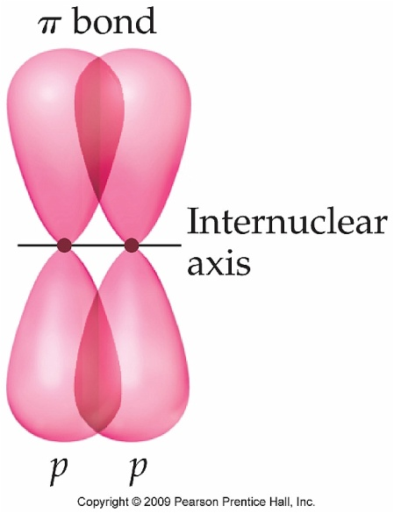
Valence Bond Theory
Key Ideas
Covalent bonds are formed by the overlap of atomic orbitals, each containing one electron
Each of the bonded atoms retains its own atomic orbitals, but the electron pair is shared by both atoms
The greater amount of orbital overlap, the stronger the covalent bond
Two types of overlap [ sigma (σ) and pi (π) ]

Slide 15
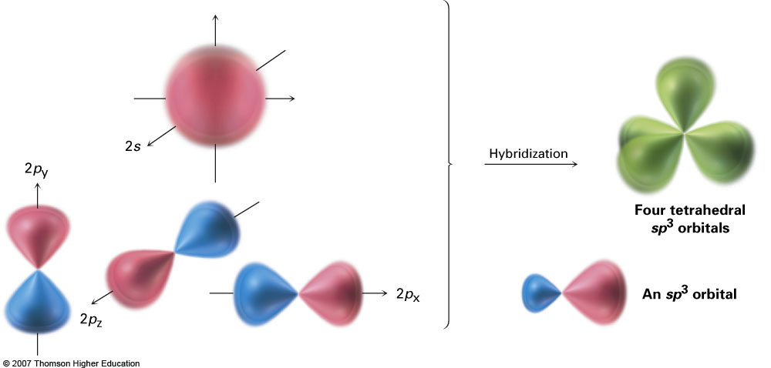
Section 1.7: sp³ Orbitals and the Structure of Methane
From the Lewis Dot Symbol for methane it is easily understood why methane forms four equivalent bonds
From electron configuration standpoint it is not so trivial:
C: [He]2s²2p²
Answer lies in the formation of hybrid orbitals:

Slide 16
Hybrid Orbitals: A Review
# of electron clouds | Electronic Geometry | Ideal Bond Angle | Hybrid Orbital Set | Example
2 | Linear | 180° | sp | BeH₂
3 | Trig. Planar | 120° | sp² | BCl₃
4 | Tetrahedral | 109.5° | sp³ | NH₃

Slide 17
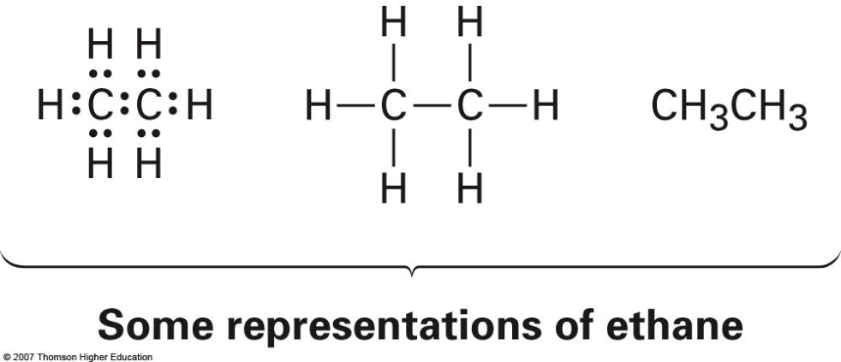
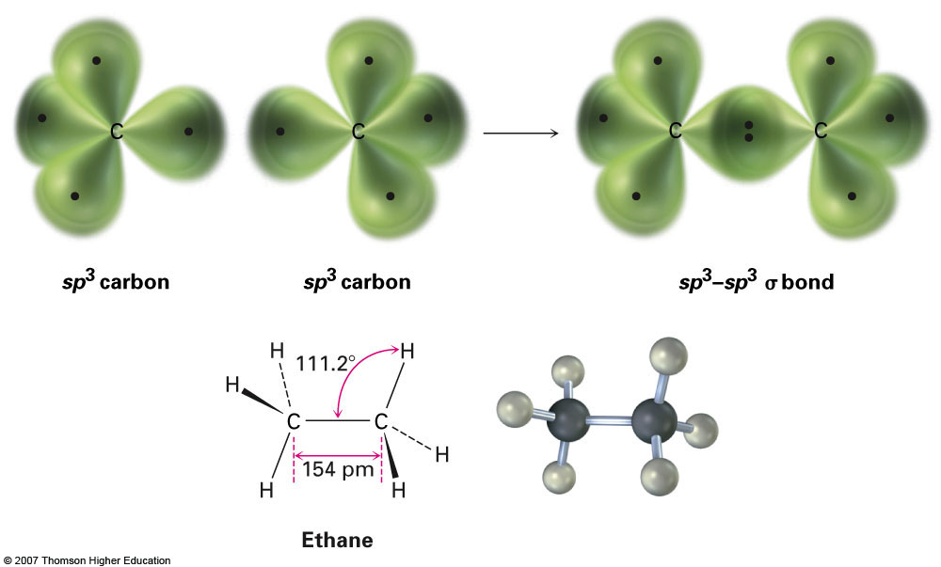
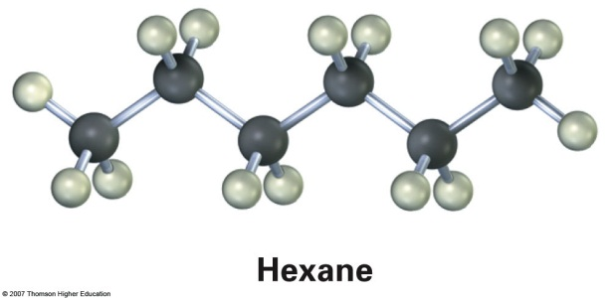
Section 1.8: The Structure of Ethane
The hybridization of orbitals explains why stable, long carbon chains are possible: The same type of hybrid orbitals are utilized.
Hydrogen atoms omitted for clarity
Even longer chains possible
(6-carbon chain shown here)

Slide 18
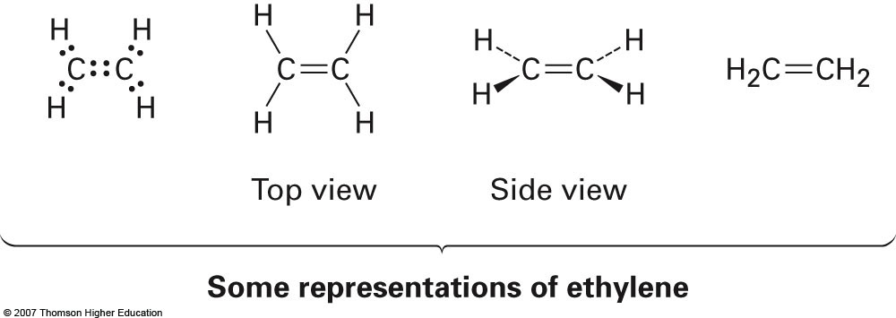
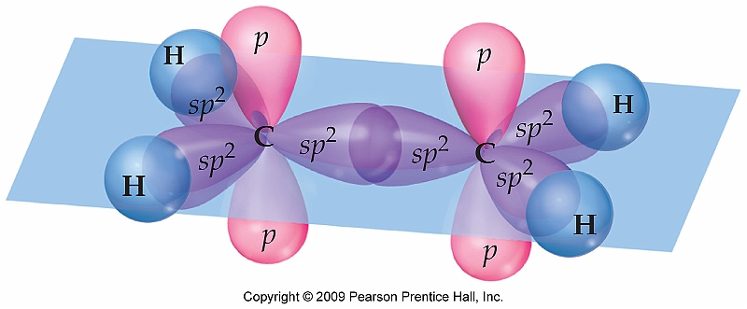
Section 1.9: Hybridization: sp² orbitals and the Structure of Ethylene
Notice the unhybridized p orbital that remains on each carbon
-- This is what
allows
the formation of
a π-bond
Additional note: Formation of pi bond(s) prevents bond rotation

Slide 19
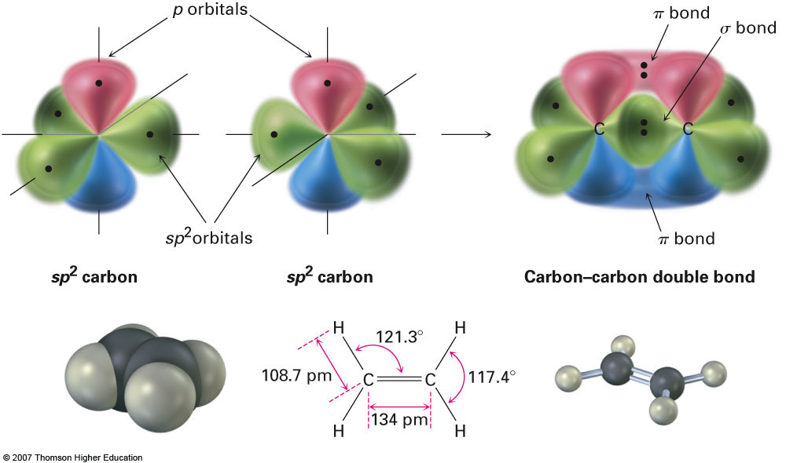
Additional View Showing Orbital Overlap

Slide 20
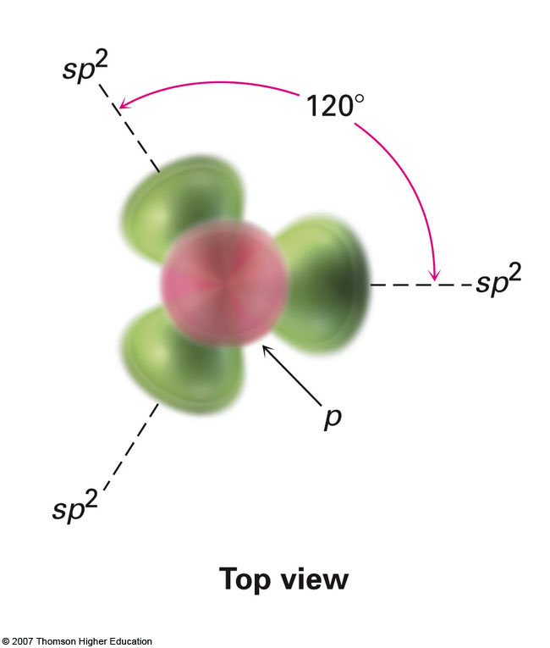
Top View To Better Show Bond Angles

Slide 21
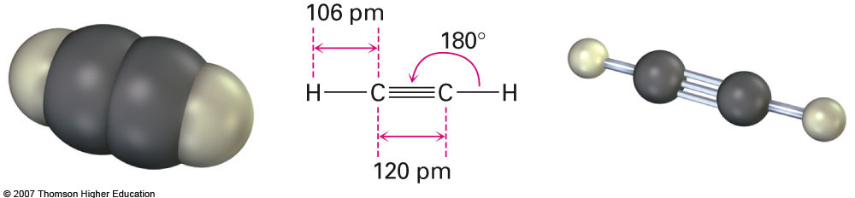
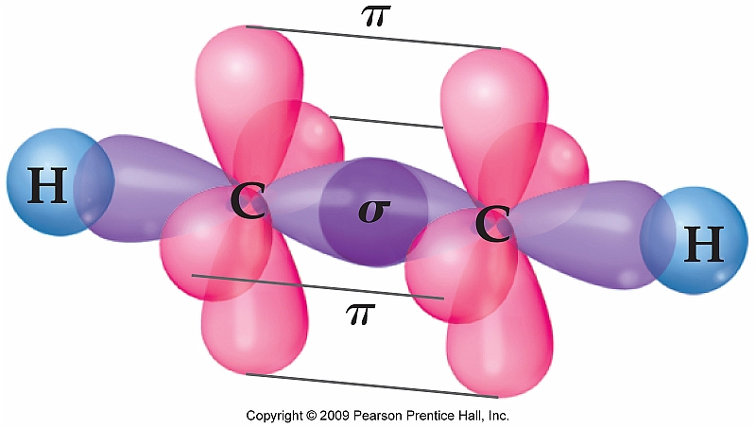
Section 1.10: sp Orbitals and the Structure of Acetylene
Unhybridized p orbitals

Slide 22
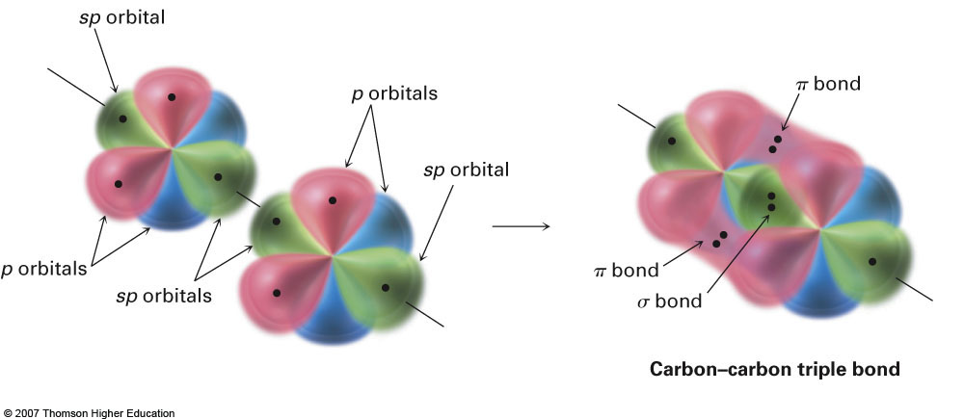
Additional View Showing Orbital Overlap

Slide 23
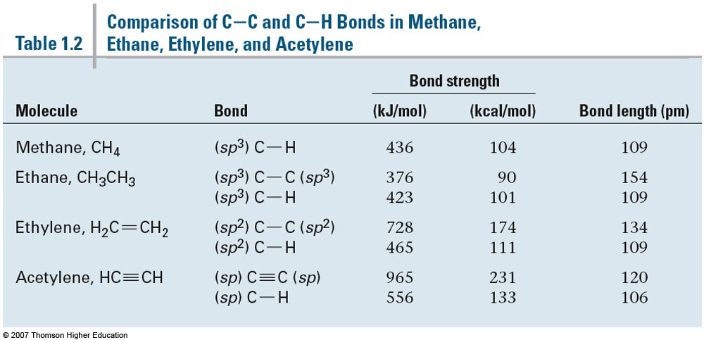
Comparison of Bond Orders

