Slide 1
Chapter 2
Polar Bonds and Their Consequences

Slide 2
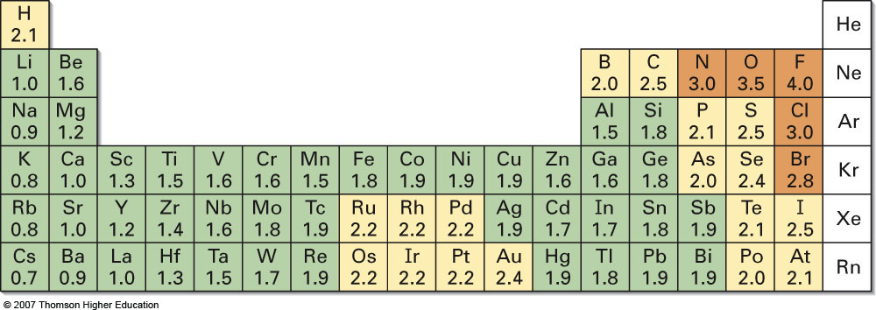
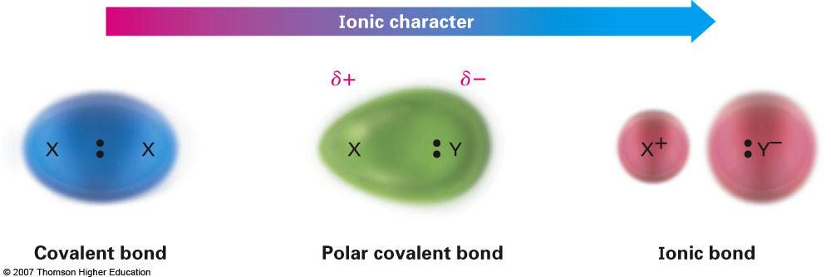
Section 2.1 Polar Covalent Bonds and Electronegativity

Slide 3
Reactivity of Polar Bonds
The degree of polarity of a chemical bond has a direct effect on reactivity
An atom’s electronegativity polarizes bonds through the inductive effect
Examples:
Chloromethane (CH₃Cl)
Electronegativity Difference: 0.5
Methylmagnesium bromide (H₃CMgBr)
Electronegativity Difference: 1.3

Slide 4
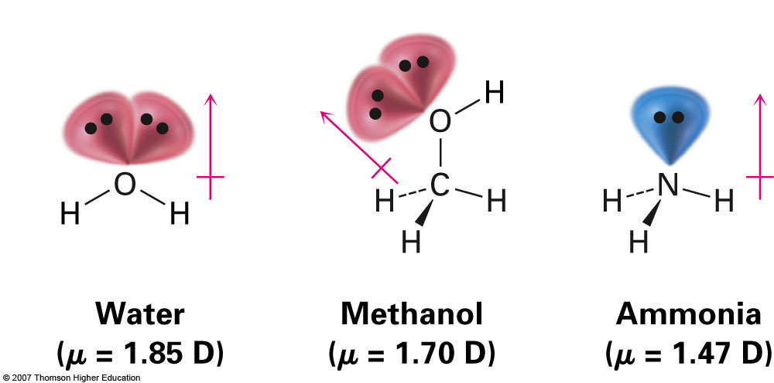
Section 2.2 Polar Covalent Bonds and Dipole Moment
A dipole moment, μ, is essentially the net polarity of all polar bonds in a molecule
Similar to vector addition
Measured in units called Debyes (D)

Slide 5
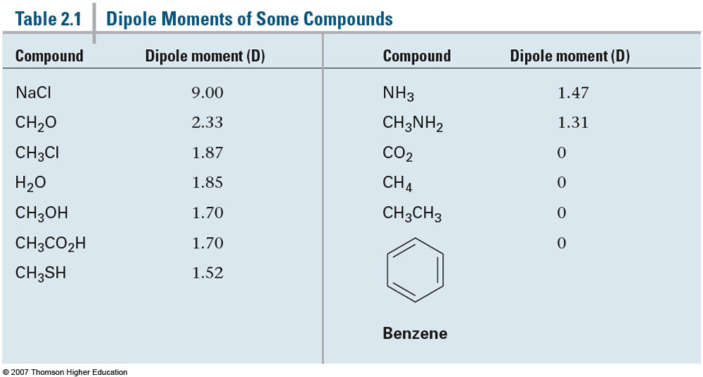
Dipole Moment Comparison
As a general rule, with the increase of aliphatic groups (C & H) a decrease in polarity is observed [Ex: H₂O vs CH₃OH and NH₃ vs CH₃NH₂]

Slide 6
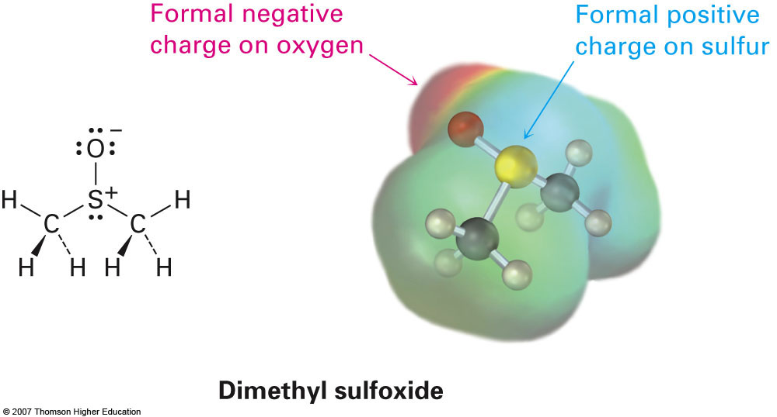
Section 2.3 Formal Charges
Essentially electronic “bookkeeping”
Please review this section if necessary
Ex: Nitromethane & Dimethyl Sulfoxide

Slide 7
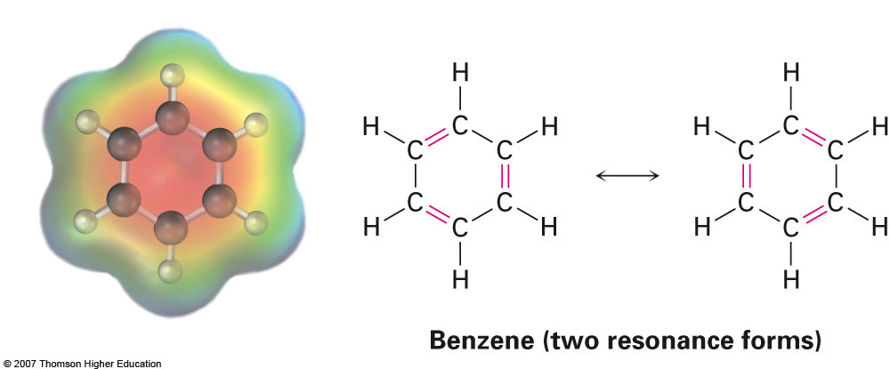
Section 2.4 Resonance
Exactly the same as discussed in AP Chemistry; however, much more important
When more than one resonance structure can be drawn the term resonance hybrid is used
Example: Carbonate ion, acetate ion, and benzene (C₆H₆)
Generally speaking any three atom grouping containing a multiple bond will have two resonance forms

Slide 8
Section 2.5 Rules for Resonance Forms
Individual resonance forms are imaginary, not real
Remember if resonance structures can be drawn the compound exists as a hybrid of all resonance structures
Resonance forms differ only in the placement of their π or nonbonding electrons
Sigma bonds are never broken
Curved arrows are used to represent the movement of electrons
Different resonance forms of a substance don’t have to be equivalent
Some resonance forms are better than others
Ex: Acetone w/ base
Resonance forms must be valid Lewis structures and obey normal rules of valency
Ex: Acetate ion
The resonance hybrid is more stable than any individual resonance form

Slide 9
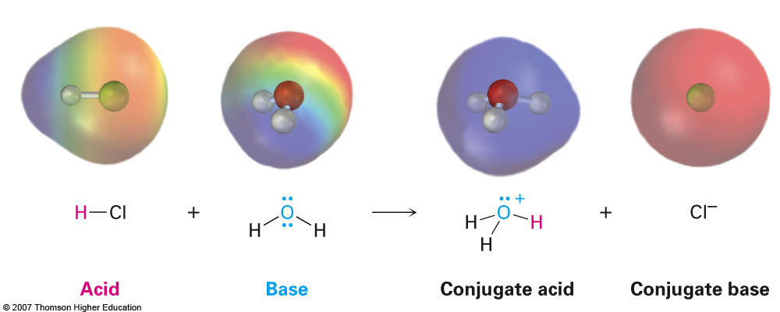
Section 2.7 Acids and Bases: The Brønsted-Lowry Definition
Brønsted-Lowry acids are substances that act as hydrogen (proton) donors
Brønsted-Lowry bases are substances that act as hydrogen (proton) acceptors

Slide 10
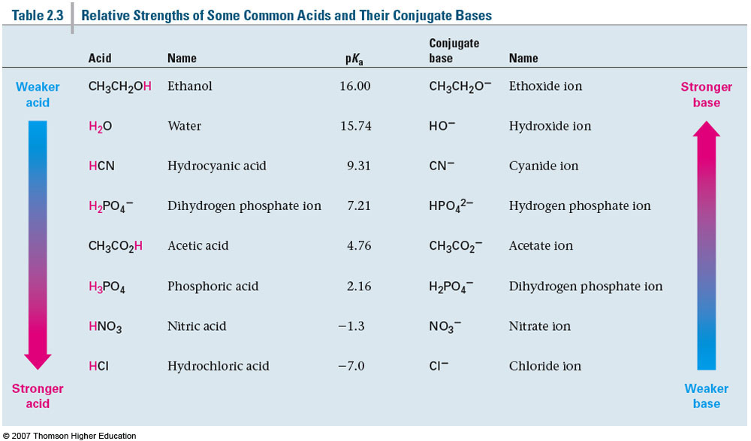
Section 2.8 Acid and Base Strength
The individual pK_{a} values are not necessarily important. Relationship between chemical structure and acid strength is much more relevant.

Slide 11
Factors that Affect the Acidity of a Given Proton
Electronegativity
Elements with higher electronegativities are better capable of accommodating a negative charge

Slide 12
Factors that Affect the Acidity of a Given Proton (cont.)
2. Atom Size
Conjugate bases with a negative charge are better stabilized by larger atoms
Charge is delocalized over a greater surface area

Slide 13
Factors that Affect the Acidity of a Given Proton (cont.)
3. Resonance stabilization of conjugate base
Using the same rationale as with atom size, a conjugate base is better stabilized by spreading the negative charge over multiple atoms

Slide 14
Factors that Affect the Acidity of a Given Proton (cont.)
4. Substituent (Inductive) Effects
Electronegative substituents near the acidic proton will increase acidity (and vice versa)
Closer the proximity of the substituent, the greater the effect

Slide 15
Summary of Compound Acidity
Factors in order of importance:
Atom (Electronegativity)
Resonance
Induction (Nearby groups that could alter acidity)
Predict the most acidic compound from each pair:

Slide 16
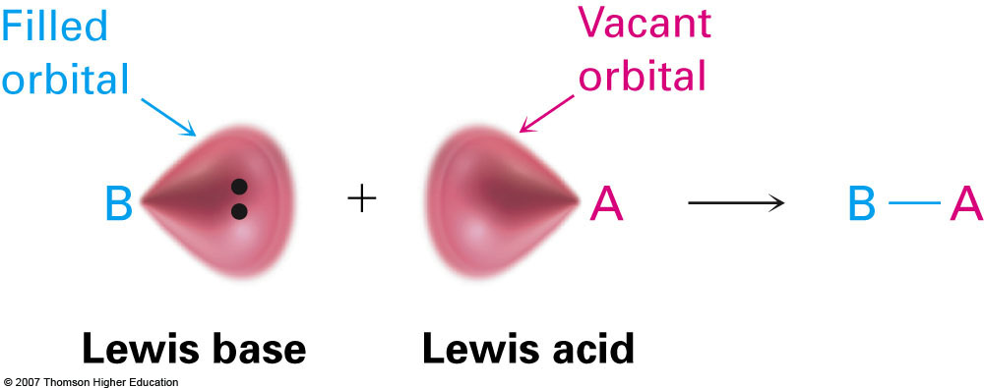
Section 2.11 Acids and Bases: The Lewis Definition
Instead of exclusively looking at a compounds ability to accept or donate protons, the Lewis acid/base theory speaks to a compounds ability to accept or donate lone pairs of electrons

Slide 17
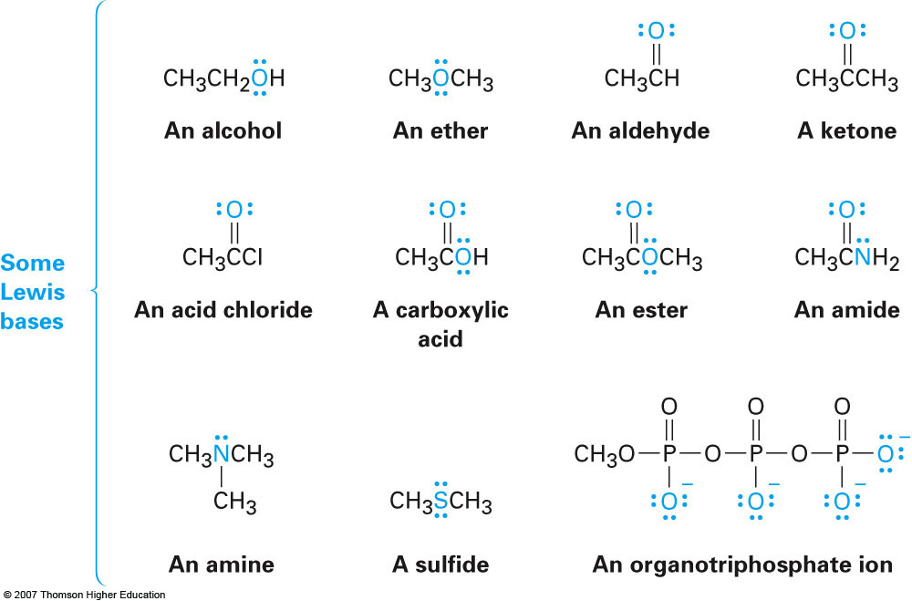
Lewis Bases
Any compound containing a nonbonding pair of electrons can act as a Lewis base
Typically, O, N, and sulfur containing compounds. Halides are too electronegative to act as good Lewis bases
Interesting example: Sulfuric acid and acetic acid

