Slide 1
Chapter 3
Alkanes and Alkane Isomers

Slide 2
Section 3.1 Functional Groups
Functional groups are essentially the groups that determine the chemical reactivity of all organic molecules
Groups you are responsible for (eventually):
Alkene
Alkyne
Arene (Aromatic ring)
Halide
Alcohol
Ether
Amine
Nitrile
Nitro
Aldehyde
Ketone
Carboxylic acid
Ester
Amide
Carboxylic acid anydride
Carboxylic acid chloride

Slide 3
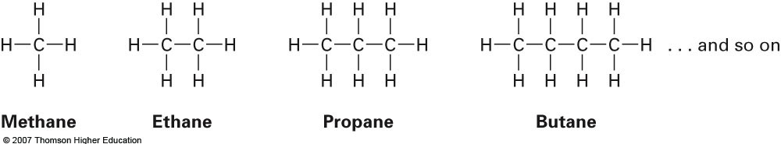
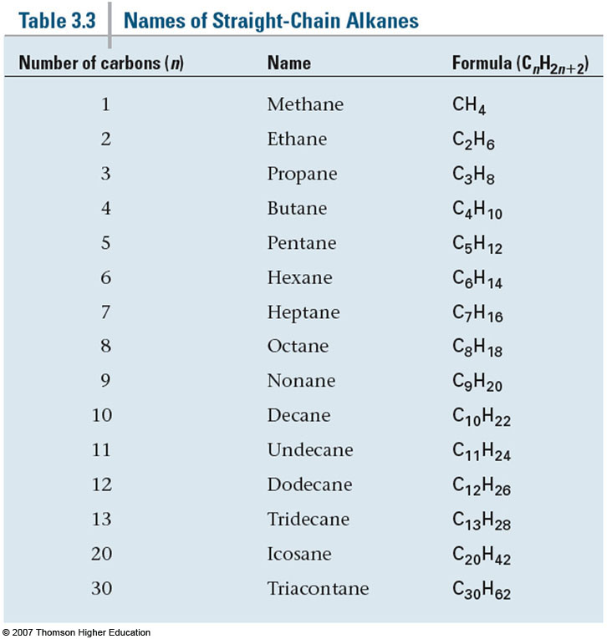
Section 3.2 Alkanes and Alkane Isomers
The formula shown in the table here is only applicable to saturated hydrocarbons (alkanes)

Slide 4
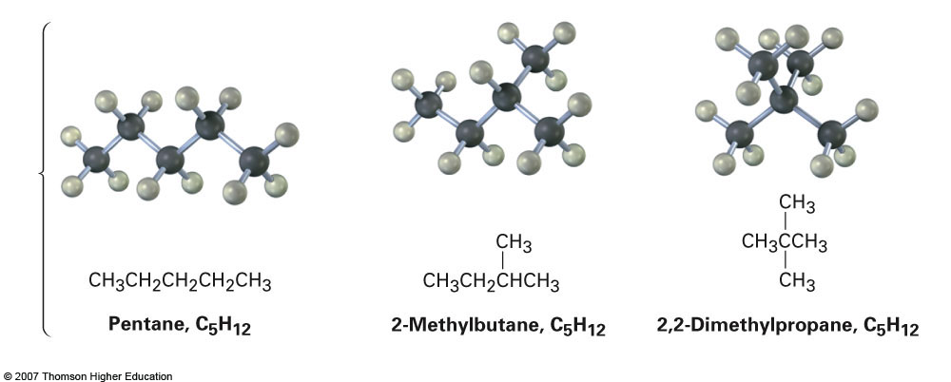
Straight-Chain vs. Branched-Chain Compounds (Constitutional Isomers)
Straight-chain alkanes are also referred to as normal alkanes (e.g. n-butane, n-hexane, etc.)
Other isomers are possible as shown below. Referred to as constitutional isomers
Same chemical formula, just connected differently

Slide 5
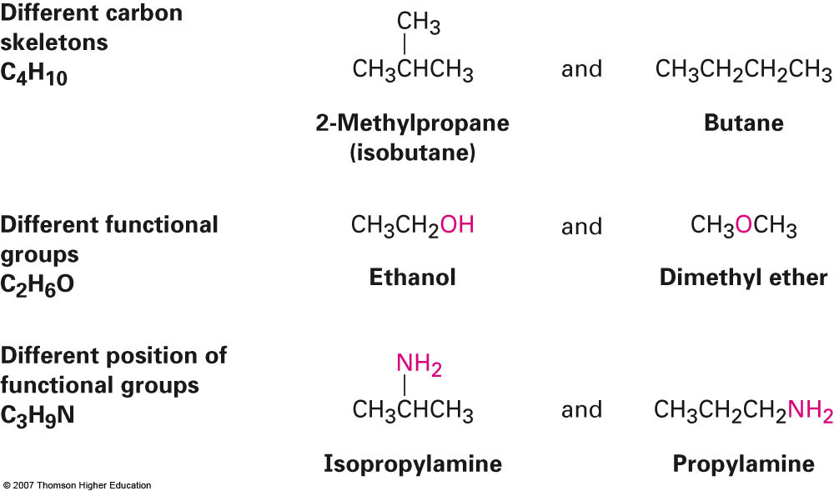
Constitutional Isomers (cont.)
Constitutional isomers are not limited to simple alkanes
Constitutional isomers may have different functional groups entirely
e.g. Nitrile vs Amine Ester vs. Ether, etc.
Ex: Propose two isomeric esters with the formula C₅H₁₀O₂

Slide 6
Determining if Two Structures Are Isomers
Same Molecular Formula?
NO
YES
Same Connectivity?
Compounds are not isomers
NO
YES
Constitutional isomers
Confirm by naming or
determining superimposability
Possibly the
same molecule
Same name
Superimposable

Slide 7
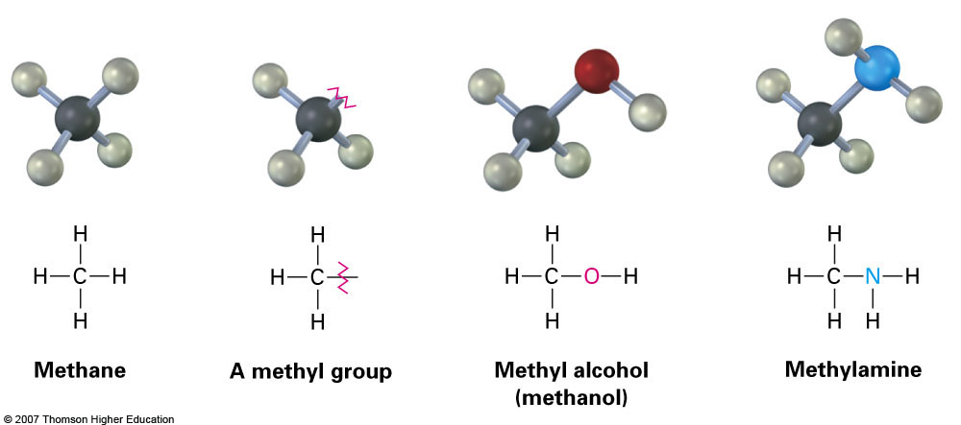
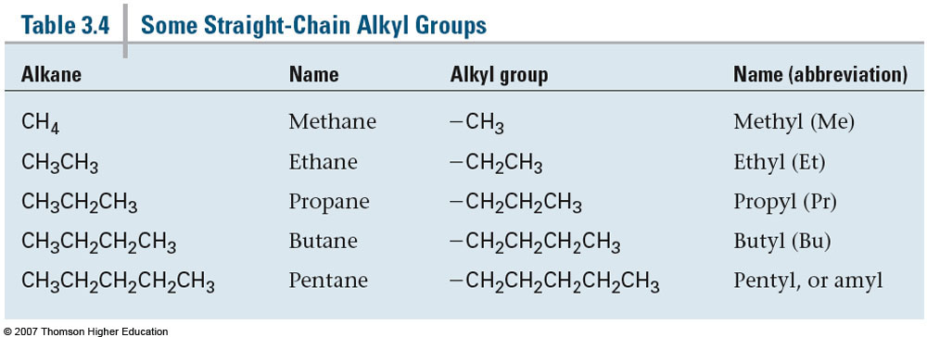
Section 3.3 Alkyl groups
Alkyl groups are partial structures of an alkane structure
Ex: CH₄ = Methane; A CH₃ group attached to a longer chain or functional group becomes a Methyl group
Groups shown here are the result of attaching a straight chain (not branched chain) to a new chain or functional group

Slide 8
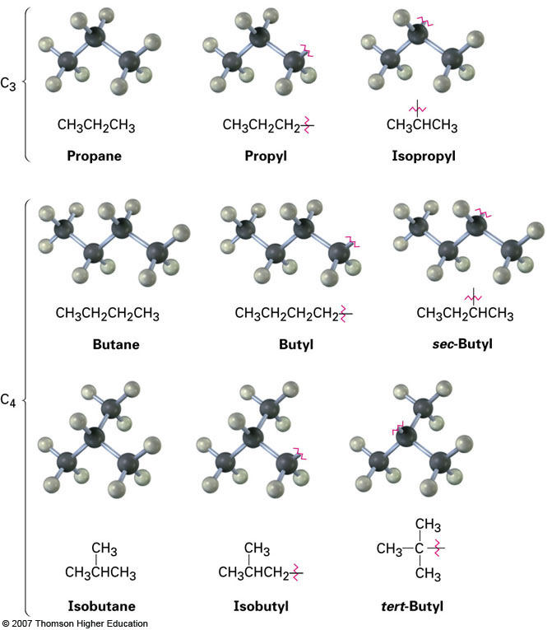
Branched Alkyl Groups from Internal Carbon Atoms
Notice the prefixes being used:
Iso-
sec-
tert-

Slide 9
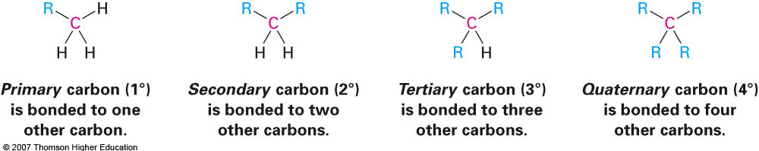
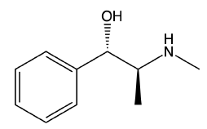
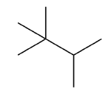
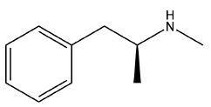
Carbon Descriptors
An “R” group in organic chemistry is essentially a generic group that can stand for anything.
How many primary hydrogens?
Secondary?
Tertiary?
Pseudoephedrine
1,1,3-Trimethylbutane
Methamphetamine

Slide 10
Section 3.4 Naming Alkanes
Step 1: Find the parent hydrocarbon
If there are more than one chains with the same length then choose the one that incorporates the most substituents
Step 2: Number the atoms in the main chain
Step 3: Identify and number the substituents
Step 4: Write the name as a single word (like our German
friends) and order the substituents alphabetically
-- Prefixes di-, tri-, etc. do not count towards ordering
Step 5: Name a complex substituent as though it were
itself compound

Slide 11
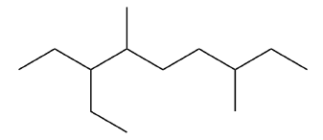

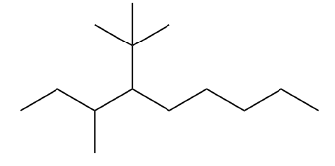
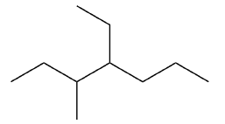
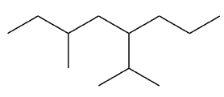
Examples
1.
2.
3.
4.
5.

Slide 12
Additional Examples

Slide 13
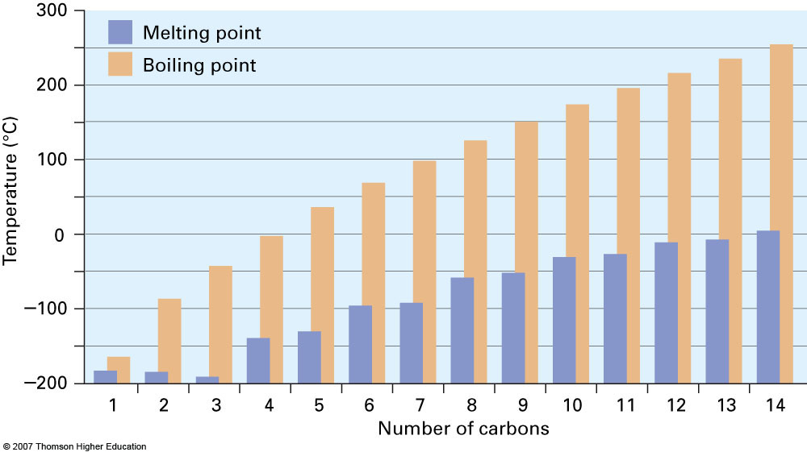
Section 3.5 Properties of Alkanes
Relatively inert compounds
Very few significant reactions; however, they will react with oxygen and with halogens in the presence of UV light
As a general rule their boiling and melting points increase with increasing molecular weight
Primarily due to an increase in van der Waal’s dispersion forces

Slide 14
Sourcing of Simple Alkanes
Pretty much all alkanes are obtained from crude oil distillation
C1-C4 are all gases
Methane is essentially natural gas
Propane is for grilling delicious meats
Butane is the primary fluid for lighters
C5-C15 are liquids
C5-C10 make up the bulk of gasoline
C11-C15 constitutes diesel fuel
C25 and higher are solids (waxes)

Slide 15
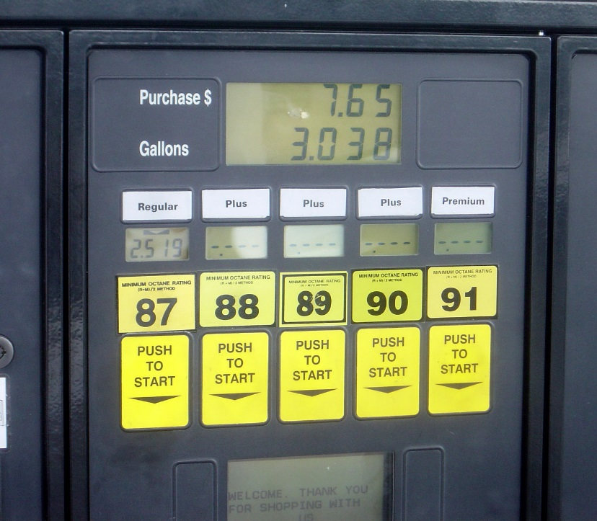
Gasoline Industry
The octane system is based on the defined values from two different compounds
Heptane (0) and 2,2,5-trimethyloctane (100)
Higher octane values can be obtained by adding compounds with greater degrees of branching

Slide 16
Hydrocarbon Refining and Cracking
To achieve better and more efficient fuels the gasoline industry relies on both refining and cracking techniques

Slide 17
Thermodynamic Stability of Isomers
Heat of combustion data can be used to directly correlate stability among a series of constitutional isomers.
Energy
Branching imparts stability on a compound

Slide 18
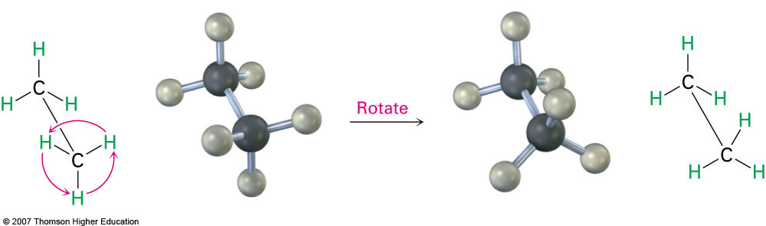
Section 3.6 Conformations of Ethane
Recall that all C-C single bonds have the ability to rotate around the bond axis due to the head-to-head overlap from the σ orbitals
As a result of this, it is possible to investigate the 3-dimensional stereochemistry associated with various compounds

Slide 19
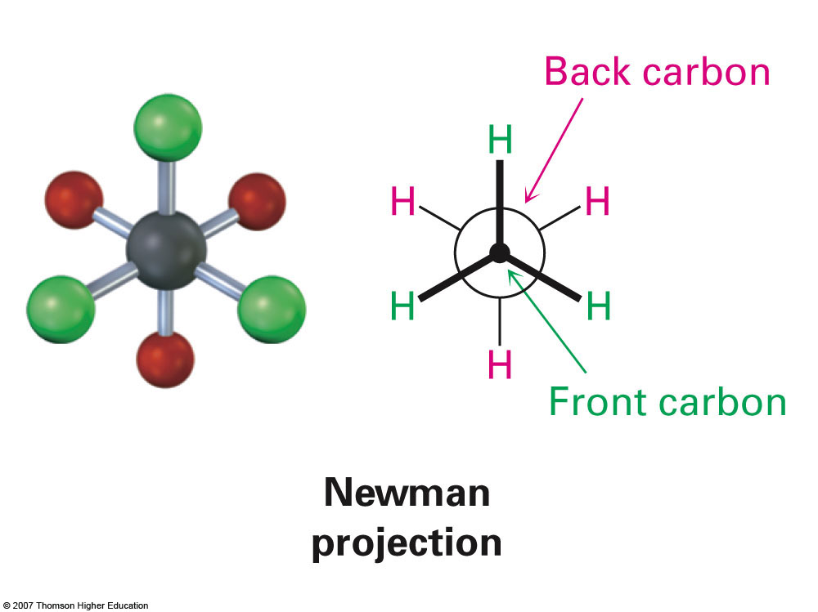
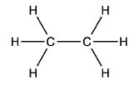
Newman Projections
When specifically looking at ethane, different atom arrangements or conformations are possible
It is helpful to visualize these different conformations using a Newman projection which views the C-C bond end-on
Ethane

Slide 20
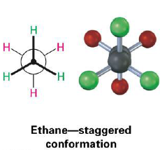
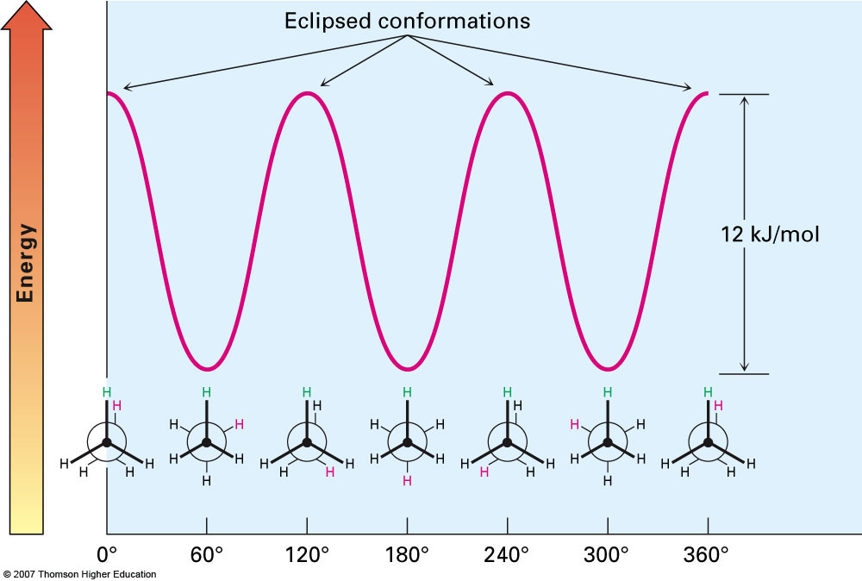
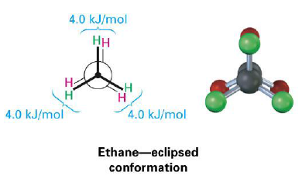
Potential Energy of Various Conformations
The staggered conformation represents the lowest energy conformer and occurs when hydrogens are as far apart from one another as possible
The eclipsed conformation represents the highest energy conformer and occurs when hydrogens are very close to each other
-- The higher energy of the eclipsed conformation is a result of torsional strain

Slide 21
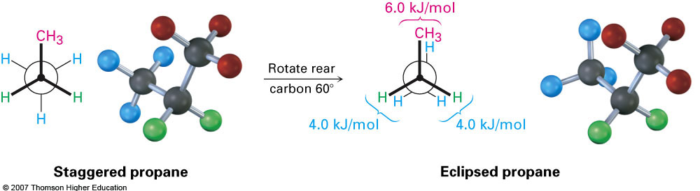
Section 3.7 Conformations of Other Alkanes
Torsional strain leads to hindered rotation around the C-C bond
Becomes even more significant when looking at propane
Notice the increased energy from the methyl group-hydrogen interaction

Slide 22
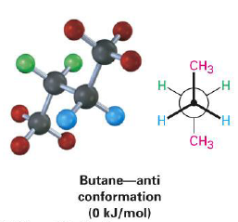
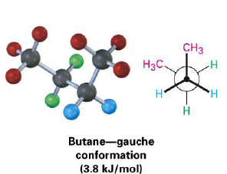
Additional Conformations of Butane
When considering the C-C bond between the two secondary carbons of butane it is possible to form two new conformations
The anti-conformation and the gauche-conformation
In addition to the torsional strain between these groups there is also steric strain
Steric strain is essentially the strain arising from spatial considerations (repulsive forces that arise when there is not enough space to accommodate all atoms)

Slide 23
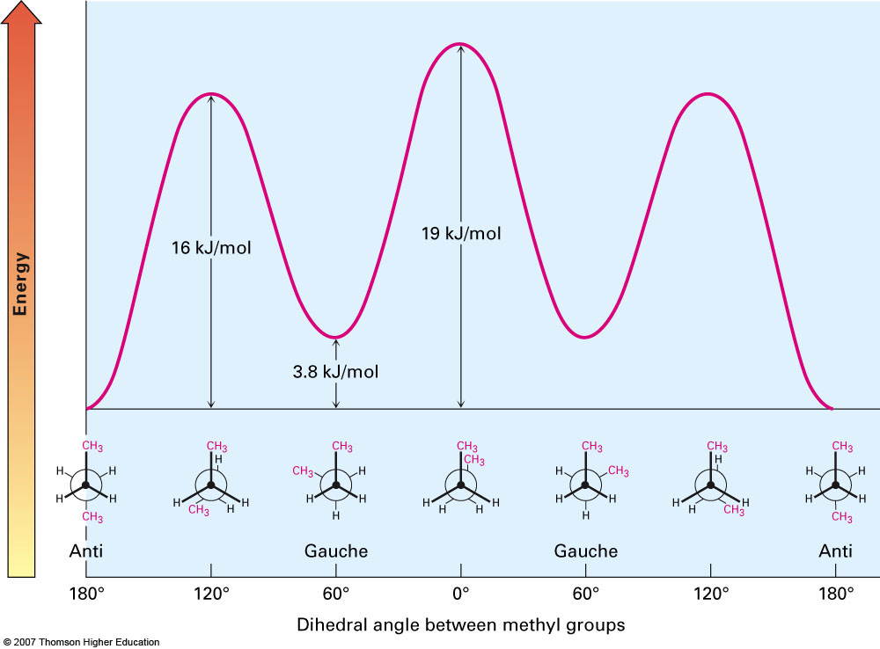
Potential Energy Diagram for All Conformations of Butane

