Slide 1
Chapter 4
Organic Compounds: Cycloalkanes and Their Stereochemistry

Slide 2
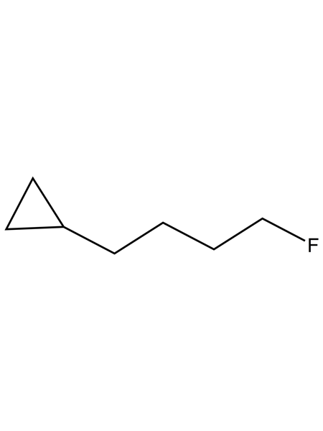
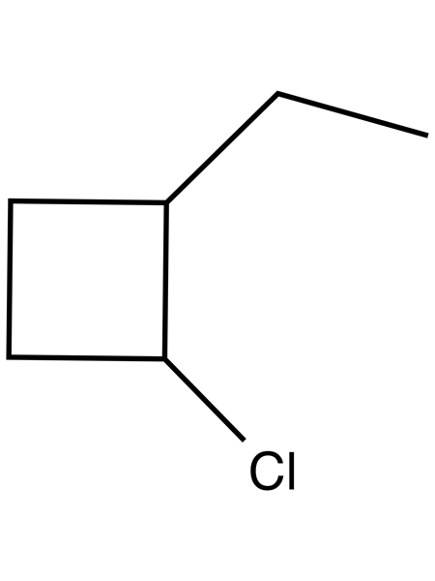
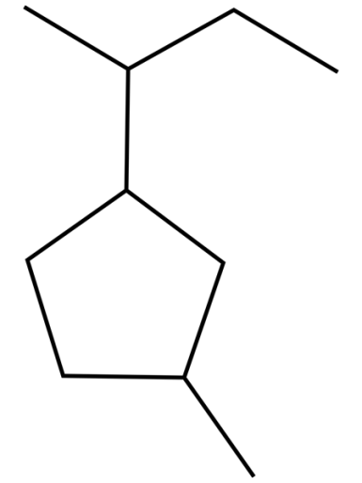
Section 4.1: Naming Cycloalkanes
Step #1: Find the parent
The ring does not always contain the most carbons
Step #2: Number the substituents, and write the name
1-chloro-2-ethylcyclobutane
1-cyclopropyl-4-fluorobutane
1-methyl-3-sec-butylcyclopentane

Slide 3
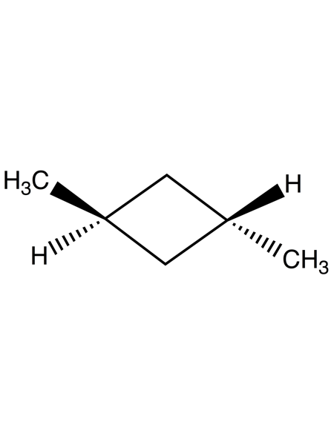
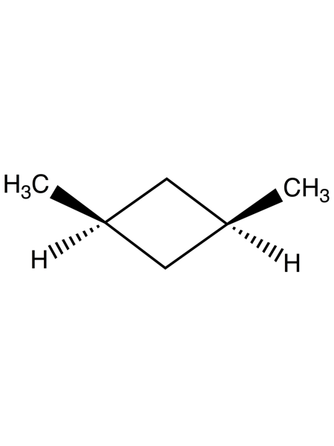
Cis-Trans Isomerism in Cycloalkanes
Because of the cyclic nature, cycloalkanes are not as flexible than their open chain counterparts
Leads to the possibility of stereoisomers
Stereoisomers have the same connectivity but different 3-dimensional arrangements of atoms
Ex: Two different stereoisomers of 1,2-dimethylbutane
cis-1,3-dimethylcyclobutane
trans-1,3-dimethylcyclobutane

Slide 4
Wedged vs. Dashed Bond Notation
Wedged bonds are employed to show substituents that protrude out of the plane
Dashed bonds are employed to show substituents that recede into the page
Examples:
trans-1-chloro-4-methylcyclohexane
cis-1-ethyl-3-methylcycloheptane

Slide 5
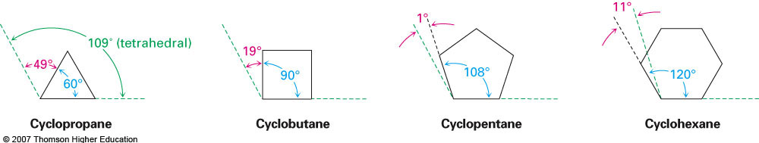
Section 4.3 Stability of Cycloalkanes: Ring Strain
Deviations from the ideal bond angle in cycloalkanes leads to angle strain
The strain imposed on a cyclic molecule as it forces bonds to be created in order to close the ring.
Note: The bond angles shown above in blue are not the correct bond angles. These are angles predicted according to theory proposed by Adolf von Baeyer

Slide 6

Overall Energy in Cycloalkanes
Overall energy is determined from the sum of:
Angle strain
Torsional strain
Steric strain
cis-1,2-Dimethylcyclopropane has more strain that trans-1,2-dimethylcyclopropane. How can you account for this difference? Which compound is more stable?

Slide 7
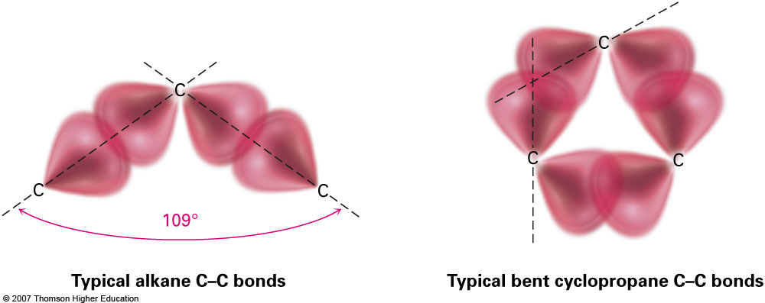
Section 4.4 Conformations of Cycloalkanes
Cyclopropane is the the most strained cyclic alkane
Primarily because of the 60° bond angles (referred to as “bent bonds”
Such large deviations in bond angles lead to the large degree of angle strain

Slide 8
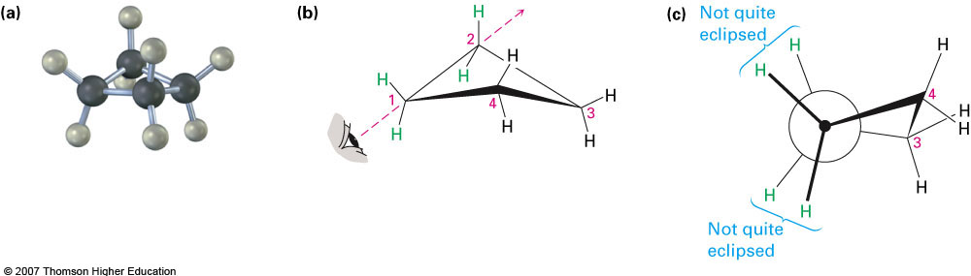
Cyclobutane
It is important to remember that these molecules contain sp³ hybridized carbons and are not flat as in the case of benzene (which contains only sp² hybridized carbons)
Experimental evidence shows that butane exists in a slightly puckered configuration (one carbon is about 25° above the plane)
Leads to lower torsional strain but higher angle strain

Slide 9
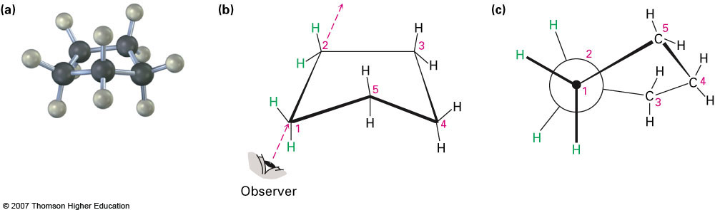
Cyclopentane
Cyclopentane represents a larger ring and therefore considerably less angle strain (26 kJ/mol vs 110 kJ/mol for cyclopropane and cyclobutane)
The three-dimensional structure of cyclopentane adopts a conformation that compromises angle strain and torsional strain

Slide 10
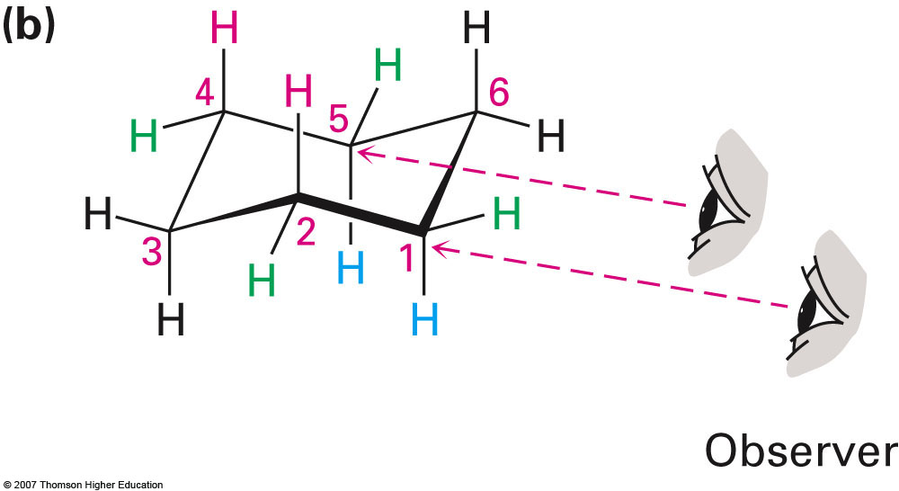
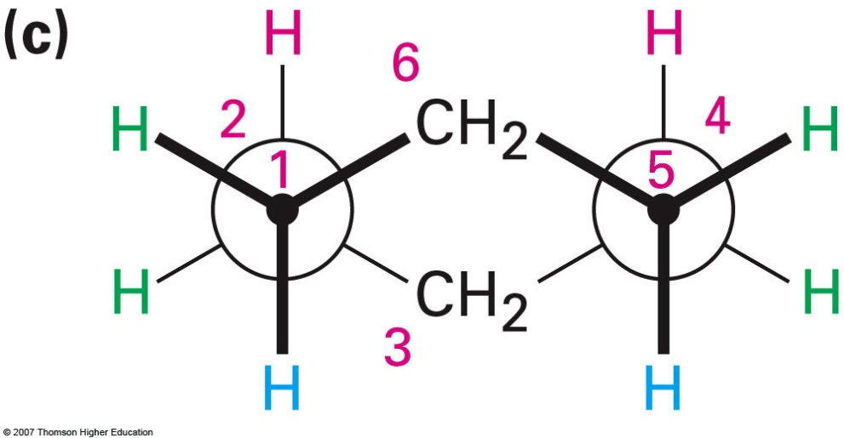
Section 4.5 Conformations of Cyclohexane
The most common of all naturally occurring ring systems
With the enlargement of the ring to 6 carbons it is capable of adopting a conformation which essentially eliminates all strain
109° bond angles and essentially no torsional or angle strain
Referred to as the chair conformation

Slide 11
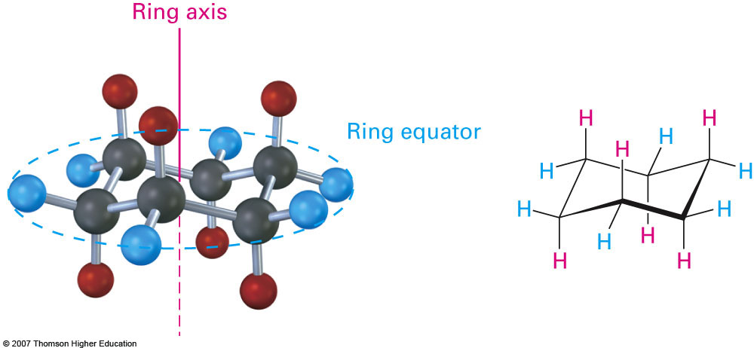
Section 4.6 Axial and Equatorial Bonds in Cyclohexane
Formation of the chair conformation in cyclohexane leads to the creation of distinct positions within the molecule
These are referred to as the axial and equatorial positions
These are not official IUPAC prefixes; however, and are not used when naming compounds

Slide 12
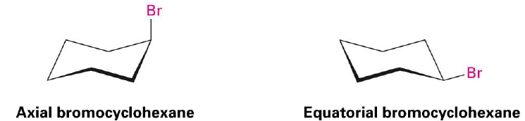

Ring Flipping in Cyclohexane
The axial and equitorial positions are not used when naming cyclohexane because these represent different conformational positions, not different constitutional isomers
Ex: Bromocyclohexane
The ring flip in cyclohexane involves all axial positions becoming equatorial and vice versa

Slide 13
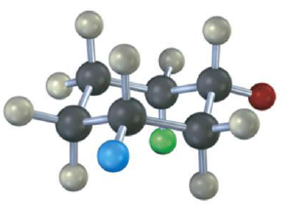
Examples
Draw two different chair conformations of cyclohexanol (hydroxycyclohexane). Identify each position as axial or equatorial
Identify each of the colored positions below as either axial or equatorial

Slide 14
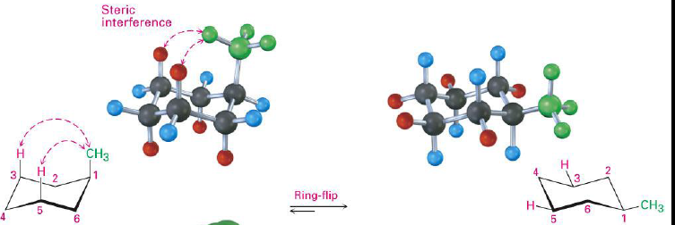

Section 4.7 Conformations in Monosubstituted Cyclohexanes
Let’s take a look at bromocyclohexane again
Why does the double arrow lying to the right (i.e. with the bromine in the equatorial position instead of axial?)
It’s a littler easier to see when looking at methylcyclohexane:

Slide 15
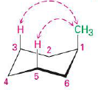


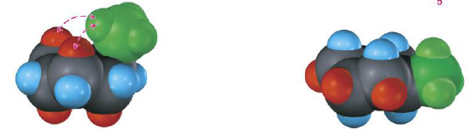
Conformations in Monosubstituted Cyclohexanes (cont.)
In the case of 1,3-dimethylcyclohexane the equatorial conformer is preferred by about 95:1 due to an energy difference of about 7.6 kJ/mol
As calculated using the equation ΔG = -RT ln (K)
The extra steric strain is due to two 1,3-diaxial interactions

Slide 16
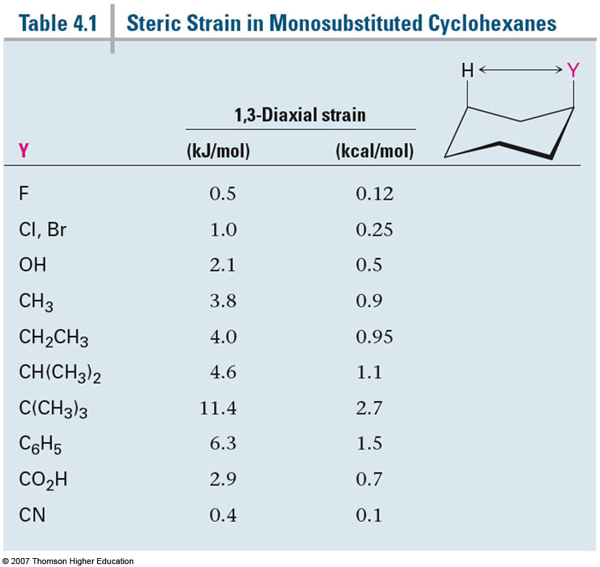
Steric Strain

Slide 17
Section 4.8 Conformations in Disubstituted Cyclohexanes
Let’s first consider the relationships between axial and equatorial positions with regards to cis- and trans- isomers:
As we go around the ring, the positions in a cis- isomer will alternate between axial and equatorial. When drawing a trans- isomer, it is necessary to switch from axial to equatorial or vice versa
Example: Draw two different chair conformations of trans-1,4-dimethylcyclohexane

Slide 18
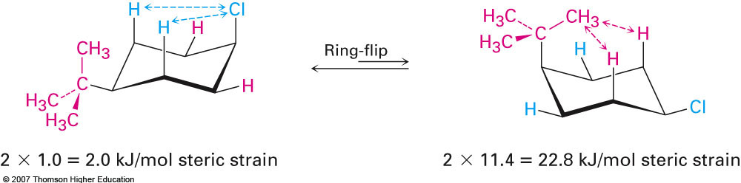
Determining the Most Stable Conformations
In monosubstituted cyclohexanes the substituent is always more stable in the equatorial position to avoid 1,3-diaxial interactions
In disubstitued the two substituents must be evaluated to see which one causes the most steric strain.
Example: Draw the most stable configuration of cis-1-tert-butyl-4-chlorocyclohexane

Slide 19
Example #2
Draw the most stable chair conformation for trans-1-Chloro-3-methylcyclohexane
cis-1-tert-Butyl-4-ethylcyclohexane

