Slide 1
Chapter 5
An Overview of Organic Reactions

Slide 2
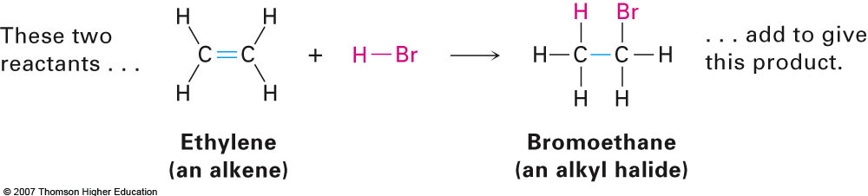
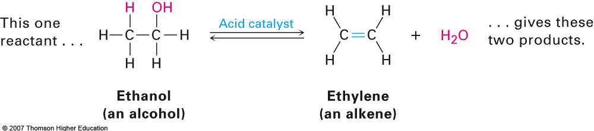
Section 5.1 Kinds of Organic Reactions
Addition reactions
Analogous to the traditional synthesis reaction
Elimination reactions
Analogous to the traditional decomposition reaction

Slide 3
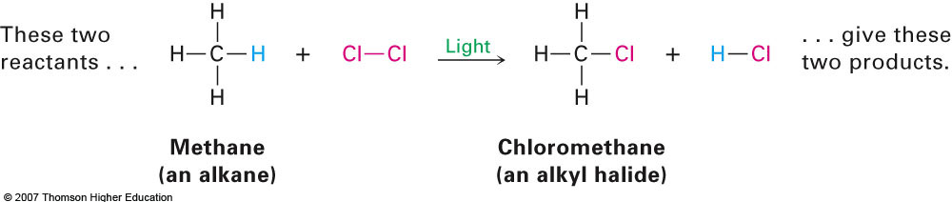

Kinds of Organic Reactions (cont.)
Substitution reactions
Usually involves one functional group being substituted for another
Rearrangement reactions
Involves a rearrangement of atoms to form a new constitutional isomer (no change in molecular formula)

Slide 4




Section 5.2 How Organic Reactions Occur: Mechanisms
Bond Breaking
Bond Making
Symmetrical
Symmetrical
Unpaired electrons referred to as radicals
Unsymmetrical
Unsymmetrical

Slide 5
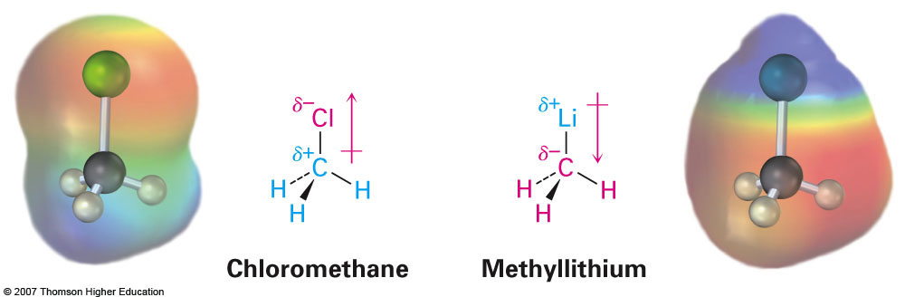
Section 5.4 Polar Reactions
As the name implies, polar reactions occur with molecules that contain highly polarized bonds (bonds that are more easily broken)
Electronegativity of elements plays a big role in the compounds reactivity
Ex: Chloromethane vs. methyllithium

Slide 6
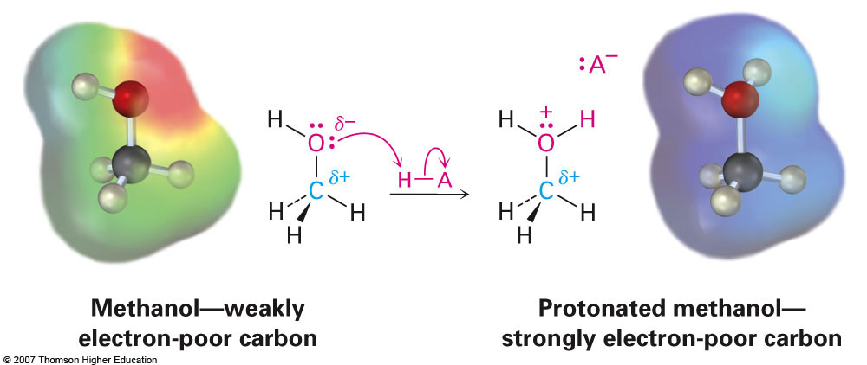
Second Example

Slide 7
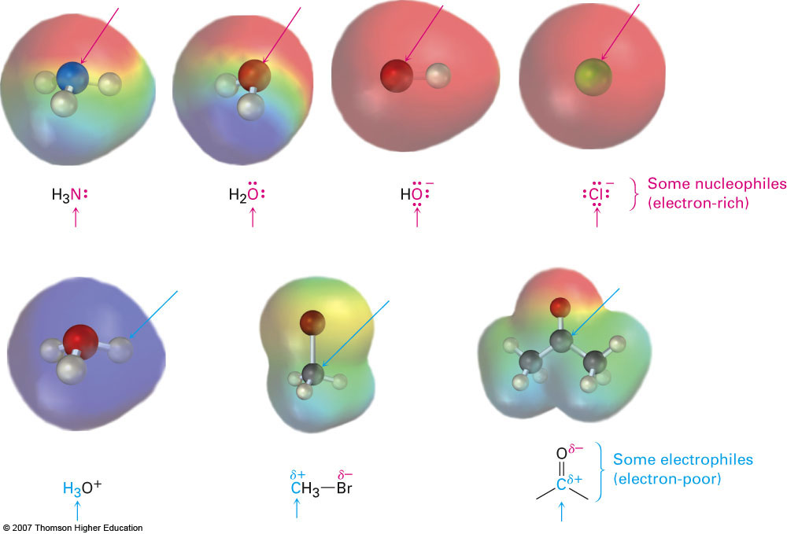
Nucleophiles vs. Electrophiles
When analyzing the mechanism for a chemical reaction it is always possible to assign the terms nucleophile and electrophile
Nucleophiles are always electron-rich species
Similar to the concept of Lewis bases
Electrophiles are always electron-poor species
Similar to the concept of Lewis acids

Slide 8
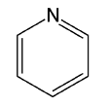
Examples
Which of the following would you expect to be a nucleophile and which an electrophile?
CH₃Br
CH₃OH
CH₃⁺ (carbocation)

Slide 9
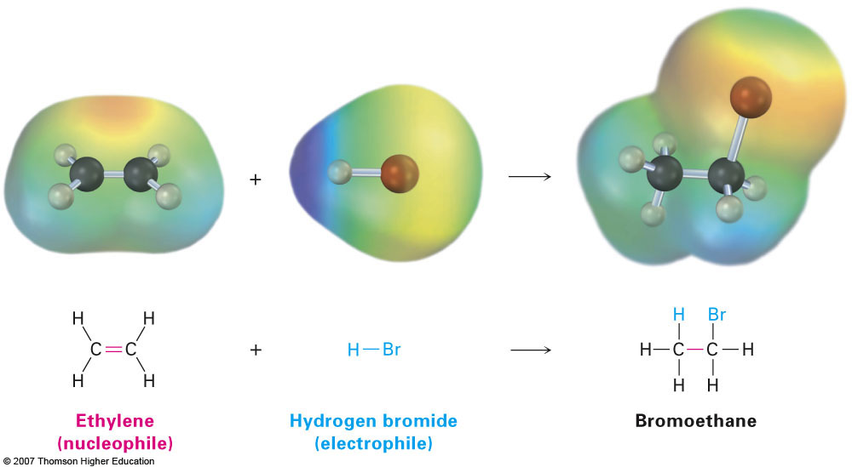
Section 5.5 An Example of a Polar Reaction: Addition of HBr to Ethylene
This is an example of an electrophilic addition reaction
Ethylene is the nucleophile and HBr acts as nucleophile
Occurs in two steps

Slide 10
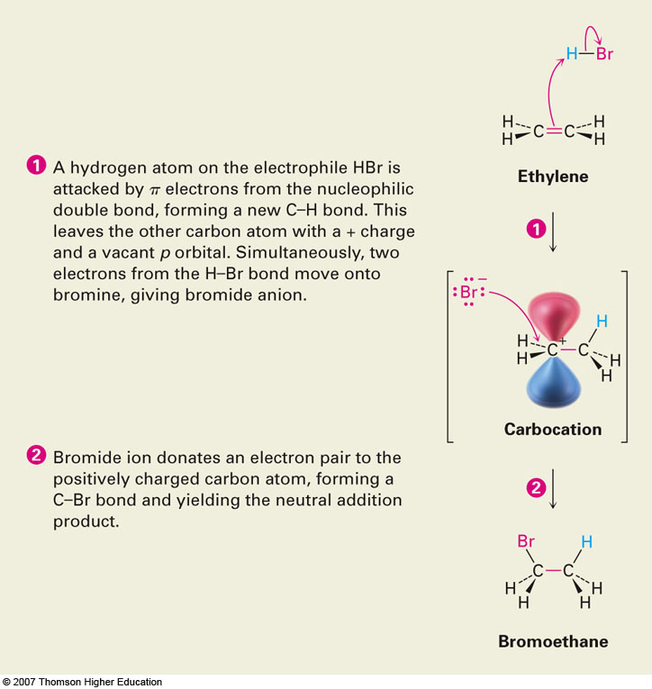
Section 5.6 Using Curved Arrows in Polar Reaction Mechanisms
Consider previous reaction

Slide 11
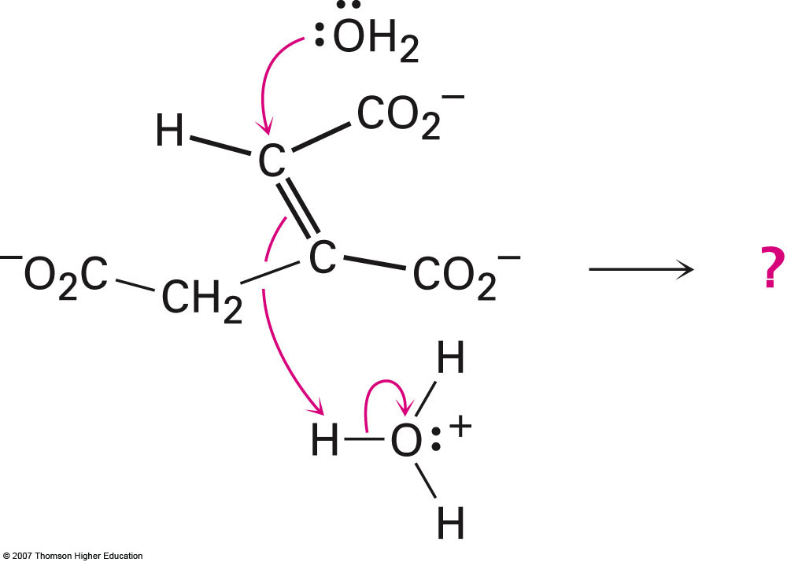
Predict the Product of the Following Rxn.

Slide 12
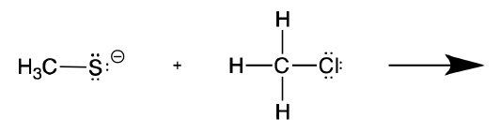

Show the Reaction Mechanism for Each of the Following Examples

Slide 13
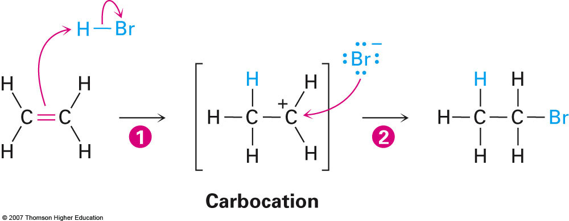
Section 5.9 Describing a Reaction: Energy Diagrams and Transition States
Let’s take a look at the reaction between ethylene and hydrobromic acid again:

Slide 14
Drawing and Interpreting Energy Diagrams
Let’s draw an energy diagram depicting this process and include the following:
Relative Gibbs free energy of reactants and products
Transition state
Activation energy (ΔG‡)
Standard Gibbs free energy change (ΔG°)

