Slide 1
Chapter 6
Alkenes: Structure and Reactivity

Slide 2

Section 6.2 Calculating a Molecule’s Degree of Unsaturation
The formation of double (or triple) bonds leads to an unsaturated molecule
Also occurs when cyclic structures are formed
Based on the fact that saturated compounds have the generic formula C_{n}H_{n+2} it is possible to calculate a molecule’s degree of unsaturation
Ex: Calculate the degree of unsaturation for the following compounds:

Slide 3

Section 6.3 Naming Alkenes
Step 1: Name the parent hydrocarbon
Step 2: Number the carbon atoms in the chain
Step 3: Write the full name
The position of the double bond is numbered based on which carbon the double bond begins with
If more than one double exists the suffixes –diene, -triene, etc. are used
Examples:
See Problems 6.4-6.6

Slide 4
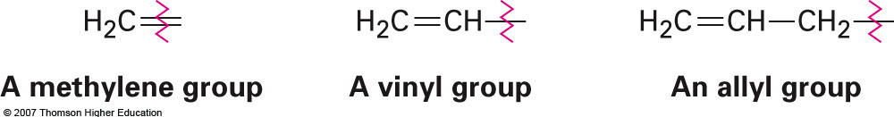
Common Names Involving Alkenes Recognized by IUPAC
The compound ethylene should technically be name ethene
Other groups that will be referred to from time to time:
Differ simply by the carbon used as the attachment point

Slide 5
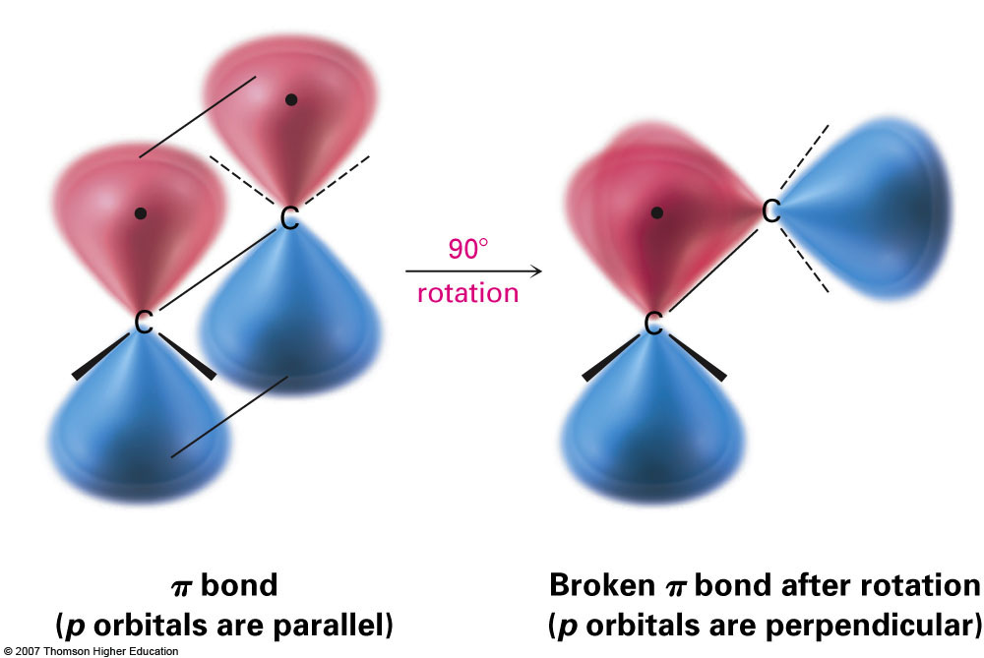

Section 6.4 Electronic Structure of Alkenes
The “second” bond of a double bond involves orbital overlap from unhybridized p orbitals
Because the overlap is not symmetrical along the bond axis rotation is not possible for C-C double bonds like it is in single bonds:
Electron Density Map for Ethylene

Slide 6
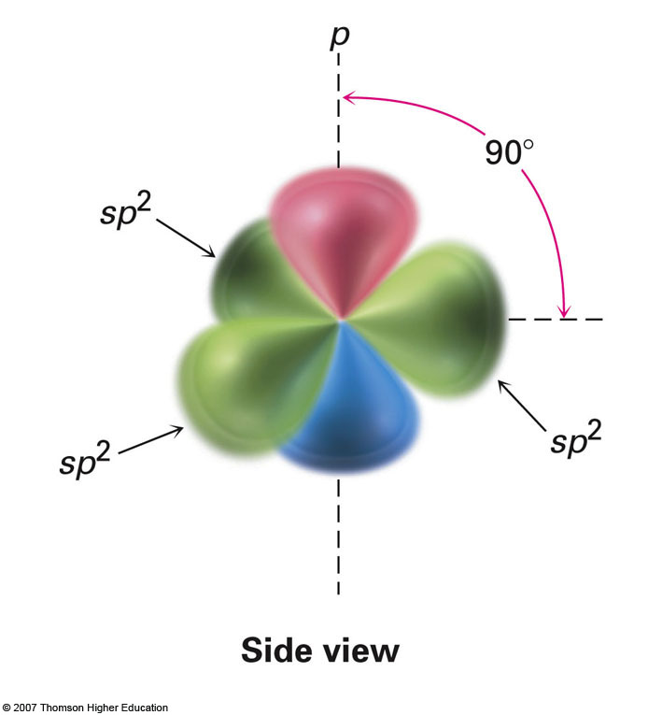
Bond Strengths and Bond Lengths
C=C double bonds are typically shorter than C—C single bonds
The bond strength is also quite different which helps explain the difference in reactivity between alkanes and alkenes.

Slide 7
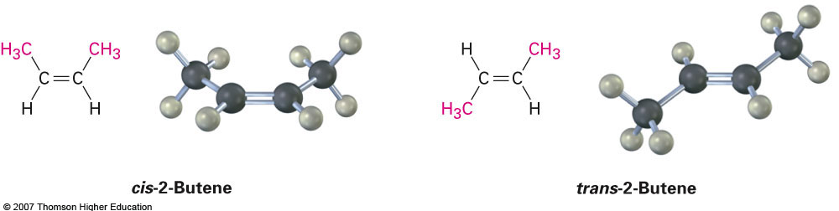
Section 6.5 Cis—Trans Isomerism in Alkenes
Cis—trans stereoisomers are possible for disubstituted alkenes similar to those found in disubstituted cycloalkanes
Due to the fact that bond rotation is impossible
Example: cis-2-butene vs. trans-2-butene

Slide 8

Section 6.6 Sequence Rules: The E,Z Designation
Cis or trans?
Cis or trans?
The terms cis and trans limit themselves to describing disubstituted alkenes only. When tri- or tetra-substituted alkenes are discussed an alternative nomenclature is necesssary
The E,Z system which utilizes a series of sequence rules

Slide 9
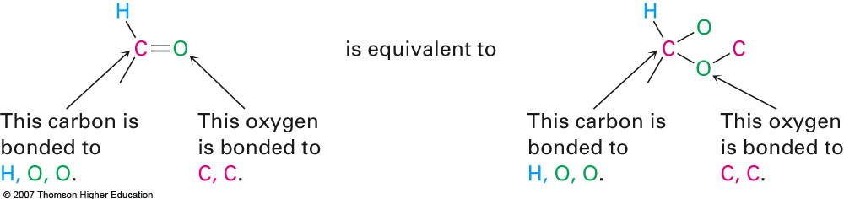
Cahn-Ingold-Prelog Selection Rules
Rule 1: Rank the atoms directly attached to the carbon of the double bond according to their atomic number
Ex: The two isomers of 3-bromo-2-chloro-2-pentene
Rule 2: If a tie exists at the first atom attached to the carbon of the double bond, then look at the second, third, fourth, etc.
Ex: The two isomers of 2-butene-1-ol
Rule 3: Multiple-bonded atoms are equivalent to the same number of single-bonded atoms:

Slide 10
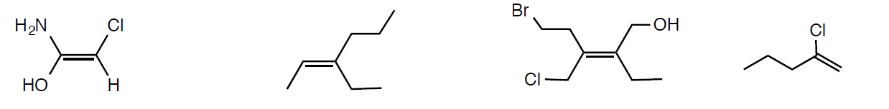
Additional Examples
E or Z? Draw the opposite

Slide 11
Section 6.7 Alkene Stability
Alkenes are inherently rigid and incapable of interconverting between cis and trans stereoisomers
However, when trans-2-butene is treated with strong acid, interconversion between the two isomers is possible
Which is therefore more stable?
Steric interactions must be considered

Slide 12
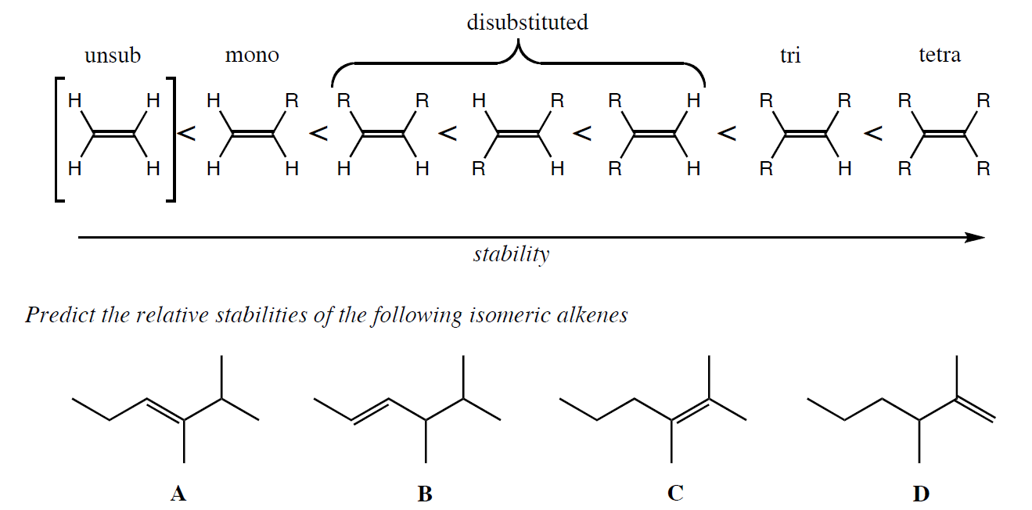
Stability in Terms of Degree of Substitution
The greater the degree of substitution the greater the stability of the alkene:

Slide 13
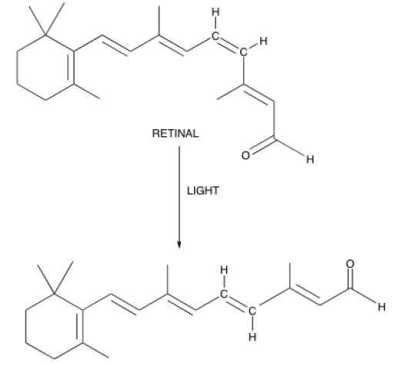
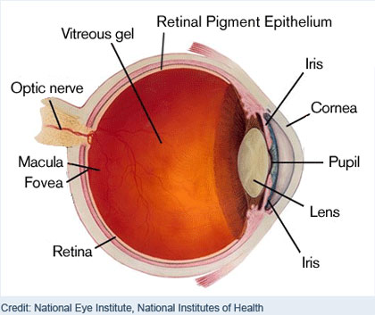
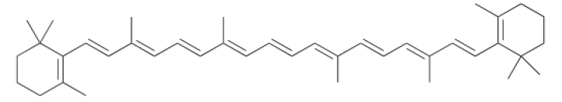
Biological Example
Beta-Carotene

Slide 14
Section 6.8 Electrophilic Addition of HX to Alkenes
Think back to the example of ethylene reacting with HBr
(We beat it to death)
It is referred to as electrophilic addition because the electrophile (HX) is added across the double bond of the alkene
Examples:
2-methyl-2-pentene reacting with HCl
1-pentene reacting with NaI/H₃PO₄

Slide 15
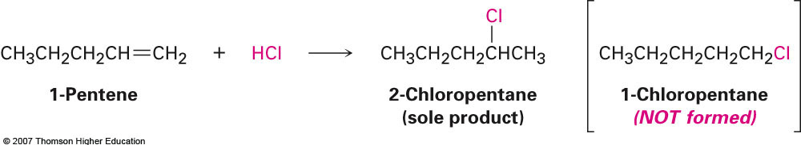
Section 6.9 Orientation of Electrophilic Addition: Markovnikov’s Rule
When considering the previous examples we see that even though one product is drawn, it is possible to form two different isomers
Only one of these isomers obeys Markovnikov’s Rule
Essentially says that when an alkene is treated with HX (X = halogen) the halogen always forms a bond to the most substituted carbon

Slide 16
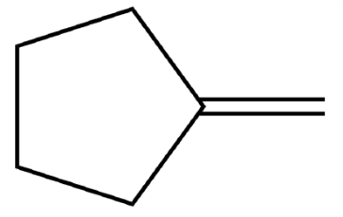
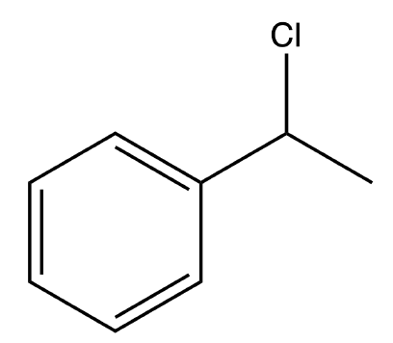
Example
What product would you expect when treating the following alkene with NaI/H₃PO₄?
NaI
H₃PO₄
Suggest a starting material to prepare the compound shown below:
?

Slide 17
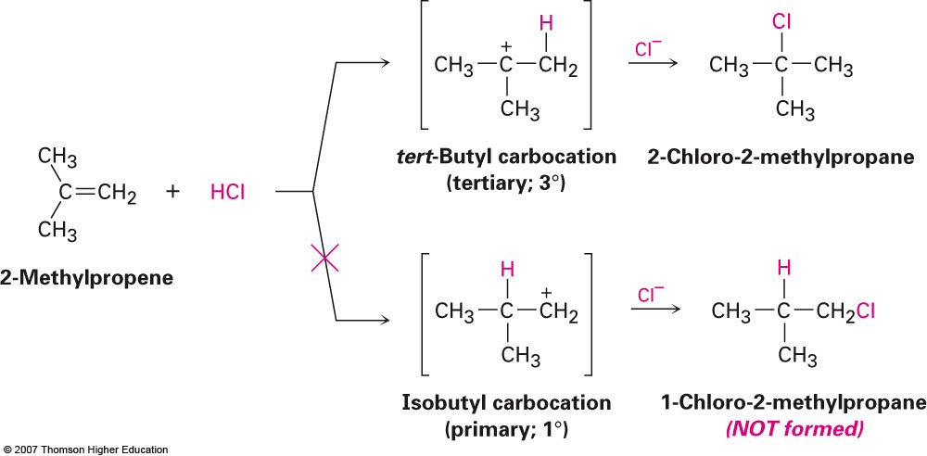
Explanation of Markovnikov’s Rule: Carbocation Stability
The more highly substituted carbocation is always the most stable:

Slide 18
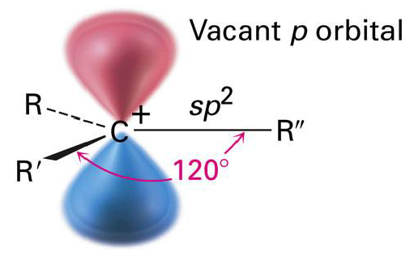
Section 6.10 Carbocation Structure and Stability
In terms of structure, carbocations have been shown to exhibit a planar three-dimensional structure indicating sp² hybridization
The vacant p-orbital is 90° away from the three other attached groups meaning that no orbital overlap is possible

Slide 19
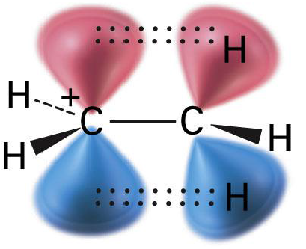
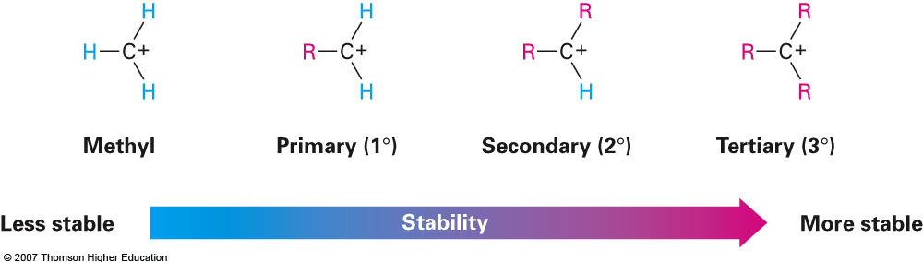
Carbocation Stability Increases with Increasing Substitution
Stability increases primarily due to inductive effect
Substituents add electron density to stabilize the positive charge of this unstable intermediate
Also due to hyperconjugation:

Slide 20
Section 6.11 The Hammond Postulate
The real reason we observe regiospecificity in electrophilic addition is due to how fast each carbocation is formed
Tertiary are formed faster than secondary, etc.
What is the link between rate of formation and stability?
The Hammond postulate essentially says that the transition state of a compound will resemble the nearest, most stable species to it
Therefore, whatever stabilizes the intermediate will stabilize the transition state
Ex: 2-methyl-1-propene reacting with HCl

Slide 21
Section 6.12 Evidence for the Mechanism of Electrophilic Addition: Carbocation Rearrangements
It is also possible for rearrangements to occur upon carbocation formation to yield a more stable ion
Ex: 3-isopropyl-1-pentene w/ HCl
Ex: 3-isopropyl-3-methyl-1-pentene w/ HCl

