Slide 1
Chapter 7
Alkenes: Reactions and Synthesis

Slide 2
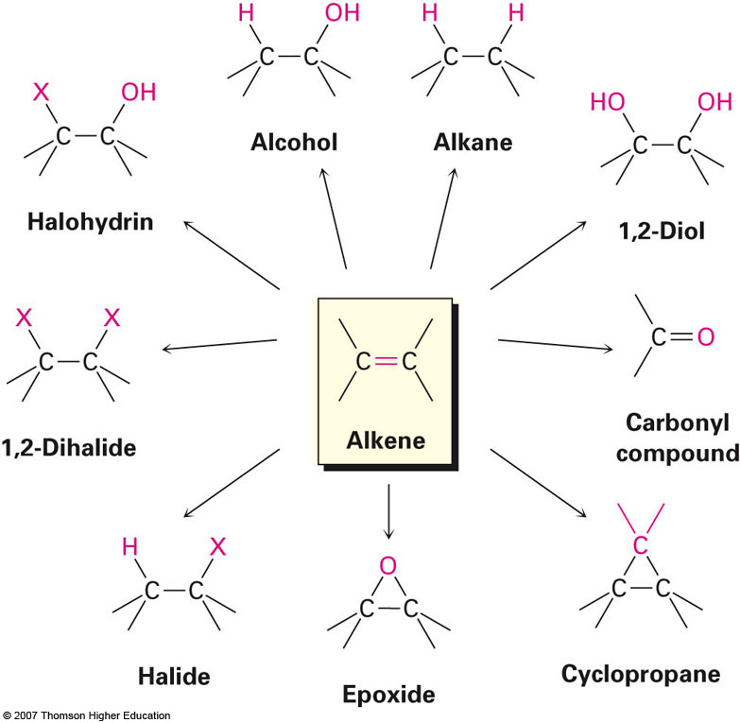
Preview of Reactions

Slide 3
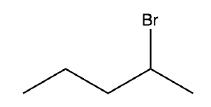



Section 7.1 Preparation of Alkenes: A Preview of Elimination Reactions
Two most common ways to prepare alkenes
Dehydrohalogenation
Dehydration
Ex: 2-bromopentane reacting w/ KOH in EtOH
KOH
EtOH
Ex: 1-Hexanol reacting w/ aqueous sulfuric acid in THF
H₂SO₄
THF

Slide 4
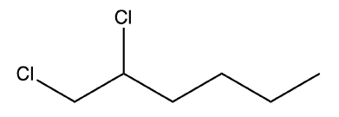

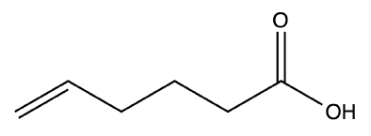
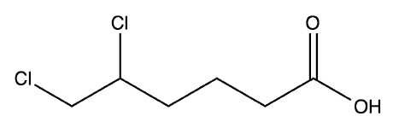
Section 7.2 Addition of Halogens to Alkenes
Cl₂
Halogens react exclusively with C-C double bonds (not carbonyls, etc.)
Cl₂

Slide 5
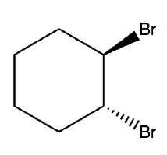
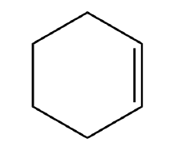
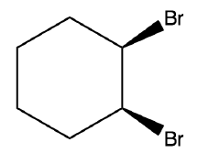
Reactions Involving Cycloalkenes
Halogens can react with cycloalkenes to form trans-1,2-dihaloalkanes
Ex: cyclohexene reacting with Br₂
Br₂
anti-addition ONLY is observed during halogenation of cycloalkenes resulting in the trans product exclusively

Slide 6
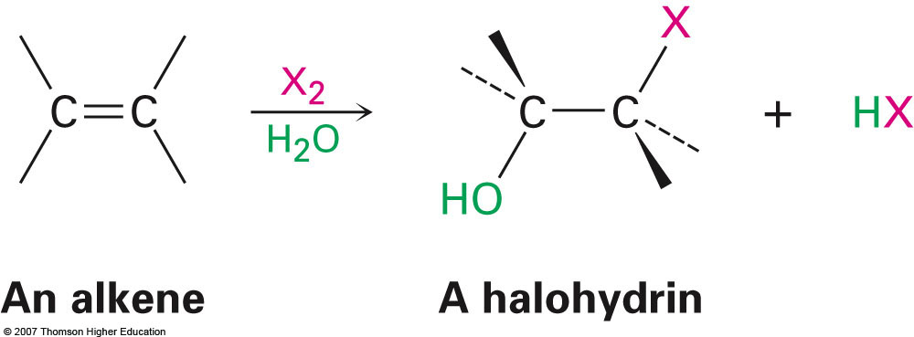
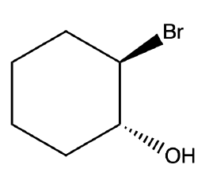
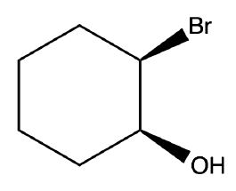
Section 7.3 Halohydrin Formation
After formation of the bromonium ion the only nucleophile present in the previous example is bromide
What happens when additional nucleophiles are present?
No syn addition observed
NBS
H₂O Acetone
92%

Slide 7
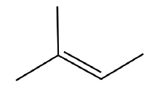
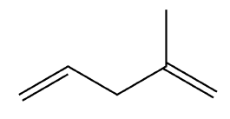
Examples
NBS
?
NaN₃ Acetone
What product would exhibit Markovnikov addition?
1 equiv. Br₂
?

Slide 8


Section 7.4 Addition to Water to Alkenes: Oxymercuration
Hydration of alkenes is possible leading to the formation of alcohols (introduction of –OH functional group)
Most straightforward method involves the use of an aqueous solution of a strong acid
H₃PO₄
250 °C

Slide 9
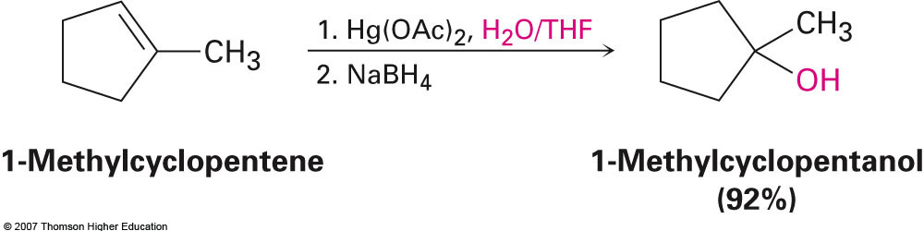
Oxymercuration Procedure
Oxymercuration utilizes mercury (II) acetate in an water/THF solvent to convert hydrate alkenes to produce alcohols
The intermediate that is initially formed is then reduced with NaBH₄ (sodium borohydride) to yield the alcohol

Slide 10
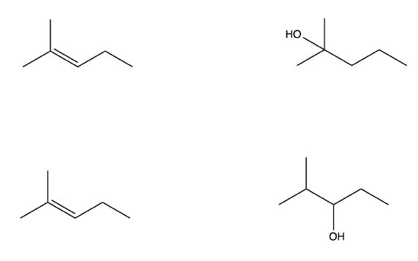
Section 7.5 Addition of Water to Alkenes: Hydroboration
Represents an additional method of converting alkene into alcohol
Complementary to oxymercuration because the hydroxy group is introduced in a non-Markovnikov fashion
1. Hg(OAc)₂, H₂O
2. NaBH₄
1. BH₃, THF
2. H₂O₂, OH⁻

Slide 11
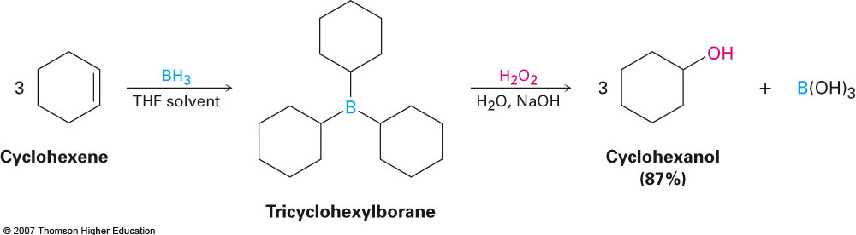
Stoichiometry of Hydroboration Step
Borane (BH₃) contains three reactive hydrogens and will therefore react with three equivalents of alkene
Ex: Cyclohexene reacting with BH₃/THF

Slide 12
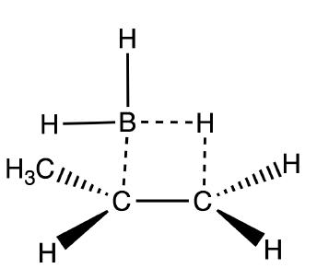
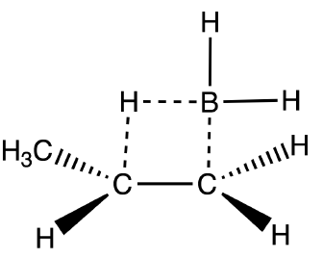
Mechanism
Addition of borane occurs in a single step and occurs in a syn fashion. No pure carbocation is formed, only a partial positively charged carbon:
Borane adds to the less substituted carbon for two basic reasons
Stability of carbocation
Steric interactions
Steric Hindrance
2° Carbocation
1° Carbocation
δ⁻
δ⁻
δ⁺
δ⁺

Slide 13
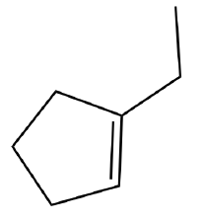
Example
Notice that the second step of the reaction involves peroxide which oxidizes the borane intermediate to the desire alcohol product
1. BH₃, THF
1. Hg(OAc)₂, H₂O
2. H₂O₂, OH⁻
2. NaBH₄

Slide 14
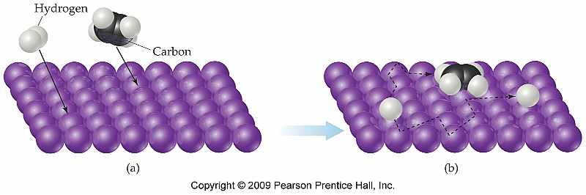
Section 7.7 Reduction of Alkenes: Hydrogenation
Hydrogenation reactions are performed using a heterogeneous catalyst (typically Pt, Pd/C, or PtO₂)
Involves syn-addition of H₂ across the double bond of an alkene
Highly influenced by steric interactions
Will add to the least sterically hindered side of a double bond which has implications for stereochemistry in cycloalkenes

Slide 15
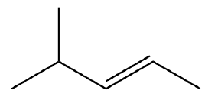
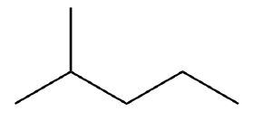
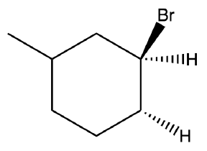
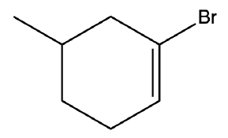
Examples
H₂
Pd/C or PtO₂
EtOH
H₂
Pd/C or PtO₂
EtOH
syn product observed

Slide 16
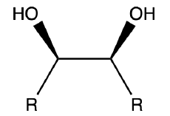
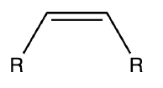
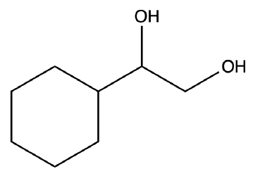
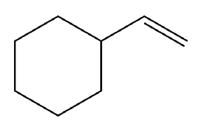
Section 7.8 Oxidation of Alkenes: Epoxidation and Hydroxylation
Hydroxylation involves the addition of two –OH groups across the double bond of an alkene
1. OsO₄
A 1,2-Diol Product
(Glycol)
2. NaHSO₃
1. OsO₄
2. K₃Fe(CN)₆
80%

Slide 17
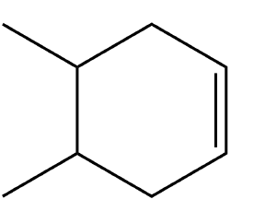
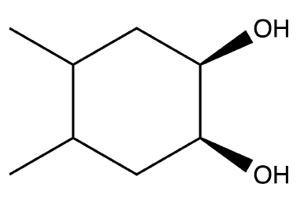
Stereochemistry of Hydroxylation Reactions
Where stereochemistry must be considered (cycloalkenes) hydroxylation using OsO₄ occurs via syn addition yielding the cis product exclusively
1. OsO₄
2. NaHSO₃

Slide 18
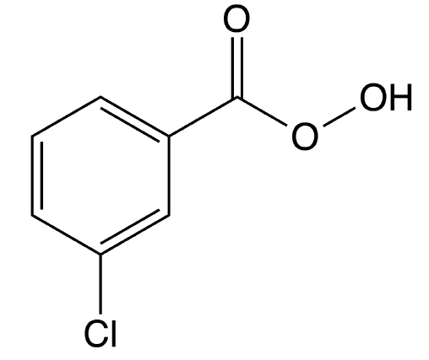
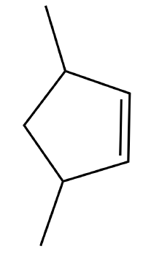
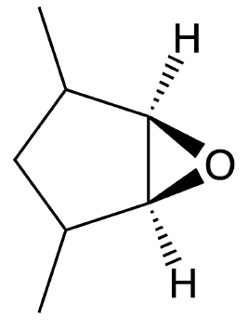
Epoxidations Using m-CPBA
Epoxidations involve the creation of an oxygen containing three-membered ring and can be used as a complimentary way creating 1,2-diols
epoxide functional group
meta-Chloroperoxy-
benzoic acid
m-CPBA
CH₂Cl₂ (solvent)
syn-addition is observed

Slide 19
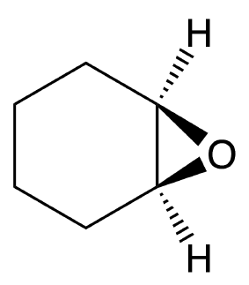
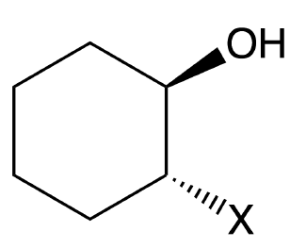
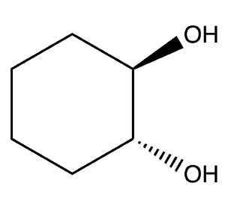
Epoxides from 1,2-Halohydrins
Many times performed in two steps
Conversion of alkene to halohydrin
Conversion of halohydrin to epoxide
NaOH
H₃O⁺
trans-substituted product
observed only

Slide 20
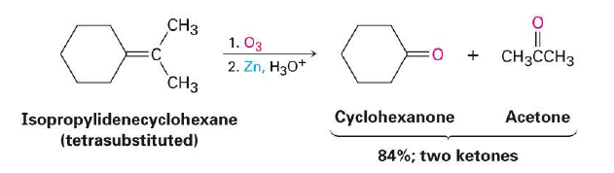
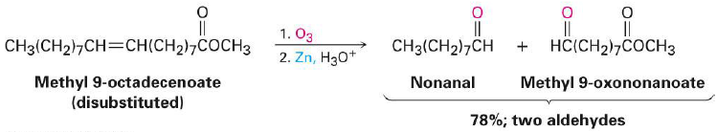
Section 7.9 Oxidation of Alkenes: Cleavage to Carbonyl Compounds
Products from ozonolysis depend on the degree of substitution in the reactants
Tetrasubstituted alkenes yield two products containing the ketone functional group
Disubstituted alkenes yield two products containing the aldehyde functional group

