Slide 1
Chapter 8
Alkynes: An Introduction to Organic Synthesis

Slide 2
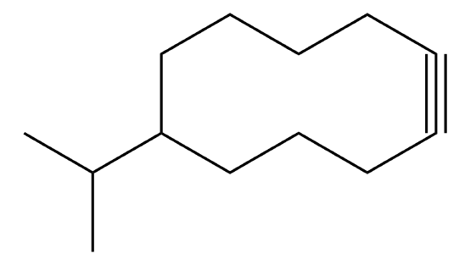
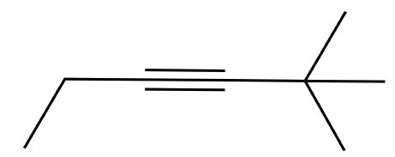
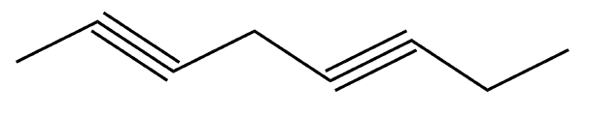
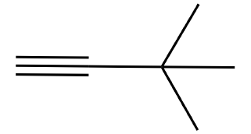
Section 8.1 Naming Alkynes
Nomenclature for alkynes is very much like that of alkenes
The suffix –yne is used in place of –ene

Slide 3
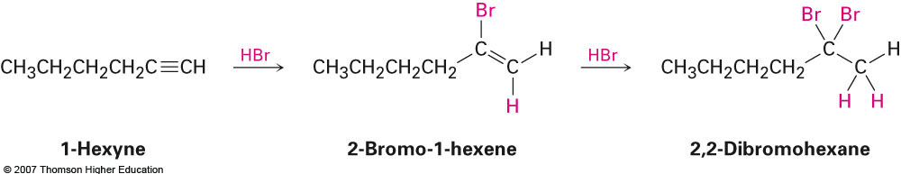
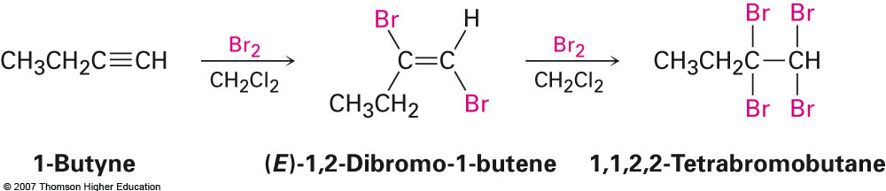
Section 8.3 Reactions of Alkynes: Addition of HX and X₂
Reactions are analogous to those for alkenes; however, it is possible to react with more than one equivalent of each reagent:

Slide 4
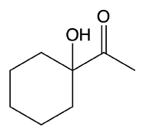
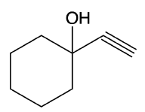
Section 8.4 Hydration of Alkynes
This hydration is similar to the oxymercuration procedure; however, no NaBH₄ is required.
An enol intermediate is formed which quickly converts to the ketone product
Can be thought of as almost like a Markovnikov addition of a ketone (although the mechanism is a little more complex)
H₂O, HgSO₄
H₂SO₄
79%
If unsymmetrical, internal alkynes are used then a mixture of the two possible ketones is observed

Slide 5
Examples
2-butyne is treated with aqueous HgSO₄ and H₂SO₄
2-pentyne reacting with two equivalents of HBr
Propyne reacting with one equilvalent of Cl₂

Slide 6
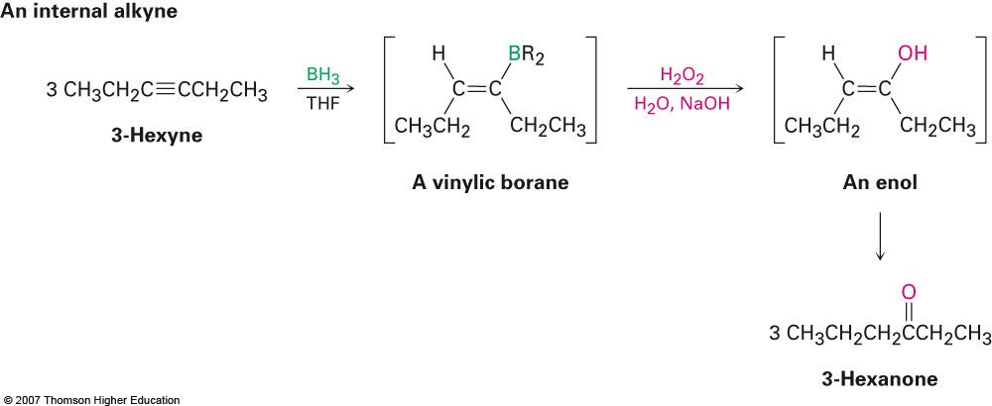
Hydroboration/Oxidation of Alkynes
Depending on the location of the triple bond, either aldehydes or ketones are obtained
Aldehydes for terminal alkynes and ketones for internal

Slide 7
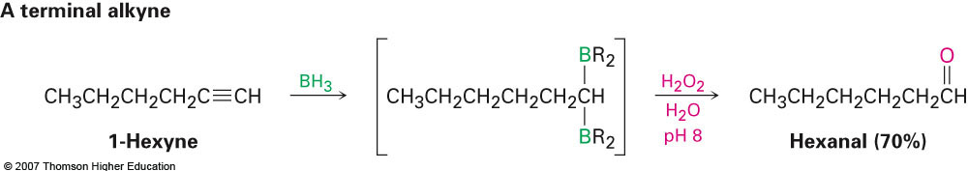
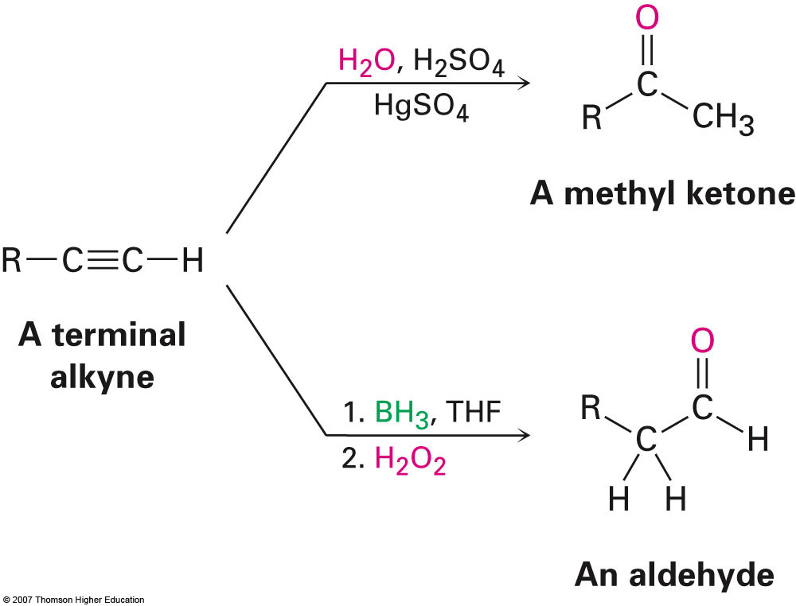
Hydroboration of Terminal Alkynes
Borane adds to the least substituted carbon twice and subsequent reaction with peroxide provides the aldehyde product
Provides a complimentary method to oxymercuration which would otherwise yield the ketone product

Slide 8

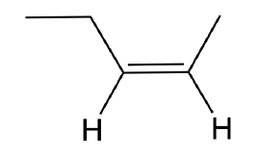
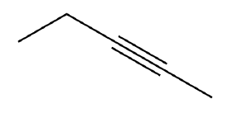
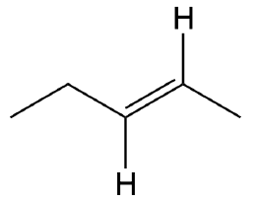
Section 8.5 Reduction of Alkynes
Reduction of alkynes works essentially the same as with alkenes and uses the same catalysts
However it is possible to stop the reaction after reducing one π bond with specialized reagents
Alkane Product
2 equiv. H₂
Pd/C
cis-product only
(syn addition)
1 equiv. H₂
Lindlar catalyst
Li
NH₃
trans-product only
(anti addition)

Slide 9
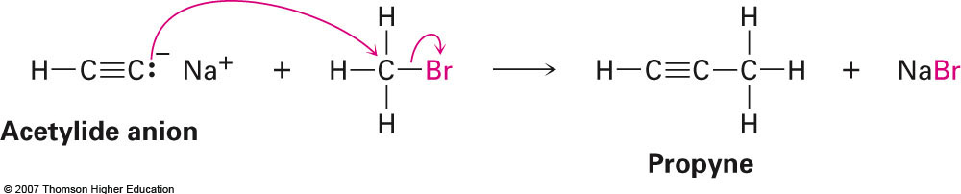
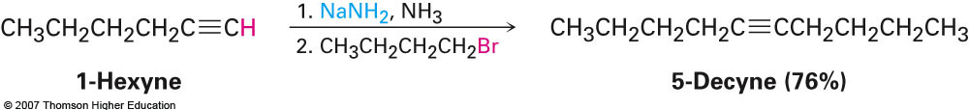
Section 8.7 Alkyne Acidity: Formation of Acetylide Anions
Unlike alkenes, alkynes can be treated with strong bases, such as sodium amide (NaNH₂) to yield the carbanion which can be used to react with alkyl halides to produce a longer carbon chain
Only works with primary alkyl halides, however

