Slide 1
Chapter 9
Stereochemistry

Slide 2
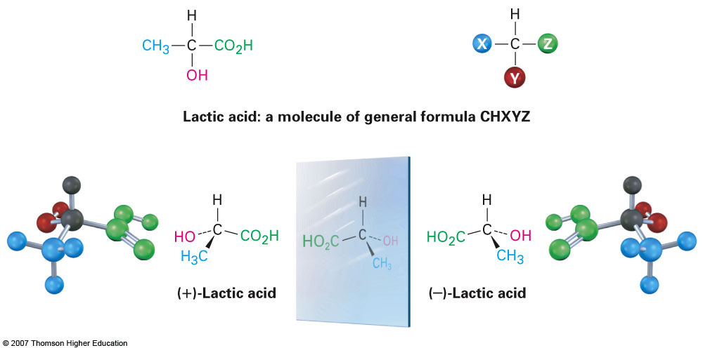
Section 9.1 Enantiomers and the Tetrahedral Carbon
Enantiomers are a special category of stereoisomers
They represent two compounds that are identical in chemical formula but yet represent mirror images of each other

Slide 3
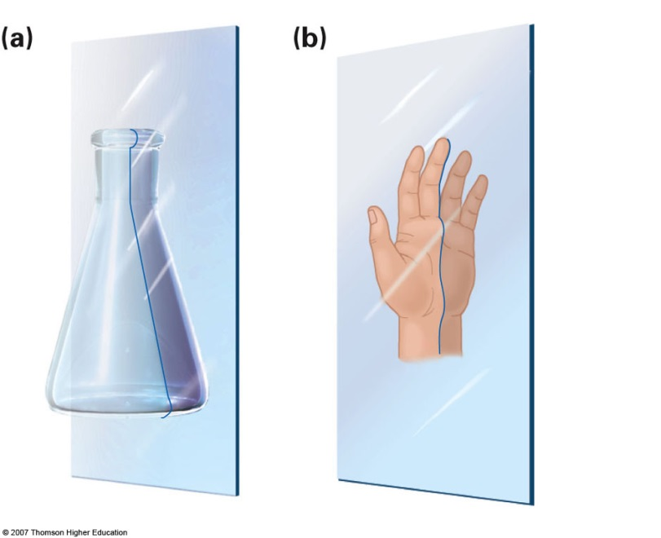
Section 9.2 The Reason for Handedness in Molecules: Chirality
Molecules that can exist as two enantiomeric forms are referred to as chiral
Chiral carbon centers must have 4 different substituents in order to be chiral
Another way to predict chirality is to look for a plane of symmetry
If a plan of symmetry exists then the two mirror images of the compound will be identical and therefore achiral

Slide 4
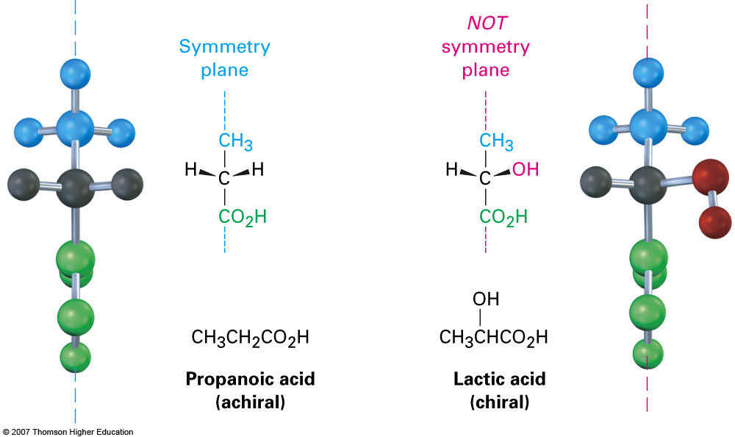
Example

Slide 5
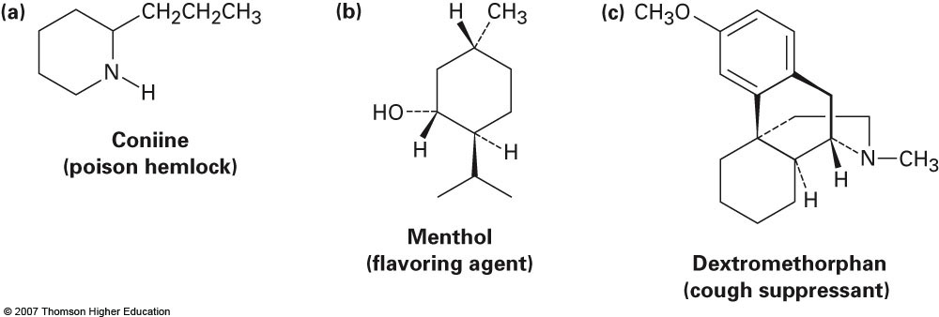
Examples
Identify the chiral centers in each of the molecules shown below

Slide 6
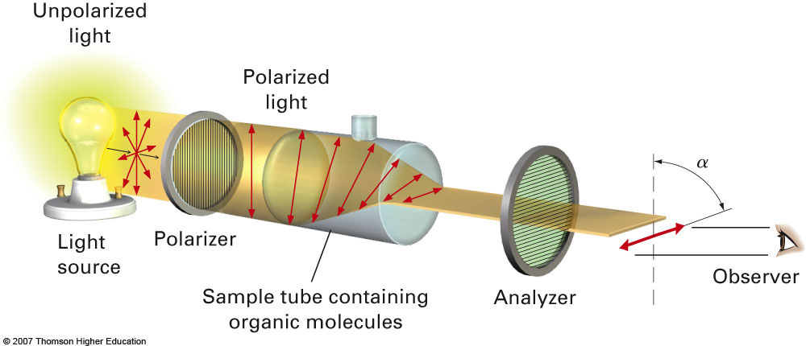
Section 9.3 Optical Activity
Chiral compounds have the ability to rotate a plan of polarized light and are therefore referred to as optically active
The light can be rotated clockwise (-) and referred to as levorotary
Alternatively, it can be rotated counterclockwise (+) and referred to as dextrorotary

Slide 7
Section 9.5 Sequence Rules for Specifying Configuration
The good news is that we use the same Cahn-Ingold-Prelog selection rules when assigning priority to substituents
The bad news is that trying to see the molecules in 3-D will cause gray matter to leak out of your ears (use molecular models if necessary)
Example: CHBrClF

Slide 8
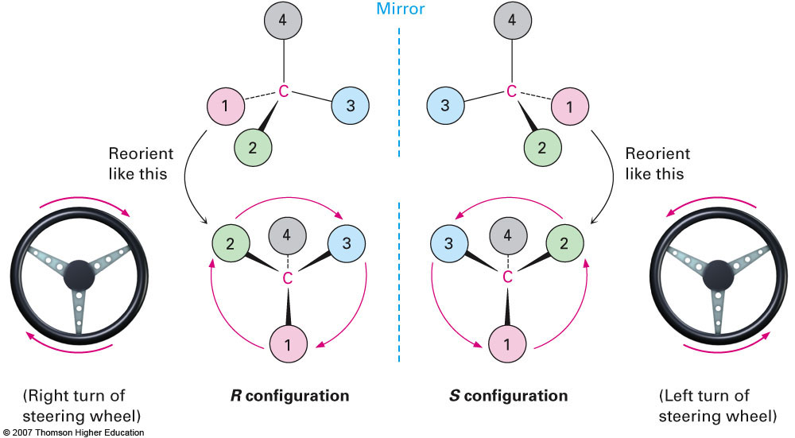
R vs S Configurations

Slide 9
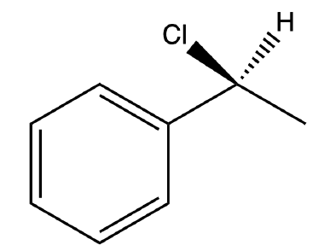
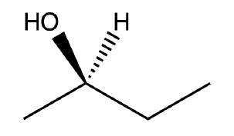
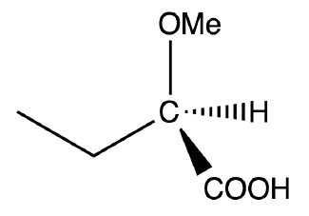
Additional Examples
Assign the chiral centers in each of the compounds below as either the R or the S configuration

Slide 10
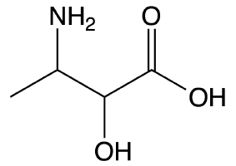
Section 9.6 Diastereomers
The compounds discussed thus far have been relatively simple because they contained only one chiral center
What about compounds with multiple chiral centers?
(Generally speaking if a compound has n chiral centers, it will have 2^{n} possible stereoisomers)
Ex: The amino acid threonine (2-amino-3-hydroxybutanoic acid)

Slide 11
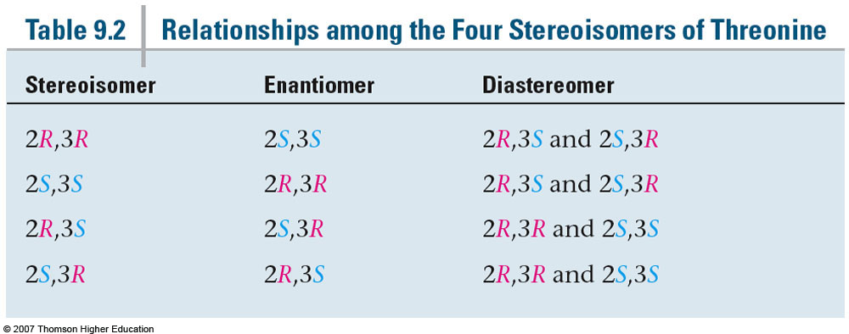
Relationships Among the Three Stereoisomers of Threonine
If both chiral centers change they will exist as a pair of enantiomers
If only one chiral center changes they will exist as a pair of diastereomers

Slide 12
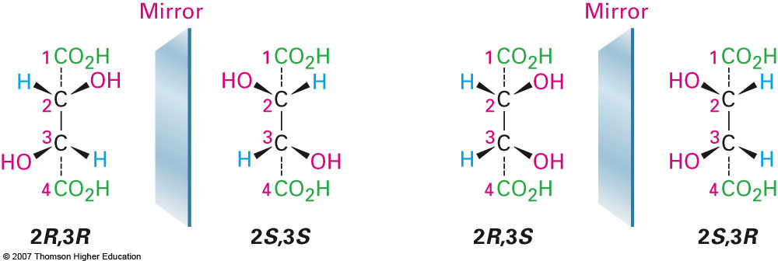
Section 9.7 Meso Compounds
Consider the 4 stereoisomers of tartaric acid shown below:
Do these compounds contain chiral centers?
Are they actually chiral?

Slide 13
Section 9.8 Racemic Mixtures and the Resolution of Enantiomers
A racemic mixture is simply a 50/50 mixture of both enantiomers of a compound
If both enantiomers are present in an exact 1:1 ratio then all optical activity is lost (the mixture will not rotate a polarized plane of light)
It is possible to resolve a racemic mixture in several ways:
Use a series of reactions to produce the diastereomer
Diasteromers are different compounds and therefore have different chemical and physical properties which can be taken advantage of
Use a form of chromatography that is capable of separating enantiomers
Fractional crystallization

Slide 14
Section 9.9 A Review of Isomerism
Isomers
Constitutional Isomers
Stereoisomers
Enantiomers
Diastereomers

Slide 15
Section 9.12 Chirality at Nitrogen, Phosphorous, and Sulfur
It is possible for chirality to exist at centers other than carbon
Nitrogen: Chirality possible but rapid inversion at the nitrogen atom leads to the loss of chirality ( a single enantiomer cannot be observed)
Phosphorous: Inversion at phosphorous atoms is slower than that of nitrogen and enantiomers can be isolated
Sulfur: The only possibilities for sulfur are sulfonium salts (R₃S⁺) which behave as phosphines and can be isolated as separate enantiomers

Slide 16
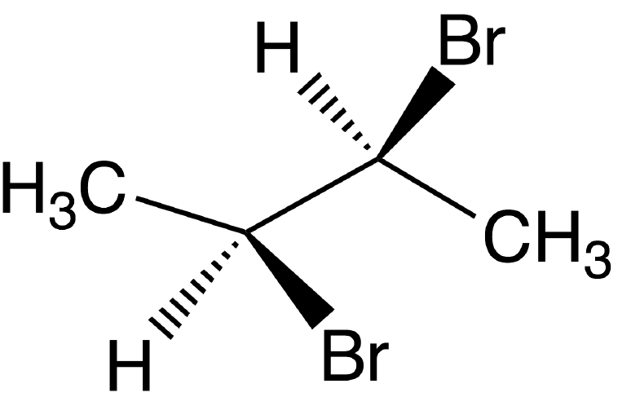
Examples

Slide 17
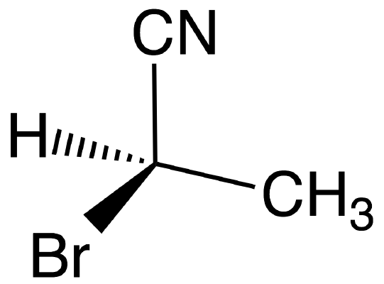
Examples

