Slide 1


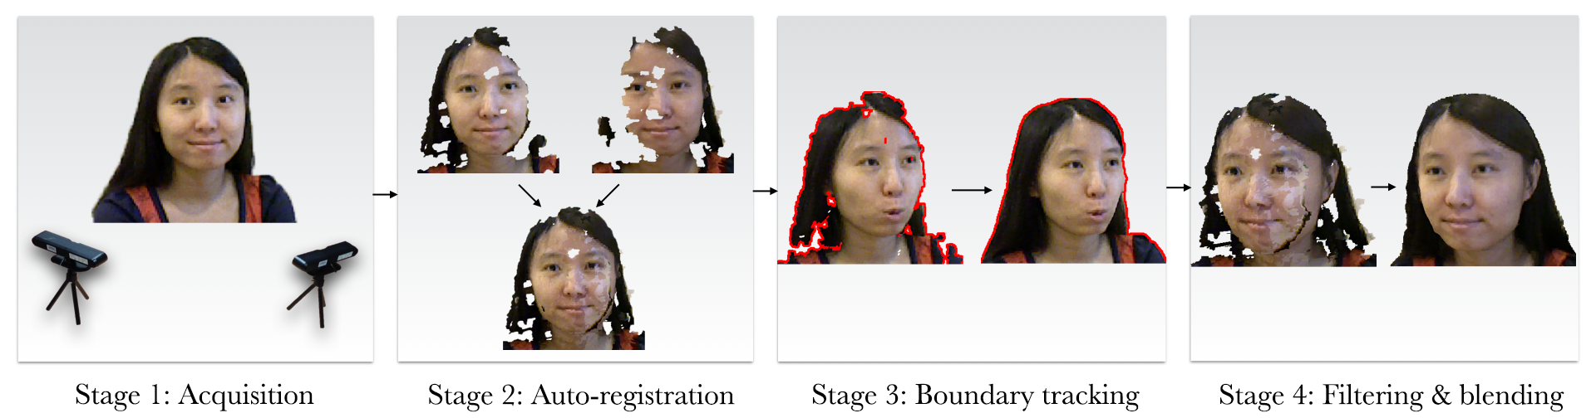
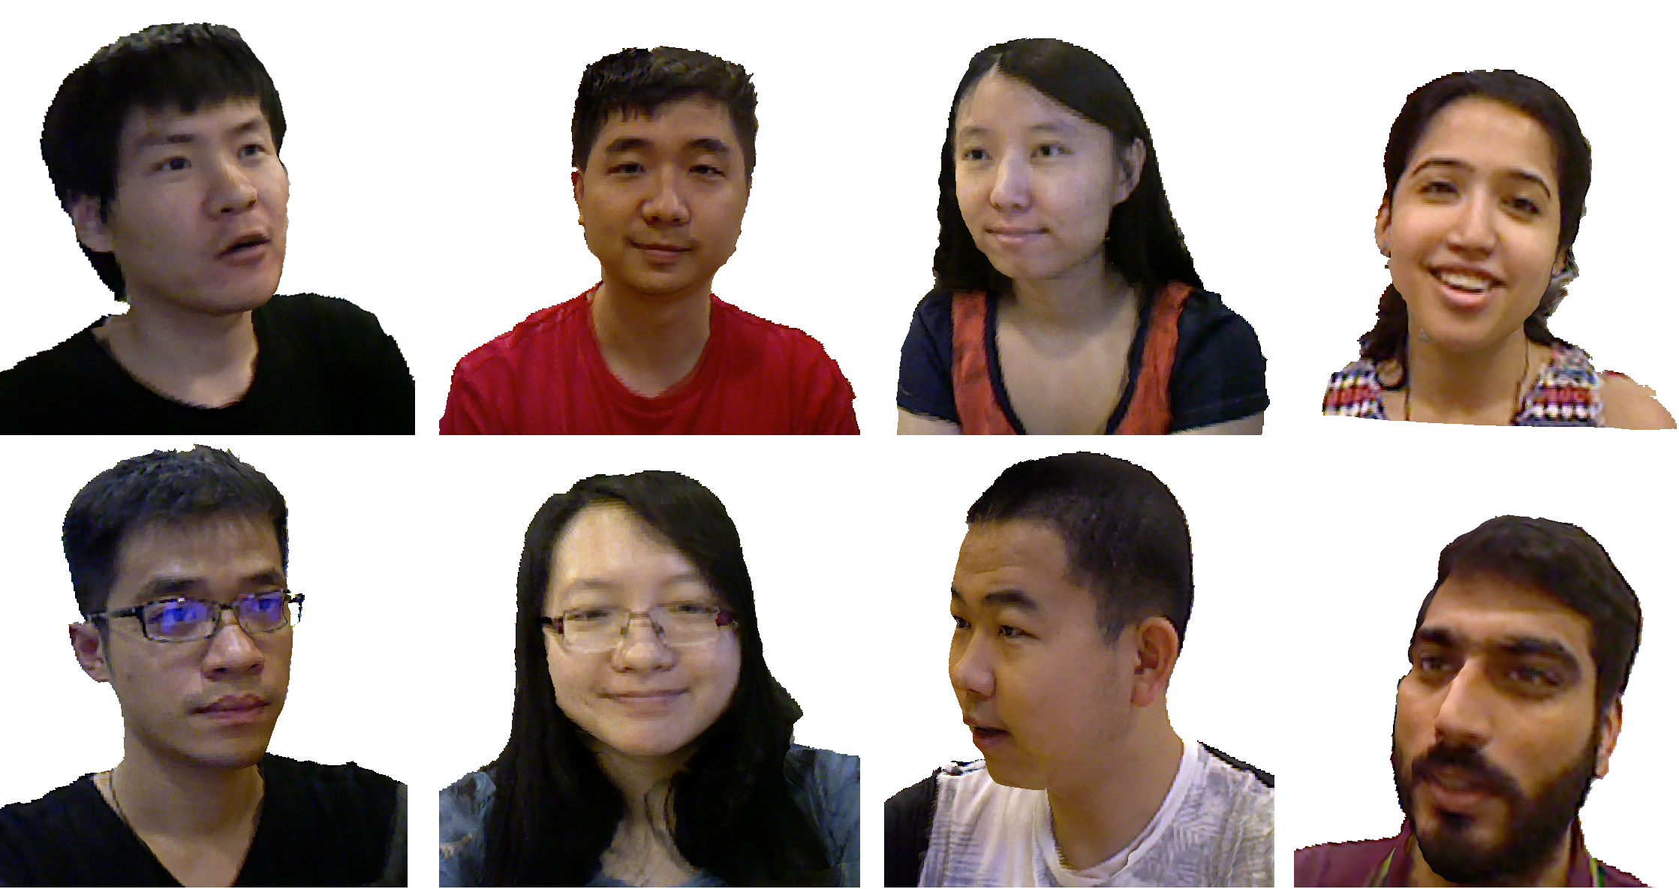


FaceCollage: A Rapidly Deployable System for Real-time
Head Reconstruction for On-The-Go 3D Telepresence
Fuwen Tan1, Chi-Wing Fu2, Teng Deng3, Jianfei Cai3, Tat-Jen Cham3
1University of Virginia, 2The Chinese University of Hong Kong, 3Nanyang Technological University
Introduction
Stage 4: Filtering & Blending
FaceCollage, a rapidly deployable system for robust and real-time 3D head reconstruction, aiming to fill the demand gap between 2D basic videoconferencing software and complex 3D telepresence system.
Key advantages:
Simple to deploy: two consumer-grade RGBD cameras with single PC.
Effective integration of two RGBD live streams.
Realistic 3D head reconstruction and automatic adaptation to sudden movement.
Geometry preprocessing for removing artifacts.
Cross filtering for geometry consistency.
$$f_{V}\left(x,t\right)=\frac{1}{N(x,t)}\sum_{(x^{′},t^{′})∈N(x,t)}{(w_{c}w_{d}w_{s}d_{V}\left(x^{′},t^{′}\right)+{\tilde{w}}_{c}{\tilde{w}}_{d}{\tilde{w}}_{s}(d_{\tilde{V}}(x^{′},t^{′})))}$$
Alpha blending for texture consistency.
$$I\left(P\right)=\frac{w_{1}⋅I_{l}\left(P\right)+w_{2}⋅I_{r}(P)}{w_{1}+w_{2}}$$
where $w_{1}={\left(n_{p}⋅v_{l}\right)}^{2}$ and $w_{2}={\left(n_{p}⋅v_{r}\right)}^{2}$.
System Overview
Four computational stages:
Figure 1. An overview of our system.
Stage 2: Auto-registration
Performance
The calibration of two cameras is preformed by directly registering the two partial 3D face models based on face features.
Face Data Collection and Preprocessing.
Initial Face Alignment through face features.
Iterative Refinement though dense correspondences by minimizing the Horn-Schunck energy.
$$E\left(w\right)=\int_{Ω}{ψ\left({\left|I_{L}^{D}\left(x+w\right)−I_{R}^{D}\left(w\right)\right|}^{2}\right)dx}+\int_{Ω}{α ψ\left({\left|∇I_{L}^{D}\left(x+w\right)−∇I_{R}^{D}\left(w\right)\right|}^{2}\right)dx}+\int_{Ω}{β{\left|∇w\right|}^{2}dx}$$
Where $Ω$ is the image domain, $w$ is the optimal displacement field between left image $I_{L}^{D}$ and right $I_{R}^{D}$ at frontal direction $D$, $ψ$ is a nonlinear mapping function, and $α$ and $β$ are trade off parameters.
Representative visual results are shown in Figure.2
Time performance.
Online processing performance on Desktop: 39.56ms per frame, 25 FPS.
 | One-Time | Online
Stage | Auto-registration | Boundary tracking | Cross filtering | Alpha blending
Time | 13s ~ 32s | 26ms | 8.3ms | 5.26ms
Stage 3: Boundary Tracking
An effective and efficient boundary tracking method that can locally re-align the depth and the color images through a depth-assisted active contour model.
Figure 2. Qualitative examples of the final output of our system from different viewpoints. Please refer to the supplementary video for animated versions of these results
Contact: DENG TENG Email: dengteng@ntu.edu.sg Tel: (65) 9159-6529

