Slide 1




AI IN HUMAN RESOURCE SYSTEMS
TEAM-14

Slide 2


Problem statement
PROBLEM STATEMENT
AI is becoming increasingly important in the field of HR. It can help automate and streamline HR processes.
The goal of our topic is to develop a Neural network model using synthetic data to determine the factors that are most important in the hiring process.
Identifying the skills and demographic characteristics
By understanding these factors HR professionals can make informed decisions.

Slide 3

CHALLENGES
Bias and fairness
Transparency and interpretability
Skill shortage

Slide 4
Research Papers
Integration of Artificial Intelligence in Human Resources, Ginu George & Mary Thomas
Artificial Intelligence Techniques in Human Resource Management – A Conceptual Exploration, Stefan Strohmeier and Franca Piazza

Slide 5
Key Concepts
AI has increased efficiency in HR -> reducing time spent on non-strategic administrative tasks -> HR managers can focus on the human experience of employees at their company
Optimized the candidate search, interviewing, hiring, and onboarding processes
Leveraged employee data to personalize experience and customize recommendations
Drastically reduced costs

Slide 6
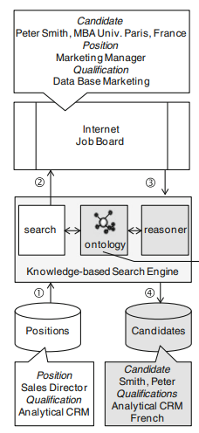
Task Specific Benefits
Talent acquisition & Turnover
Reduced candidate search workload by up to 75% & cost per hire by around 71% (George and Thomas 2019)
Knowledge-Based Search Engines for candidate search and resume screening- groups words that constitute a 'domain' and matches positions with candidates (see figure)
Chatbots (NLP)
90% of employees miss or forget information during orientation -> chatbot automation allows employees to clarify company policies, employee benefits, and other company information -> improving role clarity
Neural Networks for turnover prediction - identify the employees that are likely to leave through classification model based on passed turnover data (Strohmeier and Piazza 2015)

Slide 7
Task Specific Benefits
Learning and Development & Staffing
Better metrics: high volume of data can be used to predict & assess performance levels -> personalize the recommendation of internal career opportunities based on skills and previous project experience
Genetic algorithms assist HR managers by automating staffing - essentially optimization, projects and employees are constrained by skills and how many projects they can work -> updates employee metrics
Allows HR personnel to focus on emerging HR research, stay updated on cutting edge technical resources and learning opportunities
AI can be used to improve efficacy of HR strategies -> continuously updating employee profiles thru feedback surveys -> informs employee support approach

Slide 8
Technical Demo
AI Application in Resume Screening
Synthetic Dataset
Sequential Neural Network Model
Real-World Data Application
https://colab.research.google.com/drive/1iRA1XfGXM3gnmRSVaWr1KdKTWTpKAxlb?usp=sharing

Slide 9
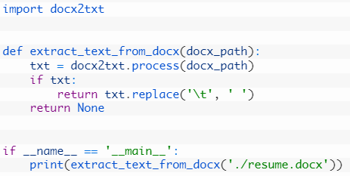
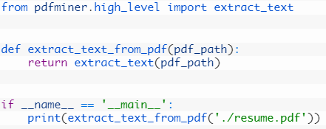
Resume Data Collection
Extracting Text From Resumes – pip install docx2txt
Extracting Fields – Skills, Education, etc.
https://colab.research.google.com/drive/1l0dbTlCyltCUJ5yyHGtyQJF8GbN9QkhM?usp=sharing

Slide 10
Ethical Concerns
Lack of human intelligence
Cultural matches
Privacy Issues
Mining data and consent, collection
Training on bias data can amplify the bias when hiring
Marginalized groups
Accountability – no one is directly responsible
Lack of transparency
Mitigation:
Monitoring recruitment values, guidelines, anonymize data
Auditing and performance checks – unbiased and transparency

Slide 11
CONCLUSION
Our neural network sequential model has demonstrated the potential to improve HR decision-making by predicting whether an employee will be hired or not based on their skills.
Our model also has the potential to reduce the time and resources required for the hiring process, as it can quickly and accurately evaluate a large number of job applicants based on their skills.
We believe that our findings have important implications for organizations seeking to optimize their hiring processes and improve their overall performance.
Thank you for your attention

Slide 12
Works Cited
Eloundou, Tyna, et al. “GPTs Are Gpts: An Early Look at the Labor Market Impact Potential of Large Language Models.” ArXiv.org, 23 Mar. 2023, https://arxiv.org/abs/2303.10130.
George, Ginu, and Mary Rani Thomas. “Integration of Artificial Intelligence in Human Resource.” Integration of Artificial Intelligence in Human Resource, International Journal of Innovative Technology and Exploring Engineering (IJITEE), https://www.researchgate.net/profile/Ginu-George/publication/339351810_Integration_of_Artificial_Intelligence_in_Human_Resource/links/5fc83745a6fdcc697bd79a13/Integration-of-Artificial-Intelligence-in-Human-Resource.pdf.

