Slide 1
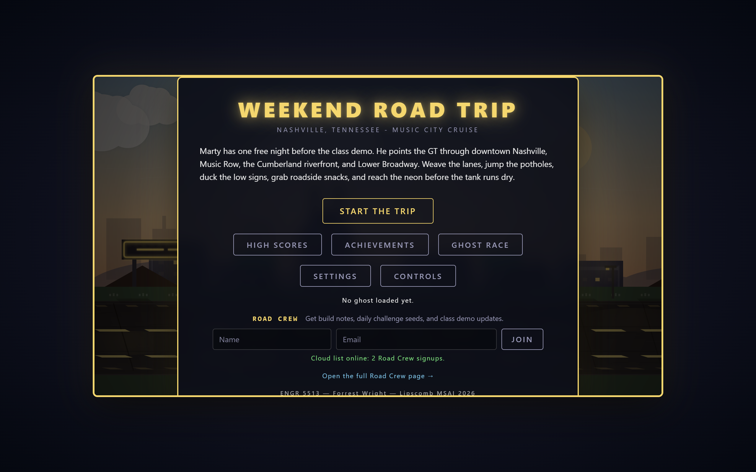
ENGR 5513 · APPLIED AI IN ENGINEERING · FINAL BOSS
WEEKEND
ROAD TRIP
A browser game, shipped like a product: Vercel production + preview deployments, Neon Serverless Postgres, and 7 CI gates on every push.
the production title screen — live right now, Road Crew form wired to Neon
weekend-road-trip-forrestw200.vercel.app
Forrest Wright — Lipscomb MSAI ’26 ENGR 5513, Summer 2026 — Dr. Steve Nordstrom

Slide 2
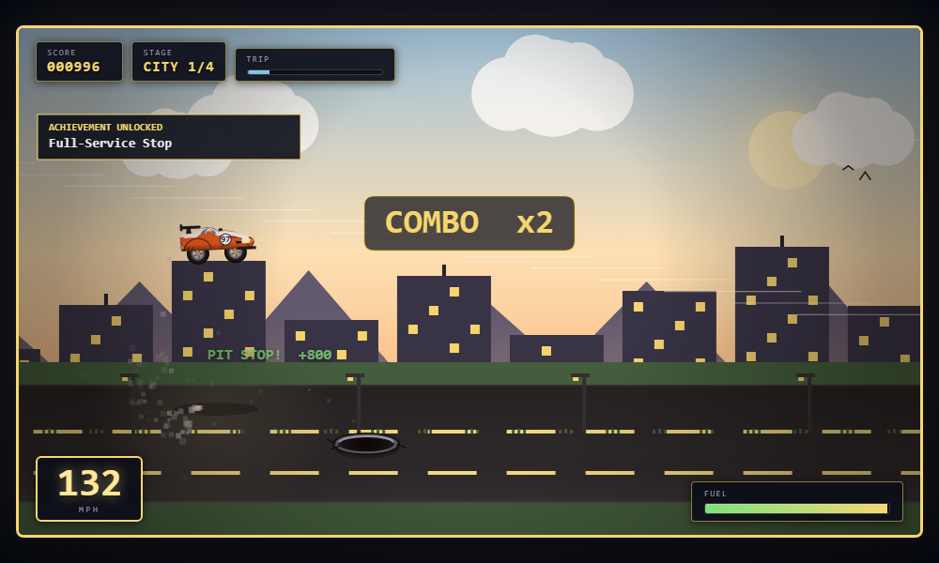
THE GAME
Weekend Road Trip in 30 seconds
THREE LANES + JUMP + DUCK
Throttle is automatic — your inputs are positioning. Difficulty peaks under the Broadway neon.
GHOST RACE
Every run records replay telemetry; export a JSON ghost and a classmate races you asynchronously.
REAL GEOGRAPHY
Parallax scenery anchored to WGS84 landmarks — the Ryman, Music Row, the Cumberland riverfront.
one tank of gas, four legs of Nashville: downtown → Music Row → riverfront → Lower Broadway
PLAYS ANYWHERE
0 ENGINE
0 ASSETS
0 BUILD STEP
Keyboard, gamepad, touch; reduce-motion, colorblind contrast, screen-shake toggle.
vanilla JS + Canvas
procedural art + audio
open index.html
2 / 10

Slide 3
ASSIGNMENT MAP
Five stages — all of them shipped
# | STAGE | SHIPPED AS | STATUS
1 | Basic Next.js app | “Neon Spur Tours” — Next.js App Router app (repo: final-boss-next) | DEPLOYS TONIGHT
2 | Vercel + GitHub integration | Both repos auto-deploy from GitHub on every push — zero manual steps | LIVE
3 | Feature-branch preview deployments | Game PRs #29 & #30 each got a public preview URL before merge; feature/preview-colorway on the Next app | PROVEN
4 | Landing page → emails in Neon, live counter | “Road Crew” signup at /waitlist — validated, upserted, counter live (currently 2) | LIVE
5 | Deploy the game + scores in a database | Weekend Road Trip on Vercel production; cloud leaderboard in Neon game_high_scores | LIVE
Stages 1–4 live in their own repo (final-boss-next); stage 5 is the game repo — same Vercel + Neon pattern at production scale.
3 / 10

Slide 4
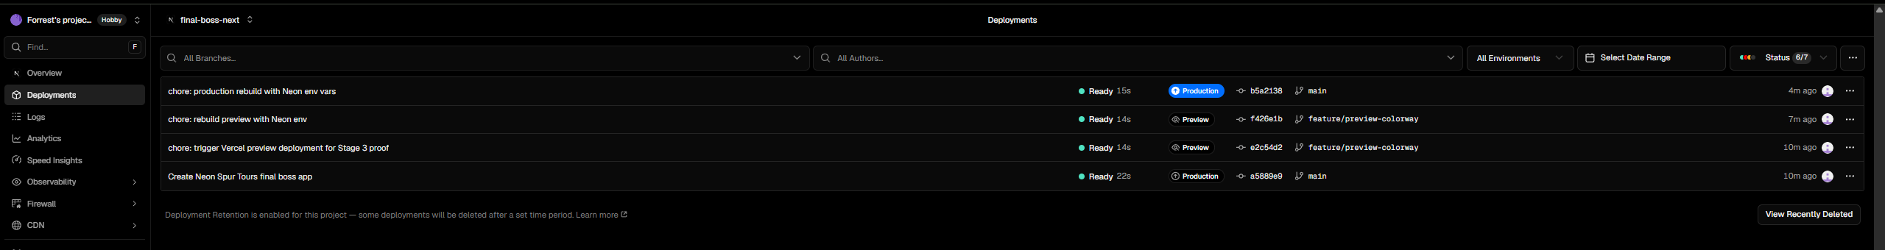
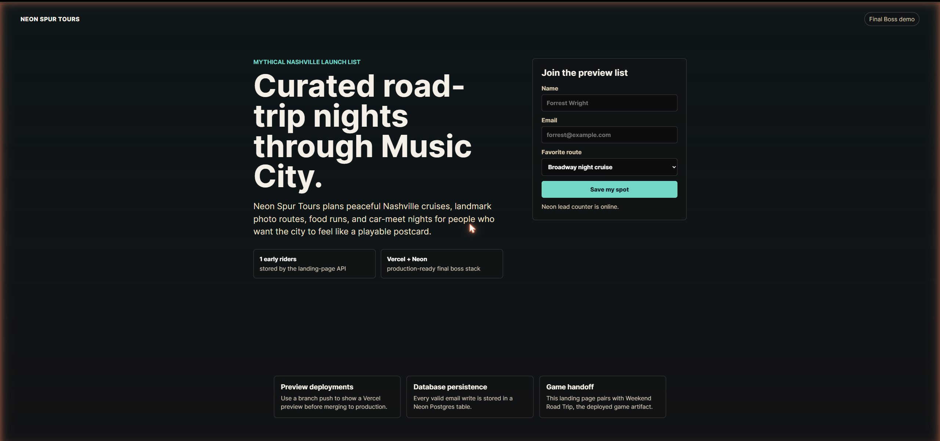
STAGES 1–4
Neon Spur Tours — the Next.js warm-up
THE APP
final-boss-next.vercel.app LIVE · HTTP 200
Next.js App Router landing page collecting email leads through app/api/leads/route.js into Neon Postgres.
THE PREVIEW PROOF
2 Production + 2 Preview deployments — all Ready
Branch feature/preview-colorway restyles the page — its Vercel preview URL shows a change live without touching production.
WHY IT MATTERS
Stages 1–4 rehearse the exact pipeline the game runs at full scale: GitHub → Vercel → Neon, previews before production.
github.com/fwwright1001-coder/final-boss-next
feature/preview-colorway — live on its own preview URL
landing form → Neon neon_spur_leads — counter live: “1 early riders”
4 / 10

Slide 5
DEPLOYMENT ARCHITECTURE
One codebase, three live deployments
github.com/fwwright1001-coder/weekend-road-trip
main @ b0b4156 — every deployed byte is in source control
PRODUCTION
PR PREVIEWS
GITHUB PAGES
weekend-road-trip-
forrestw200.vercel.app
one public URL
per pull request
fwwright1001-coder
.github.io/weekend-road-trip
main branch. Vercel serverless functions live, writing to Neon Postgres.
PRs #29 (game-feel rework) & #30 (landing page) were each playable on their own URL before merge.
Static fallback — Pages can’t run serverless, so the same client degrades to localStorage and says so.
The client detects its surface at runtime — cloud when the API answers, localStorage when it can’t. Both paths are contract-tested in CI.
5 / 10

Slide 6
CI / CD
Every merge earns its way in
push /
open PR
7 CI gates
(GitHub Actions)
Vercel preview
URL on the PR
merge
to main
production
promote
PASS
balance-sim the fairness proof: 500 seeded runs, 10 acceptance criteria — no obstacle layout is unavoidable; skill beats grinding
PASS
highscores API contract 19 checks — cloud leaderboard writes
PASS
highscores client contract 11 checks — local-first save + sync
PASS
run-selftests 19 in-game self-tests, run headlessly
PASS
launch client contract 17 checks — Road Crew form + static fallback
PASS
smoke-dom every JS element reference resolves
PASS
waitlist API contract 20 checks — validation, upsert, 503s
All 7 gates green locally today (2026-06-11). The same suite runs in GitHub Actions on every push and PR — a red gate blocks the merge.
6 / 10

Slide 7
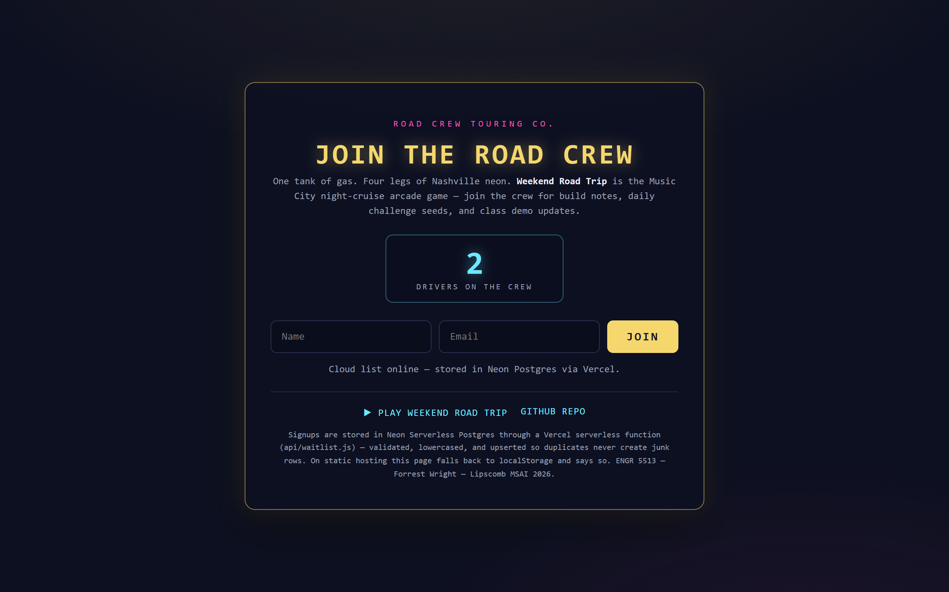
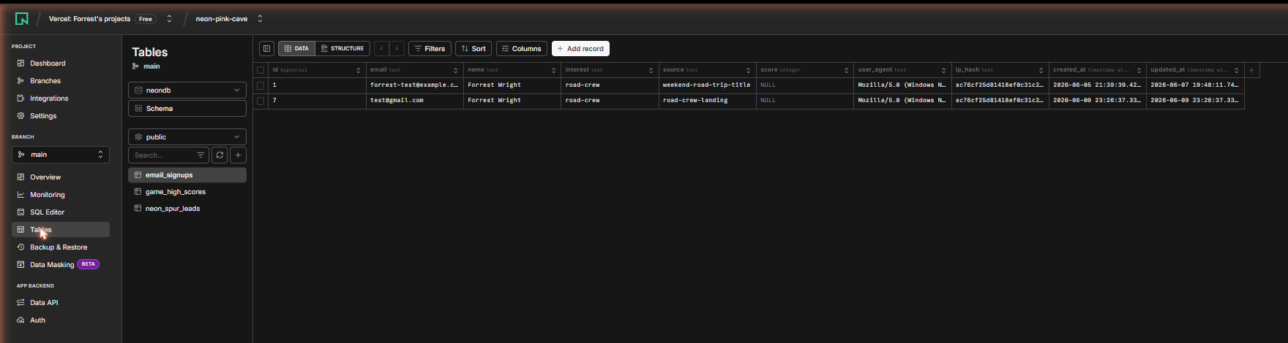
DATA · NEON SERVERLESS POSTGRES
Two tables, zero ways to strand a player
email_signups
Road Crew signups from /waitlist and the title screen.
Validated + lowercased; duplicates upsert one row — the live counter can’t be inflated. No raw IPs stored, only a short salted hash.
game_high_scores
The cloud leaderboard.
Scores save to localStorage FIRST, then sync to Neon — a failed cloud write can never trap the player on a saving screen.
live now: the Road Crew counter, served from Neon
api/waitlist.js + api/highscores.js auto-create their schema on first use; missing env vars return a clean 503 with a setup message — never a crash.
Neon console — email_signups rows, all three tables
7 / 10

Slide 8
HOW IT WAS BUILT
Agents propose. Checks dispose.
PARALLEL BUILD
$ node sim/balance-sim.js
[2] no unavoidable blockers ... PASS
[5] jump span < min gap ....... PASS
[6] open lane reachable ....... PASS
[7] skill dominates (12.6x) ... PASS
ACCEPTANCE: ALL CRITERIA MET ✔
4 AI agents in isolated git worktrees, each owning one lane of the codebase, integrating through written cross-component contracts.
ADVERSARIAL REVIEW
A 6-reviewer pass independently re-verified every finding before it counted: 10 real bugs confirmed — all fixed, all re-gated.
THE RULE
No AI-authored change merged unless the balance sim and self-tests stayed green. The machine, not the model, has the final say.
THE RECEIPT
The sim caught a layout where the jump arc (654 px) outgrew the obstacle gap (460 px) at escalated speed — physically unsolvable. Flagged in design, never shipped.
Honest scope: this is AI orchestration + software engineering — no machine-learning claims. Full split in AI-CONTRIBUTIONS.md.
8 / 10

Slide 9
LIVE DEMO · 5 MINUTES
Nothing pre-recorded. All of it is live.
1
Join the Road Crew on /waitlist — watch the Neon counter tick up live
2
Play a run on production — lanes, jumps, near-miss combos
3
Finish → enter initials → the cloud leaderboard renders from Neon
4
Vercel dashboard — production + the PR preview deployments
5
Neon console — the rows we just wrote, in both tables
6
GitHub Pages fallback — same game, localStorage mode
weekend-road-trip-forrestw200.vercel.app
…vercel.app/waitlist
fwwright1001-coder.github.io/weekend-road-trip
If the Wi-Fi dies: GitHub Pages + localStorage demos every game feature offline.
9 / 10

Slide 10

VERIFY EVERYTHING
Every claim here is checkable tonight
PLAY
READ · GITHUB.COM
production weekend-road-trip-forrestw200.vercel.app
road crew …vercel.app/waitlist
fallback fwwright1001-coder.github.io/weekend-road-trip
game repo fwwright1001-coder/weekend-road-trip
stages 1–4 fwwright1001-coder/final-boss-next
docs DEPLOYMENT · ARCHITECTURE · AI-CONTRIBUTIONS
Questions — or export a ghost JSON
and race me on your machine.
Forrest Wright · ENGR 5513 Applied AI in Engineering · Lipscomb MSAI · Summer 2026
the ghost car — racing a saved replay

