Slide 1
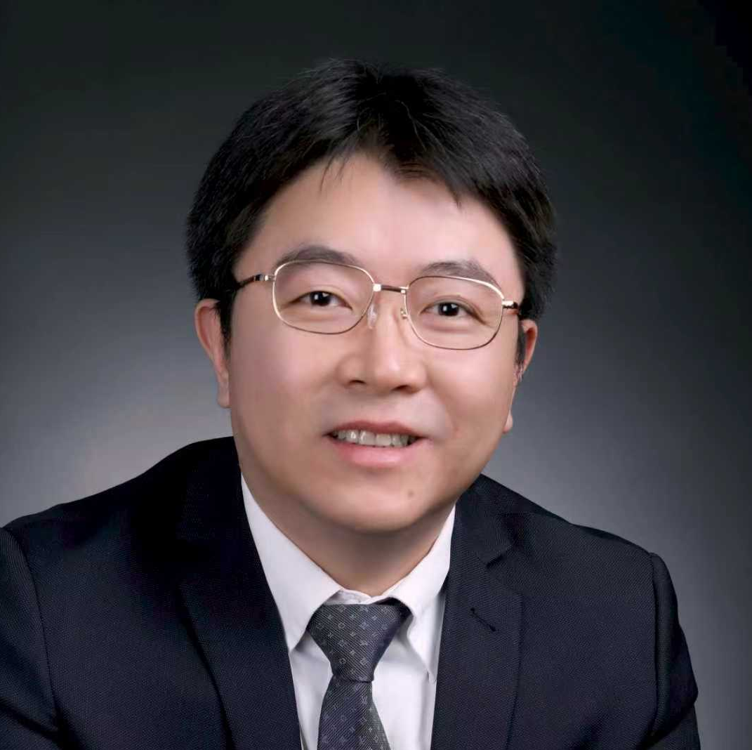
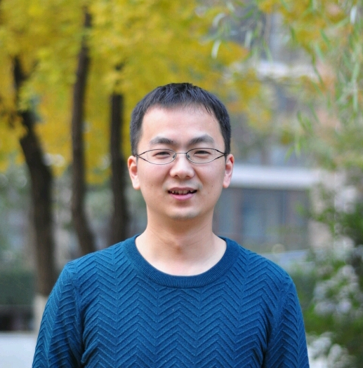
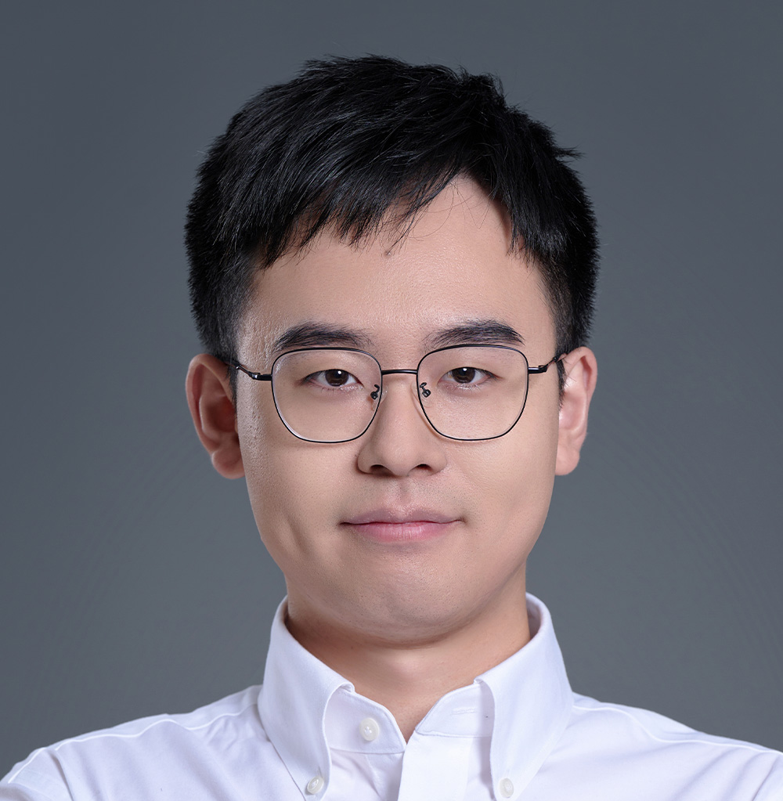
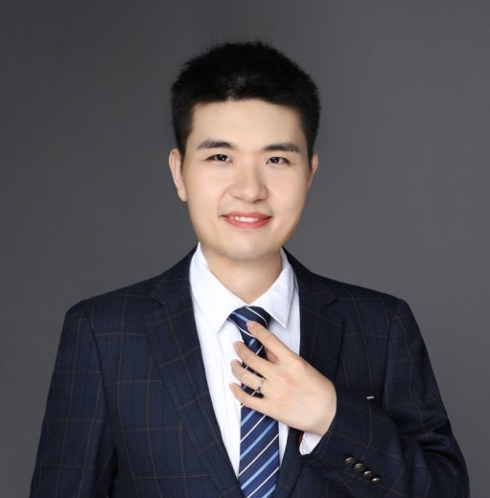
Panel: Bridging the gap between LLM and intelligent applications
Prof. Ji-Rong Wen
Renmin University of China
Dr. Zhenyu Guo
Ant Group
Prof. Minchen Yu
CUHK
Dr. Bojie Li
Pine AI

