Slide 1



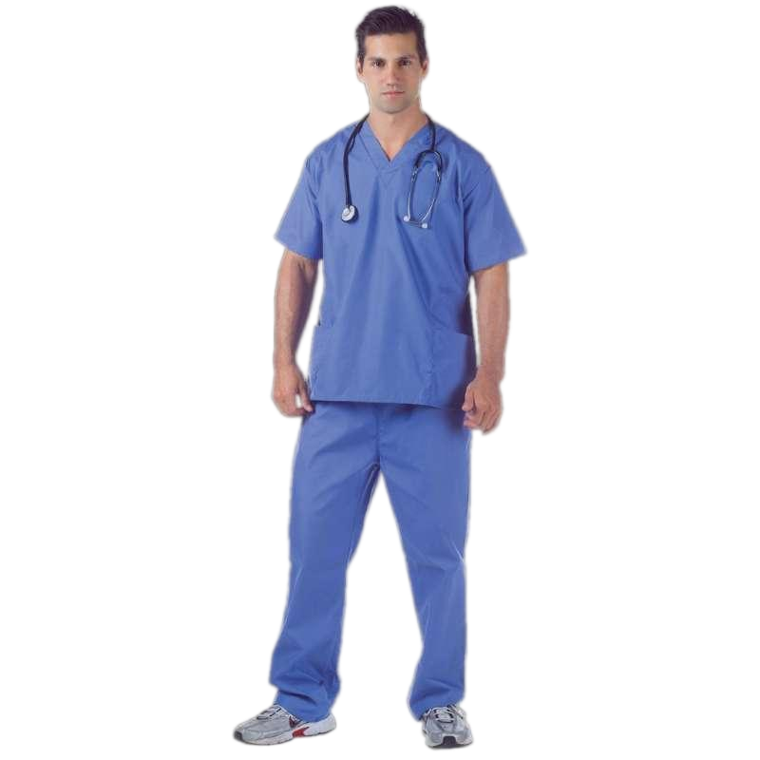


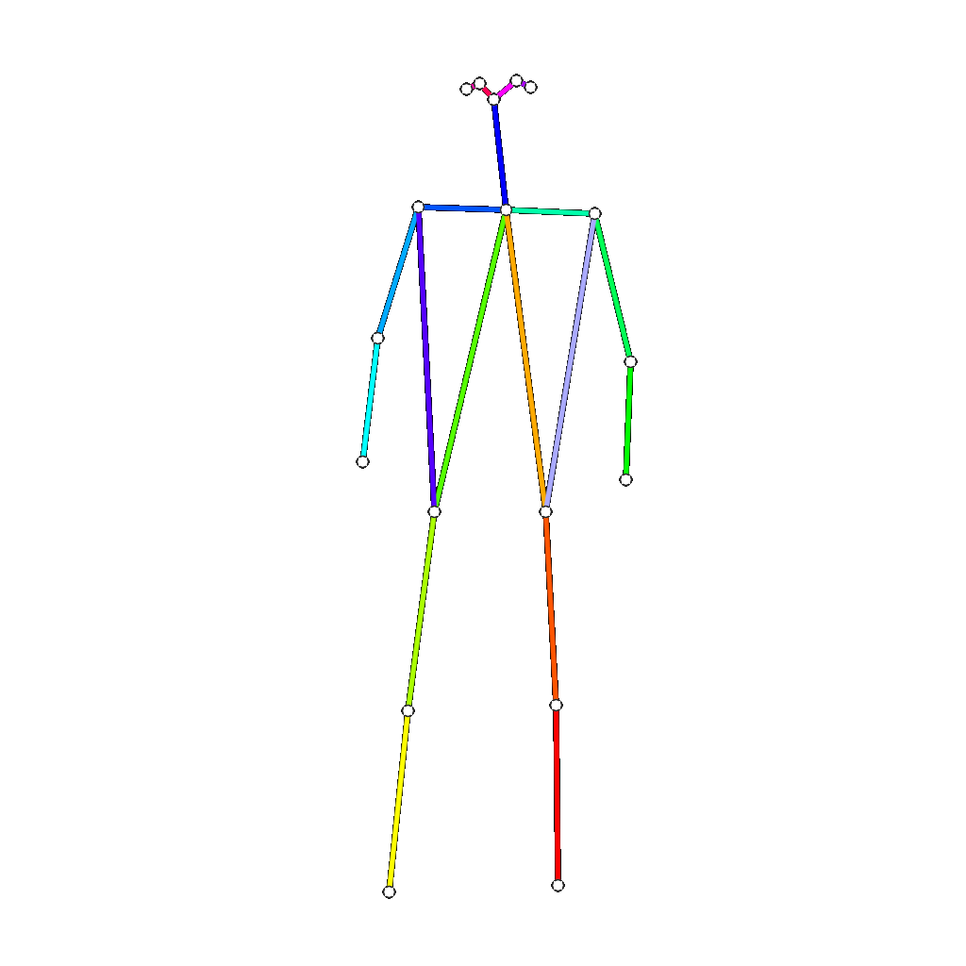
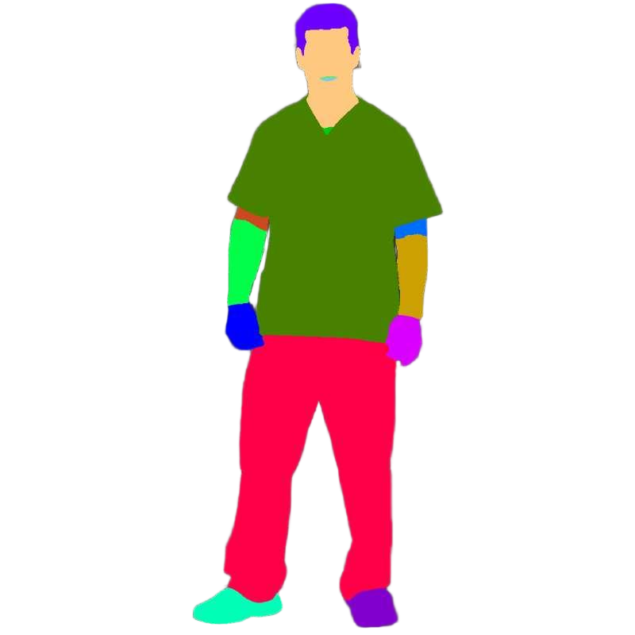
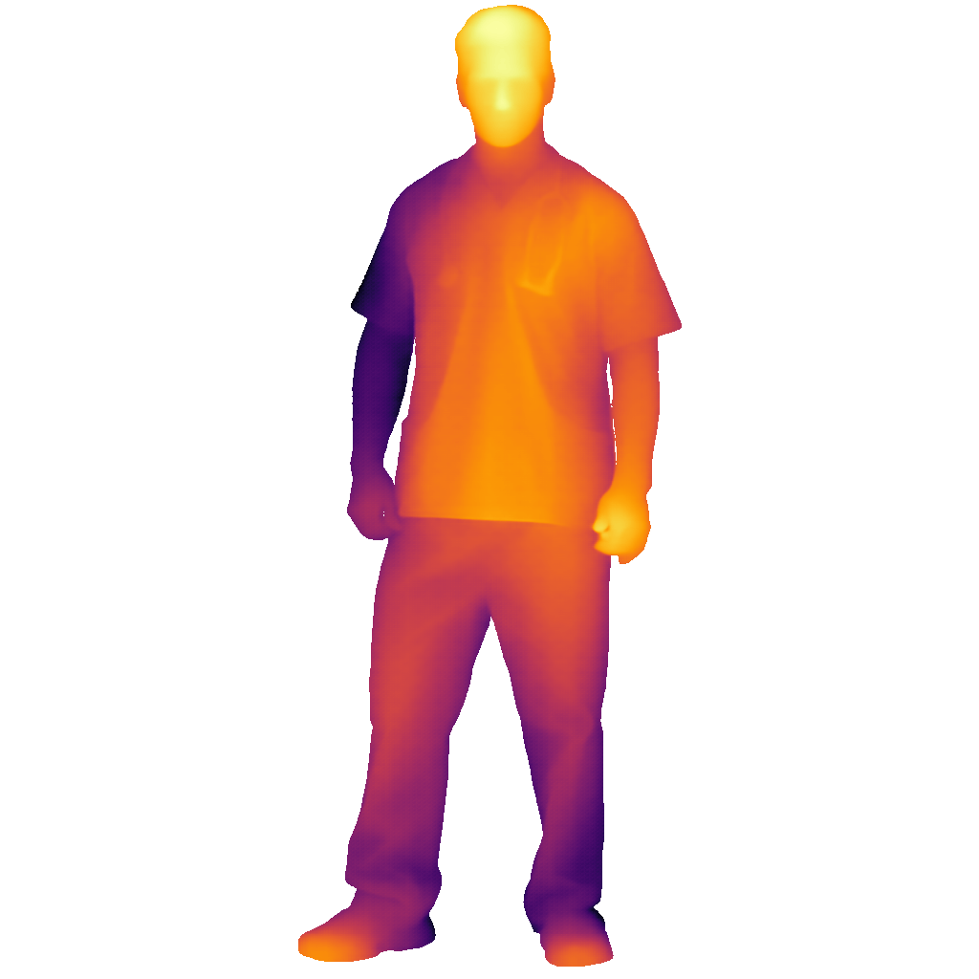
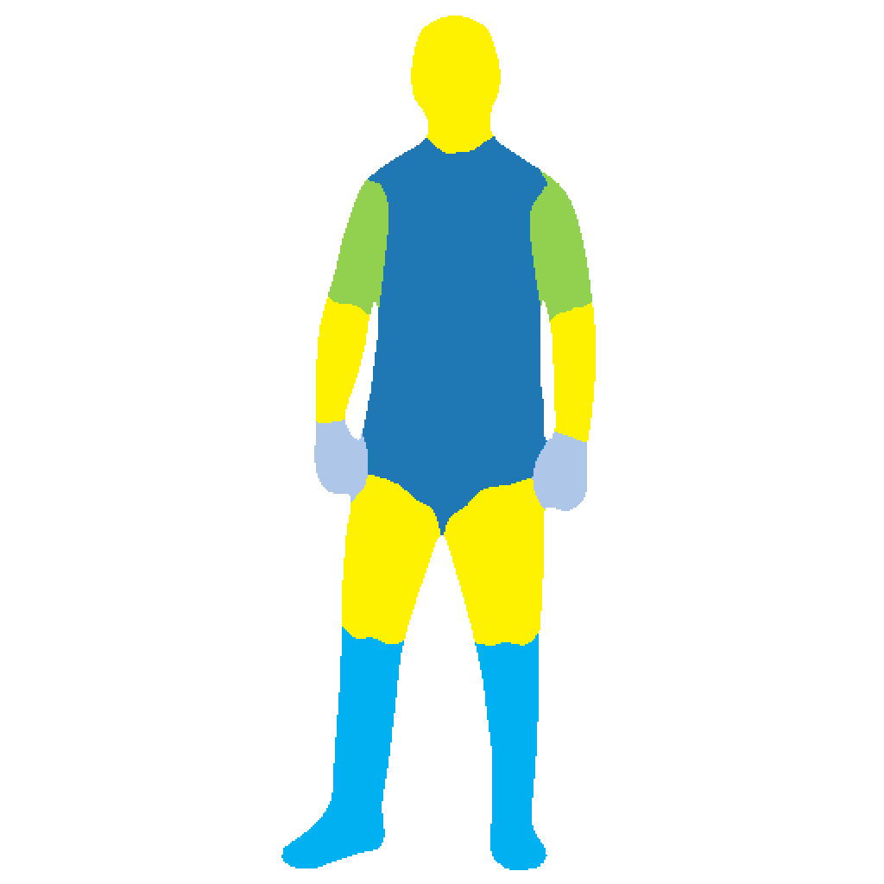
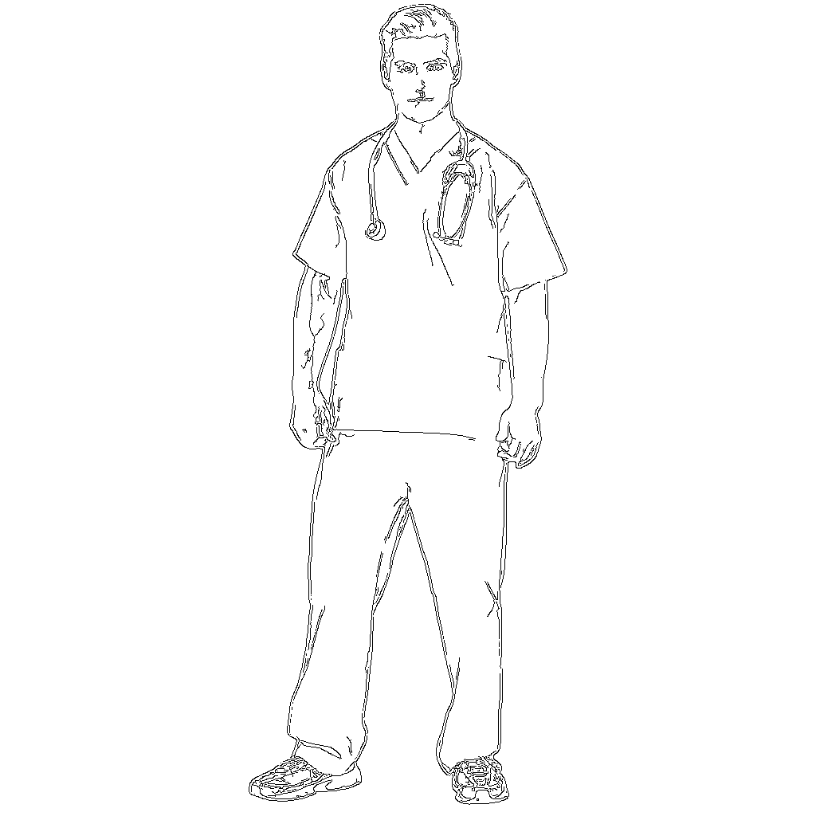
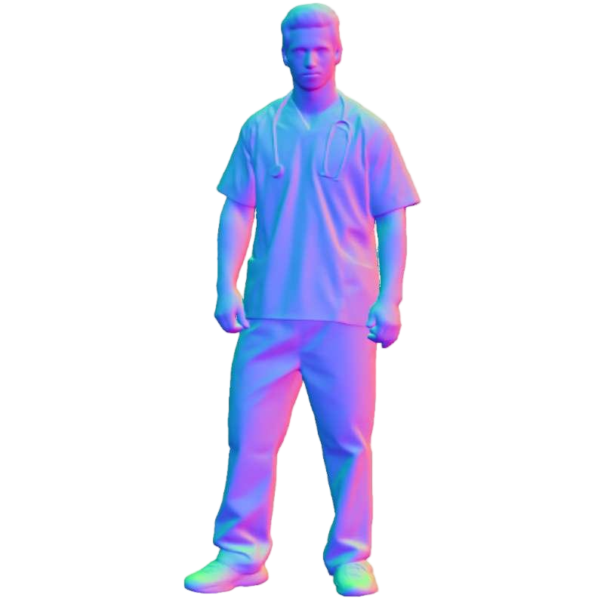

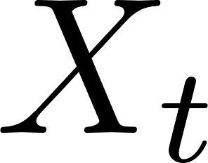
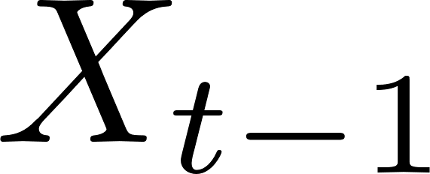

(a) HumanFlow
(b) Illustration of Notation
Token-ControlNet
Image Token
Adding
Trainable
Control
Encoder
Text Token
Control Token
Frozen
Control Condition
(c) Control Condition
Double Stream
Block 0
Double Stream
Block i
…
Zero-Linear
Zero-Linear
VAE
Encoder
Keypoint
Segmentation
Depth
Densepose
Canny
Normal
Input Image
Double Stream
Block 0
Double Stream
Block i
Single Stream
Block 0
Single Stream
Block j
VAE
Decoder
…
…
Prompt: A short-haired man is wearing a blue surgical gown
Text
Encoder
FLUX Backbone
Output Image

