Slide 1
Enumerations & Autoboxing

Slide 2
Enumeration Fundamentals
An enumeration is a list of named constants that define new data type and its legal values.
Can hold values that was declared in the list
Java enumerations appear similar to enumerations in other
languages, but similarity is only skin deep.
In C++, enumerations are simply lists of named integer constants.
In Java, enumeration defines a class type.
  Ex: Enumerations can have constructors, methods and instance variables.

Slide 3
Enumeration Fundamentals
An enumeration is created using the enum keyword.
enum Apple
{
Jonathan, GoldenDel, RedDel, Winesap, Cortland
}
The identifiers Jonathan, GoldenDel, and so on are called
enumeration constants.
Each is implicitly declared as a public, static final member of
Apple.
Their type is the type of the enumeration in which they are
declared, which is Apple here.
Once we have defined an enumeration, we can create a variable of
that type.

Slide 4
For ex. Apple ap;
ap is of type Apple, the only values that it can be assigned are those
defined by enumeration.
For ex. ap = Apple.RedDel
Two enumeration constants can be compared for equality by using
the = = relation operator.
For ex. if (ap = = Apple.GoldenDel1)….
When an enumeration constant is displayed using println(), its name
is output.
For ex. System.out.println(Apple.winesap);
  out put is Winesap

Slide 5
An enumeration value can also be used to control a switch statement.
all of the case statements must use constants from the same enum as that used by the switch expression.
  For example, this switch is perfectly valid:
// Use an enum to control a switch statement.
switch(ap) {
case Jonathan:
// ...
case Winesap:
// ...
case statements, the names of the enumeration constants are used without being qualified by their enumeration type name.
That is, Winesap, not Apple.Winesap, is used.
This is because the type of the enumeration in the switch expression has already implicitly specified the enum type of the case constants.

Slide 6
There is no need to qualify the constants in the case statements with their enum type name.
In fact, attempting to do so will cause a compilation error

Slide 7
public enum Apple
{
Jonathan, GoldenDel, RedDel, Winesap, Cortland
}
public class EnumDemo
{
public static void main(String args[])
{
Apple ap;
ap=Apple.RedDel;
System.out.println("Value of ap:"+ap);
ap=Apple.GoldenDel;
if(ap==Apple.GoldenDel)
System.out.println("ap contains GoldenDel");

Slide 8
switch(ap)
{
case Jonathan : System.out.println("Jonathan is red");
break;
case GoldenDel : System.out.println("Golden is yellow");
break;
case RedDel : System.out.println("Red Delicious is red");
break;
case Winesap : System.out.println("Winesap is red");
break;
case Cortland : System.out.println("Cortland is red");
break;
}
}
}
output:Value of ap: RedDel
ap contains GoldenDel.
Golden Delicious is yellow.

Slide 9
The values() and valueOf() Methods
All enumerations automatically contain two predefined methods:
public static enum-type[] values() : - returns an array that contains a
list of the enumeration constants.
public static enum-type[] valueOf(String str) :- returns the
enumeration constant whose value corresponds to the string passed
in str.

Slide 10
public class EnumDemo2
{
public static void main(String args[])
{
Apple ap;
System.out.println("Here are all Apple constants: ");
Apple allapples[]= Apple.values();
for(Apple a: allapples)
System.out.println(a);
for(Apple a: Apple.values())
System.out.println(a);
System.out.println("ap contains :"+Apple.valueOf("RedDel"));
}}
enum Apple{ Jonathan, GoldenDel, RedDel, Winesap, Cortland}

Slide 11
OUTPUT:
Here are all Apple constants:
Jonathan
GoldenDel
RedDel
Winesap
Cortland
Jonathan
GoldenDel
RedDel
Winesap
Cortland
ap contains:RedDel

Slide 12
Type Wrappers
Java uses primitive types such as int or double to hold the basic data
types supported by the language.
Primitive types use these quantities for the sake of
performance.
Using objects for these values would add an unacceptable overhead
even for the simple calculations.
Thus, the primitive types are not part of the object hierarchy, and they do not inherit Object. But sometimes we will need an object representation.
Many of the standard data structures implemented by java operate
on objects, which means we can’t use these data structures to store
primitive types.
To handle this situation, java provides type wrappers which are
classes that encapsulate a primitive type within an object.

Slide 13
Wrapper classes in Java
The wrapper class in Java provides the mechanism to convert primitive into object and object into primitive.
Since J2SE 5.0, autoboxing and unboxing feature convert primitives into objects and objects into primitives automatically.
The automatic conversion of primitive into an object is known as autoboxing and vice-versa unboxing.
Use of Wrapper classes in Java
Java is an object-oriented programming language, so we need to deal with objects many times like in Collections, Serialization, Synchronization, etc.
different scenarios, where we need to use the wrapper classes are,
Change the value in Method: Java supports only call by value.
So, if we pass a primitive value, it will not change the original value. But, if we convert the primitive value in an object, it will change the original value

Slide 14
Serialization: We need to convert the objects into streams to perform the serialization.
If we have a primitive value, we can convert it in objects through the wrapper classes.
Synchronization: Java synchronization works with objects in Multithreading. java.util package:
The java.util package provides the utility classes to deal with objects.
Collection Framework: Java collection framework works with objects only.
All classes of the collection framework (ArrayList, LinkedList, Vector, HashSet, LinkedHashSet, TreeSet, PriorityQueue, ArrayDeque, etc.) deal with objects only.

Slide 15
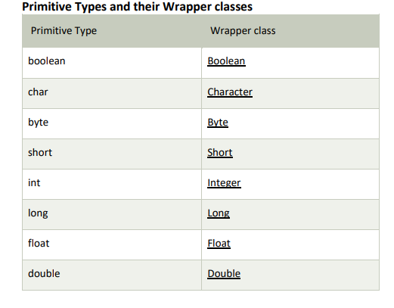

Slide 16
Type wrappers are Double, Float, Long, Integer, Short, Byte,
Character and Boolean.
These classes offer a wide array of methods that allow to fully
integrate the primitive types into java’s object hierarchy.
Character
Character is a wrapper around a char.
  Constructor : Character (char ch)
  static Character valueOf(char ch)
  ch specifies the character that will be wrapped by the Character
  object being created.
char charValue() : obtains the char value contained in a Character
object.
It returns the encapsulated character.

Slide 17
Boolean
Boolean is a wrapper around boolean values.
Boolean(boolean boolValue)
Boolean(String boolString)
In first version, boolValue must be either true or false.
In second version, if boolString contains the string “true”, then the
new Boolean object will be ture. Else it will be false.
boolean booleanValue() : obtains a boolean value from a Boolean
object.
It returns the boolean equivalent of the invoking boject.

Slide 18
The Numeric Type Wrappers
These are Byte, Short, Integer, Long, Float and Double.
All of the numeric type wrappers inherit the abstract class Number.
Number declares methods that return the value of an object in each
of the different number formats.
  byte byteValue() : returns the value of an object as byte.
  double doubleValue() : returns the value of an object as double.
  float floatValue() : returns the value of an object as float.
  int intValue() : returns the value of an object as int.
  long longValue() : returns the value of an object as long.
  short shortValue() : returns the value of an object as short.

Slide 19
All of the numeric type wrappers define constructors that allow an
object to be constructed from a given value or a string
representation of that value.
Integer(int num)
Integer(String str)
If str does not contain a valid numeric value, then a NumberFormat
Exception is thrown.
All of the type wrappers override toString(). It returns the human-
readable form of the value contained within the wrapper.

Slide 20
public class wrap {
public static void main(String args[]) {
// boxing
Integer iob= new Integer(100);
//unboxing
int i=iob.intValue();
System.out.println(i+ " " + iob);
}
}
Boxing : The process of encapsulating a value within an object.
Unboxing : The process of extracting a value from a type wrapper.

Slide 21
Autoboxing
Autoboxing is the process by which a primitive type is automatically
encapsulated into its equivalent type wrapper whenever an object of
that type is needed.
Auto-unboxing is the process by which the value of a boxed object
is automatically extracted from a type wrapper when its value is
needed.
There is no need to call a method such as intValue() or
doubleValue().
Auto-un/boxing is very important to generics, which operates only
on objects.

Slide 22
public class Autobox
{
public static void main(String args[])
{
Integer iob = 10; // autobox an int
int i=iob; // auto-unbox
System.out.println(i+ " " + iob);
}
}

Slide 23
AutoBoxing and methods
Autoboxing/unboxing might occur when an argument is passed to a
method, or when a value is returned by a method.
public class AutoBox1
{
static int m(Integer v)
{
return v; //auto-unbox to int
}
public static void main(String args[])
{
Integer iob = m(100);
System.out.println(iob);
}
}

Slide 24
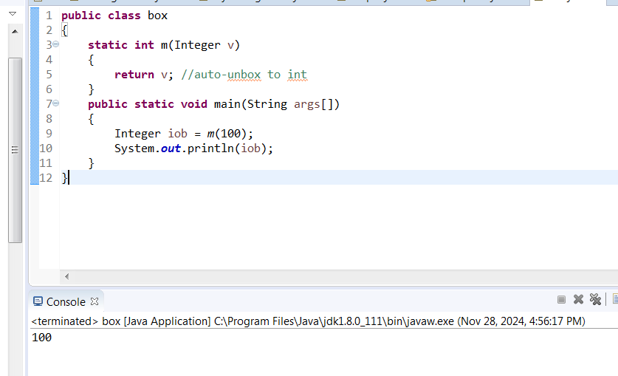

Slide 25
Autoboxing/Unboxing Occurs in Expressions
public class AutoBox3
{
public static void main(String args[])
{
Integer iob, iob2;
int i;
iob=100;
System.out.println("Original value of iob : "+iob);
++iob; // unboxes iob, increments & then reboxes result to iob
System.out.println("After ++iob: "+iob);

Slide 26
I iob2=iob+(iob/3); // unboxes iob, evaluated & then result is reboxed and assigned to iob2
System.out.println("iob2 after expression: "+iob2);
i=iob+(iob/3); // result is not reboxed.
System.out.println("i after expression: "+i);
}
}
After ++iob: 101
iob2 after expression: 134
i after expression: 134

Slide 27
public class AutoBox4 {
public static void main(String args[]){
Integer iob= 100;
Double dob=98.6;
dob=dob+iob;
System.out.println("dob after expression: "+dob);
}
}
dob after expression: 198.6

Slide 28
Autoboxing/Unboxing Boolean and Character Values
Java also supplies wrappers for boolean and char. These are
Boolean and Character.
public class AutoBox5
{
public static void main(String args[])
{
Boolean b=true;
if(b) // b is auto-unboxed
System.out.println("b is true");
Character ch = 'x'; // box
char ch2=ch; //unbox
System.out.println("ch2 is "+ch);
}
}
Output:
b is true
ch2 is x

Slide 29
Autoboxing/Unboxing Helps prevents Errors
Autoboxing/Unboxing helps to prevent errors.
public class UnboxingError {
public static void main(String args[]){
Integer iob=1000;
int i=iob.byteValue();
System.out.println(i);
}
}
Above program outputs -24 as out instead of 1000.
Because value of iob is manually unboxed by callling byteValue(),
which causes the truncation of the value stored in iob.
This results in garbage value of -24 getting assigned to i.
Auto-unboxing prevents this type of error because the value in iob
will always auto-unbox into a value compatible with int.

Slide 30
A word of warning
Double a,b,c;
a=10.0;
b=4.0;
c=Math.sqrt(a*a+b*b);
System.out.println("Hypotenuse is "+c);
Thought the above code is technically correct, it is a very bad use
of autoboxing/unboxing.
The reason is that each autobox and auto-unbox adds overhead that
is not present if the primitive type is used.
One should restrict the use of the type wrappers to only those cases
in which an object representation of a primitive type is required.

