Slide 1

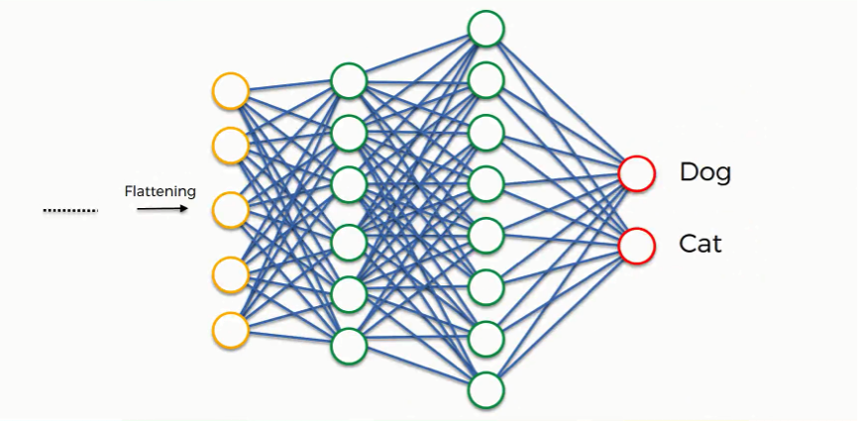
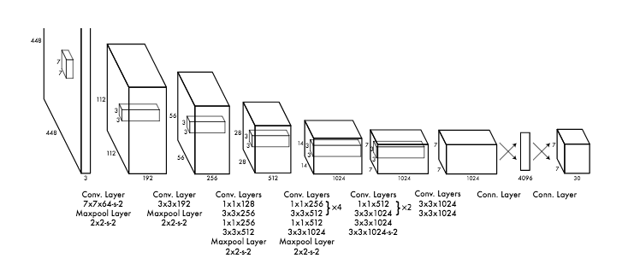
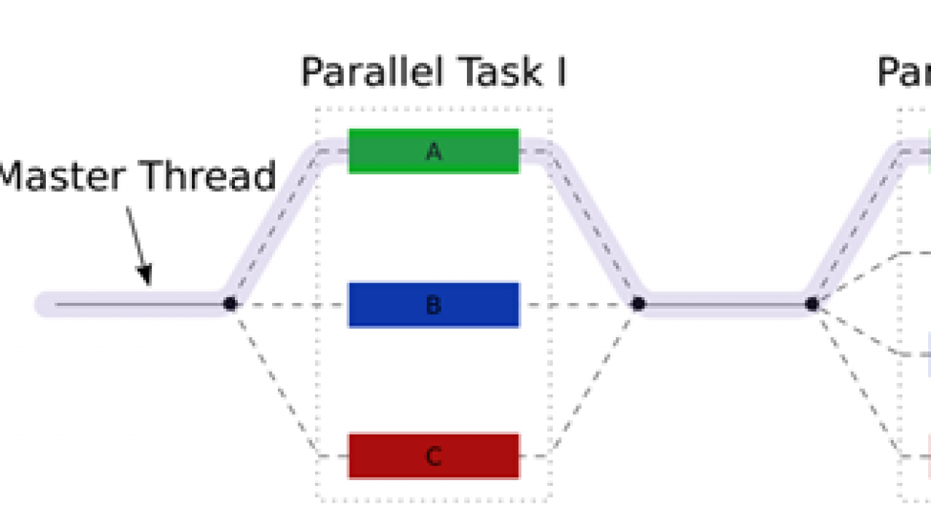
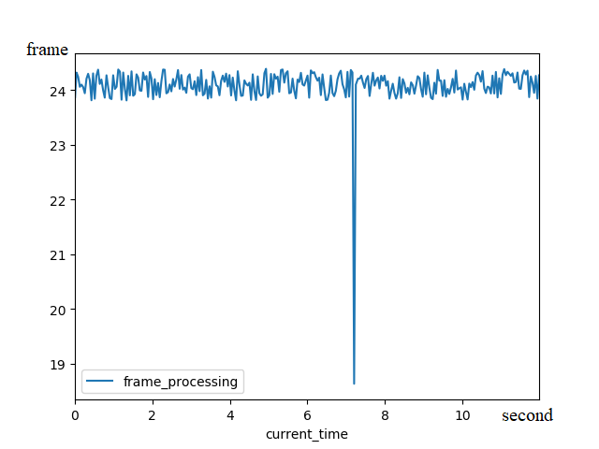
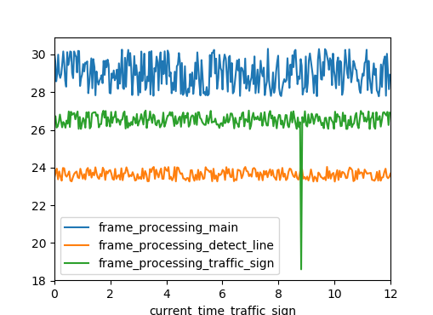
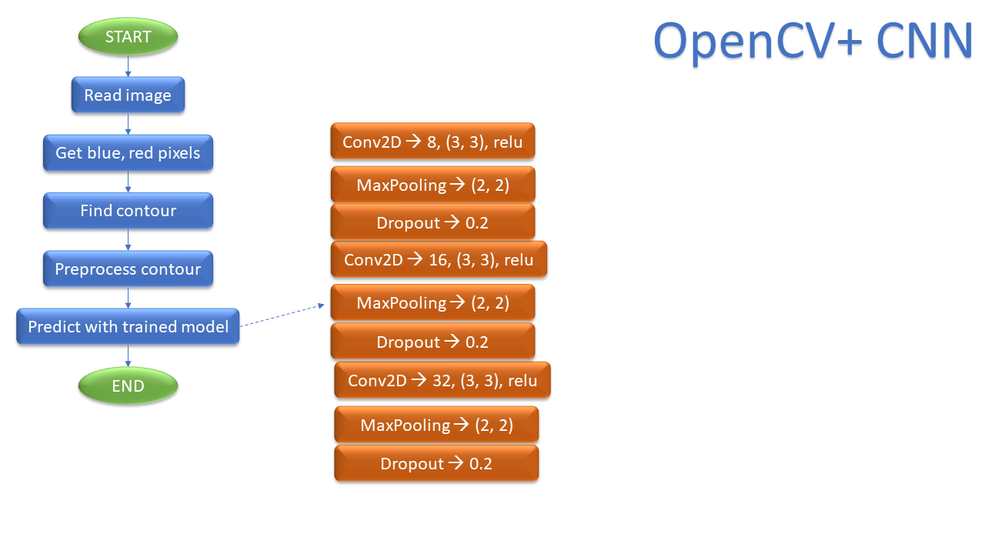
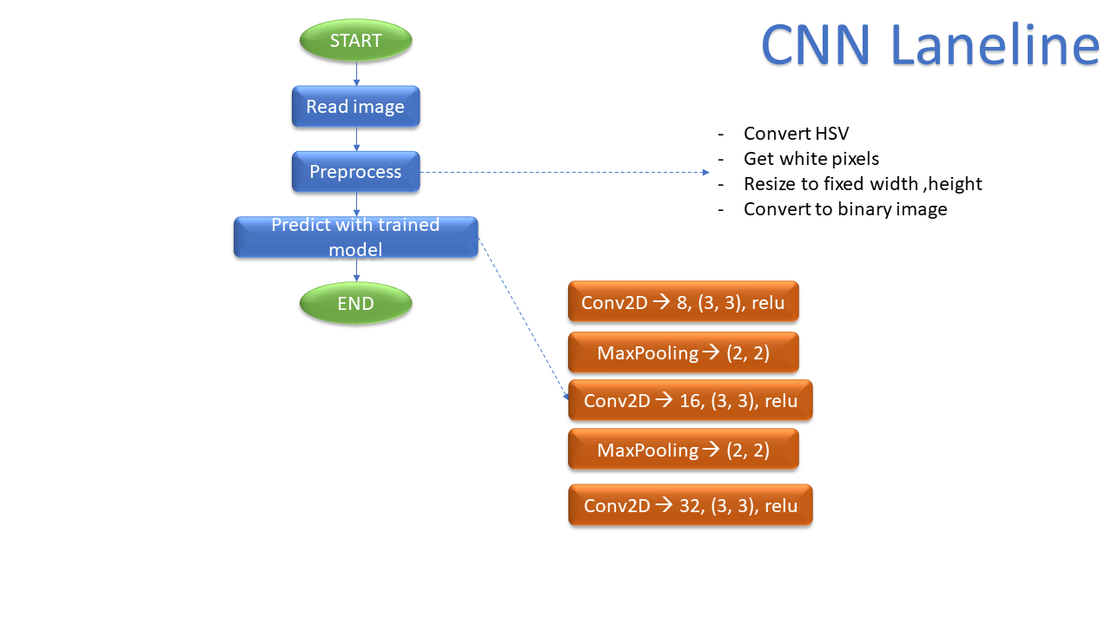
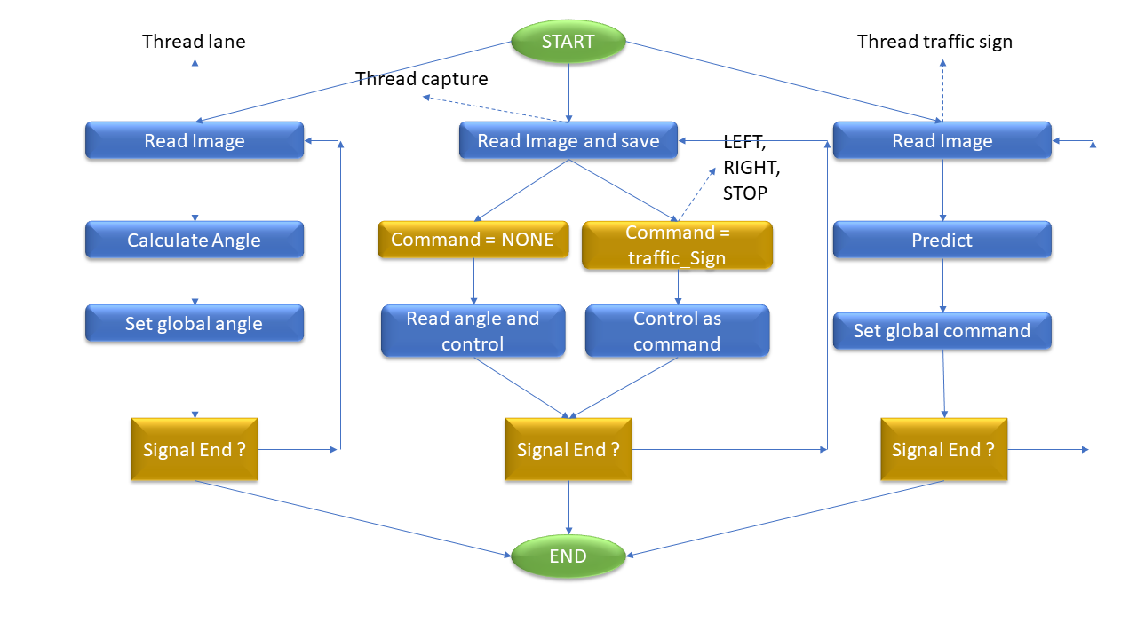
Research and Implement Control Program for Autonomous Car with Deep Learning
M.S.Pham Minh Quan
quanpm@uit.edu.vn
Bui Anh Khoa
15520364@gm.uit.edu.vn
ABSTRACT
In era of industrialization, automation is one of the most important factor in 4.0 technology. And Automatic vehicle has a significant role. In this project, our target is to build a simulated Radio Controlled car with 3D camera implemented on it. Besides, we use Deep Learning to create a neural network for detecting and recognizing road line, traffic sign. In addition to accelerate processing progress, we add multi-threading programing as a separated module. We finished the simulation of car with Unity 3D application, which is researched and built based on C# programing language, and deployed this system to Nvidia Jetson TX2 board. As the result, we successfully operate the system with high durability on Radio Controlled Car. Further more, Unity application can be reused in many projects in the future.
INTRODUCTION
RESULT
There are many ways to solve the problem “how to detect road line and traffic sign”. We research 3 ways:
OpenCV + CNN
Accuracy: 97%
Train samples: 1000
Test samples: 300
Accuracy
YOLO v3
Accuracy: 97%
Train samples: 250
Test samples: 80
OpenCV
Convolutional Neural Network
(CNN)
YOLO v3
Non-Multithreading
Speed
In order to accelerate real time processing progress: We use
- Multithreading Programming
Multithreading
PROPOSED METHOD
The lowest FPS is when processing traffic sign
OpenCV + CNN Algorithm
CNN (detect road) Algorithm
CONCLUSION
Strong point
Durability of Radio Controlled Car’s Control Program
Realtime processing: program could reach 30fps
High Accuracy of detecting and recognizing road lane and traffic sign
Low price (~30 million VNĐ)
YOLO v3: use full YOLO model
Multithreading Programming Algorithm
Weak point
Yolo v3 processing speed is slow
Uncertainly worked with outdoor environment
The dataset has small amount of samples
Algorithm is still restricted in some functions compared to other algorithm in the world

Slide 2
HARDWARE IMPLEMENTATION OF AES WITH S-BOX USING COMPOSITE FIELD
PhD. Lam Duc Khai
khaild@uit.edu.vn
Do Quang Huy
14520360@gm.uit.edu.vn
Nguyen Minh Duc
14521198@gm.uit.edu.vn
ABSTRACT
Summarize: Why you choose this project? What is your target? What have you done? What is your result?
Use 1 to 3 sentences to answer each question. The purpose of this section is to give reader a quick look about your thesis and make first impression that make people want to read more.
NOTE: Size of this poster is 36 inch x 48 inch. If you want to print this, go to File → Export → Create PDF/XPS Document. Then print the pdf file.
You can move texts and blocks based on your length of each section.
You can change the font size (all section must have the same font size) to fit your content.
INTRODUCTION
RESULT
Show your purpose when you choose this project: what problem do you solve, what are limitations of current methods, what is your proposed method.
Show your detail target: project limitations with measurable indicators.
Try to use graphics (Icons, SmartArt, Flowchart, Images) to make your poster easy to understand and more attractive.
Show and explain the result that you have achieved: prototype images, measurement results, comparison tables, etc.
Compare to the targets that you have written in Introduction section.
Try to use graphics (Icons, SmartArt, Flowchart, Images, Tables) to make your poster easy to understand and more attractive.
PROPOSED METHOD
Show your proposed method: system flowchart, algorithm, core formula, etc.
Explain what you have done.
Try to use graphics (Icons, SmartArt, Flowchart, Images) to make your poster easy to understand and more attractive.
CONCLUSION
Do your proposed method work? Is it efficient when compare to other methods? What are the advantages and disadvantages of your method?
Future work?

