Slide 1
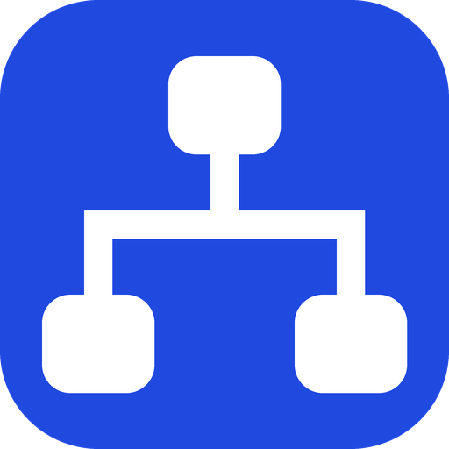
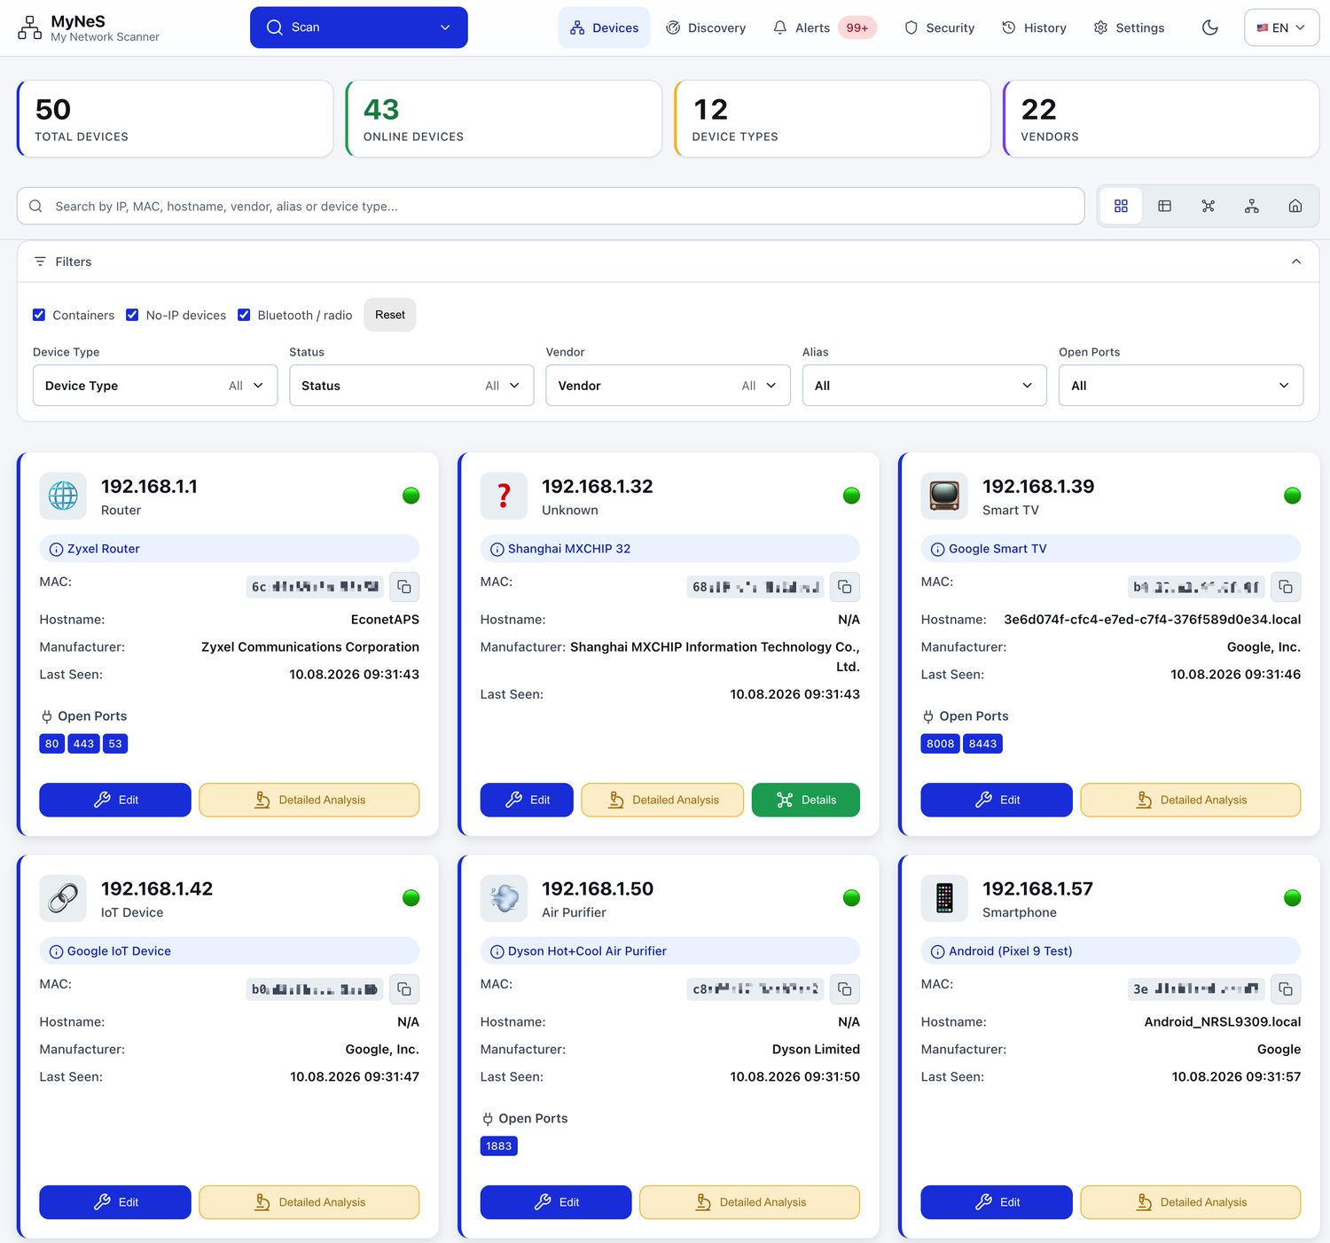
My Network Scanner
Devices
Discovery
Alerts
Security
History
Settings
self-hosted
My Network Scanner
MyNeS
You cannot secure what you cannot name.
Most home networks carry more devices than their owner can list. MyNeS finds every one of them, works out what it is from vendor, ports and protocols, lets you give it a name that means something, and tells you when something new appears.
Docker
Home Assistant add-on
CasaOS
MyNeS Mobile — the same engine, on the phone
App Store
Google Play
iOS
Android
github.com/fxerkan/my_network_scanner
Devices — every card is one real thing on your LAN

Slide 2
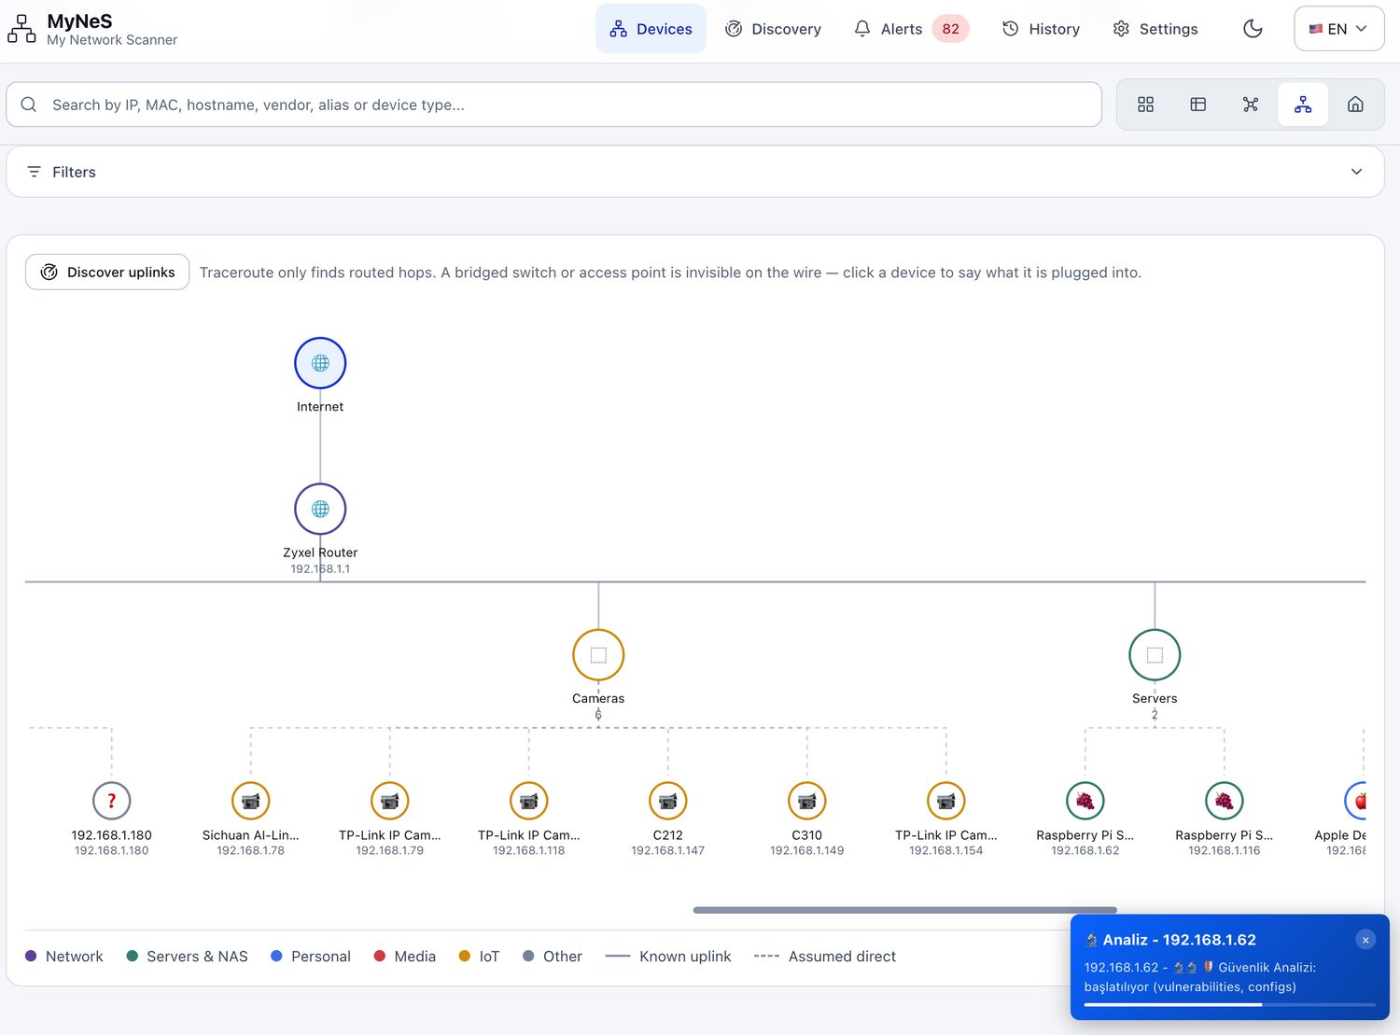
My Network Scanner
Devices
Discovery
Alerts
Security
History
Settings
self-hosted
And it draws the shape of the network, not just a list.
The graph view traces uplinks, so a bridged switch or an access point that is invisible on the wire still shows up in the right place. Click a device and the whole path lights up.
ARP + TCP sweep
who answers
IEEE OUI table
which vendor, offline
mDNS · SSDP · NetBIOS
what it calls itself
Ports + banners
what it actually is
Home Assistant over MQTT
where it ends up
Graph view — uplinks traced, not guessed

Slide 3
My Network Scanner
The problem
self-hosted
Half of a 2026 smart home has no IP address.
What MyNeS listens to
6
5
37k+
0
Every scanner in the category walks the IP range. That was the whole network in 2015. Today the devices that matter most — the ones that watch, listen and unlock — often aren't on it at all.
DISCOVERY PROTOCOLS
WAYS TO READ THE MAP
IEEE VENDOR RECORDS
PACKETS LEAVING YOUR LAN
Zigbee bulbs, plugs and sensors speak to a hub over 802.15.4, never to your router.
An IP scan answers, “which addresses are up”. That is not the same question as “what is in my house”.
1
Z-Wave locks and thermostats are on their own 868/908 MHz mesh.
MyNeS runs both: ARP + nmap for the IP side, and five more protocols for everything else.
2
Bluetooth LE tags, scales and wearables advertise constantly — and hold no IP.
Zigbee and Z-Wave visibility is read from an existing Zigbee2MQTT / Z-Wave JS broker over MQTT — MyNeS does not talk to a radio itself.
3
4
Matter devices announce themselves over mDNS in a way most scanners never parse.

Slide 4
My Network Scanner
The product
self-hosted
Your family's friendly network scanner.
One self-hosted web app that discovers, identifies, names and watches every device on the LAN — and hands the whole inventory to Home Assistant.
Discover — automatic range detection, raw ARP layer-2 sweep, 1000+ port service detection through nmap.
Identify — IEEE OUI (37,000+ vendors), hostname patterns, service signatures, and an optional Identify with AI pass.
Name and own — edit any device, add aliases, notes, types and trust levels; back the whole inventory up as JSON.
Watch — scheduled re-scans, a diff against the last run, and alerts on what matters.
Integrate — Home Assistant MQTT Discovery, InfluxDB, Prometheus, and a full documented REST API.
Own it — AGPL-3.0, one container, runs on the Raspberry Pi you already have.

Slide 5
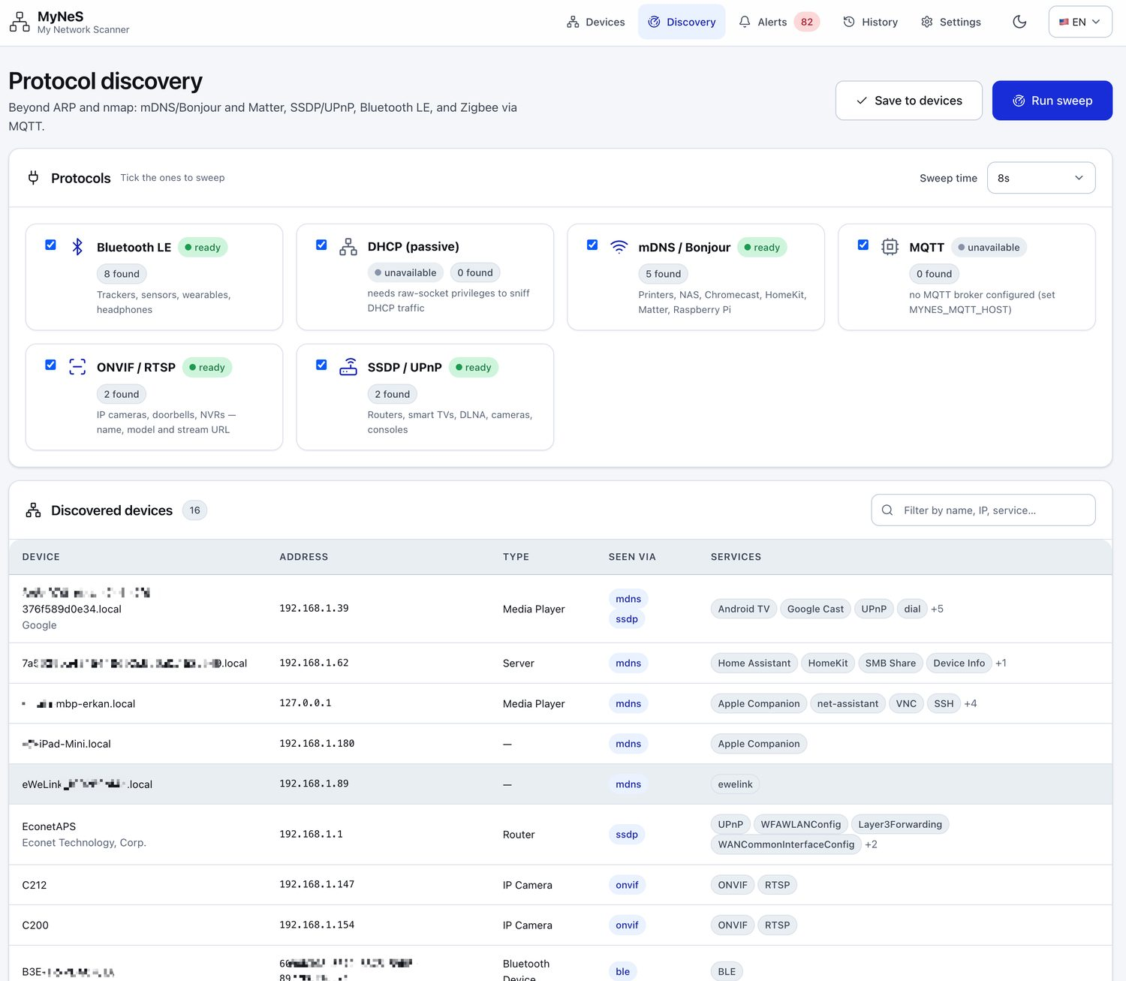
My Network Scanner
Discovery
self-hosted
Six protocols, not one.
MyNeS listens to everything that announces itself, then merges it all into one device record.
ARP (layer 2) — raw frames find devices that never answer a ping. Falls back to ping sweep + OS ARP cache without privileges and tells you it did.
mDNS / Bonjour — printers, NAS boxes, Chromecasts, HomeKit bridges.
Matter — _matter._tcp announcements over mDNS.
SSDP / UPnP — routers, smart TVs, cameras, consoles.
Bluetooth LE — the devices with no IP address at all.
MQTT — Zigbee2MQTT, Z-Wave JS and Tasmota retained topics (needs your existing broker).
Docker — running containers, their virtual networks and IP assignments, nested under the host that runs them.

Slide 6
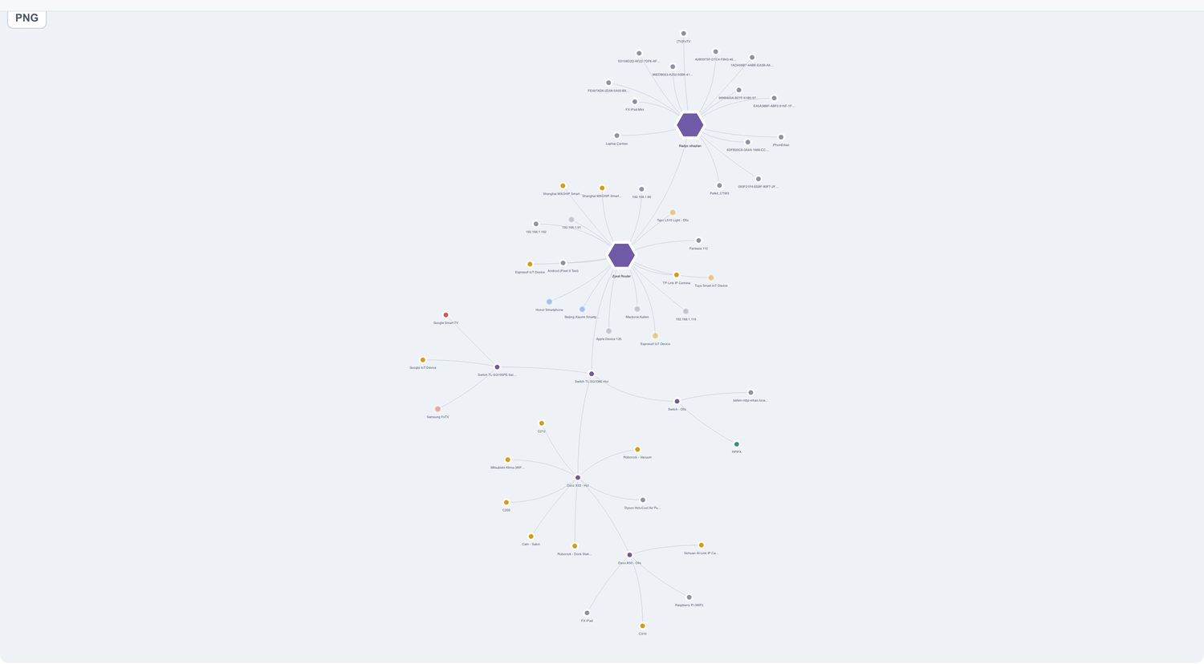
My Network Scanner
The views
self-hosted
A device list is not a network.
The same inventory, read five ways — switched from one control in the toolbar.
Card and Table — detail, bulk editing, sortable and reorderable columns.
Graph — the whole network at a glance, with subnet gateways at the centre. A host's Docker bridge networks group under that host, not as peer LANs.
Topology — what is plugged into what: Internet → router → switch/AP → group → device.
Floor plan — drag each device onto a plan of your actual home.
All five read the same store, so a rename in one is a rename everywhere.

Slide 7
My Network Scanner
The views
self-hosted
From cable path to living room.
Two views nobody else in this category ships.
Topology answers the question a list cannot: what is this device actually connected through? Useful the moment a switch or an access point misbehaves.
Floor plan puts the inventory where you actually live — drag a camera to the hallway, a plug to the kitchen.
A device in the wrong room on the plan is usually a device you forgot you owned.
Both views are built from the same scan data — no extra configuration, no separate diagram to maintain.

Slide 8
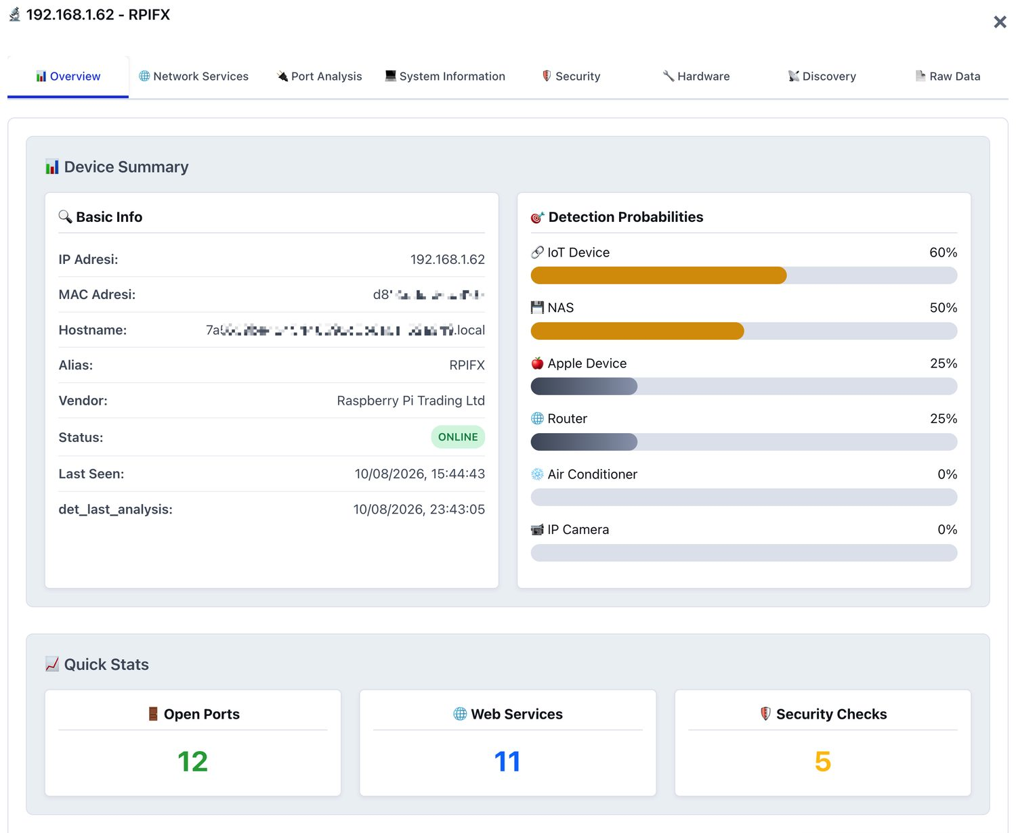
My Network Scanner
Identification
self-hosted
From a MAC address to Device Type and Name.
Identification is the hard half of network scanning. MyNeS stacks every cheap signal first, and only then offers to spend an AI call.
OUI / vendor — IEEE OUI, MA-M, OUI-36, IAB and CID records, 37,000+ organisations, refreshed from IEEE with an online API fallback.
Hostname patterns, open-port and service signatures, banner grabs on ports already known to be open.
Confidence scores and automatic alias suggestions, classified into IoT / Server / Router / Phone and more.
Identify with AI — send only the collected signals (vendor, OUI, hostname, open ports, banners) to Anthropic, OpenAI or OpenRouter and get ranked candidates back, each mapped to a real MyNeS device type.
The button does not appear at all without a key: it is opt-in, not a dependency.
Honest gap: Fing's crowdsourced fingerprint database is larger. On obscure hardware MyNeS will guess where Fing knows.

Slide 9
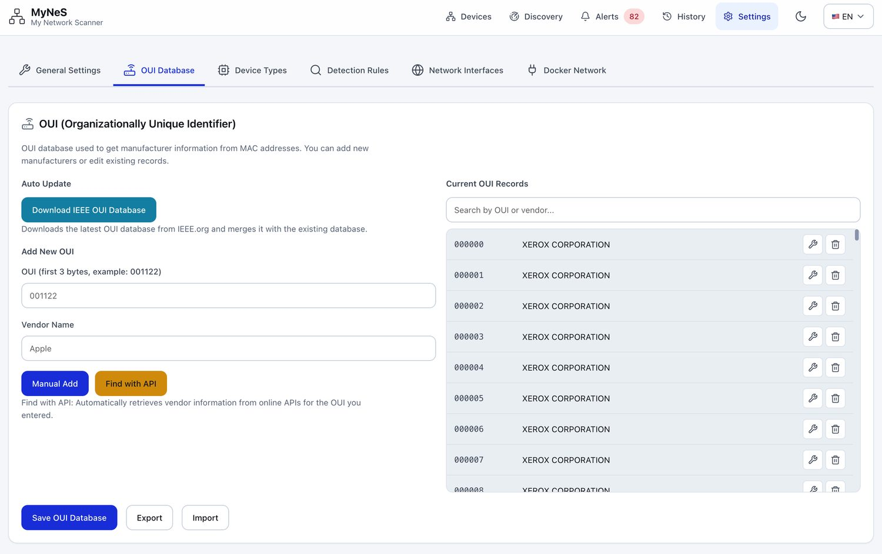
My Network Scanner
Identification
self-hosted
A knowledge base that answers before the LLM does.
mynes-ai is the optional hosted Identify-with-AI backend shared by the web and mobile apps. It tries local knowledge first and only spends an LLM call when that is not enough — so most answers cost nothing.
Step
What it does
1 · OUI DB
Resolve the vendor straight from the MAC
2 · Catalog
Full-text match on any attribute (SQLite FTS5)
3 · Doc RAG
Nearest manual / troubleshooting snippets
4 · LLM
Web search over OUI, manuals and vendor sites
5 · Crawl
Headless fallback when web search is blocked
# a confident catalog hit answers with no LLM and no cost
curl -X POST localhost:8182/identify -H 'content-type: application/json' -d '{
"query_type": "identify",
"facts": {"mac":"a8:41:f4:…",
"oui_vendor":"AzureWave", "open_ports":[80]}
}'

Slide 10
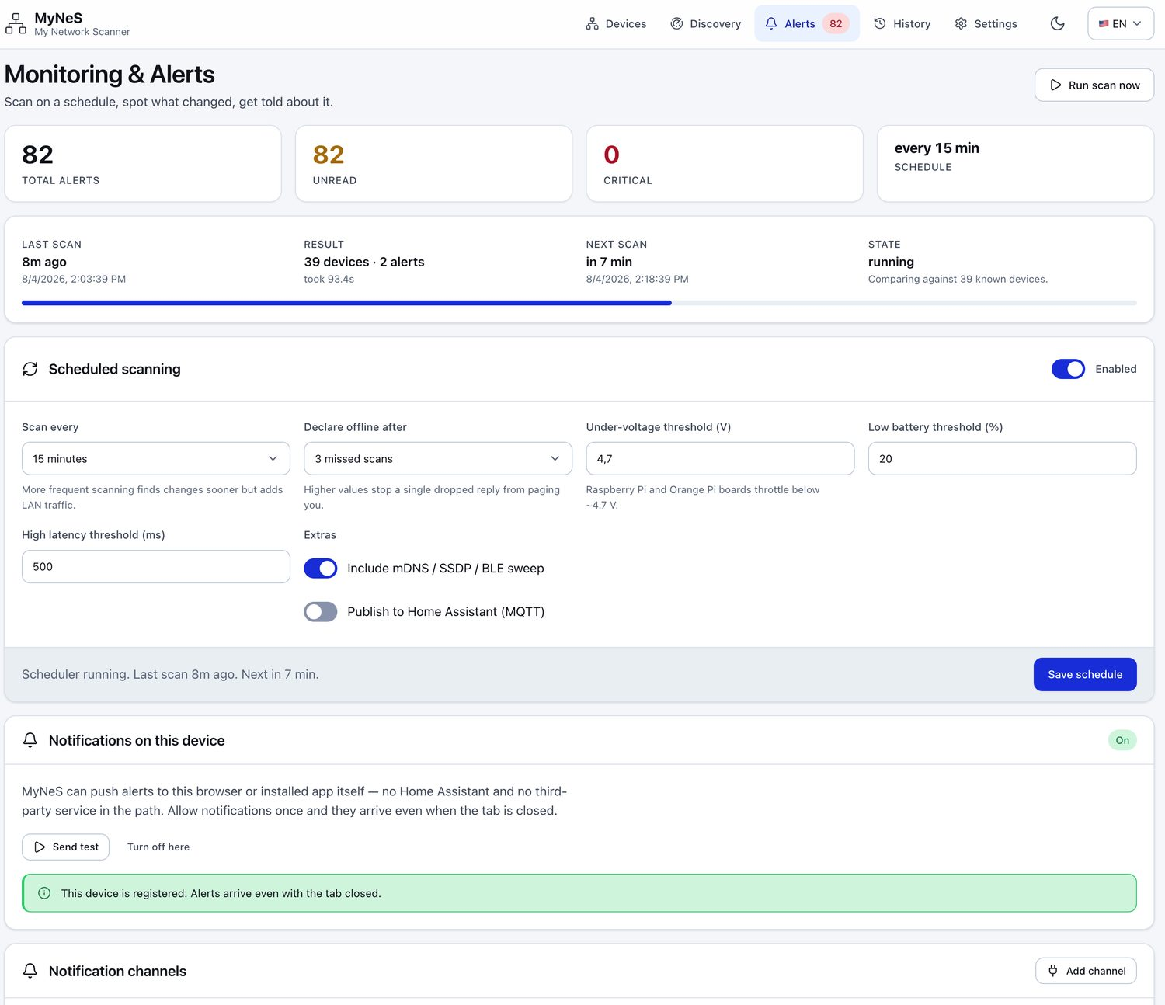
My Network Scanner
Monitoring
self-hosted
Scan, diff, and only then interrupt me.
MyNeS re-scans on a schedule, diffs the result against the previous run, and raises only what changed in a way you would want to know about.
New device joined · device went offline · IP changed
MAC changed for a known IP — the ARP-spoofing signal.
A new port opened on a device that did not have it yesterday.
Low voltage (Raspberry Pi power problems), low battery, high latency, weak signal.
Channels: MyNeS's own Web Push (no Home Assistant and no third-party service needed), Home Assistant notify, ntfy, Telegram, Webhook, Slack, Discord and e-mail.
Rotating daily logs with a day picker survive a restart, so “what happened at 03:00” is answerable.

Slide 11
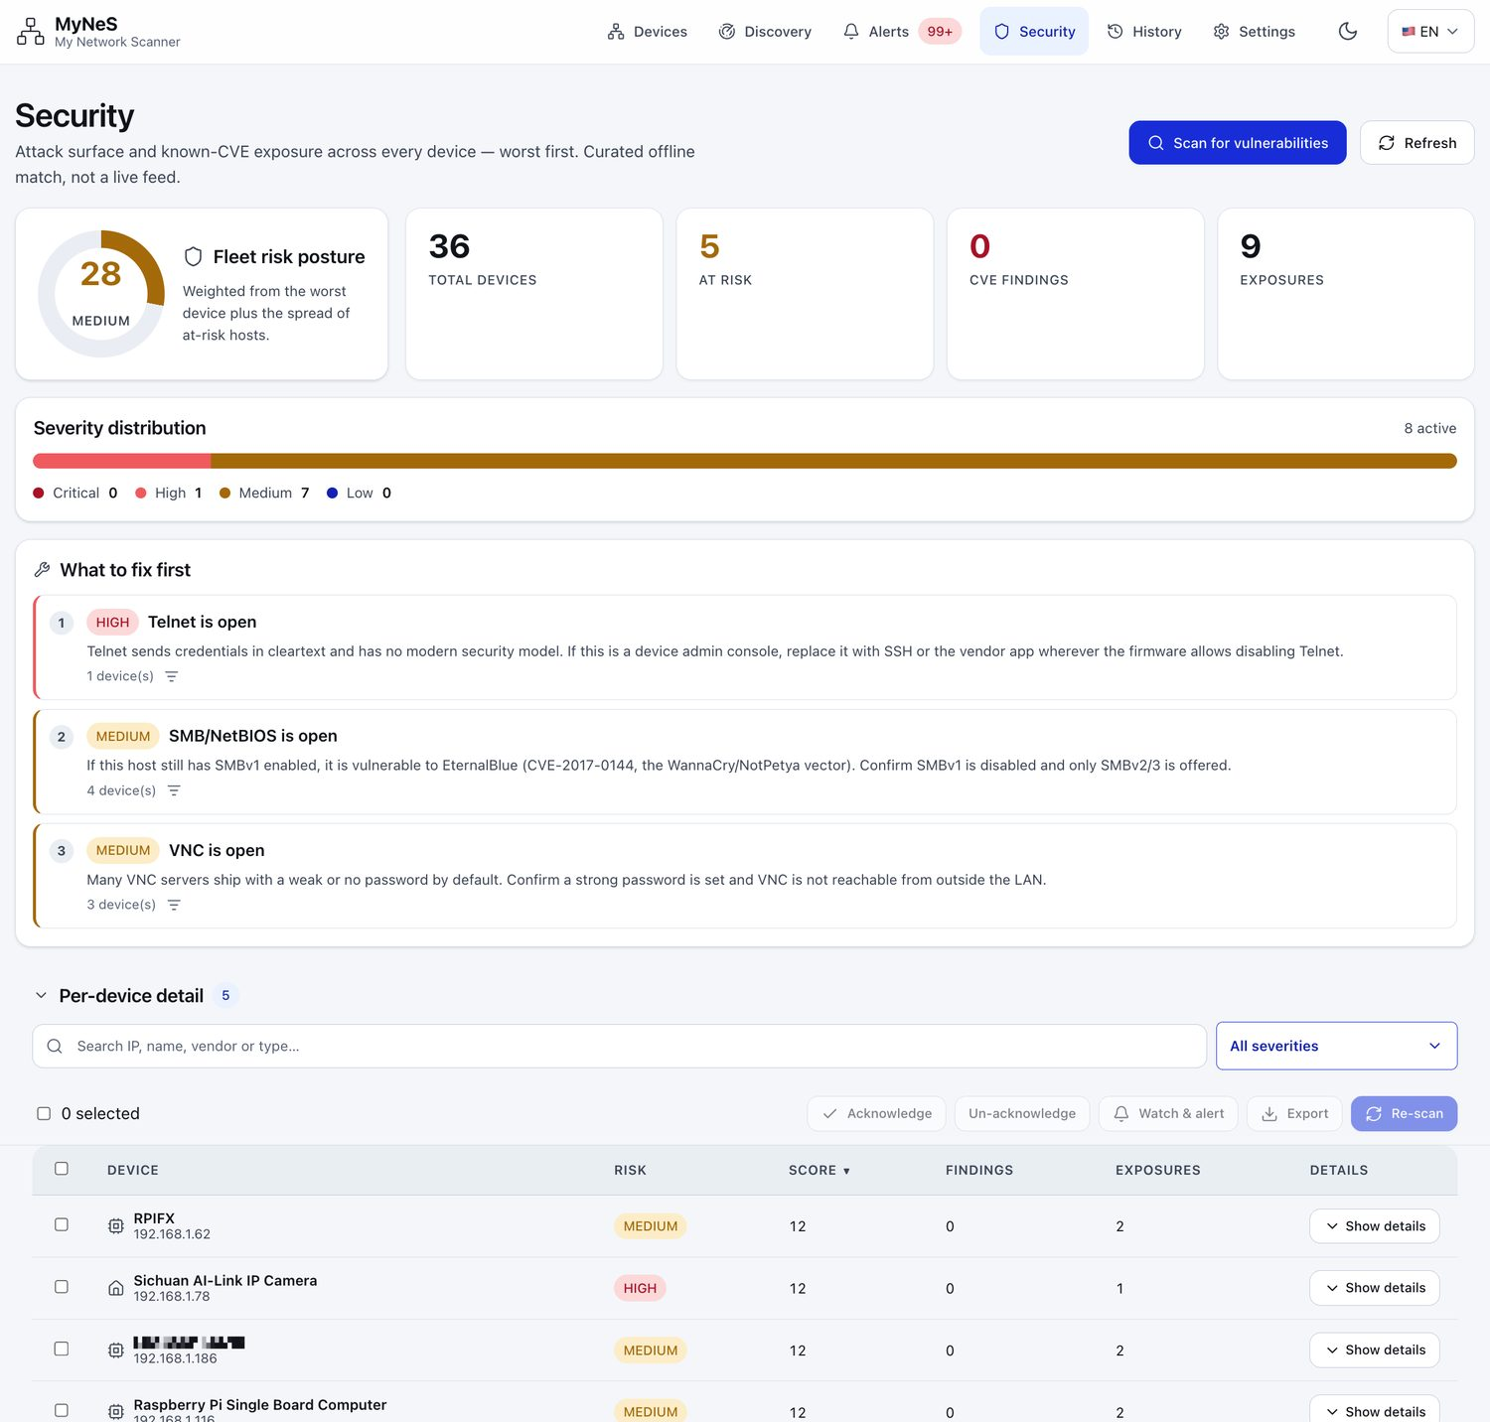
My Network Scanner
Security
self-hosted
The whole LAN's exposure, worst first.
One screen for fleet risk and known-CVE exposure, built from a curated offline mapping rather than a live feed.
Fleet risk score with a severity split — Critical / High / Medium / Low.
What to fix first — exposed Telnet, SMB/NetBIOS (EternalBlue), VNC and friends, each with the number of devices affected.
Per device — scan, acknowledge, watch & alert, export.
Encrypted credential storage (Fernet / AES-256) for SSH, FTP, HTTP and SNMP, with restricted file permissions.
Sensitive data is stripped on export, so a shared inventory file is safe to share.
The container is hardened: no perl-base, debconf, gosu, curl, pip or setuptools — 70 CVEs Debian had not patched, removed by deletion. Runs as uid 1000, never privileged.

Slide 12
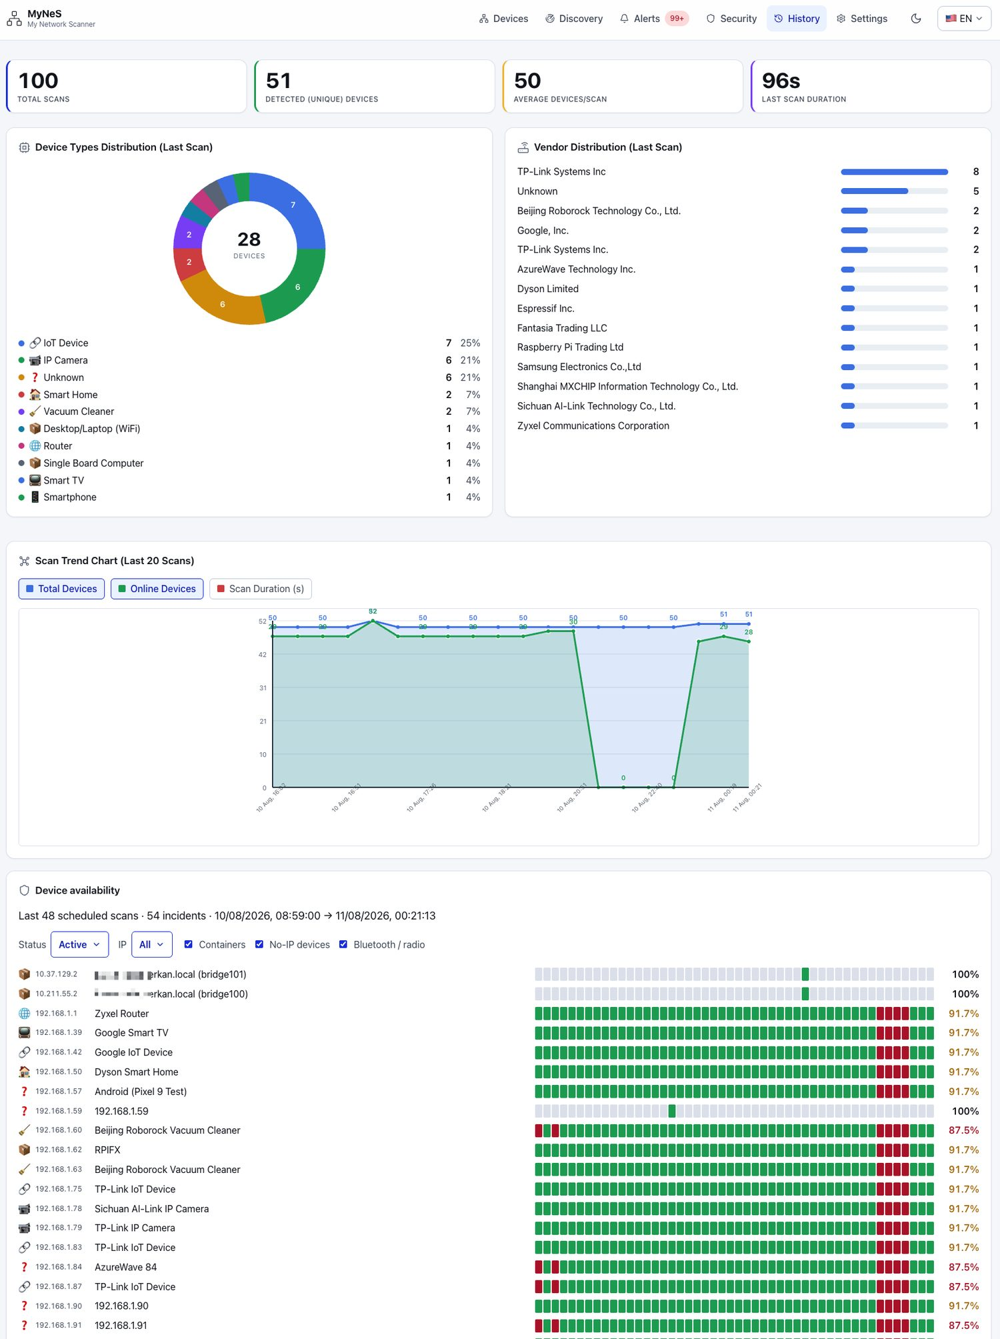
My Network Scanner
History
self-hosted
Your network, over time.
Every scan is kept, so the inventory is a history rather than a snapshot.
Per-scan results, device counts and statistics you can page back through.
When did this device first appear? — the question that turns an unknown MAC into a story.
JSON backup and restore for the whole inventory: aliases, notes, custom types, trust levels.
Every save snapshots the previous store first (v1.8.1) — a degraded scan can no longer quietly wipe a year of device edits.

Slide 13
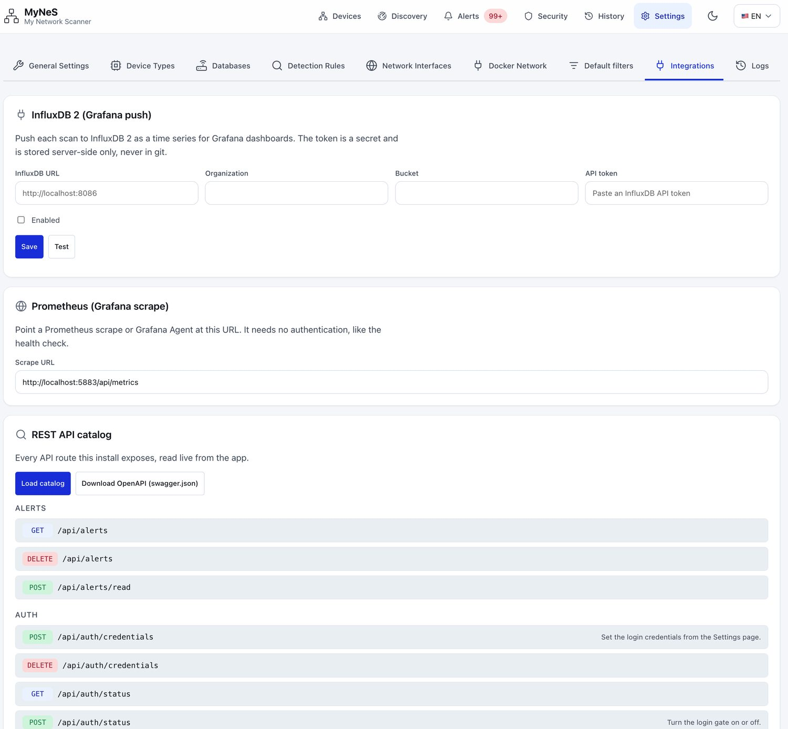
My Network Scanner
Integrations
self-hosted
A first-class target, not an afterthought.
Home Assistant is where most of this inventory wants to end up — so MyNeS speaks its native language.
MQTT Discovery push — every discovered device becomes an HA entity with no glue code and no template YAML.
REST / WebSocket pull from HA, so MyNeS can compare what it found against HA's own device registry and flag the ones that quietly unplugged.
A Home Assistant add-on (mynes-addon, aarch64 + amd64) installs it from the Add-on Store like any other.
InfluxDB 2 push and Prometheus scrape for Grafana dashboards.
A live REST API catalogue read from the running app and downloadable as OpenAPI (swagger.json).
GET /api/capabilities tells you exactly which discovery methods are working and why the others are not.

Slide 14
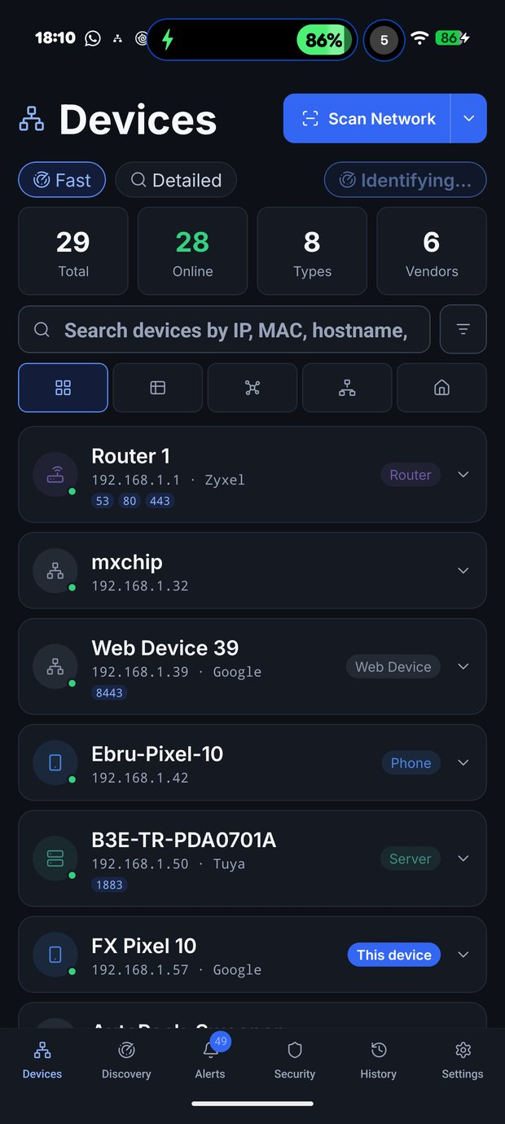
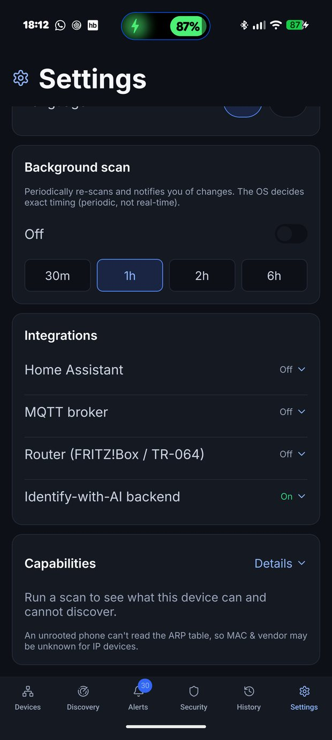
My Network Scanner
Mobile
self-hosted
The phone is the scanner.
Not a remote control for a server — a standalone app that runs the whole scanning engine on-device. No server to run, no Docker, no pairing.
React Native + Expo + TypeScript — one codebase, Android and iOS, captured here on a real iPhone and a Pixel 10 Pro XL scanning a live home network.
Ping / TCP-connect sweep primes the kernel ARP cache, then the bundled mynes-ping native module reads MAC addresses out of it — without root. On iOS it reads the route buffer directly (NET_RT_FLAGS).
Vendor offline from the bundled IEEE table; names from reverse-DNS, then mDNS, SSDP and NetBIOS; type from ports refined by banner grabs.
Design parity is generated, not copied — the web app's design-system.css and icon set compile into the mobile theme, so the two never drift.
The honest constraint: an unrooted phone cannot send raw ARP, so some pure-IP devices keep an unknown MAC. The capabilities screen says so rather than hiding it.
Devices
Capabilities

Slide 15
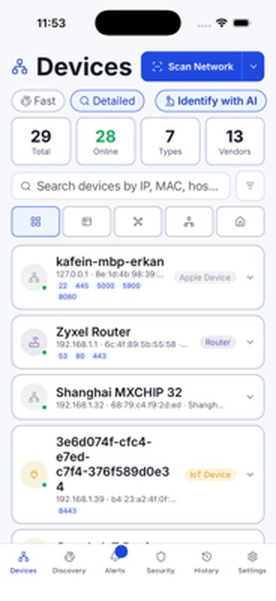
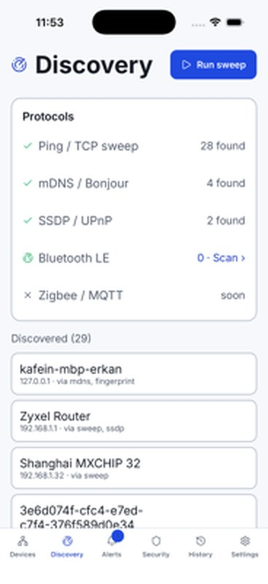
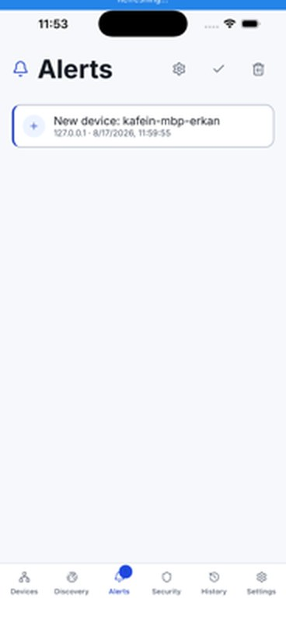
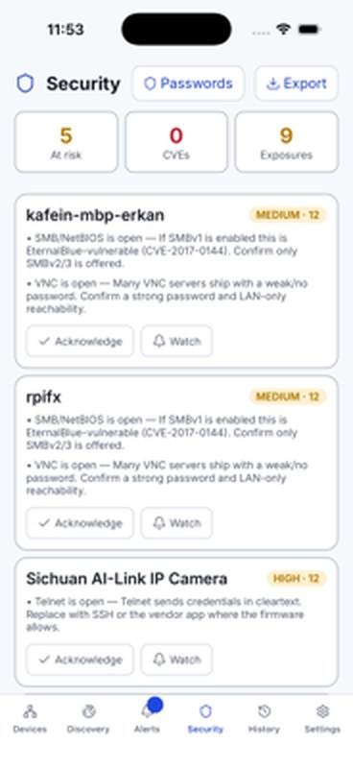
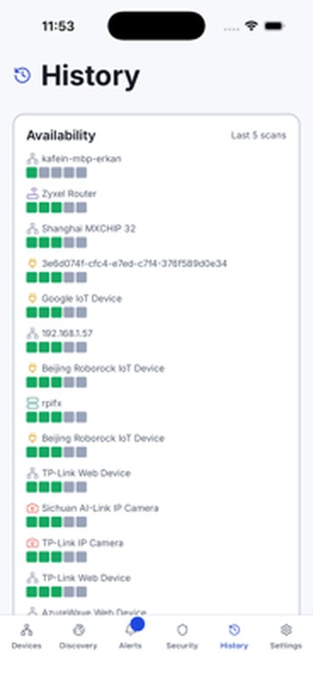
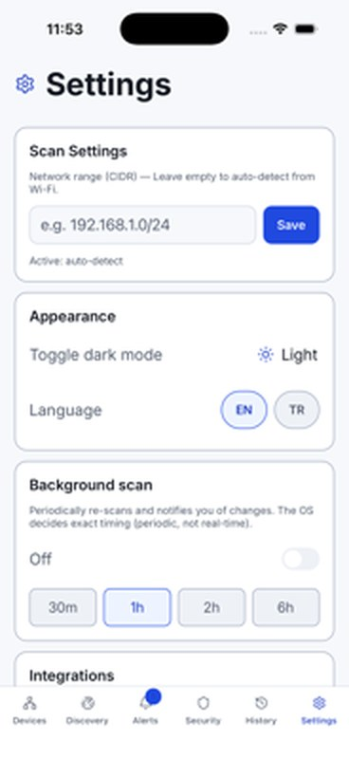
My Network Scanner
Mobile
self-hosted
Everything the web app does, in your pocket.
Devices
Discovery
Alerts
Security
History
Settings
Devices — live counters (total / online / types / vendors), search, and the same card, table, graph, topology and floor-plan switches as the web app.
Light and dark follow the OS; the interface ships in Turkish and English.
Discovery · Alerts · Security · History · Settings — the same five pillars, laid out for a thumb.

Slide 16
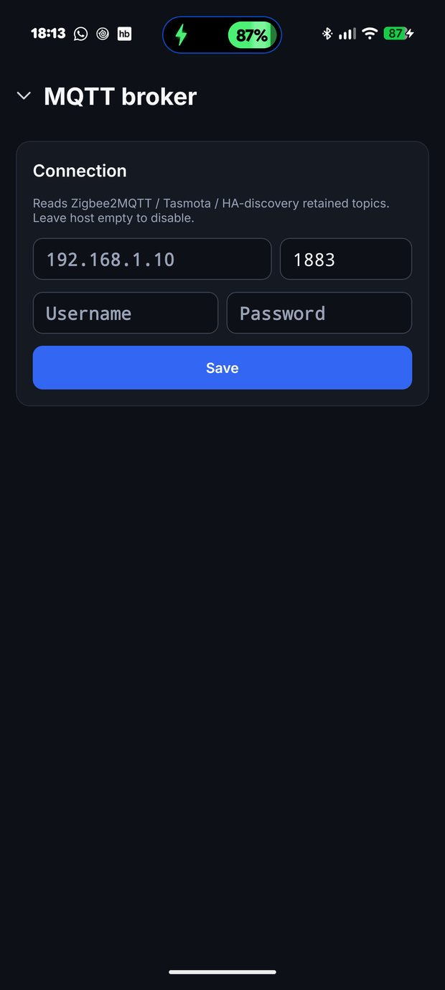
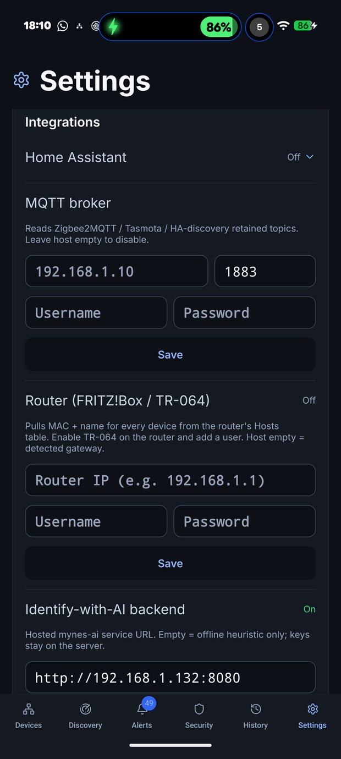
My Network Scanner
Mobile
self-hosted
The same integrations, from the phone.
The mobile app carries the settings the web app has — not a reduced subset.
MQTT broker — point it at Zigbee2MQTT / Z-Wave JS / Tasmota and the radio devices appear on the phone too.
Home Assistant and Router (FRITZ!Box / TR-064) — pull MAC and name for every device from the router's own hosts table.
Identify-with-AI backend — point it at your own mynes-ai instance, or leave it empty for the offline heuristic. Provider keys stay on the server, never on the phone.
Background scan every 30 m / 1 h / 2 h / 6 h, with OS-decided timing and a notification when something changes.
Scan range auto-detected from Wi-Fi, or set a CIDR by hand.
Dark mode and EN / TR switch right in Settings.
MQTT broker
Integrations

Slide 17
My Network Scanner
The family
self-hosted
MyNeS is not one app — it is a small ecosystem.
Each piece is independently useful, and each one is optional except the first.
Core
Mobile
AI
Home Assistant
CasaOS
my_network_scanner
mynes-mobile
mynes-ai
mynes-addon
mynes-casaos-store
The scanner, the web UI and the API. Python + Flask, AGPL-3.0, published to Docker Hub for amd64 and arm64.
Standalone Android and iOS app running the scan engine on-device. React Native + Expo + TypeScript.
Optional hosted Identify-with-AI backend. Local catalog + RAG first, LLM only when needed. Keys never leave it.
Add-on repository for Home Assistant. Install from the Add-on Store; aarch64 and amd64.
Third-party app store source for CasaOS and ZimaOS, so MyNeS installs with one click there too.

Slide 18
My Network Scanner
Who it's for
self-hosted
Persona 01
Homelab / Self-hoster
Runs a Pi, a NAS or a mini-PC with a dozen containers on it. Wants to know exactly what is on the LAN, and wants it to stay on the LAN.
The pain today
What they use
What they get
Fing wants an account, and the inventory lives on someone else's servers.
Docker Compose with network_mode: host plus NET_RAW and NET_ADMIN — the minimum that lets raw ARP and multicast actually see the LAN.
AGPL-3.0, one container, no account and nothing phoning home.
Angry IP Scanner is a one-shot tool: no history, no naming, nothing persists between runs.
linux/amd64 and linux/arm64 — the Pi in the cupboard is enough.
GET /api/capabilities — says which discovery methods are live and why the rest are not, instead of silently finding fewer devices.
A dozen containers on three Docker networks show up as mystery IPs with no context.
Runs as uid 1000, never privileged, on a base image stripped of 70 unpatched CVEs.
Docker awareness — containers, virtual networks and IP assignments, nested under the host that runs them.
No record of when a device first appeared or when a port opened.
Scan history and rotating daily logs that survive a restart.
Grafana is already running, but the LAN is the one thing not in it.
InfluxDB 2 push / Prometheus scrape straight into the Grafana that is already up.
A device store that snapshots itself before every save, so a bad scan is one file-copy away from undone.
ntfy, Telegram, Discord, Slack or a webhook for alerts; the full REST API for everything else.

Slide 19
My Network Scanner
Who it's for
self-hosted
Persona 02
Smart-home owner / Home Assistant user
Has forty devices in Home Assistant and no idea how many more are on the network. Half the house talks Zigbee, and no scanner has ever shown any of it.
The pain today
What they use
What they get
Zigbee bulbs and Z-Wave locks are invisible to every IP scanner they have tried.
MQTT discovery — point MyNeS at the Zigbee2MQTT / Z-Wave JS broker that is already running and the radio devices land in the inventory.
The devices that were never on the network map are on it now.
A device stopped responding last week and nobody noticed until the automation failed.
Matter over mDNS (_matter._tcp) and Bluetooth LE advertisements for the rest.
Offline detection that fires before an automation breaks.
HA's device registry and the actual network have quietly drifted apart.
MQTT Discovery push — every device becomes an HA entity automatically, no template YAML.
One inventory that HA and a human can both read.
Adding a new device to HA means hunting for its IP by hand.
REST / WebSocket pull from HA to compare found devices against HA's registry and flag the ones that unplugged.
Alerts through HA's own notify service — or MyNeS's Web Push, with no HA in the loop at all.
NetAlertX finds the IP devices, but not the radio ones.
The Home Assistant add-on (mynes-addon) so it installs from the Add-on Store like anything else.
Named dependency: Zigbee/Z-Wave visibility needs an existing MQTT broker. MyNeS reads its retained topics; it does not drive a radio.
The floor plan — drag each device into the room it is actually in.

Slide 20
My Network Scanner
Who it's for
self-hosted
Persona 03
End user / the family
Not a DevOps engineer and will never run Docker. Wants one honest answer to one question: who is on my Wi-Fi right now?
The pain today
What they use
What they get
The router's admin page lists twenty MAC addresses and names none of them.
The mobile app — install, open, scan. The phone runs the engine; there is no server to set up at all.
An answer in a minute, with no account and no cloud.
“Is that unknown device the neighbour, or my own robot vacuum?”
Card view with the plain-language summary: total, online, types, vendors.
Every device with a real name, a type and a room — because you named them once.
Every friendly app wants an account and puts the house inventory in someone's cloud.
Trust levels — mark each device Known, Unknown or Trusted, then filter for what is left.
The interface in Turkish, throughout, not a partial translation.
There is no server at home and there is never going to be one.
Background scan every hour, with a notification when a new device joins.
Light and dark follow the phone; the layout works from 320px to a TV.
Most of these tools are English-only.
Wake-on-LAN to bring the desktop up from the sofa.
Honest limits: an unrooted phone cannot read every MAC, so some devices stay partly unknown — and the app says which.
Or, on a shared computer: the PWA — add the web app to the home screen, no store needed.

Slide 21
My Network Scanner
The market
self-hosted
Self-hosted Fing that also sees the devices with no IP address.
✓ yes ~ partial ✕ no ★ only MyNeS
Capability
MyNeS
Fing
Angry IP Scanner
Advanced IP Scanner
NetAlertX
nmap / Zenmap
License & cost
AGPL-3.0 · free
Proprietary · free app, paid box/tiers
GPL-2.0 · free
Proprietary · freeware
GPL-3.0 · free
NPSL · free
Account required
✕ none
✓ for most useful features
✕
✕
✕
✕
Cloud / telemetry
✕ none
central to the product
✕ none
~ update check
✕ none
✕ none
Runs as
Self-hosted web app
Mobile + desktop + hardware
Desktop app
Windows desktop
Self-hosted web app
CLI (+ Zenmap)
ARP layer-2 discovery
✓ raw + fallback
✓
✕ ping + port
✓
✓
✓
mDNS / SSDP / UPnP
✓
✓
✕
~
~
~ scripted
Matter
✓ _matter._tcp
~
✕
✕
✕
✕
Bluetooth LE ★
✓
~ mobile only
✕
✕
✕
✕
Zigbee / Z-Wave via MQTT ★
✓
✕
✕
✕
✕
✕
Docker containers & networks ★
✓
✕
✕
✕
✕
✕
Monitoring + alerts
✓ 8 rule types
~ box / premium
✕
✕
✓ its core
✕
Home Assistant integration
✓ MQTT Discovery + add-on
✕
✕
✕
~ community
✕
Views
Card, table, graph, topology, floor plan
List
List
List
List
~ Zenmap topology
Native mobile app
✓ iOS + Android + PWA
✓ native
✕
✕
~ PWA
✕
Device fingerprint depth
~ OUI + heuristics + AI
✓ crowdsourced, largest
✕
✕
~
✓ best in class
Maturity
Young · 2025– · one maintainer
~15 years · a company
~20 years
~15 years
Several years, active
~25 years

Slide 22
My Network Scanner
The market
self-hosted
Where MyNeS wins — and where you should use something else.
Where it wins
Where it doesn't — reach for something else
It sees what nothing else sees. Bluetooth LE, Zigbee, Z-Wave and Matter are invisible to every other tool in the matrix. In a 2026 smart home that is often a third of the devices.
Device fingerprinting. Fing's crowdsourced database is far larger; obscure hardware stays unknown more often. This is the single biggest honest gap.
Self-hosted, no account, no telemetry. AGPL-3.0, one container, on hardware you already own.
WAN-side tooling. No internet speed test, no ISP outage detection, no bandwidth analysis. → Fing / Fingbox.
Home Assistant is native — MQTT Discovery push, REST pull, and an official add-on repository.
Enforcement. MyNeS observes; it does not block a device or shape traffic. → Fingbox, or your router.
Graph, topology and floor-plan views that no competitor in the category ships.
One-tap install. Fing is a tap; MyNeS is a container, host networking and a capabilities conversation.
Docker-aware — containers and their virtual networks, nested under their host.
Big networks. Python and Flask on a /16 is minutes, not seconds. This is a home LAN tool, not a campus one.
It tells you what it could not do — /api/capabilities instead of silently finding fewer devices.
Maturity. Young project, one maintainer, no decade of hardening. → NetAlertX for battle-tested presence detection.
If you need…
Reach for
A self-hosted device inventory that also sees Zigbee, Z-Wave, BLE and Matter
MyNeS
Every device in Home Assistant with no glue code
MyNeS
A scanner on a phone with no server anywhere
MyNeS Mobile
A speed test, ISP monitoring or network-level blocking
Fing / Fingbox
Deep port and service interrogation
nmap

Slide 23
My Network Scanner
Get started
self-hosted
Five ways in — pick the one that matches your house.
The container is the reference install. The add-on and the CasaOS source are the same image with the setup already done; the phone needs no server at all.
Docker · the reference
Home Assistant add-on
CasaOS / ZimaOS
# host networking is what lets it see the LAN
# Settings → Add-ons → Store → ⋮ → Repositories
# App Store → ⋮ → Add Source
docker compose up -d
github.com/fxerkan/mynes-addon
https://cdn.jsdelivr.net/gh/fxerkan/
mynes-casaos-store@gh-pages/store/main.zip
# then open
# install, start, open on port 5883
http://<host-ip>:5883

Slide 24
My Network Scanner
MyNeS
An IP scan shows you addresses. MyNeS shows you your house.
Self-hosted. No account. No cloud. And it finds the devices that were never on the map.
docker pull fxerkan/my_network_scanner
AGPL-3.0
amd64 · arm64
Home Assistant add-on
CasaOS / ZimaOS
iOS + Android
github.com/fxerkan/my_network_scanner
Docker Hub
mynes-mobile
mynes-ai
HA add-on
MyNeS v1.8.1 · Mobile v1.0 · AGPL-3.0 · Developed by FXerkan — Code more, worry less.

