Slide 1
A experiment

Slide 2
Algorithm
Single Point Mutation
Single Point Crossover
Genetic Algorithm
# of generation:400
# of population:200
Score = \lambda*Hamming Distance + (1-\lambda)*codon usage score

Slide 3
Result

Slide 4
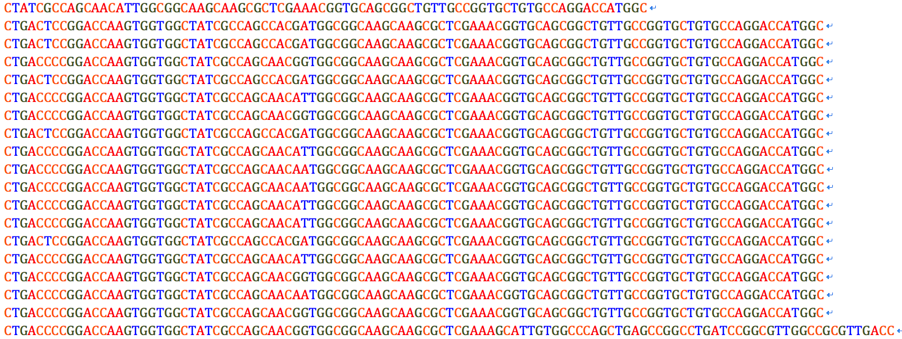
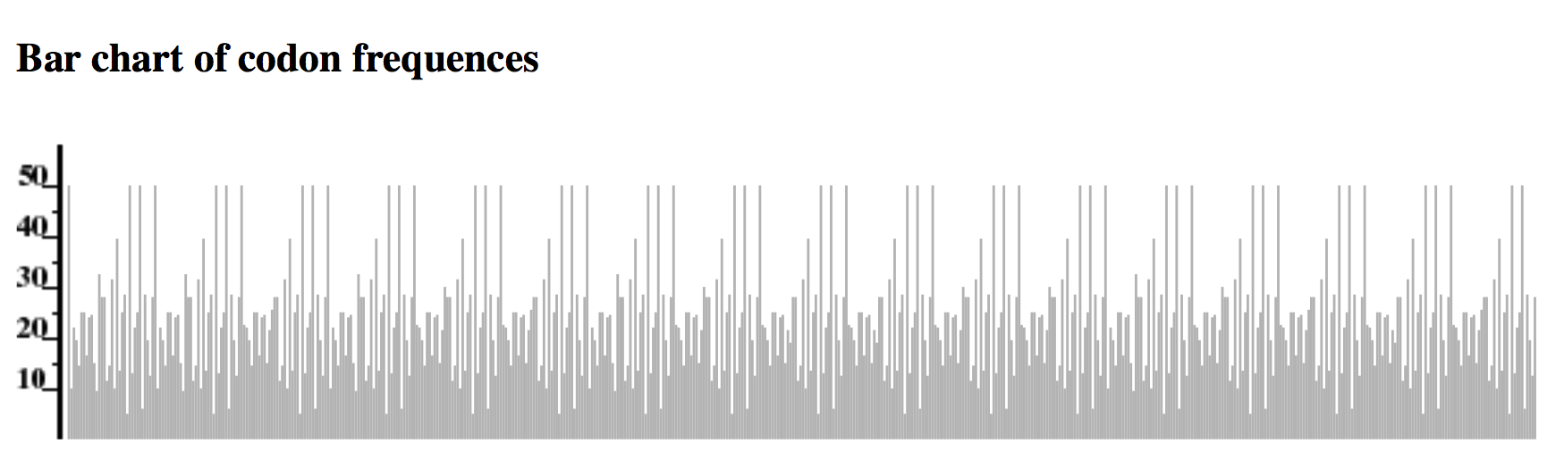
Original sequence

Slide 5
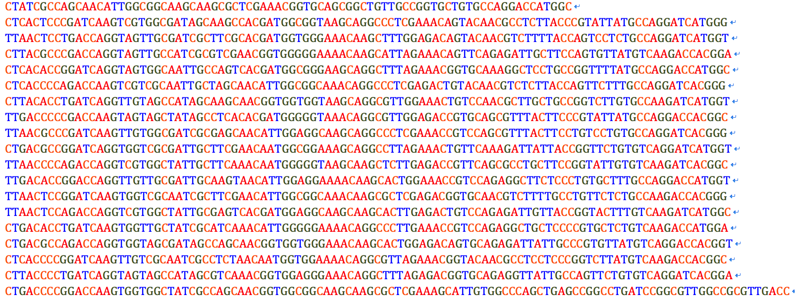
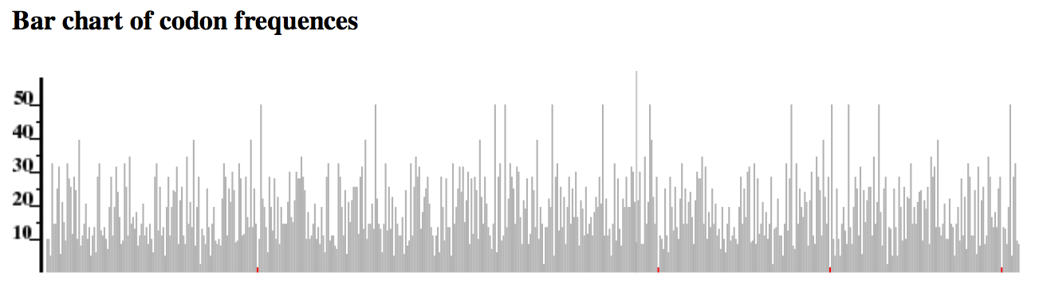
Modified sequence

Slide 6
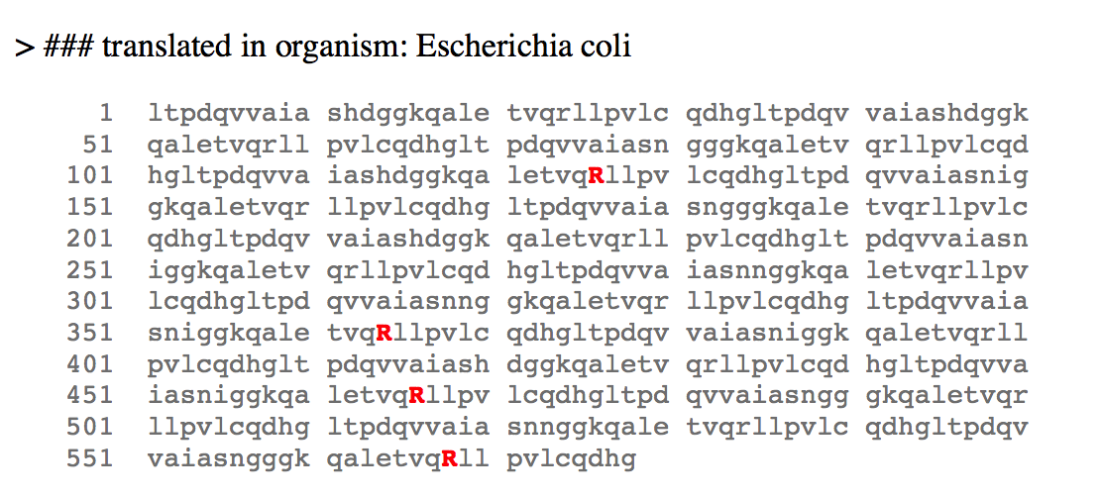
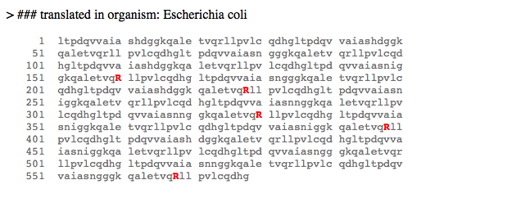
Lambda 大
Lambda 小

