Slide 1
TALE Sequence Optimization

Slide 2
DNA Sequence
CTATCGCCAGCAACATTGGCGGCAAGCAAGCGCTCGAAACGGTGCAGCGGCTGTTGCCGGTGCTGTGCCAGGACCATGGC
CTGACTCCGGACCAAGTGGTGGCTATCGCCAGCCACGATGGCGGCAAGCAAGCGCTCGAAACGGTGCAGCGGCTGTTGCCGGTGCTGTGCCAGGACCATGGC
CTGACTCCGGACCAAGTGGTGGCTATCGCCAGCCACGATGGCGGCAAGCAAGCGCTCGAAACGGTGCAGCGGCTGTTGCCGGTGCTGTGCCAGGACCATGGC
CTGACCCCGGACCAAGTGGTGGCTATCGCCAGCAACGGTGGCGGCAAGCAAGCGCTCGAAACGGTGCAGCGGCTGTTGCCGGTGCTGTGCCAGGACCATGGC
CTGACTCCGGACCAAGTGGTGGCTATCGCCAGCCACGATGGCGGCAAGCAAGCGCTCGAAACGGTGCAGCGGCTGTTGCCGGTGCTGTGCCAGGACCATGGC
CTGACCCCGGACCAAGTGGTGGCTATCGCCAGCAACATTGGCGGCAAGCAAGCGCTCGAAACGGTGCAGCGGCTGTTGCCGGTGCTGTGCCAGGACCATGGC
CTGACCCCGGACCAAGTGGTGGCTATCGCCAGCAACGGTGGCGGCAAGCAAGCGCTCGAAACGGTGCAGCGGCTGTTGCCGGTGCTGTGCCAGGACCATGGC
CTGACTCCGGACCAAGTGGTGGCTATCGCCAGCCACGATGGCGGCAAGCAAGCGCTCGAAACGGTGCAGCGGCTGTTGCCGGTGCTGTGCCAGGACCATGGC
CTGACCCCGGACCAAGTGGTGGCTATCGCCAGCAACATTGGCGGCAAGCAAGCGCTCGAAACGGTGCAGCGGCTGTTGCCGGTGCTGTGCCAGGACCATGGC
CTGACCCCGGACCAAGTGGTGGCTATCGCCAGCAACAATGGCGGCAAGCAAGCGCTCGAAACGGTGCAGCGGCTGTTGCCGGTGCTGTGCCAGGACCATGGC
CTGACCCCGGACCAAGTGGTGGCTATCGCCAGCAACAATGGCGGCAAGCAAGCGCTCGAAACGGTGCAGCGGCTGTTGCCGGTGCTGTGCCAGGACCATGGC
CTGACCCCGGACCAAGTGGTGGCTATCGCCAGCAACATTGGCGGCAAGCAAGCGCTCGAAACGGTGCAGCGGCTGTTGCCGGTGCTGTGCCAGGACCATGGC
CTGACCCCGGACCAAGTGGTGGCTATCGCCAGCAACATTGGCGGCAAGCAAGCGCTCGAAACGGTGCAGCGGCTGTTGCCGGTGCTGTGCCAGGACCATGGC
CTGACTCCGGACCAAGTGGTGGCTATCGCCAGCCACGATGGCGGCAAGCAAGCGCTCGAAACGGTGCAGCGGCTGTTGCCGGTGCTGTGCCAGGACCATGGC
CTGACCCCGGACCAAGTGGTGGCTATCGCCAGCAACATTGGCGGCAAGCAAGCGCTCGAAACGGTGCAGCGGCTGTTGCCGGTGCTGTGCCAGGACCATGGC
CTGACCCCGGACCAAGTGGTGGCTATCGCCAGCAACGGTGGCGGCAAGCAAGCGCTCGAAACGGTGCAGCGGCTGTTGCCGGTGCTGTGCCAGGACCATGGC
CTGACCCCGGACCAAGTGGTGGCTATCGCCAGCAACAATGGCGGCAAGCAAGCGCTCGAAACGGTGCAGCGGCTGTTGCCGGTGCTGTGCCAGGACCATGGC
CTGACCCCGGACCAAGTGGTGGCTATCGCCAGCAACGGTGGCGGCAAGCAAGCGCTCGAAACGGTGCAGCGGCTGTTGCCGGTGCTGTGCCAGGACCATGGC
CTGACCCCGGACCAAGTGGTGGCTATCGCCAGCAACGGTGGCGGCAAGCAAGCGCTCGAAAGCATTGTGGCCCAGCTGAGCCGGCCTGATCCGGCGTTGGCCGCGTTGACC

Slide 3
ltpdqvvaiashdggkqaletvqrllpvlcqdhg
ltpdqvvaiashdggkqaletvqrllpvlcqdhg
ltpdqvvaiasngggkqaletvqrllpvlcqdhg
ltpdqvvaiashdggkqaletvqrllpvlcqdhg
ltpdqvvaiasniggkqaletvqrllpvlcqdhg
ltpdqvvaiasngggkqaletvqrllpvlcqdhg
ltpdqvvaiashdggkqaletvqrllpvlcqdhg
ltpdqvvaiasniggkqaletvqrllpvlcqdhg
ltpdqvvaiasnnggkqaletvqrllpvlcqdhg
ltpdqvvaiasnnggkqaletvqrllpvlcqdhg
ltpdqvvaiasniggkqaletvqrllpvlcqdhg
ltpdqvvaiasniggkqaletvqrllpvlcqdhg
ltpdqvvaiashdggkqaletvqrllpvlcqdhg
ltpdqvvaiasniggkqaletvqrllpvlcqdhg
ltpdqvvaiasngggkqaletvqrllpvlcqdhg
ltpdqvvaiasnnggkqaletvqrllpvlcqdhg
ltpdqvvaiasngggkqaletvqrllpvlcqdhg

Slide 4
RVD and target DNA Sequence
hd hd ng hd ni ng hd ni nn nn ni ni hd ni ng nn ng
CCTCATCAGGAACATGT

Slide 5
Algorithm
Single Point Mutation
Single Point Crossover
Genetic Algorithm
# of generation:400
# of population:200
Score = \lambda*Hamming Distance + (1-\lambda)*codon usage score

Slide 6
Result

Slide 7
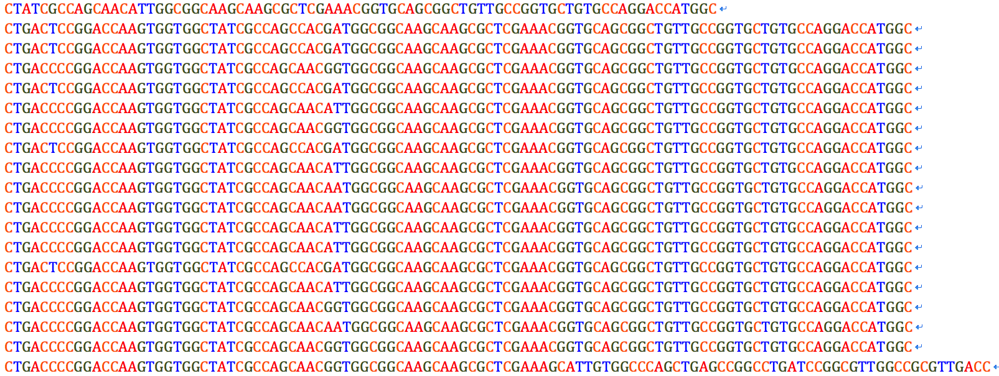
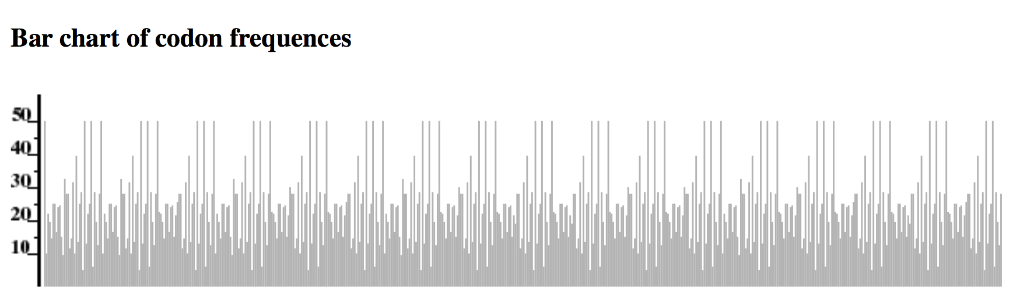
Original sequence

Slide 8
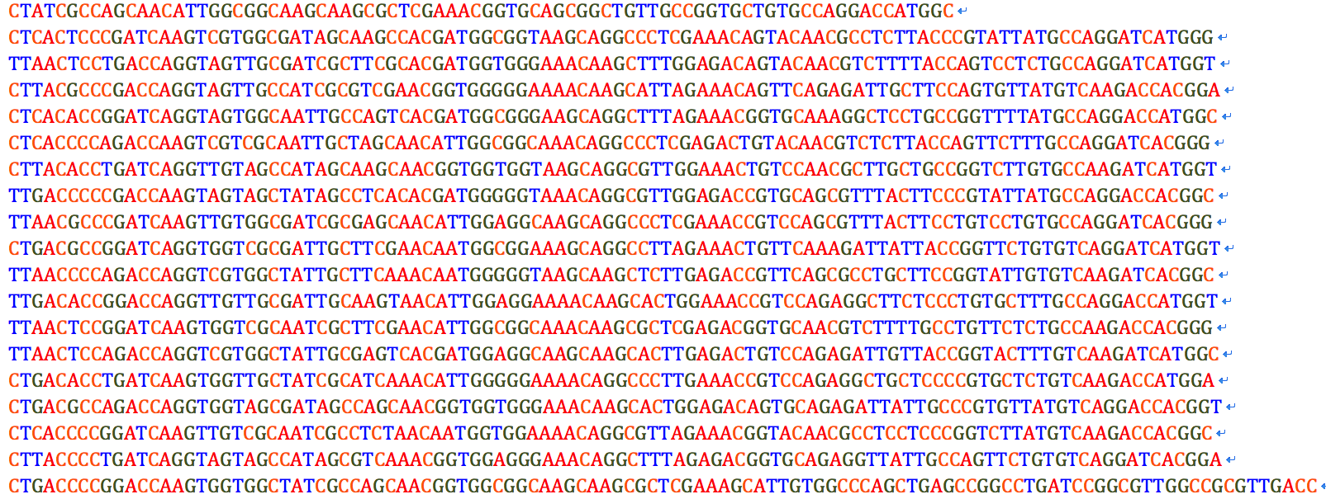
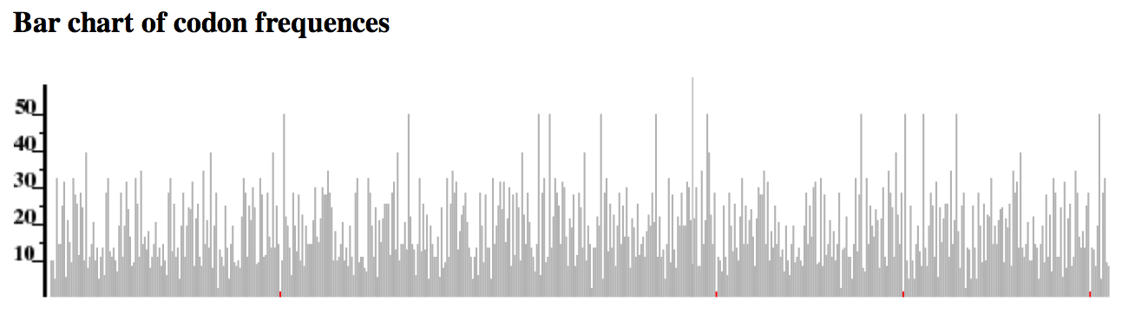
Modified sequence

Slide 9
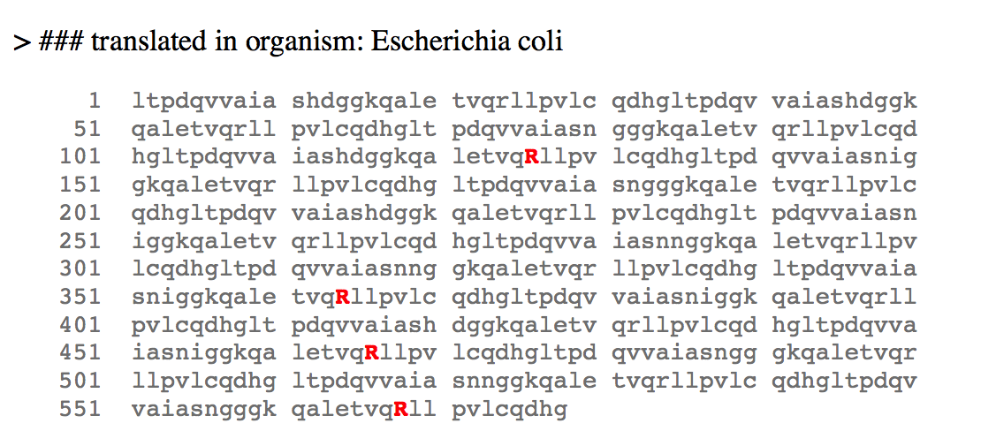
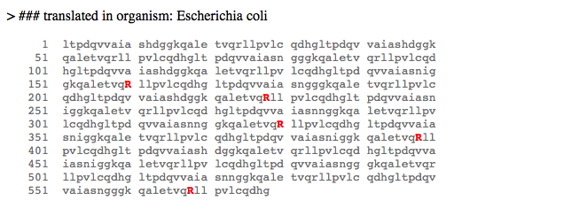
Lambda 大
Lambda 小

Slide 10
What to do next?
Find a mechanism for 同源重组 and modify the objective function.
Find a better genetic algorithm(SAGA? Particle Swarm?)
A variable of crossover and mutation methods.
…

Slide 11
Thank you!
Fork me on Github: http://github.com/Eureka22

