Slide 1
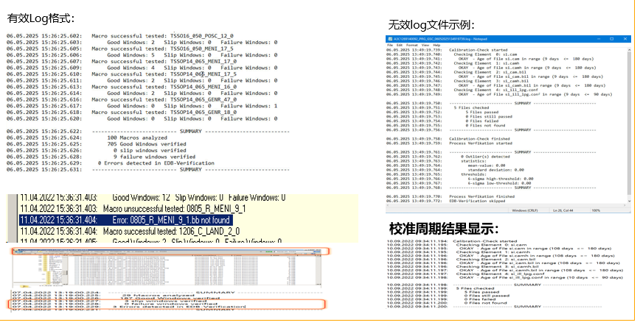
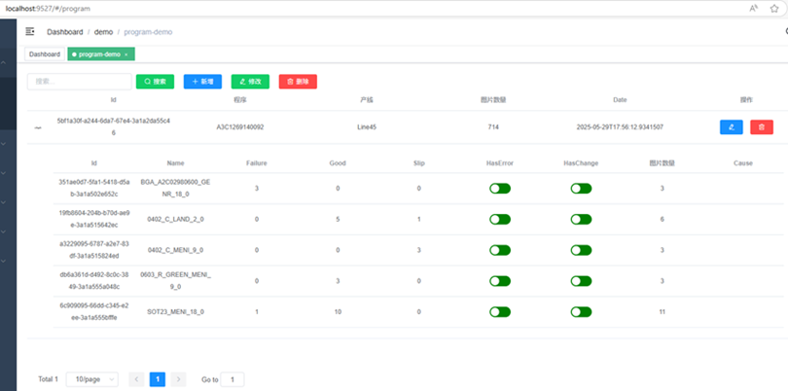
EDBMonitor
background
Before
A No systematized management
B Not Visualization
C Manual Check
After
1 Visualization
2 Systematized management
3 Email Notification

Slide 2
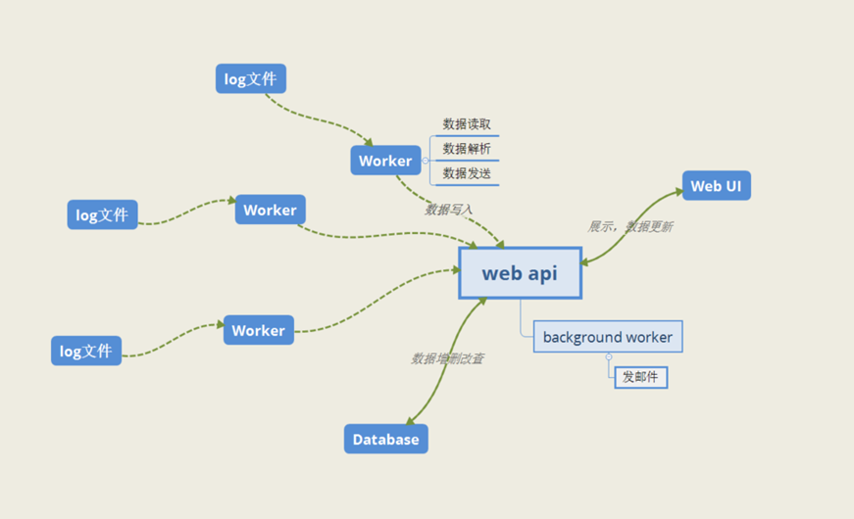
EDBMonitor
structure
A
B
C

