Slide 1
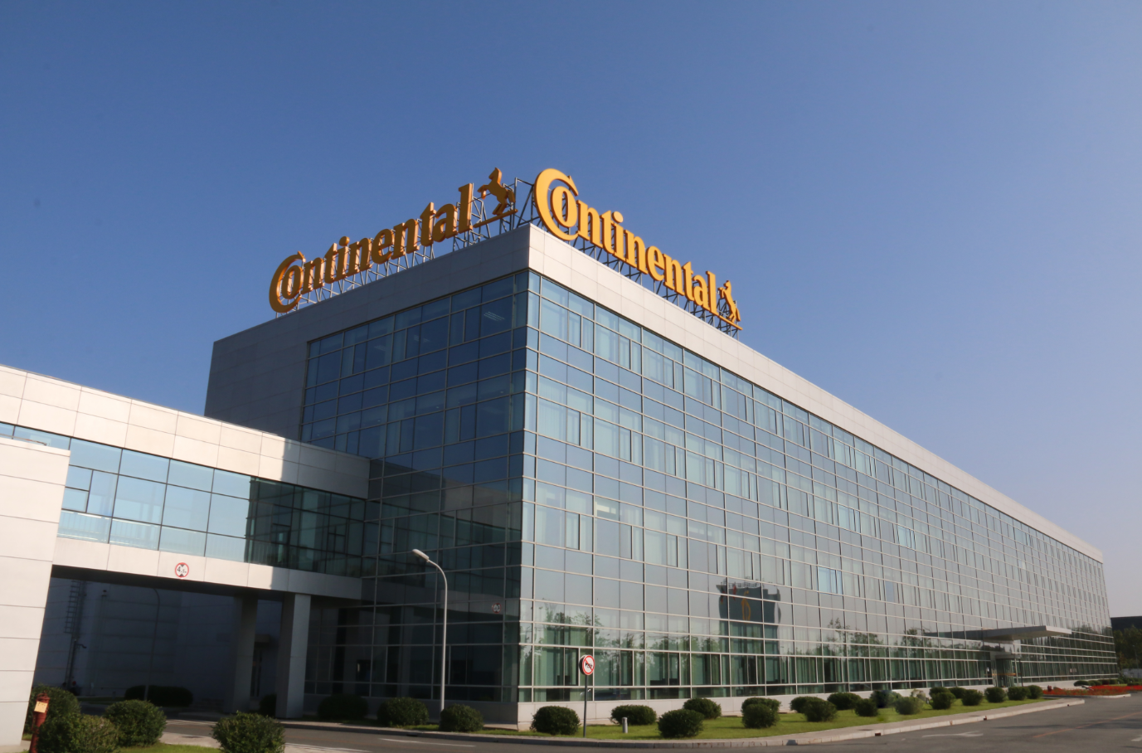
Project Report
Ji Fengxiang@Central IE PT
www.continental-corporation.com

Slide 2
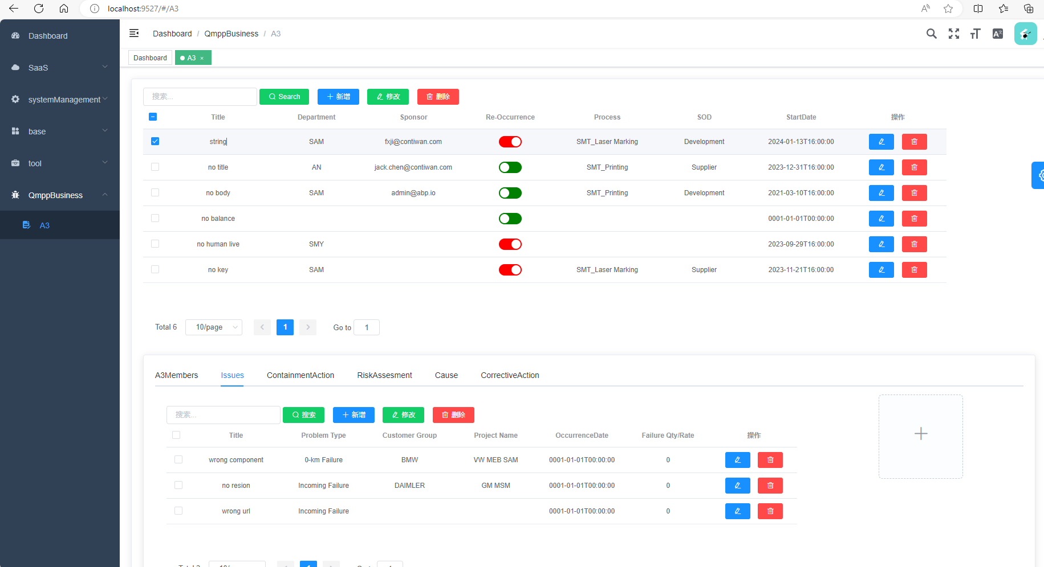
Future situation
Locally
Faster
Systematic

Slide 3
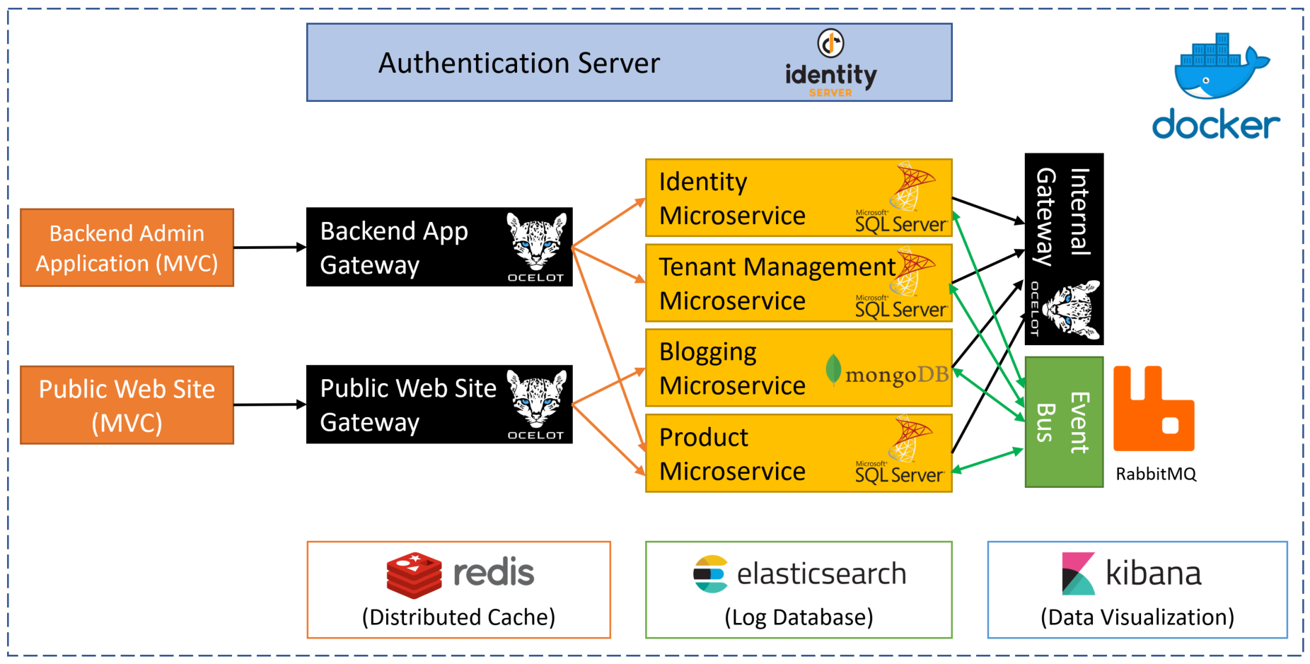
MicroService

Slide 4
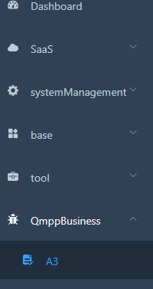
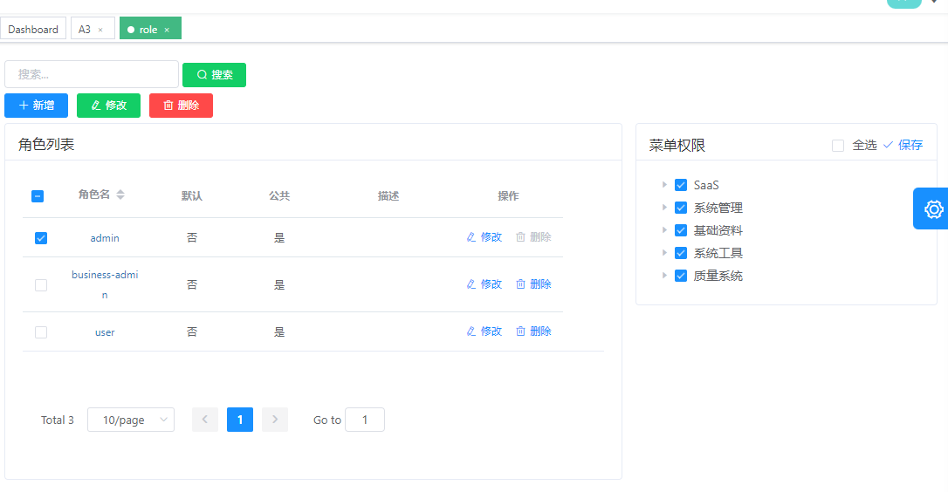
Role Base Access Control
Notes:
基于角色的权限控制

Slide 5
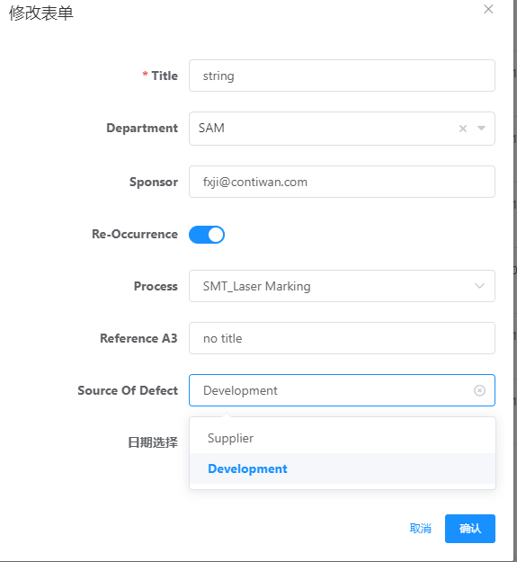
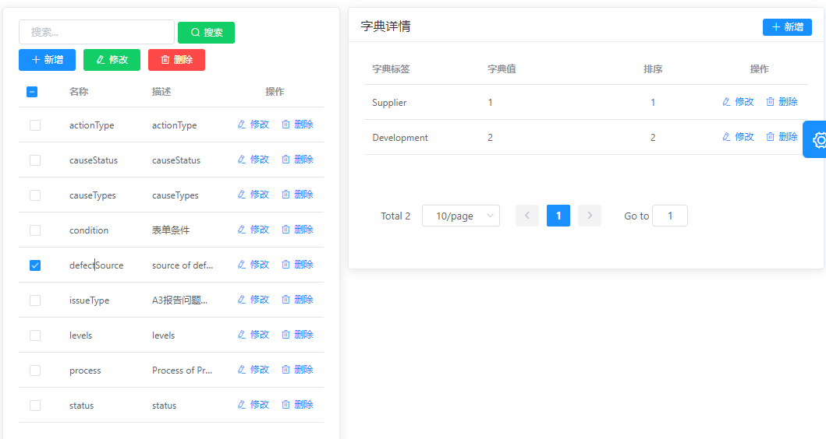
Less input More selection
Select
Dynamic options

Slide 6
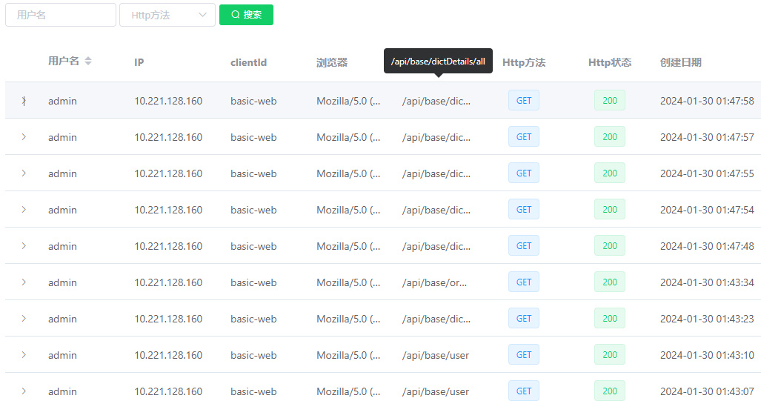
Log

Slide 7

Function
General Info
Team Members
Issue info
Containment Action
Risk Assessment
Cause
Corrective Action

Slide 8
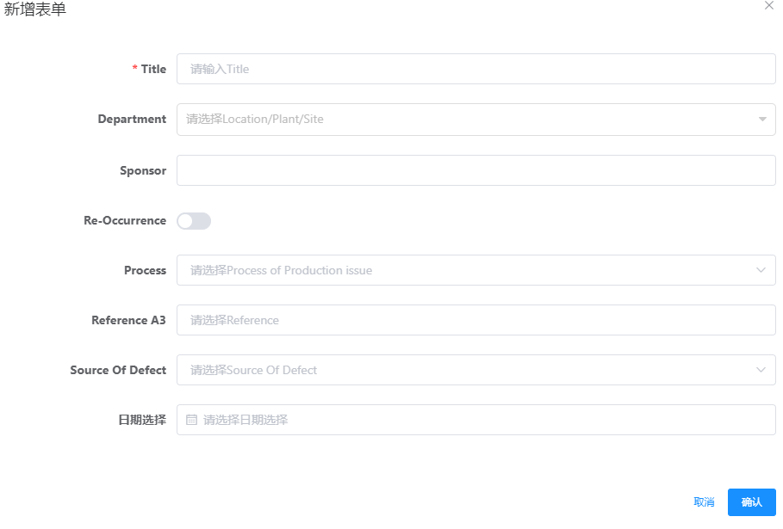
General info
Add new A3

Slide 9
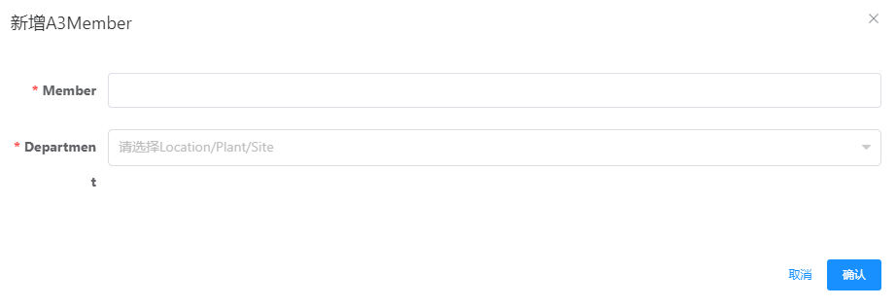
Team Members
Select related A3
Add Team Member

Slide 10
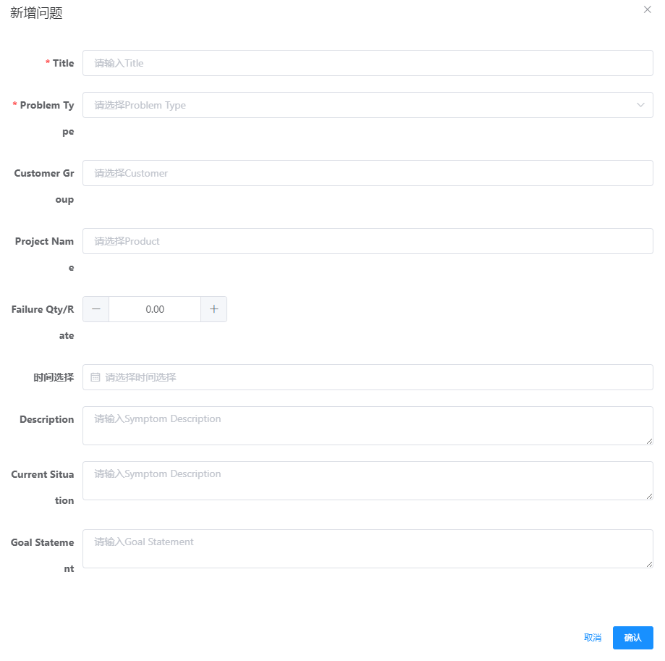
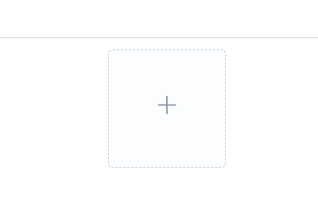
Issue info
Select related A3
Add Issue
Upload attachment

Slide 11
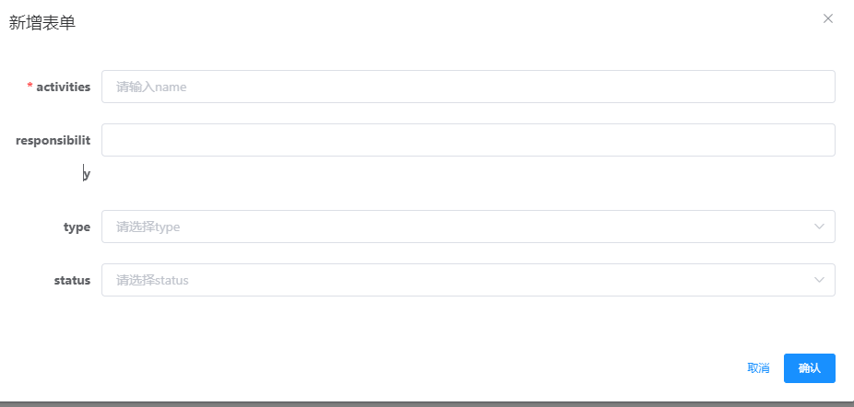
Containment Action
Select related A3
Add Containment Action

Slide 12
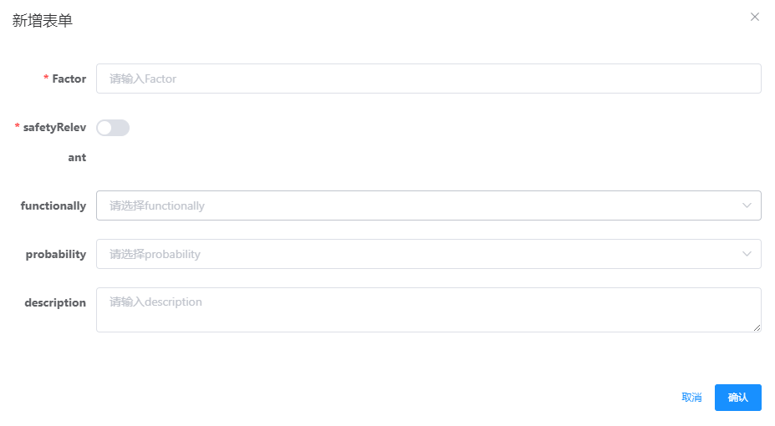
Risk Assessment
Select related A3
Add Risk Assessment

Slide 13
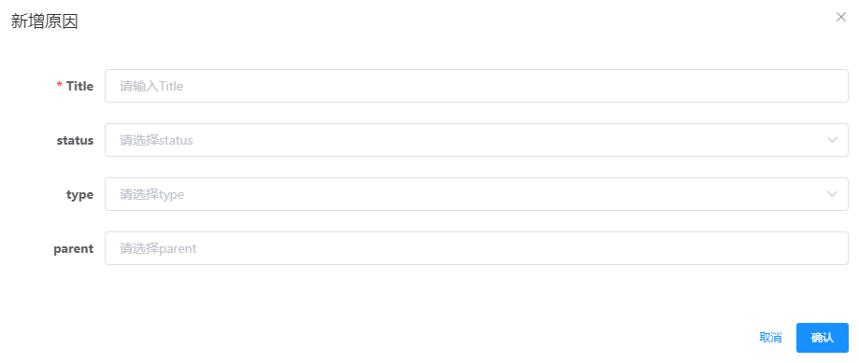
Cause
Select related A3
Add Cause

Slide 14
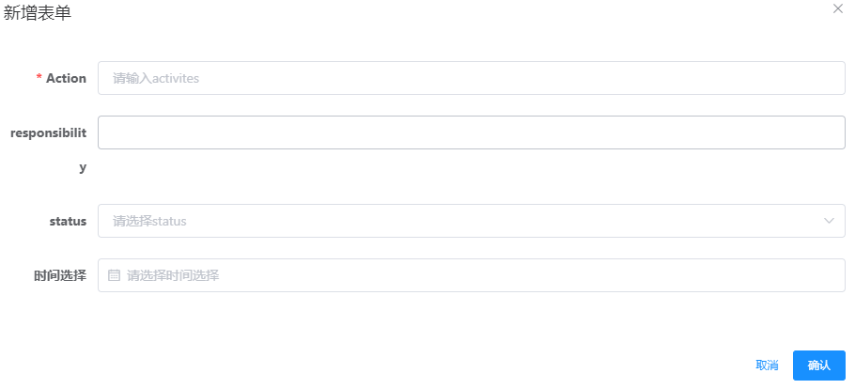
Corrective Action
Select related A3
Add Corrective Action

Slide 15


