Slide 1
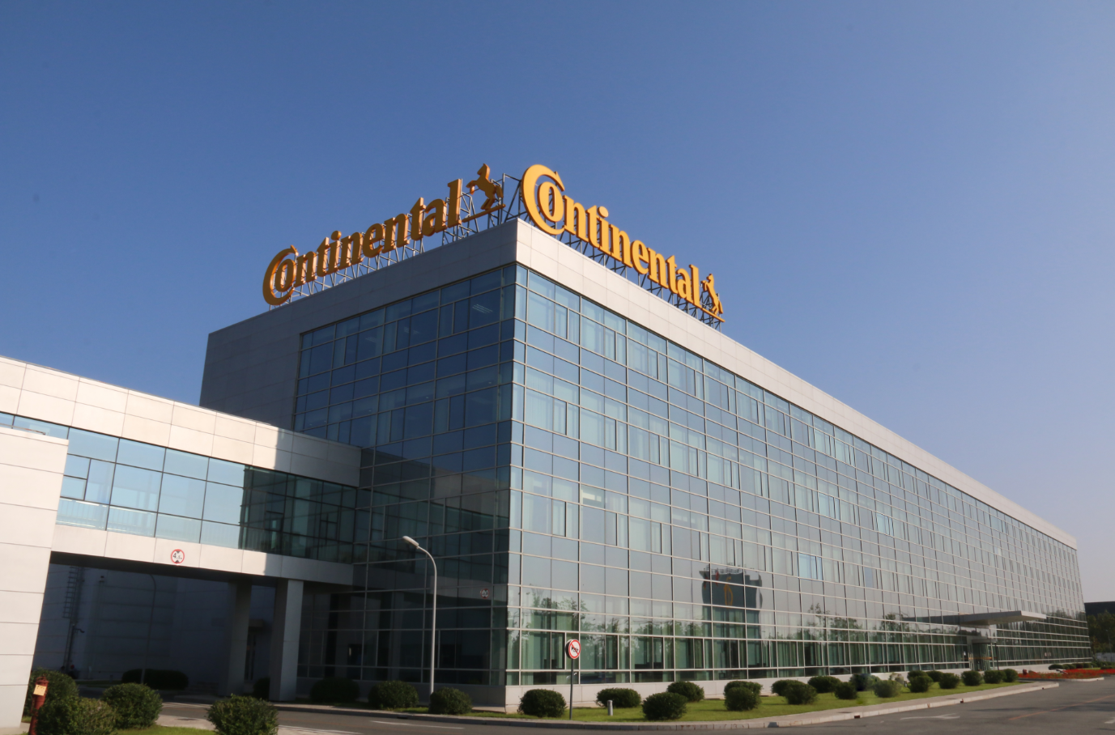
Project Report
Ji Fengxiang@Central IE PT
www.continental-corporation.com

Slide 2
Background
A3 electronic

Slide 3
Current situation
Paper or Mendix system at global
Lower
Limit

Slide 4
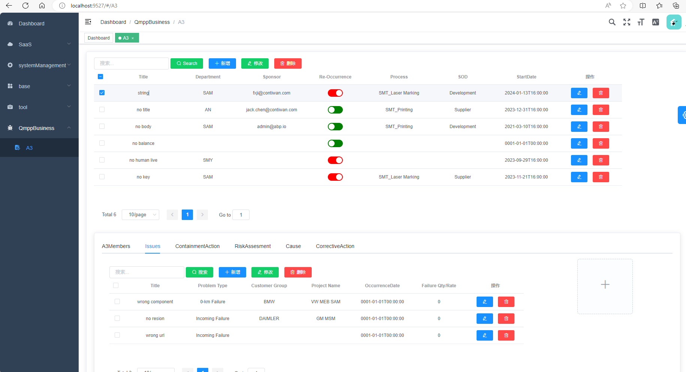
Future situation
Locally
Faster
Systematic

Slide 5
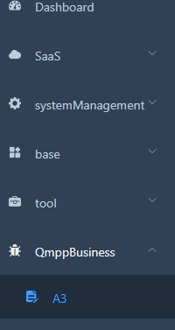
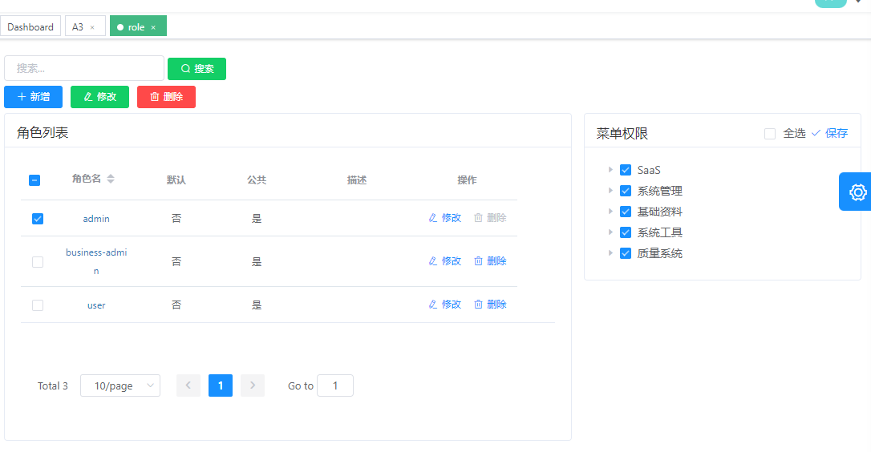
Role Base Access Control
Notes:
基于角色的权限控制

Slide 6
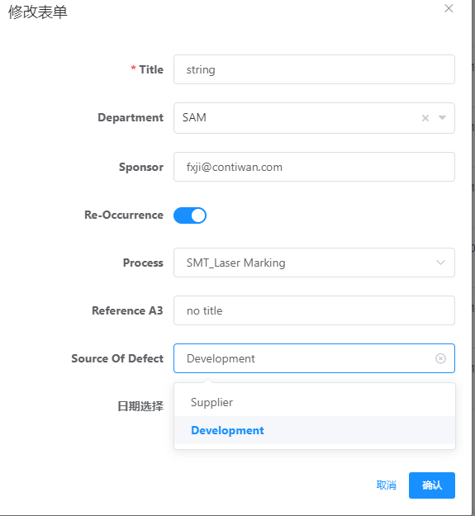
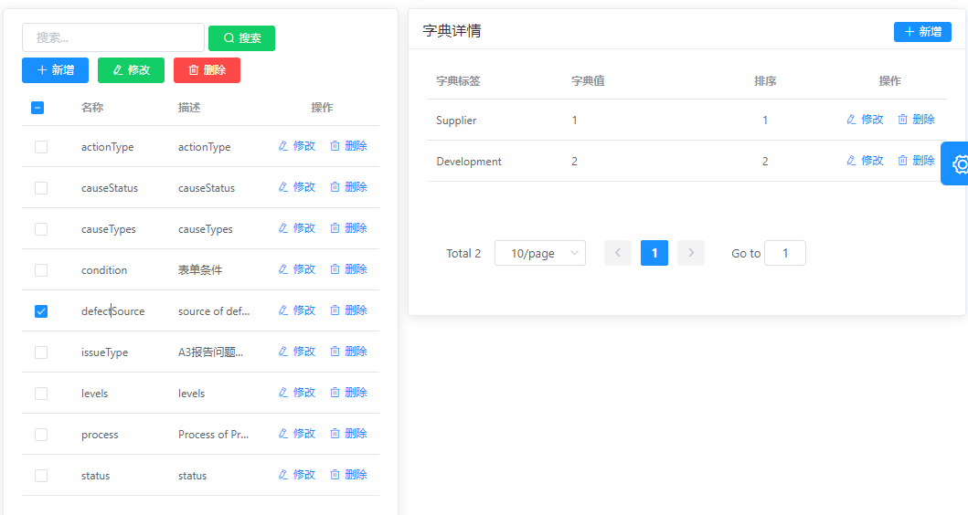
Less input More selection
Select
Dynamic options

Slide 7
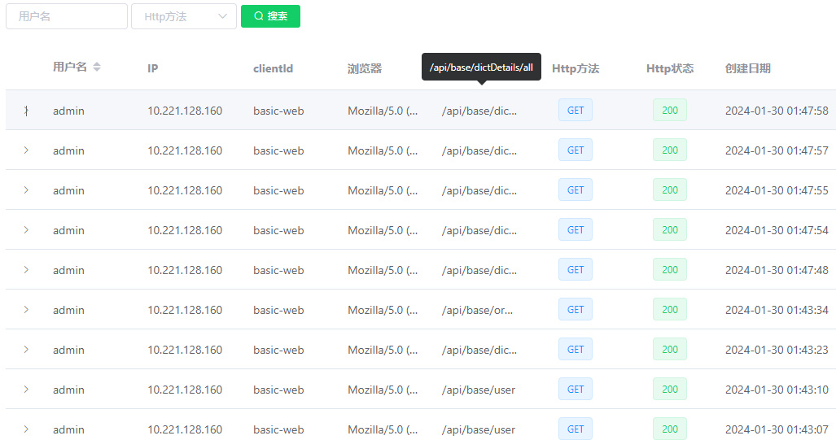
Log

Slide 8

Function
General Info
Team Members
Issue info
Containment Action
Risk Assessment
Cause
Corrective Action

Slide 9
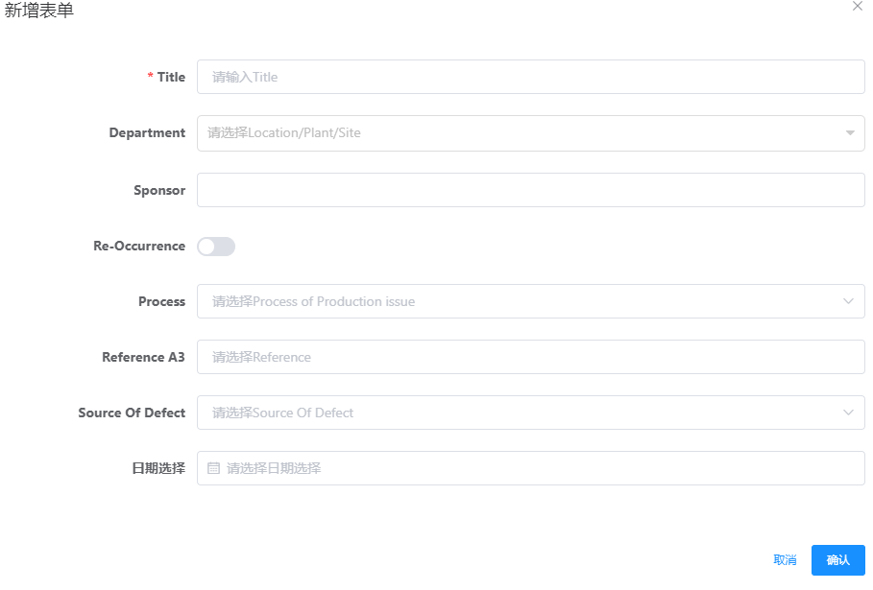
General info
Add new A3

Slide 10
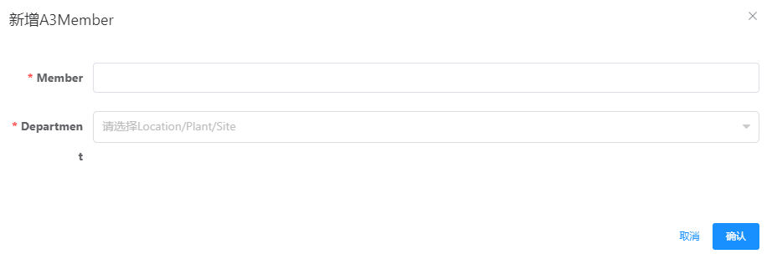
Team Members
Select related A3
Add Team Member

Slide 11
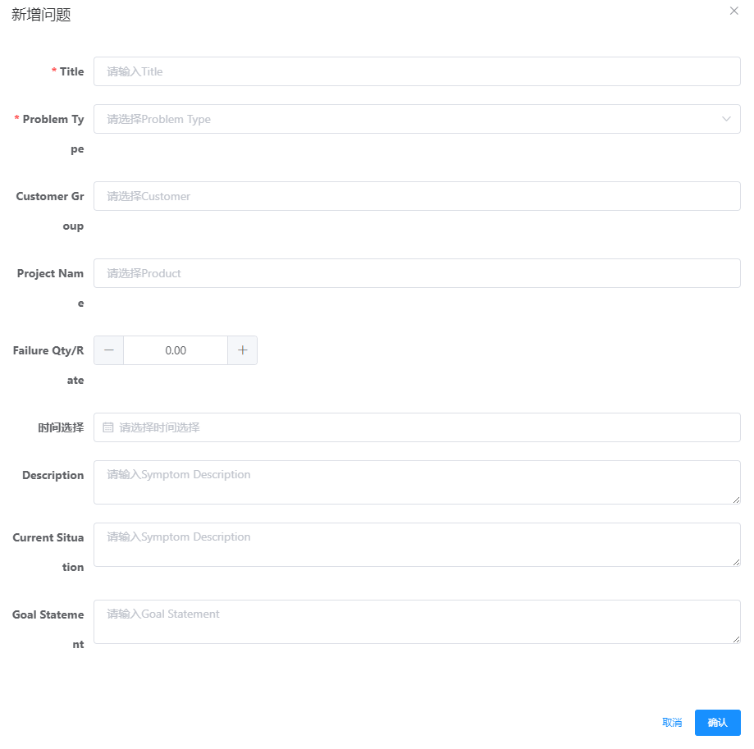
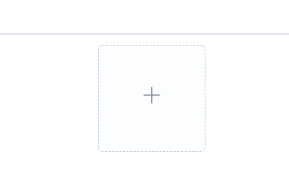
Issue info
Select related A3
Add Issue
Upload attachment

Slide 12
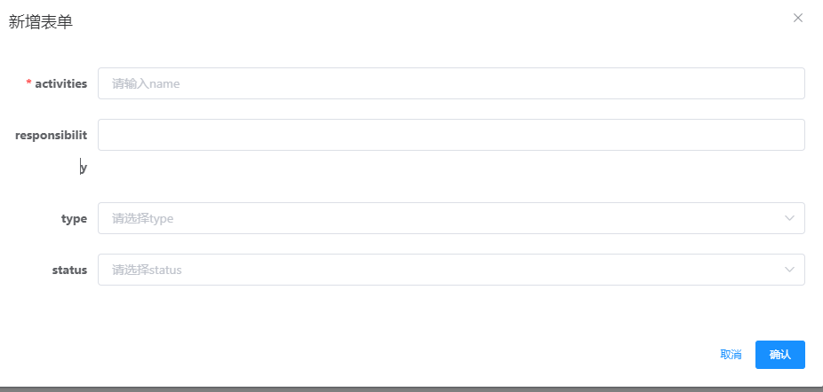
Containment Action
Select related A3
Add Containment Action

Slide 13
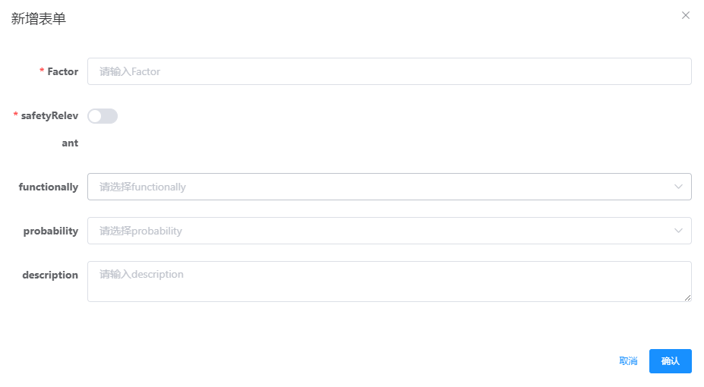
Risk Assessment
Select related A3
Add Risk Assessment

Slide 14
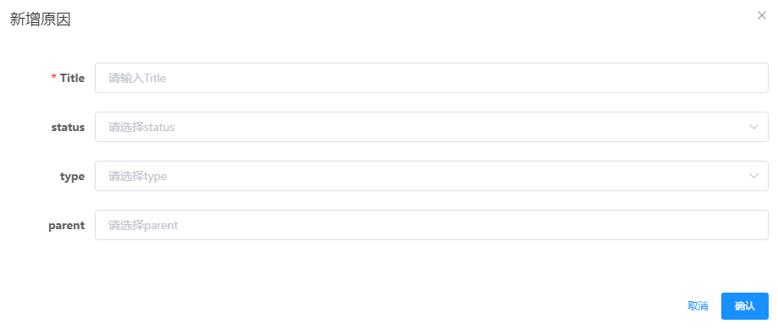
Cause
Select related A3
Add Cause

Slide 15
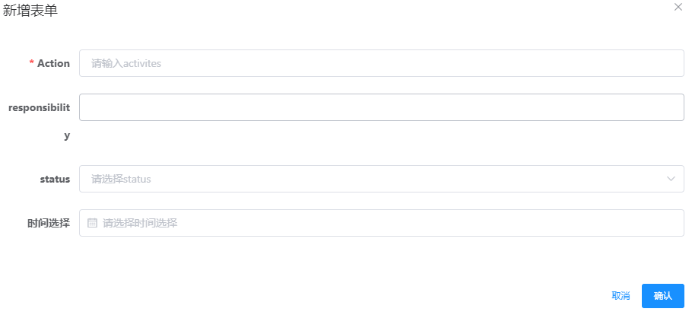
Corrective Action
Select related A3
Add Corrective Action

Slide 16
Benefit
Increase efficiency
current 60s/42pcs vs future 2s/42pcs
Decrease cost
No omission
Notes:
可以避免漏扫

Slide 17


