Slide 1
COMP 512 – Project final delivery
F. Lafrance, F.-X. Lemire

Slide 2
General architecture

Slide 3
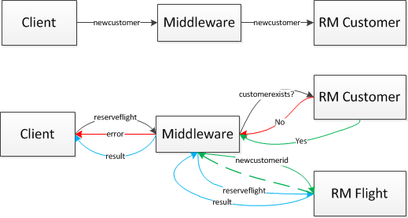
Customer management

Slide 4
Middleware
Routes messages between RMs and clients
Pools of proxies (1 per RM)
Queue of available proxies
Semaphore to make threads wait
Allows fine-grained management of proxies
Contains Transaction Manager / Lock Manager

Slide 5
Transaction manager
Instance variable at the RM
Allocates new transaction IDs
Manages:
Transaction results
Participants
Times-to-live
Heartbeats (with the handler)

Slide 6
Lock manager
Instance variable at the RM
Locking algorithm: 2PL
Lock conversion:
Normal case
When another transaction holding an R-lock ends:
T1: | T2:
R(x) | R(x)
W(x) (blocks) | …
… | …
(unblocks) | C

Slide 7
RMs
Pessimistic data management
Queue of pending operations per transaction
Write to master table only when committing
Timeout mechanism

Slide 8
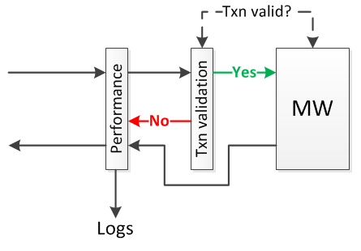
Handlers
(RM has no transaction validation handler)

Slide 9
2PC
MW asks RMs to prepare
Pending operations are written to a temp file
If all vote yes, MW confirms the commit
Operations are written to the master table, which is saved.

Slide 10
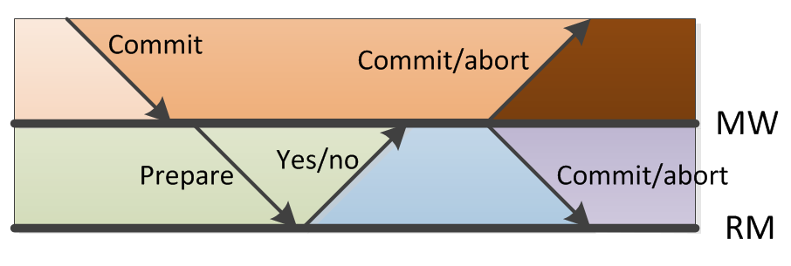
Recovery
Cases handled:

Slide 11
Testing
Automated client: runs transactions from a specified file with given rate, method, amount
Performance scenarios:
One client, one RM
One client, multiple RMs
Multiple clients
Local, over LAN
%1,start
%2,queryflight,%1,767
abort,%1,%2,==,0
reserveflight,%1,1,767
commit,%1

Slide 12
Performance figures: one client
Time per transaction (6 ops/txn) for various scenarios over 1000 transactions

Slide 13
Performance figures: multiple clients

