Slide 1
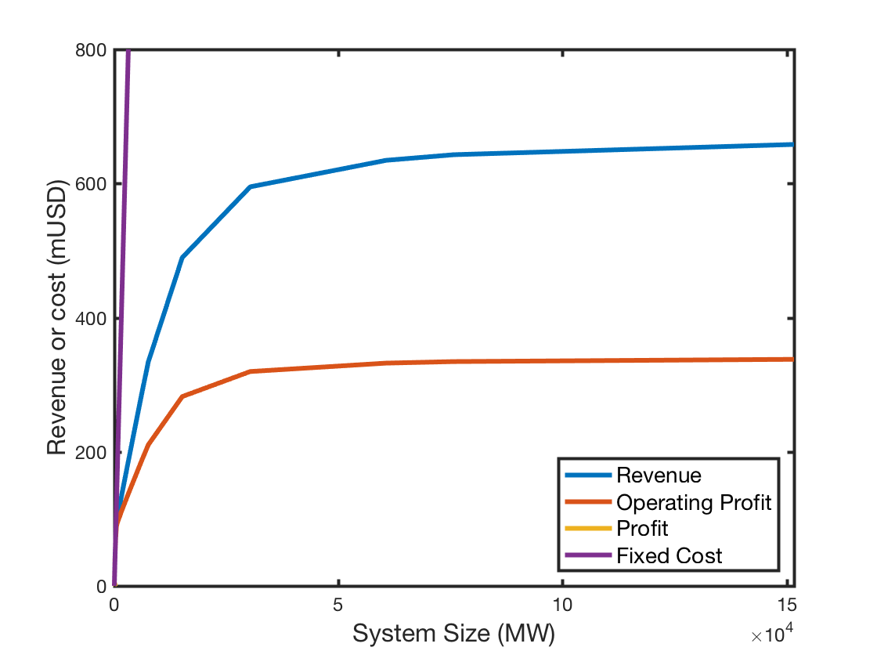
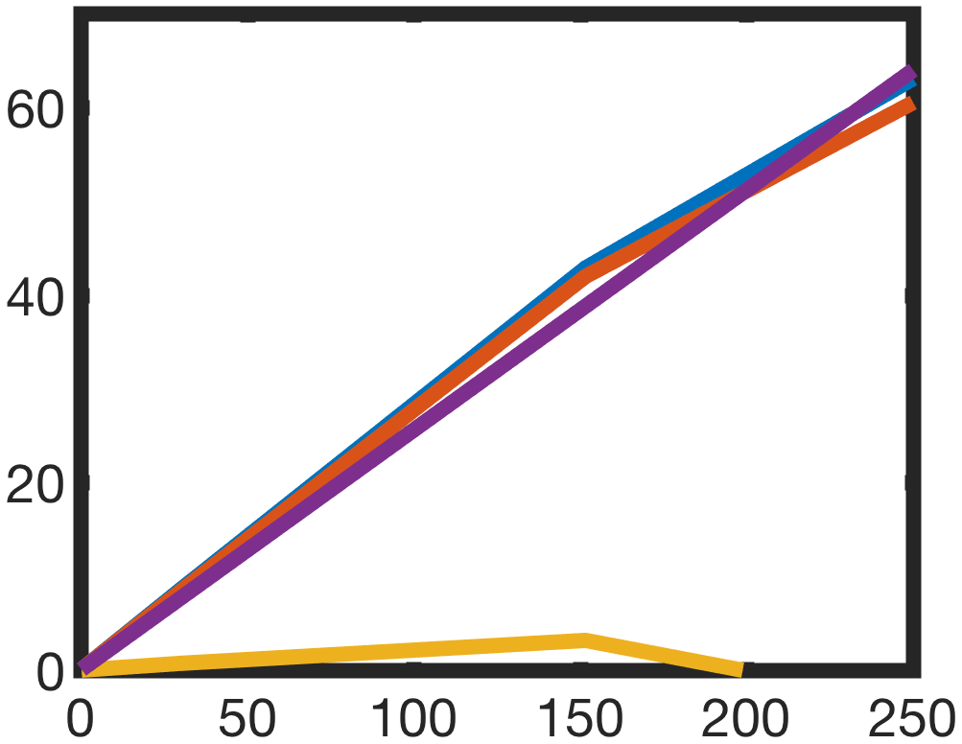
max. Revenue
max. System Size with pos. Profit
max. Profit
max. marginal Revenue

Slide 2
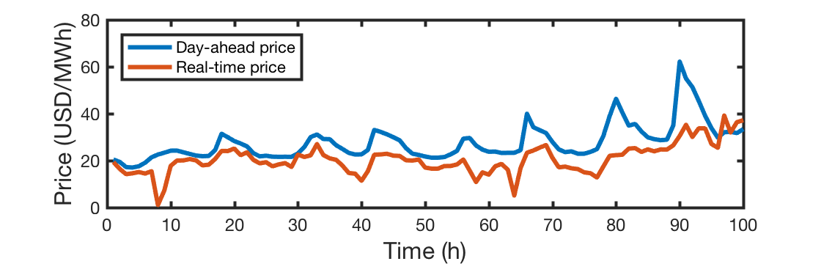
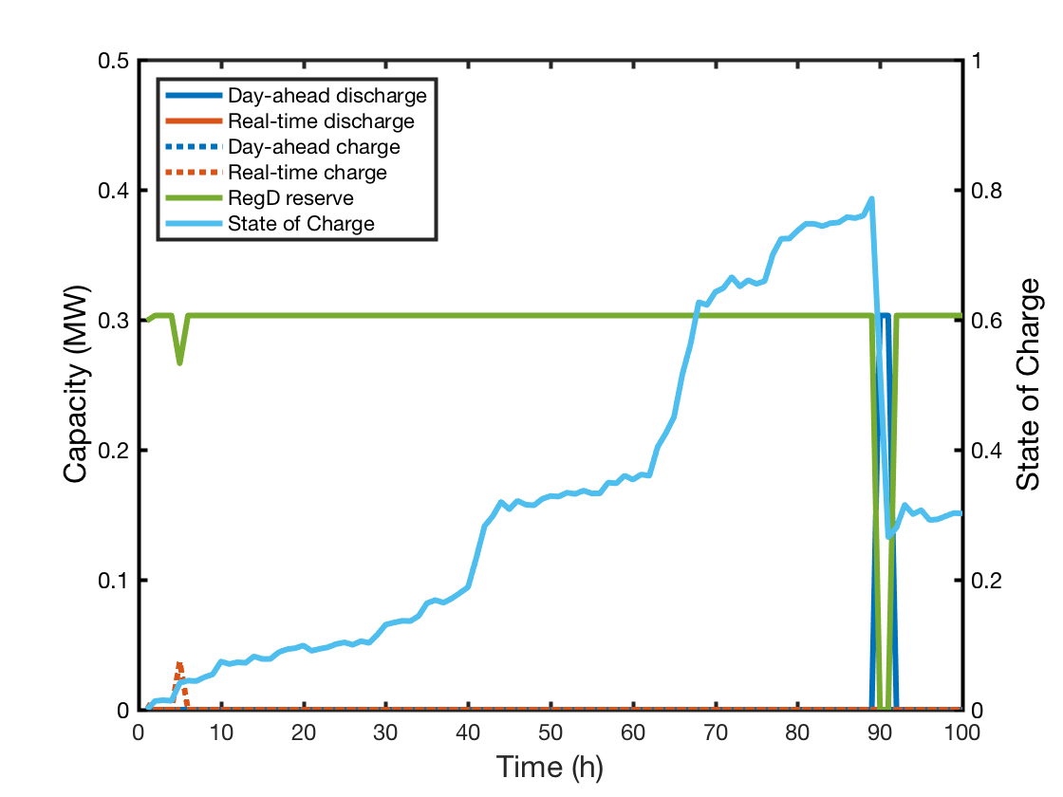

Slide 4
 | DA | ID | BE | PCR | SCR
Profitability ratio | -95.0% | -93.4% | 7% | -39.8% | -95.5%

Slide 5
DE Stacking

Slide 6
PJM ESS

Slide 7
NSW ESS

Slide 8
DE EV2G

Slide 9
PJM EV2G

Slide 10
NSW EV2G

Slide 11
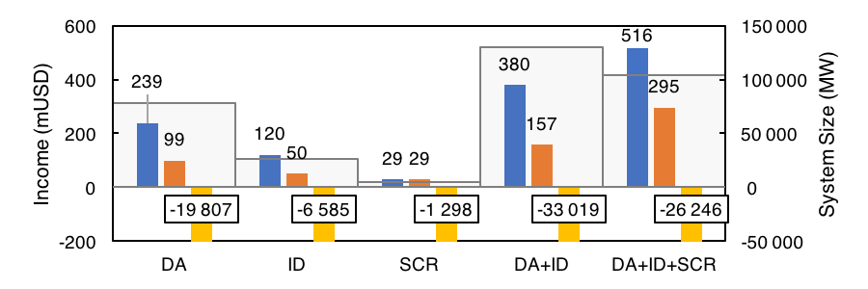
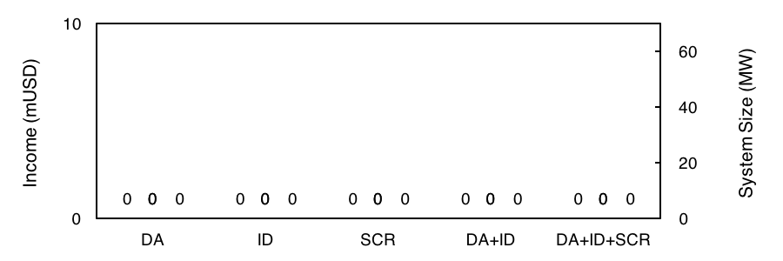
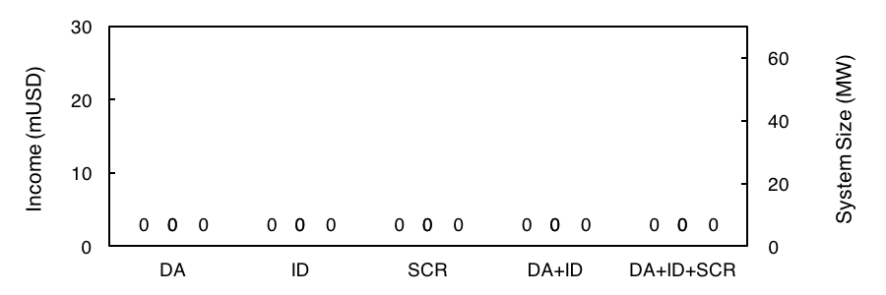
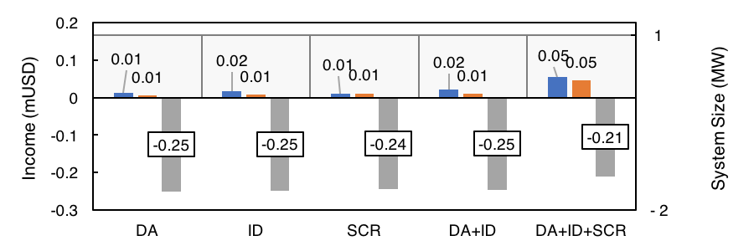

Slide 13
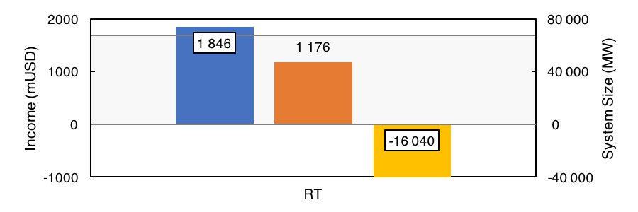
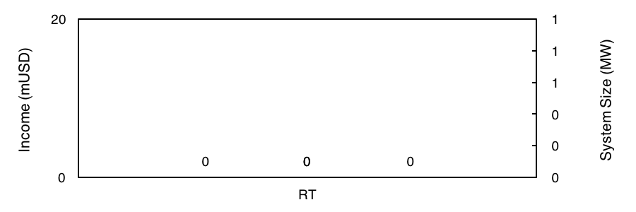
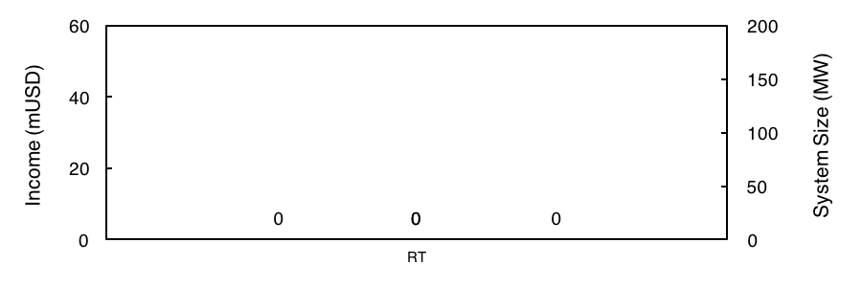
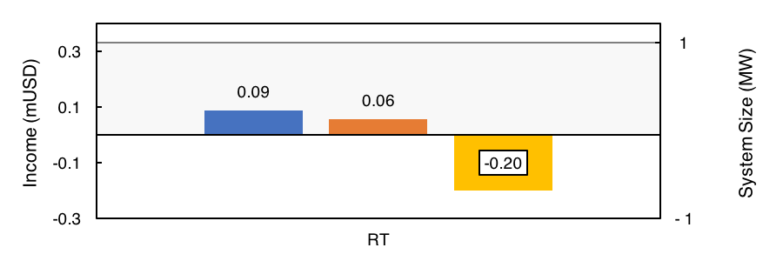

Slide 17
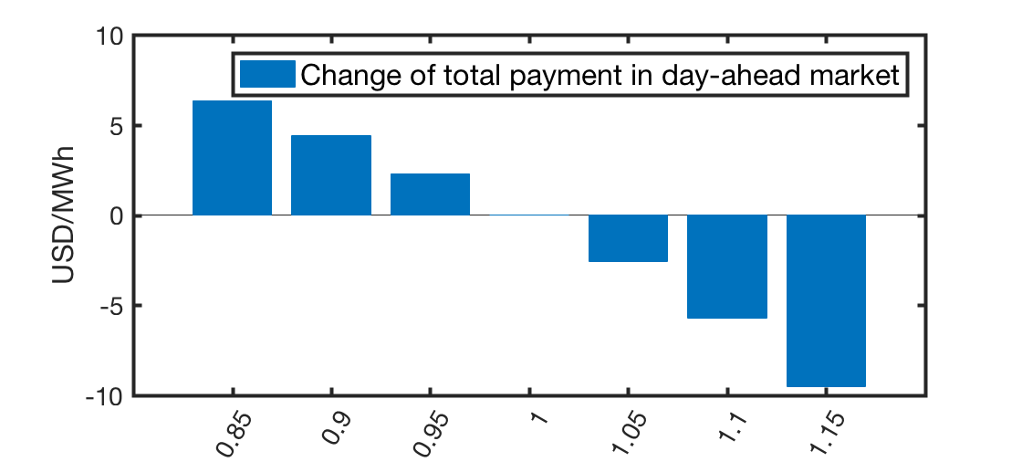
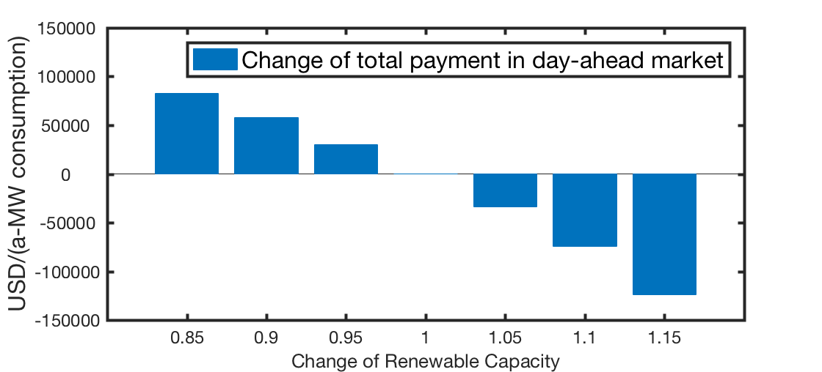
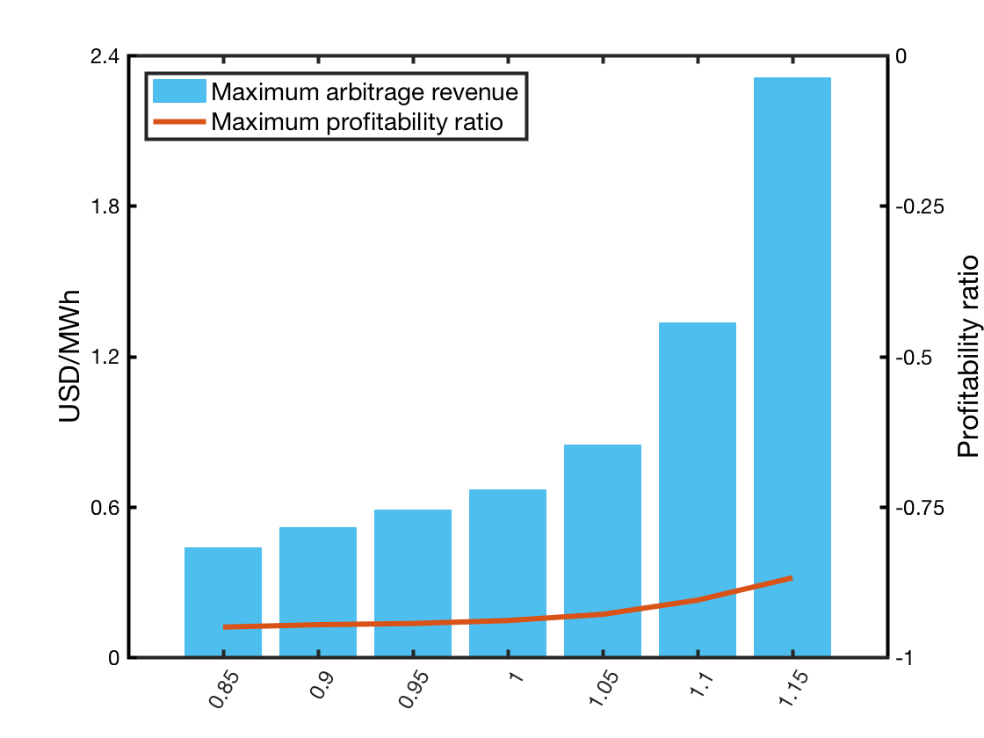
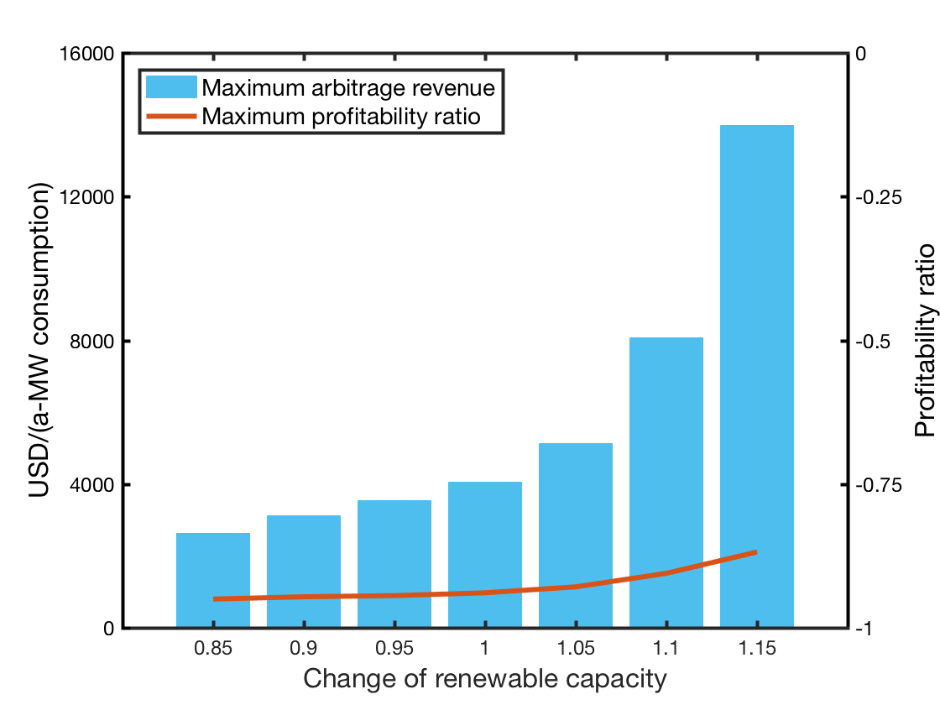
Change of renewable capacity

Slide 18
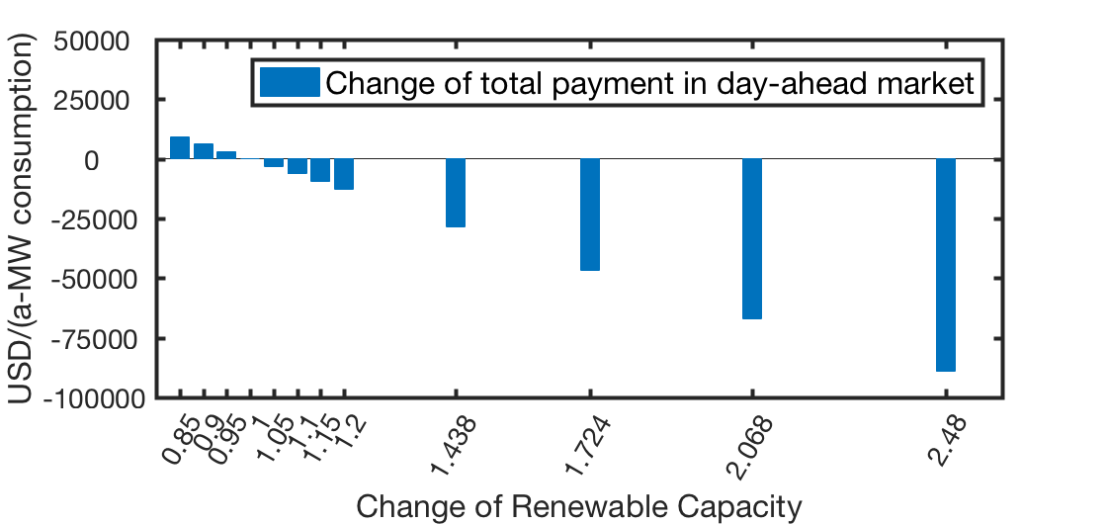
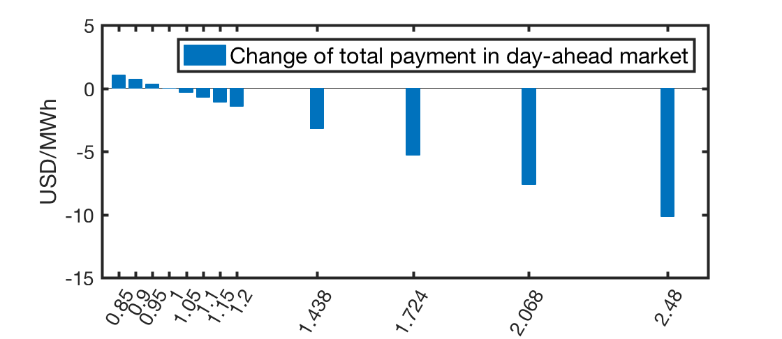
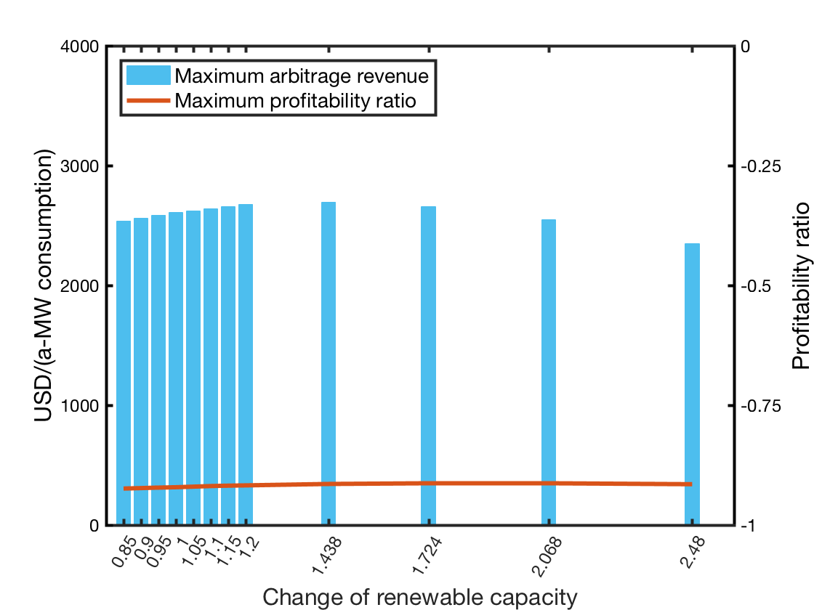
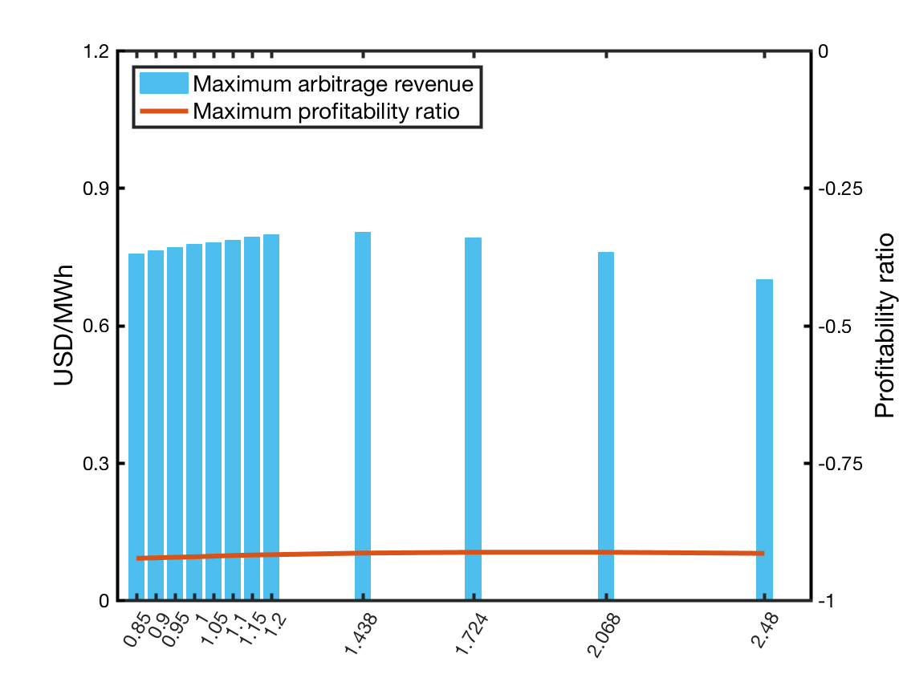
Change of renewable capacity

Slide 19
17

Slide 20
 | DA | ID | BE | PCR | SCR | DA+ID | DA+ID+SCR
Profitability ratio | -95.0% | -93.4% | 7.0% | -39.8% | -95.5% | -95.3% | -76.1%

Slide 21
 | DA | RegD | RegA | DA+RT | DA+RT+RegD | DA+RT+RegA
Profitability ratio | -94.0% | 4.0% | -52.3% | -87.5% | 7.1% | -29.0%

Slide 22
 | RT
Profitability ratio | -70.6%

