Slide 2
General
In US and Australia, the system operator is also the market operator, while they are separate in Europe
With the first mode, the ISOs or AEMO (Australian Energy Market Operator) require the market participants to provide more information such than price & volume and run more sophisticated optimization for market clearing to obtain the minimum system cost
As a consequence, the ISOs (and AEMO) have larger impacts on the markets, compared to the TSOs in Europe. The profitability of flexibility management systems could be very sensitive to the business rules and market designs
In addition, bilateral transactions are also monitored in ISO/AEMO market while it is not included in the exchange volumes in Europe power markets
Power Pool
Power Exchange
SC
PM
SC
PM / Bilateral transactions
ISO
TSO
AS
TO
AS
TO
SC: Scheduling Coordinator
PM: Power Market
AS: Ancillary Service coordinator
TO: Transmission Owner

Slide 3
Day-ahead (D -1)
Operating day (D)
Day-ahead market
Intra-day market
Power exchange
Balancing energy market
Power pool
Day-ahead market
Real-time market

Slide 4
Long-term
Week-ahead
Day-ahead
Operating day
Procuring capacity
Delivering balancing energy
Capacity
Energy
Centralized procurement
Decentralized procurement
System Operator
System Operator
Obligation
Obligation
Service
Provision
Obligation
Service
Provision and procurement
Electricity Market participant
Electricity Market participant
Payment
Charge
Bilateral agreement and/ or market organized by system operator
Payment
Ancillary Service provider
Electricity Market participant
Ancillary Service provider

Slide 5
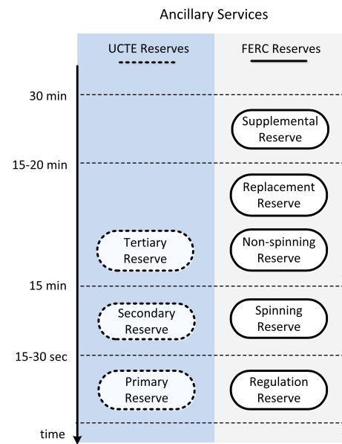

Slide 6
Indirect participation (in complement with existing load)
No
Power pool
Is accessible?
Energy market
Power pool or Power Exchange
Yes
Marketplaces
Power exchange
Day-ahead
Intra-day
Pricing schemes
Real-time

Slide 7
Given Market & Technology
Energy market
Power pool or Power Exchange
Power pool
Power exchange
No
Yes
Is accessible?
Indirect participation (in complement with existing load)
Marketplaces
Day-ahead
Intra-day
Real-time
Pricing schemes
Conclusions of qualitative assessment

Slide 8
Given Market & Technology
Frequency control ancillary service market
Marketplaces
PCR
FCR
Various terminologies
Up / Down
Accessible (qualification)?
Yes
Centralized
Centralized or decentralized procurement?
Decentralized
Flexibility provision to system operator and market player with obligation (two asymmetric streams)
Flexibility provision to market players with obligation (one symmetric stream)
Conclusions of qualitative assessment

Slide 9
Given Market & Technology
Yes
No
Capacity market
Is there a capacity market?
Energy-only market
Yes
Other capacity remuneration mechanism?
Is accessible?
Strategic reserve or emergency product
Yes
Conclusions of qualitative assessment

