Slide 1
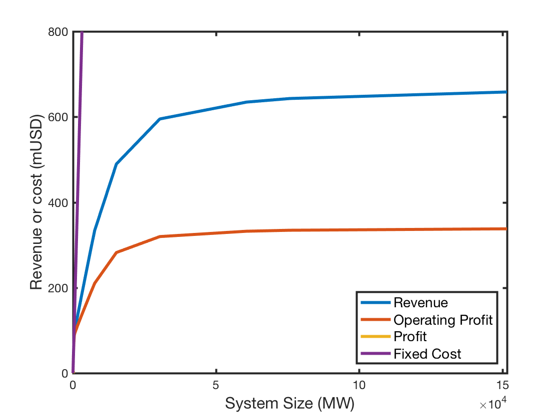
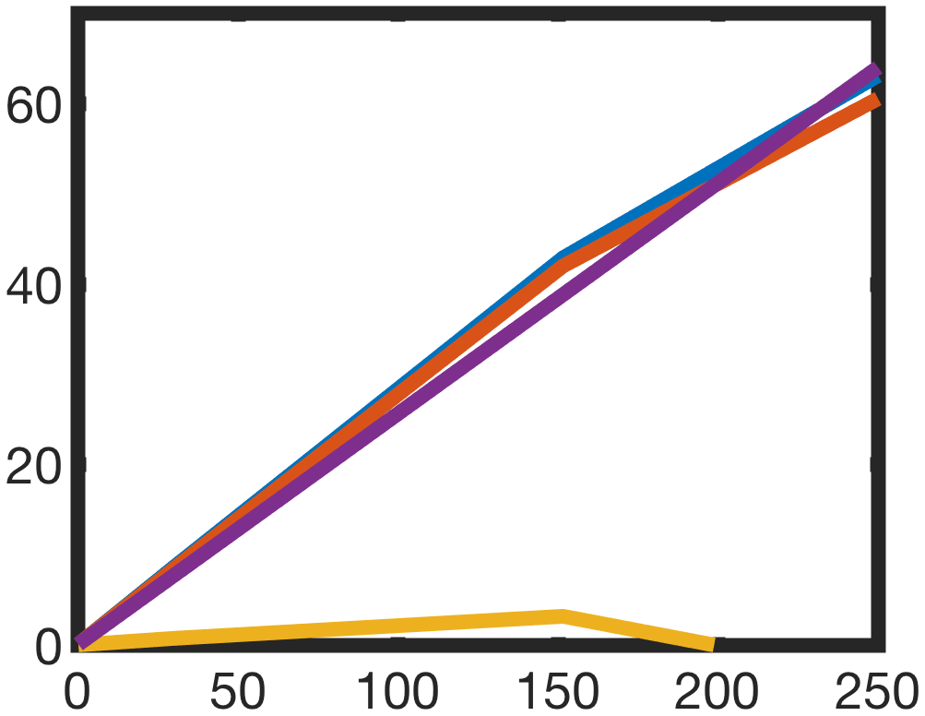
max. Revenue
max. System Size with pos. Profit
max. Profit
max. marginal Revenue

Slide 2

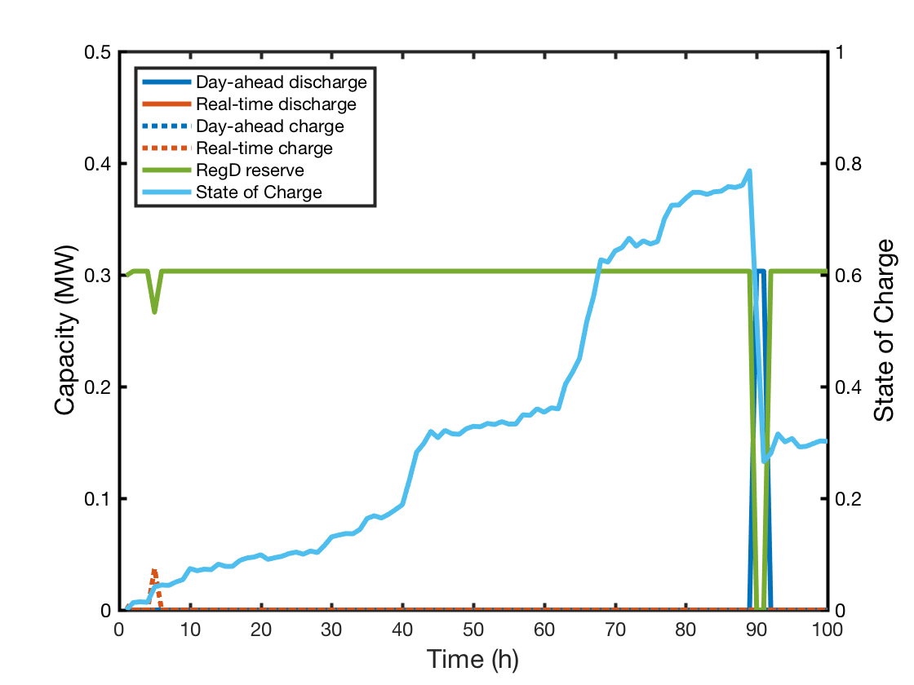

Slide 3
DE ESS

Slide 4
DE Stacking

Slide 5
PJM ESS

Slide 6
NSW ESS

Slide 7
DE EV2G

Slide 8
PJM EV2G

Slide 9
NSW EV2G

Slide 10
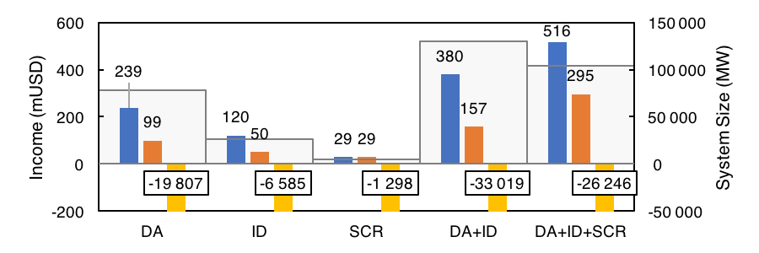
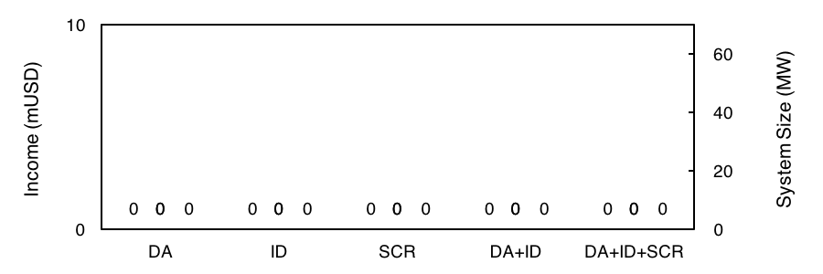
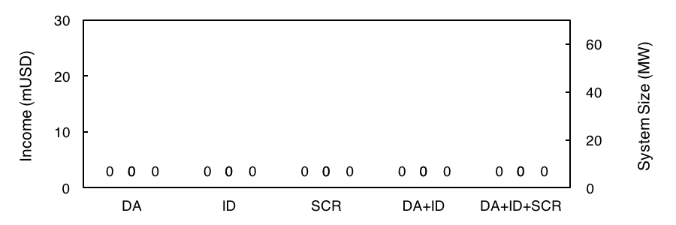
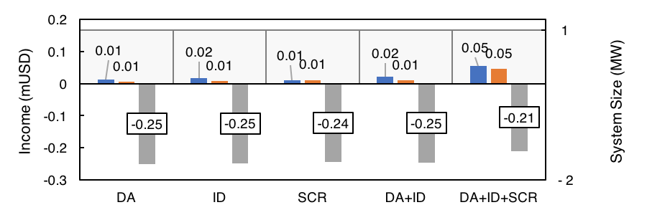

Slide 12
