Slide 1
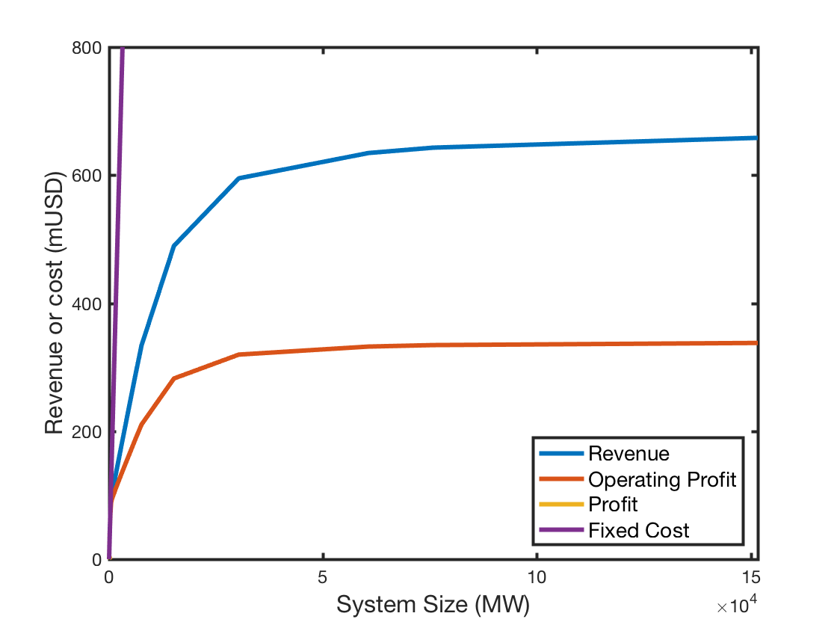
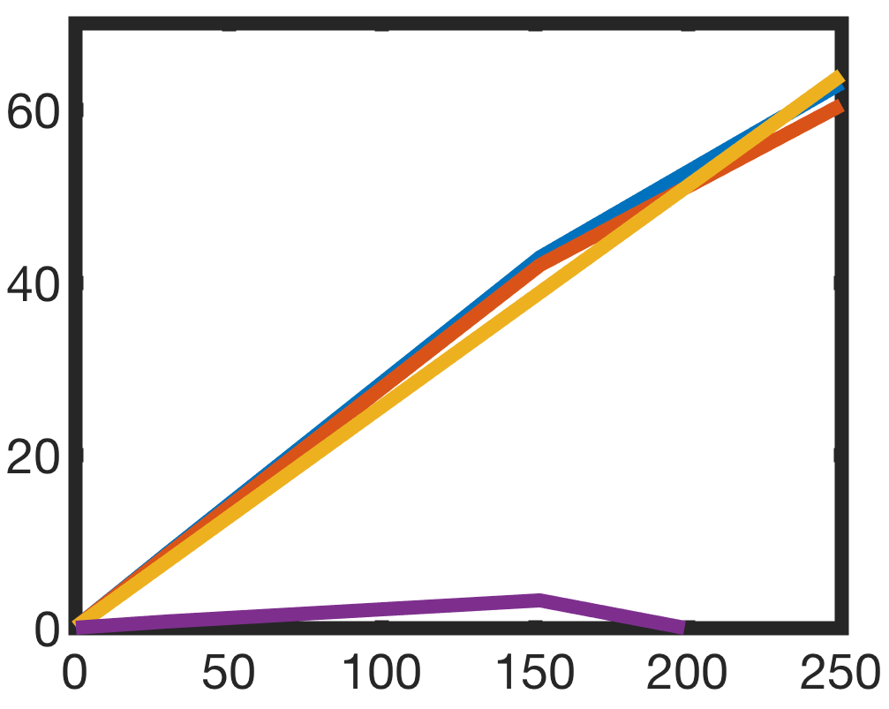
max. Revenue
max. System Size with pos. Profit
max. Profit
max. marginal Revenue

