Slide 1
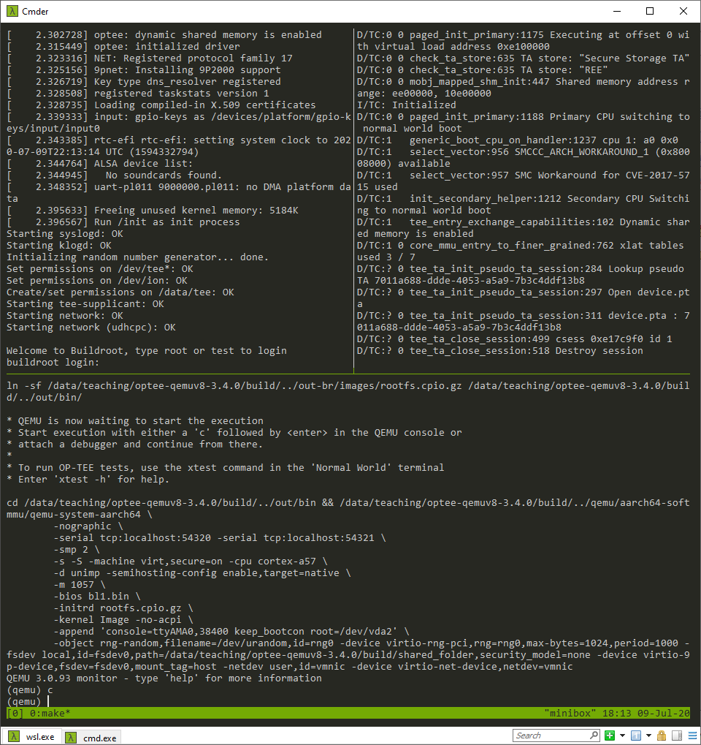
normal world
console
secure world
console
QEMU console

