Slide 1
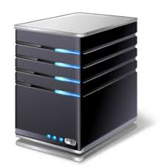

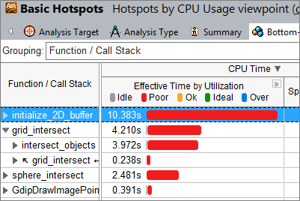
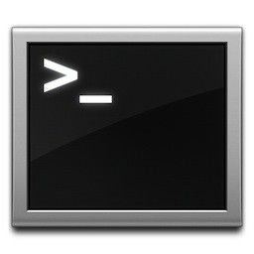
SSH
SSH
portal.cs.virginia.edu
Your local machine
CS servers
(labsrv06, granger1…)
UVA campus network

