Slide 1


Computer Security and Cryptography
Lecturer: Zhou Peng, Ph.D in Computer Network Security
pzhou@shu.edu.cn
Lecture 9

Slide 2

Computer Security and Cryptography
Lecture 9
HTTPS: goals and pitfalls

Slide 3
Goals for this lecture
Brief overview of HTTPS:
How the SSL/TLS protocol works (very briefly)
How to use HTTPS
Integrating HTTPS into the browser
Lots of user interface problems to watch for
HTTPS: goals and pitfalls

Slide 4

Threat Model: Network Attacker
Network Attacker:
Controls network infrastructure: Routers, DNS
Eavesdrops, injects, blocks, and modifies packets
Examples:
Wireless network at Internet Café
Internet access at hotels (untrusted ISP)
HTTPS: goals and pitfalls

Slide 5
SSL/TLS overview
Public-key encryption:
Alice
Bob
m
Enc
c
c
Dec
m
PK_{Bob}
SK_{Bob}
Bob generates (SK_{Bob} , PK_{Bob} )
Alice: using PK_{Bob} encrypts messages and only Bob can decrypt
HTTPS: goals and pitfalls

Slide 6

Certificates
How does Alice (browser) obtain PK_{Bob} ?
Browser Alice
CA
Server Bob
choose
(SK,PK)
PK and
proof “I am Bob”
check
proof
PK_{CA}
PK_{CA}
SK_{CA}
issue Cert with SK_{CA} :
Verify
cert
Bob’s key is PK
Bob’s key is PK
Bob uses Cert for an extended period (e.g. one year)
HTTPS: goals and pitfalls

Slide 7
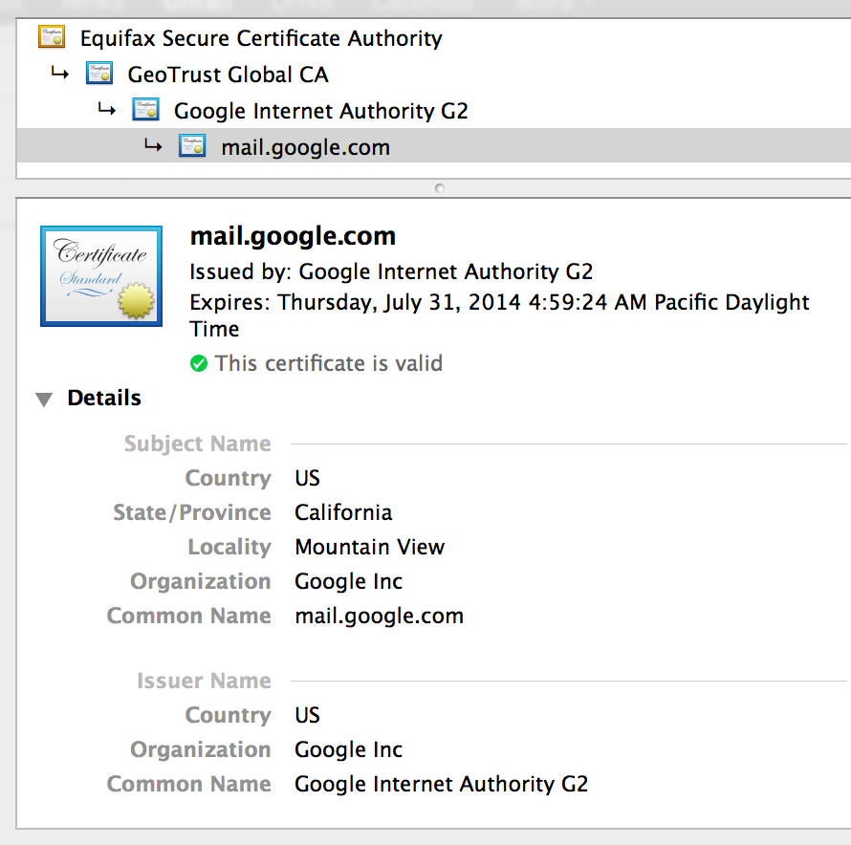
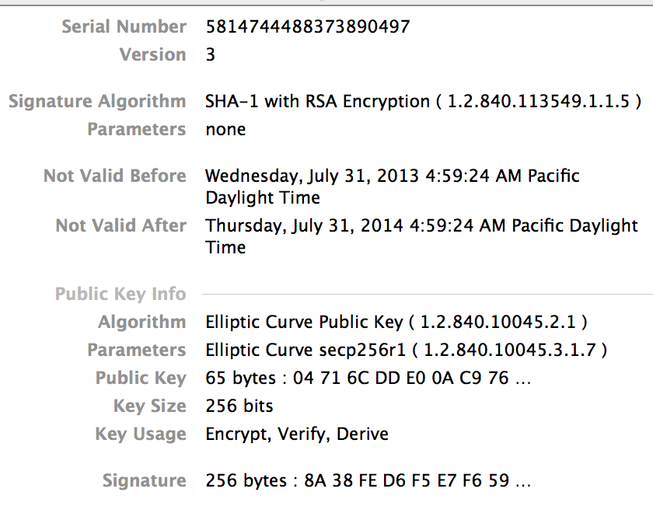
Certificates: example
Important fields:
HTTPS: goals and pitfalls

Slide 8
Certificates on the web
Subject’s CommonName can be:
An explicit name, e.g. cs.stanford.edu , or
A wildcard cert, e.g. *.stanford.edu or cs*.stanford.edu
matching rules:
“*” must occur in leftmost component, does not match “.”
example: *.a.com matches x.a.com but not y.x.a.com
(as in RFC 2818: “HTTPS over TLS”)
HTTPS: goals and pitfalls

Slide 9
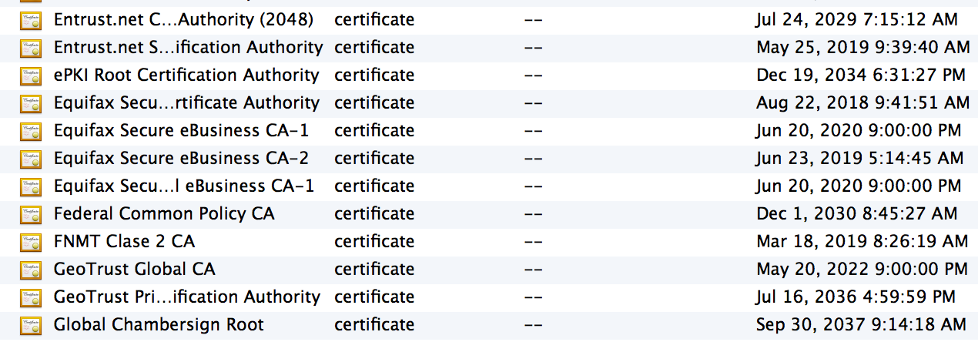
Certificate Authorities
⋮
Browsers accept certificates from a large number of CAs
Top level CAs ≈ 60
Intermediate CAs ≈ 1200
⋮
HTTPS: goals and pitfalls

Slide 10
Brief overview of SSL/TLS
browser
server
client-hello
cert
server-hello + server-cert (PK)
SK
key exchange (several options): EC-DHE
server-key-exchange
client-key-exchange
k
Finished
k
HTTP data encrypted with KDF(k)
Most common: server authentication only
HTTPS: goals and pitfalls

Slide 11
Integrating SSL/TLS with HTTP: HTTPS
web proxy
Two complications
Web proxies
solution: browser sends
CONNECT domain-name
before client-hello
Virtual hosting:
two sites hosted at same IP address.
solution in TLS 1.1: SNI (June 2003)
client_hello_extension: server_name=cnn.com
implemented since FF2 and IE7 (vista)
web server
corporate network
web server
client-hello
server-cert ???
cert_{CNN}
cert_{ABC}
HTTPS: goals and pitfalls
Notes:
SNI: server name indication

Slide 12
Why is HTTPS not used for all web traffic?
Crypto slows down web servers (but not by much if done right)
Some ad-networks do not support HTTPS (2015 stats: 20%)
Reduced revenue for publishers
Incompatible with virtual hosting (older browsers)
March 2015: IE6 ≈ 1% (ie6countdown.com)
Aug 2014: Google boosts ranking of sites supporting HTTPS
HTTPS: goals and pitfalls

Slide 13
HTTPS in the Browser
HTTPS: goals and pitfalls

Slide 14

The lock icon: SSL indicator
Intended goal:
Provide user with identity of page origin
Indicate to user that page contents were not viewed or modified by a network attacker
In reality: many problems (next few slides)
HTTPS: goals and pitfalls
Notes:
Network attacker: controls routers, DNS; can inject, delete, and modify packets

Slide 15
When is the (basic) lock icon displayed
All elements on the page fetched using HTTPS
For all elements:
HTTPS cert issued by a CA trusted by browser
HTTPS cert is valid (e.g. not expired)
Domain in URL matches: CommonName or SubjectAlternativeName in cert
HTTPS: goals and pitfalls

Slide 16
The lock UI: Extended Validation Certs
Harder to obtain than regular certs
requires human at CA to approve cert request
no wildcard certs (e.g. *.stanford.edu )
Helps block “semantic attacks”: www.bankofthevvest.com
note: HTTPS-EV and HTTPS are in the same origin
HTTPS: goals and pitfalls

Slide 17
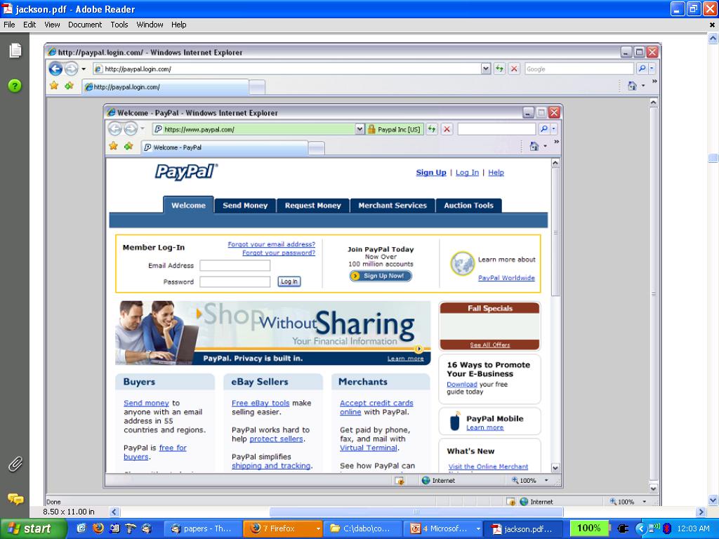
A general UI attack: picture-in-picture
Trained users are more likely to fall victim to this [JSTB’07]
HTTPS: goals and pitfalls
Notes:
Both inner and outer windows are focused

Slide 18
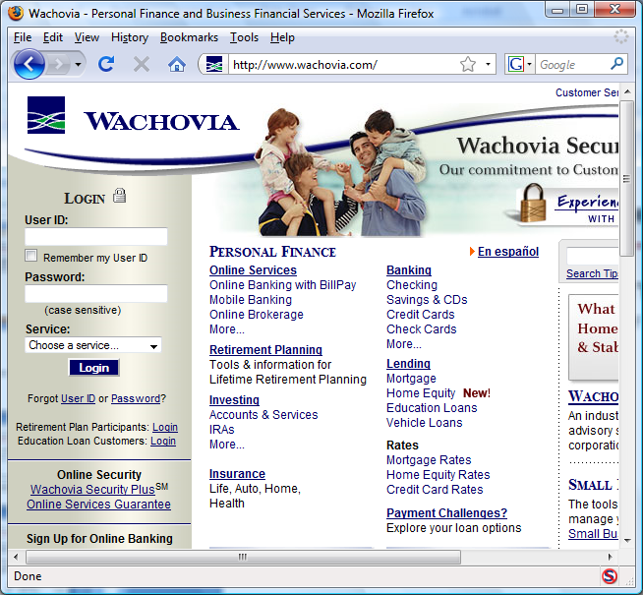
HTTPS and login pages: incorrect usage
Users often land on login page over HTTP:
Type HTTP URL into address bar
Google links to HTTP page
View source:
<form method="post"
action="https://onlineservices.wachovia.com/..."
(old site)
HTTPS: goals and pitfalls
Notes:
User has no way to tell that his password is sent over HTTPS to site. Also has no way to tell that page wasn’t modified enroute (e.g. change form action).
Note the confusing lock next to “LOGIN” that suggests this is HTTPS.

Slide 19
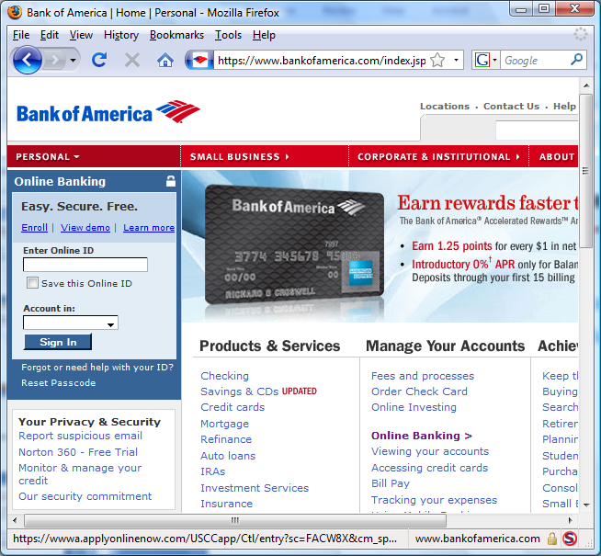
HTTPS and login pages: guidelines
General guideline:
Response to http://login.site.com should be Location: https://login.site.com
(redirect)
HTTPS: goals and pitfalls

Slide 20
Problems with HTTPS and the Lock Icon
HTTPS: goals and pitfalls

Slide 21
Problems with HTTPS and the Lock Icon
Upgrade from HTTP to HTTPS
Forged certs
Mixed content: HTTP and HTTPS on the same page
Does HTTPS hide web traffic?
Problems: traffic analysis, compression attacks
HTTPS: goals and pitfalls

Slide 22
1. HTTP ⇒ HTTPS upgrade
Common use pattern:
browse site over HTTP; move to HTTPS for checkout
connect to bank over HTTP; move to HTTPS for login
SSL_strip attack: prevent the upgrade [Moxie’08]
<a href=https://…> ⟶ <a href=http://…>
Location: https://... ⟶ Location: http://... (redirect)
<form action=https://… > ⟶ <form action=http://…>
HTTP
SSL
attacker
web server
HTTPS: goals and pitfalls
Notes:
ssl_strip: prevents browser from upgrading, but does the SSL upgrade when communicating with the server. Server has no idea this is taking place.
Similar attack done on SMTP STARTTLES : http://arstechnica.com/tech-policy/2014/11/condemnation-mounts-against-isp-that-sabotaged-users-e-mail-encryption/

Slide 23
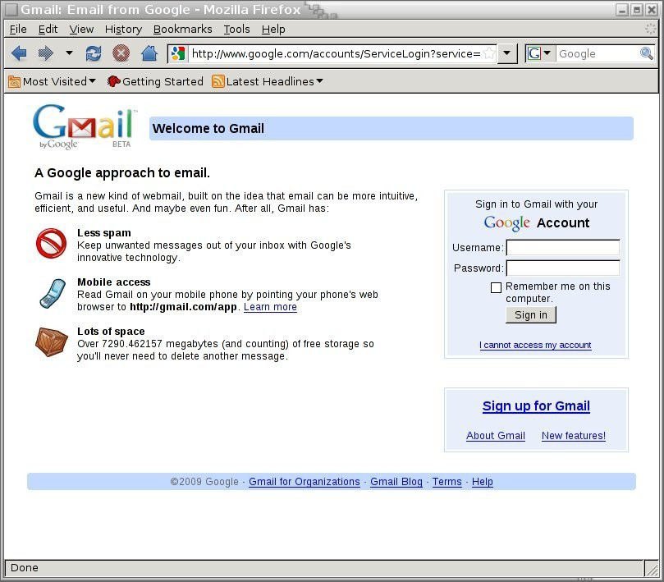
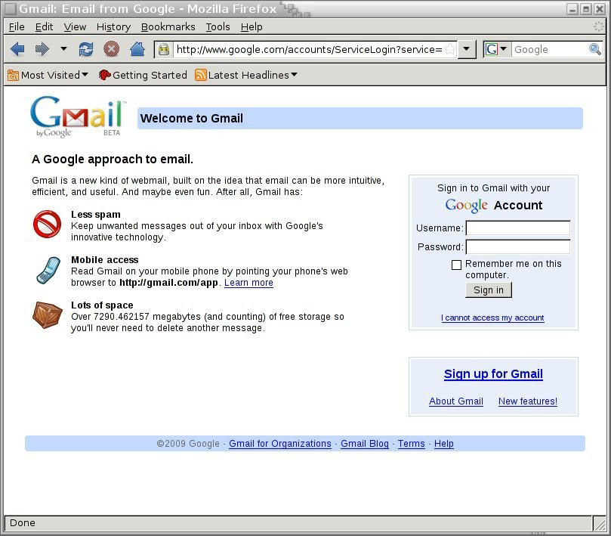
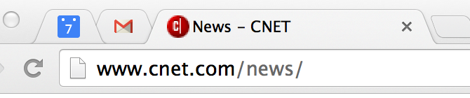
Tricks and Details
Tricks: drop-in a clever fav icon (older browsers)
⇒ fav icon no longer presented in address bar
More tricks: inject “Set-cookie” headers to delete existing session cookies in browser. Force login.
Number of users who detected HTTP downgrade: 0
⟶
HTTPS: goals and pitfalls

Slide 24
Defense: Strict Transport Security (HSTS)
Strict-Transport-Security: max-age=31⋅10⁶; includeSubDomains
(ignored if not over HTTPS)
web server
Header tells browser to always connect over HTTPS
Subsequent visits must be over HTTPS (self signed certs result in an error)
Browser refuses to connect over HTTP or if self-signed cert
Requires that entire site be served over HTTPS
HSTS flag deleted when user “clears private data” : security vs. privacy
HTTPS: goals and pitfalls
Notes:
max-age is given in seconds (31.10^6) is one year. HSTS header only accepted over HTTPS.
HSTS preloaded list: list of HSTS sites embedded in browser.
Apr. 2015: 160 sites use of Alexa Top 10K sites. (http://trends.builtwith.com/docinfo/HSTS)
Most sites (but not all) set the max-age field to one year.
To examine HSTS database use: chrome://net-internals/#hsts

Slide 25
CSP: upgrade-insecure-requests
The problem: many pages use <img src=“http://site.com/img”>
Makes it difficult to migrate a section of a site to HTTPS
Solution: gradual transition using CSP
Always use protocol relative URLs <img src=“//site.com/img”>
Content-Security-Policy: upgrade-insecure-requests
<img src=“http://site.com/img”>
<img src=“http://othersite.com/img”>
<a href=“http://site.com/img”>
<a href=“http://othersite.com/img”>
<img src=“https://site.com/img”>
<img src=“https://othersite.com/img”>
<a href=“https://othersite.com/img”>
<a href=“http://othersite.com/img”>
HTTPS: goals and pitfalls
Notes:
Resources and internal links are upgraded to HTTPS. External links are not.
Unlike HSTS, can be applied to sections of a site. Does not require changing page contents.

Slide 26
2. Certificates: wrong issuance
2011: Comodo and DigiNotar CAs hacked, issue certs for Gmail, Yahoo! Mail, …
2013: TurkTrust issued cert. for gmail.com (discovered by pinning)
2014: Indian NIC (intermediate CA trusted by the root CA IndiaCCA) issue certs for Google and Yahoo! domains
Result: (1) India CCA revoked NIC’s intermediate certificate
(2) Chrome restricts India CCA root to only seven Indian domains
2015: MCS (intermediate CA cert issued by CNNIC) issues certs for Google domains
Result: current CNNIC root no longer recognized by Chrome
⇒ enables eavesdropping w/o a warning on user’s session
HTTPS: goals and pitfalls
Notes:
India CCA event: http://googleonlinesecurity.blogspot.com/2014/07/maintaining-digital-certificate-security.html
CNNIC event: http://googleonlinesecurity.blogspot.com/2015/03/maintaining-digital-certificate-security.html

Slide 27
Man in the middle attack using rogue cert
GET https://bank.com
BadguyCert
BankCert
ClientHello
attacker
ClientHello
bank
ServerCert (rogue)
ServerCert (Bank)
(cert for Bank by a valid CA)
SSL key exchange
SSL key exchange
k₁
k₁
k₂
k₂
HTTP data enc with k₁
HTTP data enc with k₂
Attacker proxies data between user and bank. Sees all traffic and can modify data at will.
HTTPS: goals and pitfalls

Slide 28
What to do? (many good ideas)
Dynamic HTTP public-key pinning (RFC 7469)
Let a site declare CAs that can sign its cert (similar to HSTS)
on subsequent HTTPS, browser rejects certs issued by other CAs
TOFU: Trust on First Use
Certificate Transparency: [LL’12]
idea: CA’s must advertise a log of all certs. they issued
Browser will only use a cert if it is published on log server
Efficient implementation using Merkle hash trees
Companies can scan logs to look for invalid issuance
HTTPS: goals and pitfalls
Notes:
Perspectives: Wendlandt, Anderson, Perrig
Google stores all certs it sees (stored in google DNS)

Slide 29
HPKP example (HTTP header from server)
Public-Key-Pins: max-age=2592000;
pin-sha256="E9CZ9INDbd+2eRQozYqqbQ2yXLVKB9+xcprMF+44U1g=";
pin-sha256="LPJNul+wow4m6DsqxbninhsWHlwfp0JecwQzYpOLmCQ=";
report-uri="https://example.net/pkp-report"
Examine browser’s pinning DB: chrome://net-internals/#hsts
HTTPS: goals and pitfalls

Slide 30
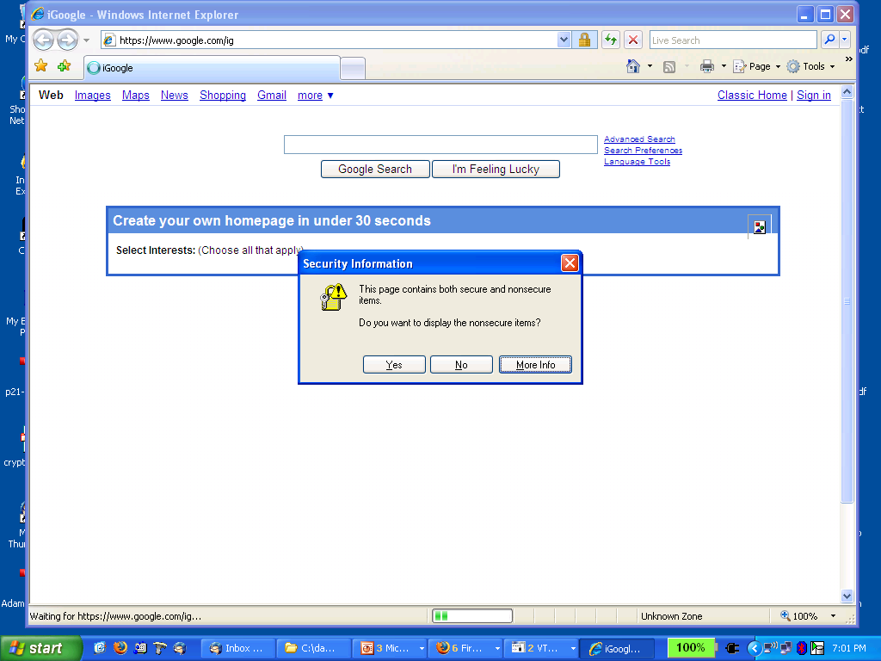
3. Mixed Content: HTTP and HTTPS
Page loads over HTTPS, but contains content over HTTP
(e.g. <script src=“http://.../script.js> )
⇒ Active network attacker can hijack session
by modifying script en-route to browser
never write this
IE7:
Old Chrome:
Chrome policy: blocked: CSS, script, frame; allowed: images, XHR
HTTPS: goals and pitfalls

Slide 31
4. Peeking through SSL: traffic analysis
Network traffic reveals length of HTTPS packets
TLS supports up to 256 bytes of padding
AJAX-rich pages have lots and lots of interactions with the server
These interactions expose specific internal state of the page
BAM!
Chen, Wang, Wang, Zhang, 2010
HTTPS: goals and pitfalls

Slide 32
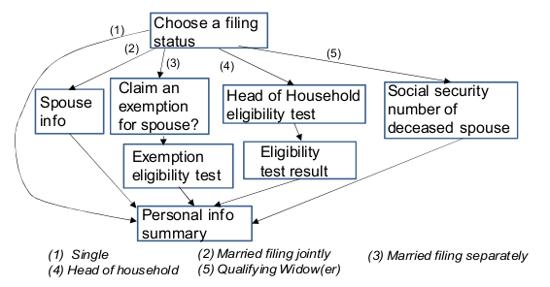
Peeking through SSL: an example [CWWZ’10]
Vulnerabilities in an online tax application
No easy fix. Can also be used to ID Tor traffic
HTTPS: goals and pitfalls

Slide 33
Peeking through SSL: compression [DR’12]
HTTPS: supports compressing data before encryption (16KB records)
Attacker: wants to recover Gmail session cookie (say)
Places Javascript on some site that issues request:
1st byte of cookie is “A” ⇒ record will compress more than when not
Script tries all possibilities to expose 1st byte. Moves to 2nd bytes …
GET gmail.com/__AAAAAAAAAAAAA….AAAAAA Cookie: session=__A 6Bh63g53ig4 Host: gmail.com
16KB
What to do: do not use compression with HTTPS
HTTPS: goals and pitfalls
Notes:
MS’01: Mantin-Shamir

Slide 34
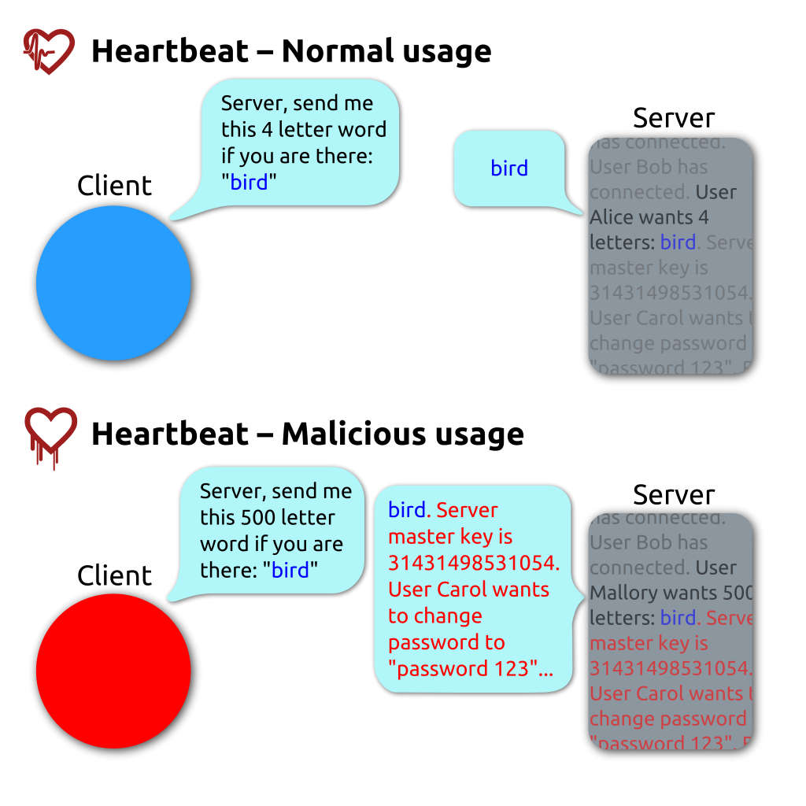
The Heartbleed Bug
HTTPS: goals and pitfalls
Notes:
MS’01: Mantin-Shamir

Slide 35

Thanks and any questions?
HTTPS: goals and pitfalls
The materials of this lecture are mostly from Stanford university

