Slide 1
Lab 1: Length Extension Attack

Slide 2
Objectives
Understand one-way hash function and data signature
Understand how to use length extension attack to append data to a signed message
Obtain hands-on experience for length extension attack

Slide 3
One-way Hash Function
A function that is easy to compute on every input, but hard to invert given random inputs
Let h() be a one-way function
Assuming h(a)=b
Given a, it is easy to compute b
Given b, it is hard to compute a
MD5, SHA-1, SHA-256 etc.
Try SHA-1 calculator at http://www.xorbin.com/tools/sha1-hash-calculator
References:
http://en.wikipedia.org/wiki/Cryptographic_hash_function

Slide 4
Message Authentication Code (MAC)
MAC is used to verify the data integrity of a message
Using a one-way function to calculate a hash value of a secret concatenated by a given message
Let m be a message and s be a secret. Let s||m be s concatenated by m
Secret s is used for authentication
Data digest h(s||m) is used by the receiver to verify whether message m is modified by attackers in transit.
Why?
References:
http://en.wikipedia.org/wiki/Message_authentication_code

Slide 5
Length Extension Attacks
A type of attack against hash functions which allow inclusion of extra data without the knowledge of secret
Attack details
Knowledge: h(s||m) and m,
Target: Appends m’ to m, and computes correct h(s||m||m’)
Exploit: A vulnerability in Merkle–Damgård construction, which literately calls hash functions on a message block basis.
References:
http://en.wikipedia.org/wiki/Length_extension_attack

Slide 6
Merkle–Damgård construction
Merkle–Damgård construction breaks original data (s||m) into message blocks.
Let b be the size of a message block.
If (s||m)%b! = 0, an additional content p should be padded to s||m to ensure (s||m||p)%b == 0.
References:
http://en.wikipedia.org/wiki/Length_extension_attack

Slide 7
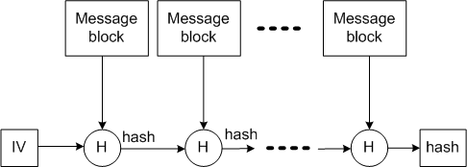
Merkle–Damgård construction
Merkle–Damgård constructs a hash chain based on message blocks, where each hash value of predecessor is used as the input to the successor hash function
References:
http://en.wikipedia.org/wiki/Length_extension_attack

Slide 8
Vulnerability
Attackers have the knowledge of h(s||m||p) and m.
Attackers should guess the length of the secret s to compute p.
Attackers thus can append arbitrary data to original data with its paddings (i.e., m||p) and can compute the correct hash of the appended message.
Why?

Slide 9
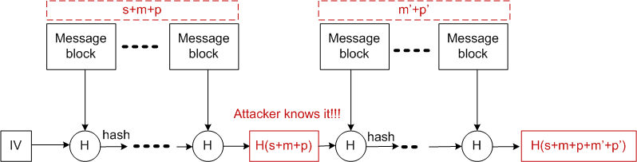
Vulnerability
The original data of h(s||m||p||m’||p’) is m||p||m’, where m’ is the data controlled by attackers and p requires the attackers to guess.
Guessing the length of secret s is the key to compute the padding content p!!!

Slide 10
Public Padding Pattern
The padded data p follows a public pattern:
Given block size b = 512 bits
The first bit of p is ‘1,’ then followed by many successive 0 bits until 64 bits left for the padding length of s||m.
References:
https://blog.skullsecurity.org/2012/everything-you-need-to-know-about-hash-length-extension-attacks

Slide 11
Padding Details
Given a length of (s||m) 80 bits (10 bytes).
Pad (512-80) = 432 bits in total
First pad format-fixed (512-80 -64) = 368 bits. The 368 bits of padding is (10000000….000), 1 ‘1’ and 367 ‘0’
The last 64 bits for padding the length of s||m
Attackers should guess length of s||m.
Length extension attack!
References:
https://blog.skullsecurity.org/2012/everything-you-need-to-know-about-hash-length-extension-attacks

Slide 12
A Length Extension Attack Example
Assuming the secret is “password”, the original data is “data”, then the SHA-1 signature is 6f5a7284246a7693c5f37f19f26609af84f56431
Attackers attempt to append “attacking” to the original data.
The new data is (you see %60 as the length of (s||m) = 12bytes = 96 (0x60) bits)
data%80%00%00%00%00%00%00%00%00%00%00%00%00%00%00%00%00%00%00%00%00%00%00%00%00%00%00%00%00%00%00%00%00%00%00%00%00%00%00%00%00%00%00%00%00%00%00%00%00%00%00%60attacking
The new signature is
a2feef179114b40605307e0ca260a3e72a56017c

Slide 13
Tool
hash_extender:
https://github.com/iagox86/hash_extender
Command line usage:
sudo apt-get install git g++ libssl-dev
git clone https://github.com/iagox86/hash_extender
cd hash_extender/
make
./hash_extender –h
./hash_extender -d data -a attacking -l 8 -s 6f5a7284246a7693c5f37f19f26609af84f56431 -f sha1 --out-data-format=html

Slide 14
Demo Page
http://158.132.255.16:25005/comp444/demo.php?d=data&h=6f5a7284246a7693c5f37f19f26609af84f56431
Attacker knows the hash function is SHA-1() and the length of secret is 8. They try to append new data “attacking” to the end of the original data:
http://158.132.255.16:25005/comp444/demo.php?d=dataattacking&h=6f5a7284246a7693c5f37f19f26609af84f56431
See what happens?
./hash_extender -d data -a attacking -l 8 -s 6f5a7284246a7693c5f37f19f26609af84f56431 -f sha1 --out-data-format=html
Type: sha1
Secret length: 8
New signature: a2feef179114b40605307e0ca260a3e72a56017c
New string: data%80%00%00%00%00%00%00%00%00%00%00%00%00%00%00%00%00%00%00 %00%00%00%00%00%00%00%00%00%00%00%00%00%00%00%00%00%00%00%00 %00%00%00%00%00%00%00%00%00%00%00%00%60attacking
http://158.132.255.16:25005/comp444/demo.php?d=data%80%00%00%00%00%00%00%00%00%00%00%00%00%00%00%00%00%00%00%00%00%00%00%00%00%00%00%00%00%00%00%00%00%00%00%00%00%00%00%00%00%00%00%00%00%00%00%00%00%00%00%60attacking&h=a2feef179114b40605307e0ca260a3e72a56017c
See what happens?

Slide 15
Preventing Length Extension Attack
Possible Solutions
MAC: h(s||m||s)
HMAC: h(s||h(s||m))
Try HMAC at http://www.freeformatter.com/hmac-generator.html
Whether the length extension attack is defeated?
Reference: http://en.wikipedia.org/wiki/Hash-based_message_authentication_code

Slide 16
Problems
Given a secret “password”, a SHA-1 hash 6d5f807e23db210bc254a28be2d6759a0f5f5d77 and an original data “polyu”, please append a new message “computing” to the end of original data, and let me know the result of appended data and the new digest. (10 marks)
Please use out-data-format=html for your answer.
Given a vulnerable web page http://158.132.255.16:25005/comp444/assignment.php?d=data&h=46071a0ad0dc4c51e83d05410ff80b80f3ee6cc1, please append a new message “attacking” to the end of parameter d and make web server accepts your data (you should see the message ” Your hash is correct. Great!” in your browser). Answer the following questions:
Hong long of the secret used by the vulnerable page? (5 marks)
What is the new digest when you successfully append “attacking”? (5 marks)

Slide 17
Problems (Cont.)
Given a block size of 512bits, is it possible that the size of padding content larger than 512 bits? If no, please elaborate your reason. If yes, please give examples. (10 marks)
Hint: each padding must have 64-bits padding length and at least one bit.
Test whether other well-known hash functions (http://en.wikipedia.org/wiki/Cryptographic_hash_function, except for SHA-1 and MD5) suffer from the length extension attacks (1 mark each).
Include the output of each successful attack.

Slide 18
Submission
The questions will be submitted with other workshop questions at the end of the term.

Slide 19
Questions?

