Slide 1
Lab2: SSL/TLS

Slide 2
Content
Understand Secure Sockets Layer and Transport Layer Security (SSL/TLS)
Understand HTTPS
Understand HTTPS Authentication
Notes:
To better understand network communication, we’ll review data transferring through a most popular Internet application: HTTP

Slide 3
SSL/TLS
Why SSL/TLS
To prevent third parties and network devices from eavesdropping or manipulating communications in the Internet
What is SSL/TLS
Secure Socket Layer (SSL) is the predecessor of Transport Layer Security (TLS)
Both are cryptography protocols that can
provide confidentiality, authentication and data integrity for secure communications in the Internet
encrypt end-to-end network traffic at the application layer

Slide 4
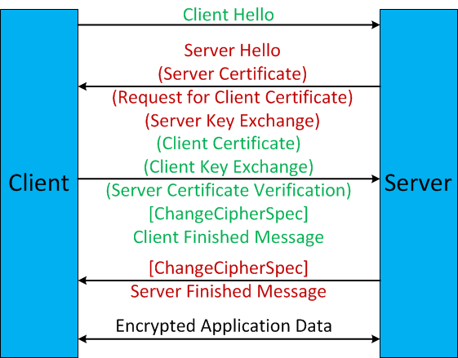
SSL/TLS Handshake
Details in http://technet.microsoft.com/en-us/library/cc785811(v=ws.10).aspx

Slide 5
SSL/TLS Certificate
SSL/TLS employs Public Key Certificates for authentication
X.509 Public Key Infrastructure (PKI) format
Certification path validation algorithm
A pure top-down hierarchy
In a certification path, each certificate signs the certificate below
Each certificate can trace back through its certification path up to a root certificate (i.e., trust anchor)

Slide 6
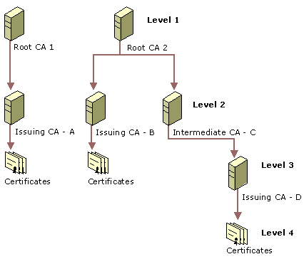
Certification Hierarchy
Source http://technet.microsoft.com/en-us/library/cc962065.aspx

Slide 7
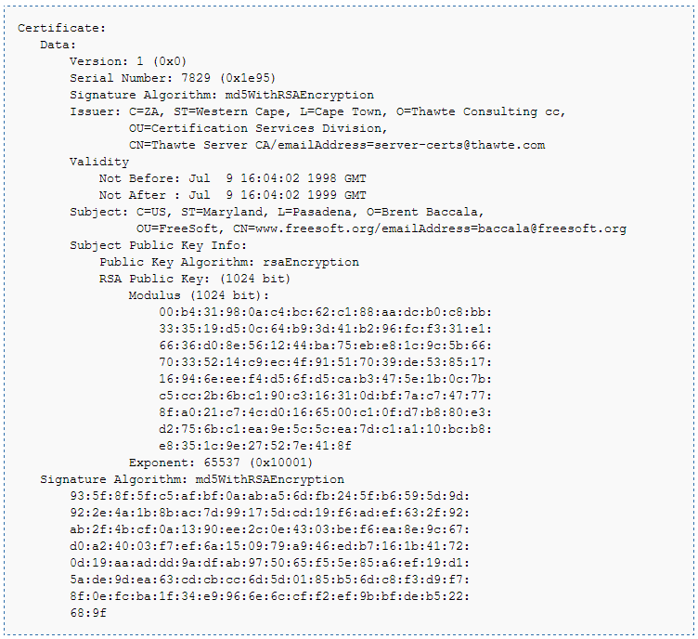
A sample of SSL/TLS Certificate
Source http://en.wikipedia.org/wiki/X.509

Slide 8
What is HTTPS
Hypertext Transfer Protocol Secure (HTTPS)
The Hypertext Transfer Protocol (HTTP) using the SSL/TLS protocol
HTTPS provides encrypted HTTP communications

Slide 9
HTTPS Authentication
HTTPS Authentication is to verify the identities of remote web servers
HTTPS Authentication Algorithm using web server certificates
Certification Path verification
Browsers install certificates of pre-trusted certification authorities
Web server certificate should be issued one of pre-trusted authorities
Hostname verification
The “CommonName” of web server certificate must match the “Domain Name” of the web server
Revocation, expiration etc.

Slide 10
Practice (1)
Experience HTTPS
Open the browser “Mozilla Firefox” in your Desktop
Visit http://www.facebook.com
Visit https://www.facebook.com
Use Wireshark to capture the traffic for analysis
Questions
(1 mark) Can you observe the content of www.facebook.com in the captured file when you visit http://www.facebook.com?
(1 mark) Can you observe the content of www.facebook.com in the captured file when you visit https://www.facebook.com?
(1 mark) What’s the default port number of HTTPS protocol?
(1 mark) How many HTTPS connections have been established when you visit https://www.facebook.com?

Slide 11
Practice (1) Cont.
Questions (Cont.)
(2 marks) In the first HTTPS connection, how many Cipher Suites your browser support?
(2 marks) In the first HTTPS connection, which Cipher Suite the web server choose?
(2 marks) Can you observe Client Certificate in the first HTTPS connection?

Slide 12
Practice (2)
Experience Certificates
Open the browser “Mozilla Firefox” in your Desktop
Visit https://www.facebook.com again
Find pre-trusted certification authorities in your “Mozilla Firefox”
Questions
(2 marks) Which Certification Authority issue the certificate of *.facebook.com?
(2 marks) How long is the certification path where the certificate of *.facebook.com locates?
(2 marks) Which public key algorithm is used in the certificate of *.facebook.com?

Slide 13
Practice (2) Cont.
Questions (Cont.)
(1 mark) What is the version of your “Mozilla Firefox”
(3 marks) Please list at least 3 pre-trusted certification authorities installed in your “Mozilla Firefox”

Slide 14
Practice (3)
Experience HTTPS Authentication
Open the browser “Mozilla Firefox” in your Desktop
Visit https://158.132.255.52
Open Wireshark to capture the traffic during the test
Questions
(1 mark) What can you observe in your “Mozilla Firefox”?
(2 marks) Does the certificate provided by https://158.132.255.52 is expired?
(2 marks) Does the certificate provided by https://158.132.255.52 is issued by a pre-trusted certification authority?

Slide 15
Practice (3) Cont.
Questions (Cont.)
(4 marks) Which verification is broken when you visit https://158.132.255.52?
(1 mark) Can you still get the content from https://158.132.255.52 if you can confirm https://158.132.255.52 is honest?

