Slide 1
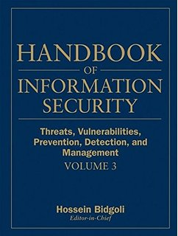

Computer Security and Cryptography
Lecturer: Zhou Peng, Ph.D in Computer Network Security
pzhou@shu.edu.cn
Lecture 1

Slide 2

Computer Security and Cryptography
Lecture 1
Course overview

Slide 3
What’s this course about?
Intro to computer security and cryptography
Some challenging fun projects
Learn about attacks
Learn about preventing attacks
Learn about modern cryptography
Lectures on related topics
Application and operating system security
Web security
Network security
Cryptography
Course overview

Slide 4
This course
Part 1: Basics (4 Lectures + 1 Lab)
Securing apps, OS, and legacy code Isolation, authentication, and access control
Cryptography overview
Part 2: Web security (5 Lectures + 1 Lab)
Building robust web sites, understand the browser security model
Part 3: Network security (3 Lectures)
Monitoring and architecting secure networks.
Course overview

Slide 5
What is security?
System correctness
If user supplies expected input, system generates desired output
Security
If attacker supplies unexpected input, system does not fail in certain ways
Course overview

Slide 6
What is security?
System correctness
Good input ⇒ Good output
Security
Bad input ⇒ Bad output
Course overview

Slide 7
What is security?
System correctness
More features: better
Security
More features: can be worse
Course overview

Slide 8

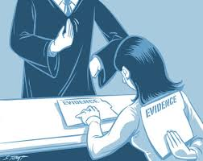
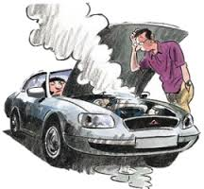
Security properties
Confidentiality
Information about system or its users cannot be learned by an attacker
Integrity
The system continues to operate properly, only reaching states that would occur if there were no attacker
Availability
Actions by an attacker do not prevent users from having access to use of the system
Course overview

Slide 9


General picture
System
Alice
Attacker
Security is about
Honest user (e.g., Alice, Bob, …)
Dishonest Attacker
How the Attacker
Disrupts honest user’s use of the system (Integrity, Availability)
Learns information intended for Alice only (Confidentiality)
Course overview

Slide 10
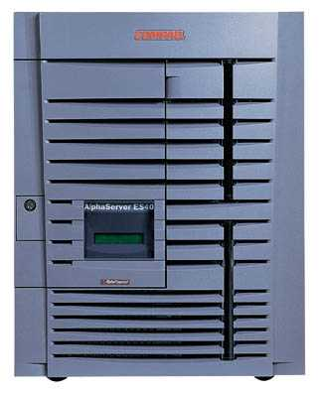
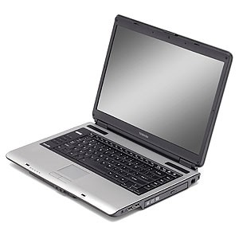
Network security
Alice
Network Attacker
Intercepts and controls network communication
System
Course overview

Slide 11
Web security
System
Alice
Web Attacker
Sets up malicious site visited by victim; no control of network
Course overview

Slide 12
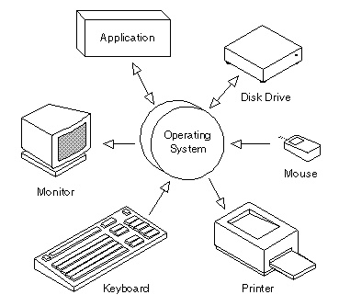
Operating system security
Alice
OS Attacker
Controls malicious files and applications
Course overview

Slide 13
System
Alice
Attacker
Confidentiality: Attacker does not learn Alice’s secrets
Integrity: Attacker does not undetectably corrupt system’s function for Alice
Availability: Attacker does not keep system from being useful to Alice
Course overview

Slide 14

Current Trends
Course overview

Slide 15
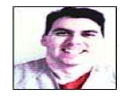
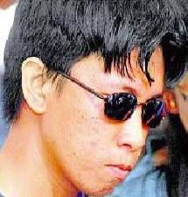
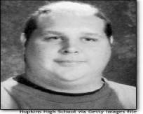
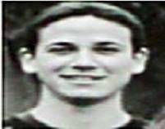
Historical hackers (prior to 2000)
Profile:
Male
Between 14 and 34 years of age
Computer addicted
No permanent girlfriend
No Commercial Interest !!!
Source: Raimund Genes
Course overview

Slide 16
The challenges
Lots of buggy software
Social engineering is very effective
Money can be made from finding and exploiting vulns.
Marketplace for vulnerabilities
Marketplace for owned machines (PPI)
Many methods to profit from owned machines
current state of computer security
Course overview

Slide 17
Lots of vulnerability disclosures (2015)
source: www.cvedetails.com/top-50-products.php?year=2015
Course overview
Notes:
Many IoT vulnerability disclosures: so many that MITRE can’t keep up with assigning new CVEs

Slide 18
Vulnerable applications being exploited
Source: Kaspersky Security Bulletin 2015
Course overview

Slide 19
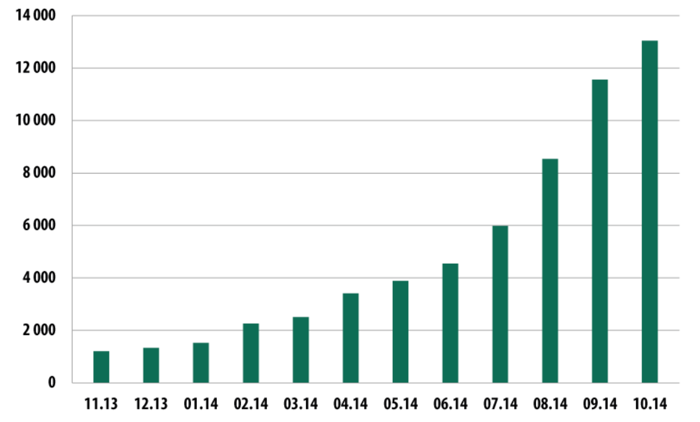
Mobile malware (Nov. 2013 – Oct. 2014)
date
The rise of mobile banking Trojans (Kaspersky Security Bulletin 2014)
Course overview

Slide 20
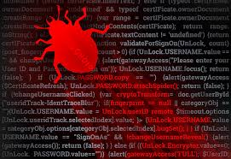
Sample attacks
Introduction
Course overview
Notes:
In this segment we will describe a few sample attacks. We will come back to this and discuss malware in far greater detail later on in the course. Here we give a few examples to illustrate the state of the world.

Slide 21
Why own machines: 1. IP address and bandwidth stealing
Attacker’s goal: look like a random Internet user
Use the IP address of infected machine or phone for:
Spam (e.g. the storm botnet)
Spamalytics: 1:12M pharma spams leads to purchase
1:260K greeting card spams leads to infection
Denial of Service: Services: 1 hour (20$), 24 hours (100$)
Click fraud (e.g. Clickbot.a)
Course overview
Notes:
DDoS service from hack-shop.org.ru
Source: http://www.defcon.org/images/defcon-15/dc15-presentations/dc-15-holt.pdf
Mobile bot-nets: more reliable because phones are always on

Slide 22



Why own machines: 2. Steal user credentials and inject ads
keylog for banking passwords, web passwords, gaming pwds.
Example: SilentBanker (and many like it)
User requests login page
Malware injects Javascript
Bank sends login page needed to log in
Bank
When user submits information, also sent to attacker
Similar mechanism used by Zeus botnet
Man-in-the-Browser (MITB)
Course overview

Slide 23
Lots of financial malware
size: 3.5 KB
spread via email attachments
also found on home routers
Source: Kaspersky Security Bulletin 2015
Course overview

Slide 24
Users attacked: stats
≈ 300,000 users worldwide
A worldwide problem
Source: Kaspersky Security Bulletin 2015
Course overview

Slide 25
Why own machines: 3. Ransomware
CryptoWall (2014-)
targets Windows
spread by spam emails
≈ 200,000 machines in 2015
A worldwide problem.
Course overview
Notes:
Good user interface. Bitcoin.

Slide 26
Why own machines: 4. Spread to isolated systems
Example: Stuxtnet
Windows infection ⇒
Siemens PCS 7 SCADA control software on Windows ⇒
Siemens device controller on isolated network
More on this later in course
Course overview

Slide 27
Server-side attacks
Financial data theft: often credit card numbers
Example: Target attack (2013), ≈ 140M CC numbers stolen
Many similar (smaller) attacks since 2000
Political motivation:
Aurora, Tunisia Facebook (Feb. 2011), GitHub (Mar. 2015)
Infect visiting users
Course overview

Slide 28
Types of data stolen (2012-2015)
Source: California breach notification report, 2015
Course overview

Slide 29
Example: Mpack
PHP-based tools installed on compromised web sites
Embedded as an iframe on infected page
Infects browsers that visit site
Features
management console provides stats on infection rates
Sold for several 100$
Customer care can be purchased, one-year support contract
Impact: 500,000 infected sites (compromised via SQL injection)
Several defenses: e.g. Google safe browsing
Course overview

Slide 30
Insider attacks: example
Hidden trap door in Linux (nov 2003)
Allows attacker to take over a computer
Practically undetectable change (uncovered via CVS logs)
Inserted line in wait4()
Looks like a standard error check, but …
if ((options == (__WCLONE|__WALL)) && (current->uid = 0))
retval = -EINVAL;
See: http://lwn.net/Articles/57135/
Course overview

Slide 31
Many more examples
Access to SIPRnet and a CD-RW: 260,000 cables ⇒ Wikileaks
SysAdmin for city of SF government. Changed passwords, locking out city from router access
Inside logic bomb took down 2000 UBS servers
⋮
Can security technology help?
Course overview
Notes:
SIPRnet = Secret Internet Protocol Router Network
Sysadmin: Terry Childs
Third example: Roger Duronio

Slide 32
How companies lose data
insider error
lost/stolen laptops
insider attack
How do we have this data?
malware/phishing
Source: California breach notification report, 2015
Course overview

Slide 33

The Marketplace for Vulnerabilities
Introduction
Course overview
Notes:
In this segment I want to tell you about market places that have evolved around exploits and vulnerabilities

Slide 34
Marketplace for Vulnerabilities
Option 1: bug bounty programs (many)
Google Vulnerability Reward Program: up to $20K
Microsoft Bounty Program: up to $100K
Mozilla Bug Bounty program: $7500
Pwn2Own competition: $15K
Option 2:
Zero day initiative (ZDI), iDefense: $2K – $25K
Course overview
Notes:
There are many people who work on finding vulnerabilities in software, such as Windows or software that runs on top of windows. Finding an explotable vulnerability can take months and the question is what to do when they find one. Most likely they publish an article in a security conference like Blackhat and boost their reputation. But it shouldn’t be too surprising that they can also make money from selling the vulnerability before announcing it at a conference. There are three options.

Slide 35
Example: Mozilla
Course overview

Slide 36
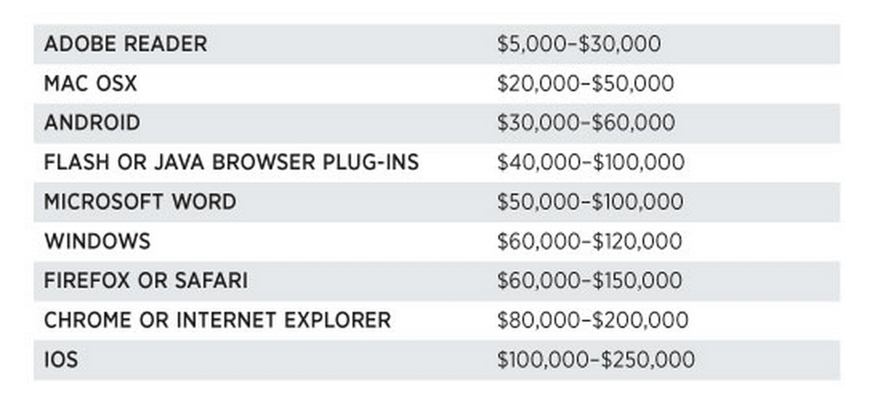
Marketplace for Vulnerabilities
Option 3: black market
Source: Andy Greenberg (Forbes, 3/23/2012 )
Course overview
Notes:
Now, the 3rd option is to go to the black market. We don’t quite know the value of vulns. there, but I list here a few quotes that suggest that prices could be higher than with the other two options.

Slide 37
Marketplace for owned machines
Pay-per-install (PPI) services
PPI operation:
Own victim’s machine
Download and install client’s code
Charge client
clients
spam bot
keylogger
PPI service
Source: Cabalerro et al. (www.icir.org/vern/papers/ppi-usesec11.pdf)
Victims
Course overview

Slide 38
Marketplace for owned machines
clients
spam bot
keylogger
Cost: US - 100-180$ / 1000 machines
Asia - 7-8$ / 1000 machines
PPI service
Source: Cabalerro et al. (www.icir.org/vern/papers/ppi-usesec11.pdf)
Victims
Course overview

Slide 39
This course
Goals:
Be aware of exploit techniques
Learn to defend and avoid common exploits
Learn to architect secure systems
Learn basics of modern cryptography
Course overview

Slide 40
This course
Part 1: Basics (4 Lectures + 1 Lab)
Securing apps, OS, and legacy code Isolation, authentication, and access control
Cryptography overview
Part 2: Web security (4 Lectures + 1 Lab)
Building robust web sites, understand the browser security model
Part 3: Network security (2 Lectures)
Monitoring and architecting secure networks.
Course overview

Slide 41

Thanks and any questions?
Course overview
The materials of this lecture are mostly from Stanford university

