Slide 1
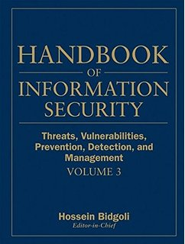
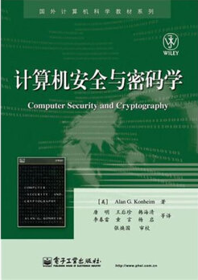
Computer Security and Cryptography
Lecturer: Zhou Peng, Ph.D in Computer Network Security
pzhou@shu.edu.cn
Lecture 10

Slide 2
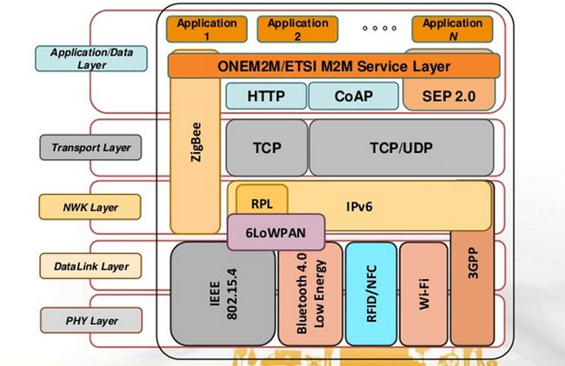
Computer Security and Cryptography
Lecture 10
Security issues in Internet protocols

Slide 3
Internet Infrastructure
Backbone
ISP
ISP
Local and interdomain routing
TCP/IP for routing and messaging
BGP for routing announcements
Domain Name System
Find IP address from symbolic name (www.cs.stanford.edu)
Security issues in Internet protocols

Slide 4
TCP Protocol Stack
Application protocol
Application
Application
Transport
TCP protocol
Transport
Network
IP protocol
IP
IP protocol
Network
Link
Data Link
Network Access
Data Link
Link
Security issues in Internet protocols

Slide 5
Data Formats
TCP Header
Application
Application message - data
message
Transport (TCP, UDP)
segment
TCP
data
TCP
data
TCP
data
Network (IP)
packet
IP
TCP
data
Link Layer
frame
ETH
IP
TCP
data
ETF
IP Header
Link (Ethernet)
Header
Link (Ethernet)
Trailer
Security issues in Internet protocols

Slide 6
Internet Protocol
IP
Version
Header Length
Type of Service
Total Length
Connectionless
Unreliable
Best effort
Notes:
src and dest ports not parts of IP hdr
Identification
Flags
Fragment Offset
Time to Live
Protocol
Header Checksum
Source Address of Originating Host
Destination Address of Target Host
Options
Padding
IP Data
Security issues in Internet protocols

Slide 7


IP Routing
Meg
Office gateway
Packet
Source
121.42.33.12
Tom
121.42.33.12
Destination
132.14.11.51
132.14.11.1
ISP
132.14.11.51
121.42.33.1
Typical route uses several hops
IP: no ordering or delivery guarantees
Security issues in Internet protocols

Slide 8
IP Protocol Functions (Summary)
Routing
IP host knows location of router (gateway)
IP gateway must know route to other networks
Fragmentation and reassembly
If max-packet-size less than the user-data-size
Error reporting
ICMP packet to source if packet is dropped
TTL field: decremented after every hop
Packet dropped if TTL=0.
Prevents infinite loops.
Security issues in Internet protocols

Slide 9
Problem: no src IP authentication
Client is trusted to embed correct source IP
Easy to override using raw sockets
Libnet: a library for formatting raw packets with arbitrary IP headers
Anyone who owns their machine can send packets with arbitrary source IP
… response will be sent back to forged source IP
Implications: (solutions in DDoS lecture)
Anonymous DoS attacks;
Anonymous infection attacks (e.g. slammer worm)
Security issues in Internet protocols

Slide 10
Transmission Control Protocol
TCP
Connection-oriented, preserves order
Sender
Break data into packets
Attach packet numbers
Receiver
Acknowledge receipt; lost packets are resent
Reassemble packets in correct order
Book
Mail each page
Reassemble book
1
19
1
5
1
Security issues in Internet protocols

Slide 11
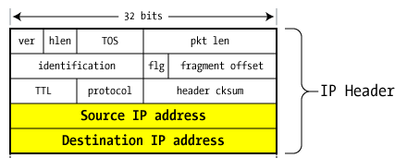
TCP Header (protocol=6)
Source Port
Dest port
SEQ Number
ACK Number
U
R
G
A
C
K
P
S
H
P
S
R
S
Y
N
F
I
N
TCP Header
Other stuff
Security issues in Internet protocols

Slide 12
Review: TCP Handshake
C
S
SYN:
SN_{C}⟵rand_{C}
AN_{C}⟵0
Listening
SN_{S}⟵rand_{S}
AN_{S}⟵SN_{C}
Store SN_{C} , SN_{S}
SYN/ACK:
Wait
SN⟵SN_{C}+1
AN⟵SN_{S}
ACK:
Established
Received packets with SN too far out of window are dropped
Security issues in Internet protocols

Slide 13
Basic Security Problems
1. Network packets pass by untrusted hosts
Eavesdropping, packet sniffing
Especially easy when attacker controls a machine close to victim (e.g. WiFi routers)
2. TCP state easily obtained by eavesdropping
Enables spoofing and session hijacking
3. Denial of Service (DoS) vulnerabilities
DDoS lecture
Security issues in Internet protocols

Slide 14
Why random initial sequence numbers?
Suppose initial seq. numbers (SN_{C} , SN_{S} ) are predictable:
Attacker can create TCP session on behalf of forged source IP
Breaks IP-based authentication (e.g. SPF, /etc/hosts )
Random seq. num. do not prevent attack, but make it harder
TCP SYN
Server
attacker
srcIP=victim
Victim
SYN/ACK dstIP=victim
SN=server SN_{S}
ACK
srcIP=victim
AN=predicted SN_{S}
server thinks command is from victim IP addr
command
Security issues in Internet protocols
Notes:
Example commands: send spam email on behalf of victim IP address
SPF: Sender Policy Framework

Slide 15
Example DoS vulnerability: Reset
Attacker sends a Reset packet to an open socket
If correct SN_{S} then connection will close ⇒ DoS
Naively, success prob. is 1/2³² (32-bit seq. #’s).
… but, many systems allow for a large window of acceptable seq. #‘s. Much higher success probability.
Attacker can flood with RST packets until one works
Most effective against long lived connections, e.g. BGP
Security issues in Internet protocols

Slide 16
Routing Security
ARP, OSPF, BGP
Security issues in Internet protocols

Slide 17
Interdomain Routing
(AS#32)
Stanford.edu
BGP
earthlink.net
(AS#4355)
Autonomous System
OSPF
connected group of one or more Internet Protocol prefixes under a single routing policy (aka domain)
Security issues in Internet protocols
Notes:
OSPF: open shortest path first

Slide 18
Routing Protocols
ARP (addr resolution protocol): IP addr ⟶ eth addr Security issues: (local network attacks)
Node A can confuse gateway into sending it traffic for Node B
By proxying traffic, node A can read/inject packets into B’s session (e.g. WiFi networks)
OSPF: used for routing within an AS
BGP: routing between Autonomous Systems Security issues: unauthenticated route updates
Anyone can cause entire Internet to send traffic for a victim IP to attacker’s address
Example: Youtube-Pakistan mishap (see DDoS lecture)
Anyone can hijack route to victim (next slides)
Security issues in Internet protocols
Notes:
OSPF: open shortest path first

Slide 19
BGP example [D. Wetherall]
1
3
3 2 7
4
2 7
2 6 5
2 6 5
3 2 6 5
5
8
2
2 7
6 5
7 2 6 5
7
2 7
7
6
6 2 7
5
7
2 6 5
5
Security issues in Internet protocols

Slide 20
Security Issues
BGP path attestations are un-authenticated
Anyone can inject advertisements for arbitrary routes
Advertisement will propagate everywhere
Used for DoS, spam, and eavesdropping (details in DDoS lecture)
Often a result of human error
Solutions:
RPKI: AS obtains a certificate (ROA) from regional authority (RIR) and attaches ROA to path advertisement. Advertisements without a valid ROA are ignored. Defends against a malicious AS (but not a network attacker)
SBGP: sign every hop of a path advertisement
Security issues in Internet protocols
Notes:
RIR: Regional Internet Registries (assign IP blocks to AS’s)
ROA: Route Origin Authorizations. Contains: AS number (ASN), validity date range, IP prefixes.
ROA says that an ASN is authorized to advertise for specific prefixes.

Slide 21
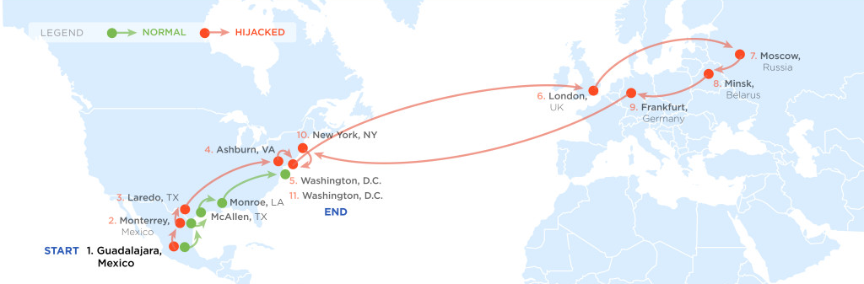
Example path hijack (source: Renesys 2013)
Feb 2013: Guadalajara ⟶ Washington DC via Belarus
route in effect
for several hours
Normally: Alestra (Mexico) ⟶ PCCW (Texas) ⟶ Qwest (DC)
Reverse route (DC ⟶ Guadalajara) is unaffected:
Person browsing the Web in DC cannot tell by traceroute that HTTP responses are routed through Moscow
Security issues in Internet protocols
Notes:
Path from DC to Guadalajara is unchanged. Only return path is changed.
More like this: Nov. 2014, March 2015.

Slide 22
OSPF: routing inside an AS
Link State Advertisements (LSA):
Flooded throughout AS so that all routers in the AS have a complete view of the AS topology
Transmission: IP datagrams, protocol = 89
Neighbor discovery:
Routers dynamically discover direct neighbors on attached links --- sets up an “adjacenty”
Once setup, they exchange their LSA databases
Security issues in Internet protocols

Slide 23




Example: LSA from Ra and Rb
Ra LSA
Net-1
Rb LSA
Ra
Rb
R3
LSA DB:
Net-1
Net-1
Ra
Ra
Rb
2
2
Rb
3
1
1
3
1
Security issues in Internet protocols
Notes:
Ra and Rb send an LSA about the connection between them. That LSA is received by R3 and it updates its own LSA database.

Slide 24
Security features
OSPF message integrity (unlike BGP)
Every link can have its own shared secret
Unfortunately, OSPF uses an insecure MAC:
MAC(k,m) = MD5(data ll key ll pad ll len)
Every LSA is flooded throughout the AS
If a single malicious router, valid LSAs may still reach dest.
The “fight back” mechanism
If a router receives its own LSA with a newer timestamp than the latest it sent, it immediately floods a new LSA
Links must be advertised by both ends
Security issues in Internet protocols

Slide 25


Still some attacks possible [NKGB’12]
Threat model:
single malicious router wants to disrupt all AS traffic
Example problem: adjacency setup need no peer feedback
Victim (DR)
a remote attacker
adjacency
phantom router
False Hello and DBD messages
adjacency
LAN
adjacency
net 1
Result: DoS on net 1
Security issues in Internet protocols
Notes:
A router can setup an adjacency with a peer router without ever hearing back from the peer. Therefore, a remote attacker can cause a victim router to setup an adjacency with a phantom peer, resulting in DoS.

Slide 26
Domain Name System
Security issues in Internet protocols

Slide 27
Domain Name System
DNS
Hierarchical Name Space
root
org
net
edu
com
uk
ca
wisc
ucb
stanford
cmu
mit
cs
ee
www
Security issues in Internet protocols

Slide 28
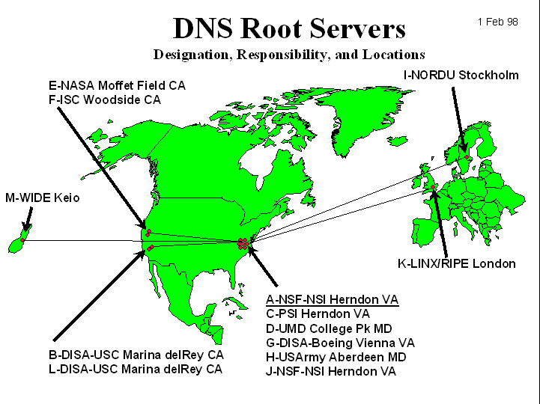
DNS Root Name Servers
Hierarchical service
Root name servers for top-level domains
Authoritative name servers for subdomains
Local name resolvers contact authoritative servers when they do not know a name
Security issues in Internet protocols

Slide 29
DNS Lookup Example
root & edu
DNS server
www.cs.stanford.edu
www.cs.stanford.edu
NS stanford.edu
stanford.edu
DNS server
Local DNS resolver
NS cs.stanford.edu
Client
A www=IPaddr
cs.stanford.edu
DNS server
DNS record types (partial list):
- NS: name server (points to other server)
- A: address record (contains IP address)
- MX: address in charge of handling email
- TXT: generic text (e.g. used to distribute site public keys (DKIM) )
Security issues in Internet protocols

Slide 30
Caching
DNS responses are cached
Quick response for repeated translations
Note: NS records for domains also cached
DNS negative queries are cached
Save time for nonexistent sites, e.g. misspelling
Cached data periodically times out
Lifetime (TTL) of data controlled by owner of data
TTL passed with every record
Security issues in Internet protocols

Slide 31
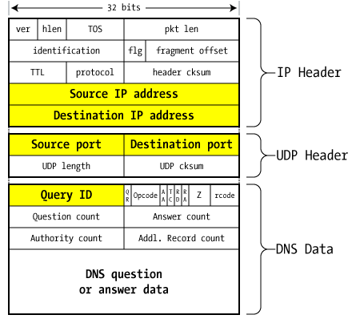
DNS Packet
Query ID:
16 bit random value
Links response to query
(from Steve Friedl)
Security issues in Internet protocols

Slide 32
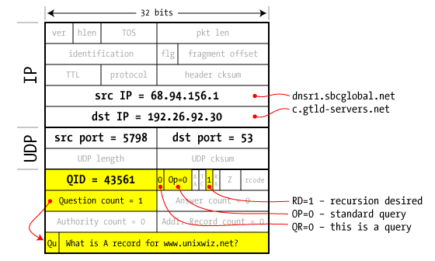
Resolver to NS request
Security issues in Internet protocols
Notes:
SBCglobal DNS resolver wants www.unixwiz.net. First queries C tld server.

Slide 33
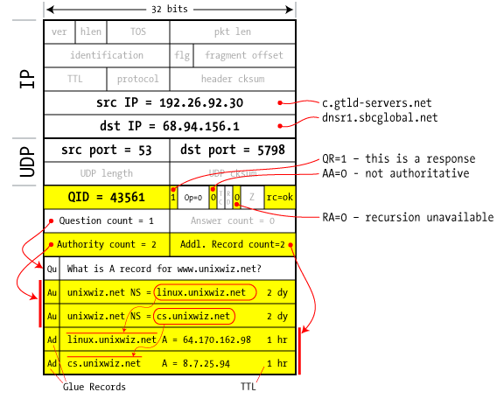
Response to resolver
Response contains IP addr of next NS server
(called “glue”)
Response ignored if unrecognized QueryID
Security issues in Internet protocols
Notes:
Response points to two name servers.

Slide 34
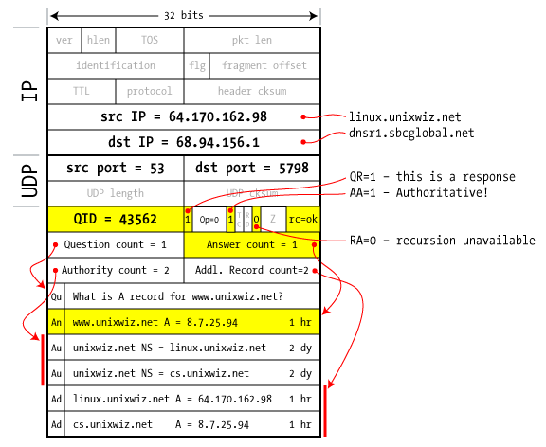
Authoritative response to resolver
bailiwick checking:
response is cached if it is within the same domain of query (i.e. a.com cannot set NS for b.com)
final answer
Security issues in Internet protocols
Notes:
NS linux.unixwiz.net provides the final answer. Response passes bailiwick checking and will be cached.

Slide 35
Basic DNS Vulnerabilities
Users/hosts trust the host-address mapping provided by DNS:
Used as basis for many security policies:
Browser same origin policy, URL address bar
Obvious problems
Interception of requests or compromise of DNS servers can result in incorrect or malicious responses
e.g.: malicious access point in a Cafe
Solution – authenticated requests/responses
Provided by DNSsec … but few use DNSsec
Security issues in Internet protocols

Slide 36
DNS cache poisoning (a la Kaminsky’08)
Victim machine visits attacker’s web site, downloads Javascript
Query:
a.bank.com
a.bank.com
QID=x₁
user
browser
local
DNS
resolver
.com
response
256 responses:
Random QID y₁, y₂, …
NS bank.com=ns.bank.com
A ns.bank.com=attackerIP
attacker wins if ∃j: x₁ = y_{j}
response is cached and attacker owns bank.com
attacker
Security issues in Internet protocols

Slide 37
If at first you don’t succeed …
Victim machine visits attacker’s web site, downloads Javascript
Query:
b.bank.com
b.bank.com
QID=x₂
user
browser
local
DNS
resolver
.com
response
256 responses:
Random QID y₁, y₂, …
NS bank.com=ns.bank.com
A ns.bank.com=attackerIP
attacker wins if ∃j: x₂ = y_{j}
response is cached and attacker owns bank.com
attacker
success after ≈ 256 tries (few minutes)
Security issues in Internet protocols
Notes:
Birthday paradox: success once x_{i} = y_{j} for some i,j .
Success probability after each try is 1/256 ⇒ needs 256 tries on average until success

Slide 38
Defenses
Increase Query ID size. How?
Randomize src port, additional 11 bits
Now attack takes several hours
Ask every DNS query twice:
Attacker has to guess QueryID correctly twice (32 bits)
… but Apparently DNS system cannot handle the load
Security issues in Internet protocols

Slide 39
DNS poisoning attacks in the wild
January 2005, the domain name for a large New York ISP, Panix, was hijacked to a site in Australia.
In November 2004, Google and Amazon users were sent to Med Network Inc., an online pharmacy
In March 2003, a group dubbed the "Freedom Cyber Force Militia" hijacked visitors to the Al-Jazeera Web site and presented them with the message "God Bless Our Troops"
Security issues in Internet protocols

Slide 40
DNS Rebinding Attack
[DWF’96, R’01]
<iframe src="http://www.evil.com">
DNS-SEC cannot
stop this attack
Firewall
www.evil.com?
ns.evil.com
DNS server
171.64.7.115 TTL = 0
192.168.0.100
www.evil.com
web server
corporate
web server
171.64.7.115
192.168.0.100
Read permitted: it’s the “same origin”
Security issues in Internet protocols

Slide 41
DNS Rebinding Defenses
Browser mitigation: DNS Pinning
Refuse to switch to a new IP
Interacts poorly with proxies, VPN, dynamic DNS, …
Not consistently implemented in any browser
Server-side defenses
Check Host header for unrecognized domains
Authenticate users with something other than IP
Firewall defenses
External names can’t resolve to internal addresses
Protects browsers inside the organization
Security issues in Internet protocols

Slide 42
Summary
Core protocols not designed for security
Eavesdropping, Packet injection, Route stealing, DNS poisoning
Patched over time to prevent basic attacks
(e.g. random TCP SN)
More secure variants exist (next lecture) :
IP ⟶ IPsec
DNS ⟶ DNSsec
BGP ⟶ SBGP
Security issues in Internet protocols

Slide 43

Thanks and any questions?
Security issues in Internet protocols
The materials of this lecture are mostly from Stanford university

