Slide 1


Computer Security and Cryptography
Lecturer: Zhou Peng, Ph.D in Computer Network Security
pzhou@shu.edu.cn
Lecture 11

Slide 2

Computer Security and Cryptography
Lecture 11
Network Security protocols

Slide 3
Network security
What is the network for?
What properties might attackers destroy?
Confidentiality : no information revealed to others
Integrity : communication remains intact
Availability : messages received in reasonable time
Network Security Protocols

Slide 4

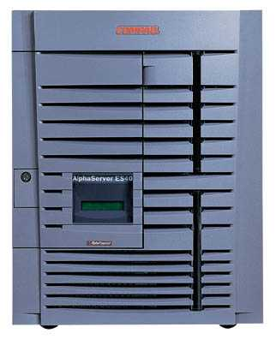

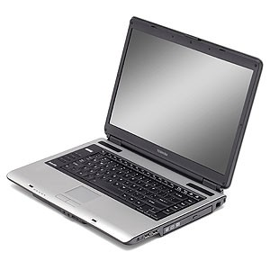
Confidentiality
Integrity
Availability
Network Attacker
Intercepts and controls network communication
System
Network Security Protocols

Slide 5

Plan for today
Protecting network connections
Wireless access– 802.11i/WPA2
IPSEC
Perimeter network defenses
Firewall
Packet filter (stateless, stateful), Application layer proxies
Intrusion detection
Anomaly and misuse detection
Network infrastructure security
BGP instability and S-BGP
DNS rebinding and DNSSEC
Network Security Protocols

Slide 6
Last lecture
Basic network protocols
IP, TCP, UDP, BGP, DNS
Problems with them
TCP/IP
No SRC authentication: can’t tell where packet is from
Packet sniffing
Connection spoofing, sequence numbers
BGP: advertise bad routes or close good ones
DNS: cache poisoning, rebinding
Web security mechanisms rely on DNS
Network Security Protocols

Slide 7
Network Protocol Stack
Application protocol
Application
Application
Transport
TCP protocol
Transport
Network
IP protocol
IP
IP protocol
Network
Link
Data Link
Network Access
Data Link
Link
Network Security Protocols

Slide 8
Link-layer connectivity
Network Security Protocols

Slide 9


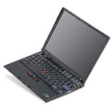
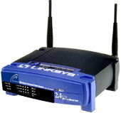
802.11i Protocol
Link Layer
Supplicant
UnAuth/UnAssoc
802.1X Blocked
No Key
Supplicant
Auth/Assoc
802.1X Blocked
No Key
Supplicant
Auth/Assoc
802.1X Blocked
MSK
Supplicant
Auth/Assoc
802.1X Blocked
PMK
Supplicant
Auth/Assoc
802.1X UnBlocked
PTK/GTK
Supplicant
Auth/Assoc
802.1X UnBlocked
New GTK
Authenticator UnAuth/UnAssoc
802.1X Blocked
No Key
Authenticator Auth/Assoc
802.1X Blocked
No Key
Authenticator Auth/Assoc
802.1X Blocked
No Key
Authenticator Auth/Assoc
802.1X Blocked
PMK
Authenticator Auth/Assoc
802.1X UnBlocked
PTK/GTK
Authenticator Auth/Assoc
802.1X UnBlocked
New GTK
Authentica-tion Server (RADIUS)
No Key
Authentica-tion Server (RADIUS)
No Key
Authentica-tion Server (RADIUS)
MSK
Authentica-tion Server (RADIUS)
No Key
Authentica-tion Server (RADIUS)
No Key
Supplicant
Auth/Assoc
802.1X UnBlocked
PTK/GTK
Authenticator Auth/Assoc
802.1X UnBlocked
PTK/GTK
Authentica-tion Server (RADIUS)
No Key
Authentica-tion Server (RADIUS)
No Key
802.11 Association
EAP/802.1X/RADIUS Authentication
MSK
4-Way Handshake
Group Key Handshake
Data Communication
Network Security Protocols
Notes:
RSNA involves three entities: the Supplicant, the Authenticator, and the Authentication Server. In an general infrastructure network, the supplicant is implemented in the mobile devices like a PDA, a cellphone or a laptop; the authenticator is implemented in the Access Point; the authentication server could be implemented either in the Access Point with the authenticator, or separately in a backend server, like a RADIUS server. When it is implemented in a separate server, the links between the authenticator and the authentication server are assumed to be physically secure.
In order to adopt 802.1X authentication in wireless networks, we consider the association between the supplicant and the authenticator as a logical 802.1X port. At the beginning, the supplicant and the authenticator are unauthenticated and unassociated, 802.1X ports are blocked, and there are no shared secrets between them.
In the first stage, the supplicant and the authenticator set up an 802.11 association. After this stage, the supplicant and the authenticator go to the authenticated and associated state. Here “authenticated” only means that 802.11 open system authentication is successful, this is not considered to be a real authentication. Now there is a radio connection between the supplicant and the authenticator, but they cannot transmit data packets to each other because the logical 802.1X port is still blocked, only protocol packets are accepted.
In the second stage, the authenticator will act as a relay, the supplicant and the authentication server run some mutual authentication protocol and generate some common secret, called MSK (Master Session Key). Then the server moves the MSK to the authenticator, and the supplicant and authenticator will derive the same PMK (Pair-wise Master Key) from the MSK locally. Here “move” means the server will delete the key itself after sending to the authenticator, because the server is assumed not to disclose and possess the key afterwards. This stage could be absent when a Pre-Shared Key or a cached PMK is used.
In the third stage, the authenticator initialize a 4-way handshake to confirm the PMK existence and derive a fresh PTK for the following data sessions. Upon this point, the 802.1X ports are unblocked to accept data packets.
As the fourth stage, the supplicant and the authenticator might also perform a group key handshake to distribute a GTK in case of multicast applications, however, this is not necessary since the GTK (Group Transient Key) could also be transmitted in the 4-way handshake.
With the shared PTK and GTK, the supplicant and authenticator could derive the encryption key and MAC key, thus perform secure data communications.
We will focus on the 4-way handshake because it is an essential part in all operation modes.

Slide 10
TCP/IP connectivity
How can we isolate our conversation from attackers on the Internet?
Network Security Protocols

Slide 11
Basic Layer 2-3 Security Problems
Transport layer security (from last lecture)
Network packets pass by untrusted hosts
Eavesdropping, packet sniffing
Especially easy when attacker controls a machine close to victim
TCP state can be easy to guess
Enables spoofing and session hijacking
Network Security Protocols

Slide 12
Virtual Private Network (VPN)
Three different modes of use:
Remote access client connections
LAN-to-LAN internetworking
Controlled access within an intranet
Several different protocols
PPTP – Point-to-point tunneling protocol
L2TP – Layer-2 tunneling protocol
IPsec (Layer-3: network layer)
Data layer
Network Security Protocols

Slide 13
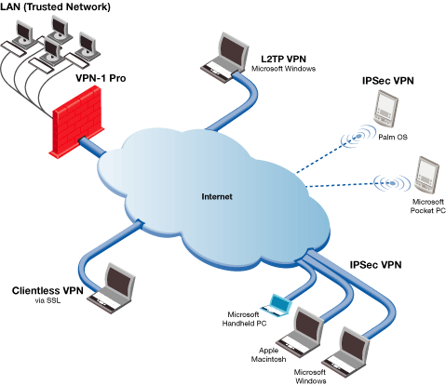
Credit: Checkpoint
Network Security Protocols

Slide 14
IPSEC
Security extensions for IPv4 and IPv6
IP Authentication Header (AH)
Authentication and integrity of payload and header
IP Encapsulating Security Protocol (ESP)
Confidentiality of payload
ESP with optional ICV (integrity check value)
Confidentiality, authentication and integrity of payload
Network Security Protocols

Slide 15
Recall packet formats and layers
TCP Header
Application
Application message - data
message
Transport (TCP, UDP)
segment
TCP
data
TCP
data
TCP
data
Network (IP)
packet
IP
TCP
data
Link Layer
frame
ETH
IP
TCP
data
ETF
IP Header
Link (Ethernet)
Header
Link (Ethernet)
Trailer
Network Security Protocols

Slide 16
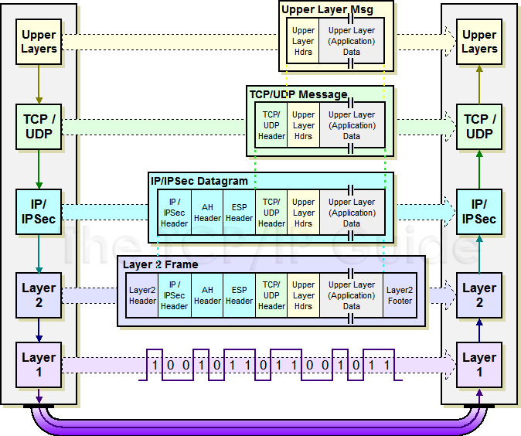
IPSec Transport Mode: IPSEC instead of IP header
http://www.tcpipguide.com/free/
t_IPSecModesTransportandTunnel.htm
Network Security Protocols

Slide 17
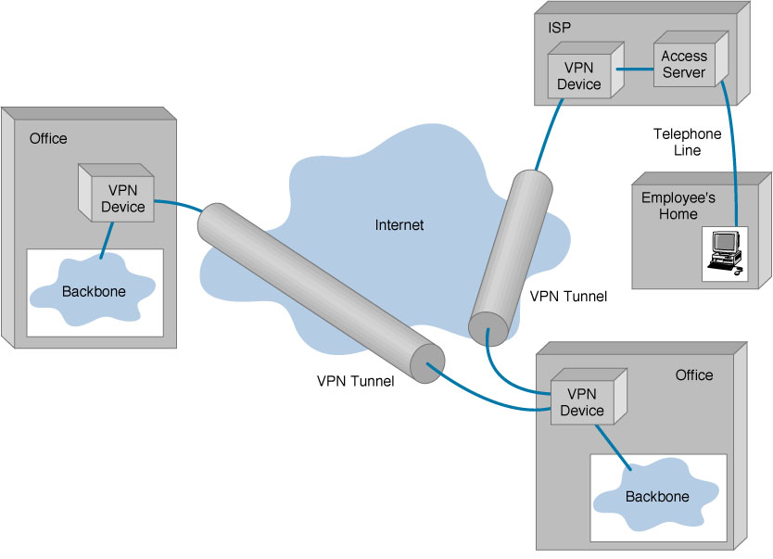
IPSEC Tunnel Mode
Network Security Protocols

Slide 18
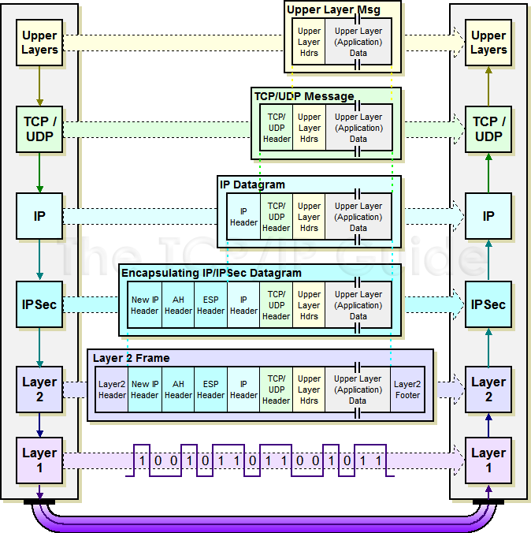
IPSec Tunnel Mode: IPSEC header + IP header
Network Security Protocols

Slide 19
IKE subprotocol from IPSEC
Key management
m1
A, (gª mod p)
B, (g^{b} mod p)
, signB(m1,m2)
signA(m1,m2)
A
B
m2
Result: A and B share secret g^{ab} mod p
Network Security Protocols

Slide 20
Mobile IPv6 Architecture
Mobility
Mobile Node (MN)
Direct connection via binding update
IPv6
Corresponding Node (CN)
Authentication is a requirement
Early proposals weak
RFC 6618 – use IPSec
Home Agent (HA)
Network Security Protocols

Slide 21
Summary of first section
Protecting network connections
Wireless access– 802.11i/WPA2
Several subprotocols provide encrypted link between user device and wireless access point
IPSEC
Give external Internet connections equivalent security to local area network connections
Mobility
Preserve network connections when a device moves to different physical portions of the network
Network Security Protocols

Slide 22
Second topic of today’s lecture
Perimeter defenses for local networks
Firewall
Packet filter (stateless, stateful)
Application layer proxies
Intrusion detection
Anomaly and misuse detection
Network Security Protocols

Slide 23
Local area Network
How can we protect our local area network from attackers on the external Internet?
Network Security Protocols

Slide 24
Basic Firewall Concept
Perimeter security
Separate local area net from internet
Firewall
Local network
Internet
Router
All packets between LAN and internet routed through firewall
Network Security Protocols

Slide 25
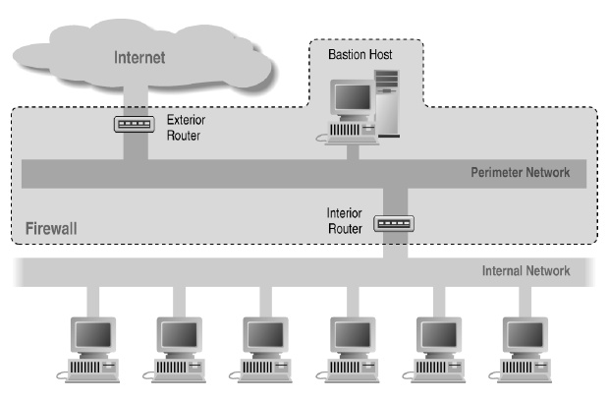
Screened Subnet Using Two Routers
Network Security Protocols

Slide 26
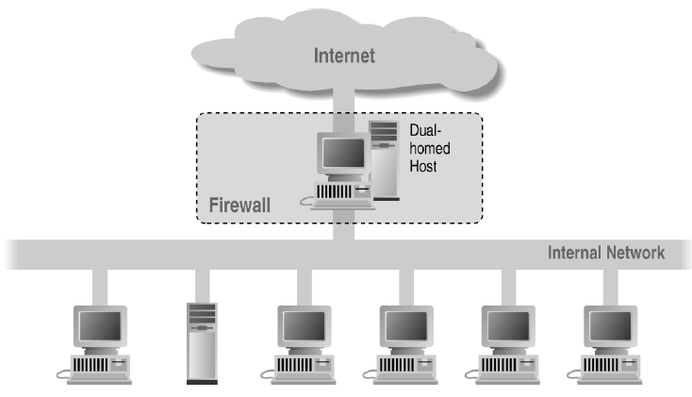
Alternate 1: Dual-Homed Host
Network Security Protocols

Slide 27
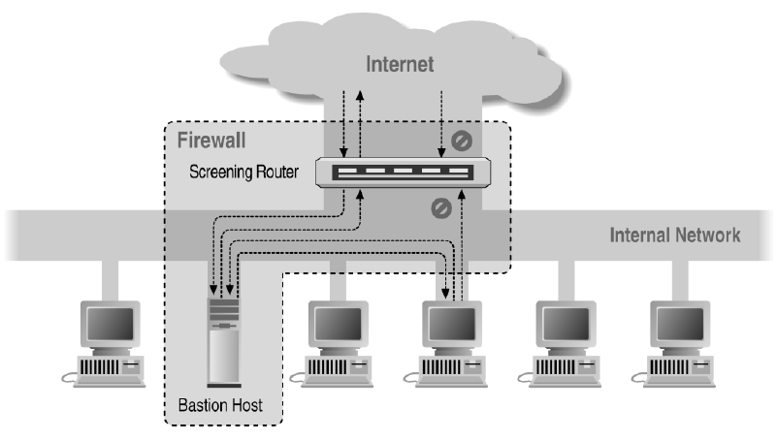
Alternate 2: Screened Host
Network Security Protocols

Slide 28
Basic Packet Filtering
Uses transport-layer information only
IP Source Address, Destination Address
Protocol (TCP, UDP, ICMP, etc)
TCP or UDP source & destination ports
TCP Flags (SYN, ACK, FIN, RST, PSH, etc)
ICMP message type
Examples
DNS uses port 53
Block incoming port 53 packets except known trusted servers
Issues
Stateful filtering
Encapsulation: address translation, other complications
Fragmentation
Network Security Protocols

Slide 29
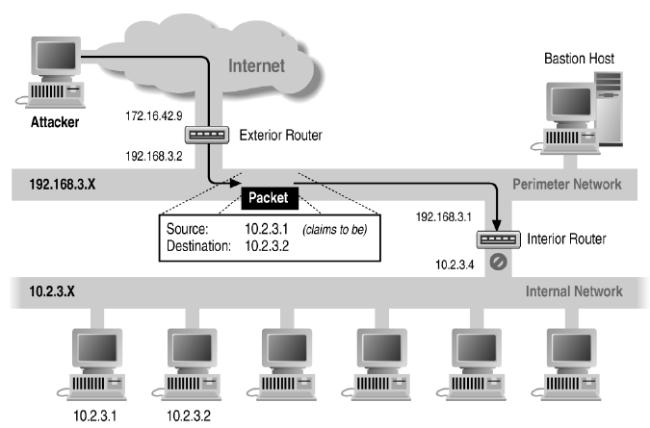
Source-Address Forgery
Network Security Protocols

Slide 30
More about networking: port numbering
TCP connection
Server port uses number less than 1024
Client port uses number between 1024 and 16383
Permanent assignment
Ports <1024 assigned permanently
20,21 for FTP 23 for Telnet
25 for server SMTP 80 for HTTP
Variable use
Ports >1024 must be available for client to make connection
Limitation for stateless packet filtering
If client wants port 2048, firewall must allow incoming traffic
Better: stateful filtering knows outgoing requests
Only allow incoming traffic on high port to a machine that has initiated an outgoing request on low port
Network Security Protocols

Slide 31
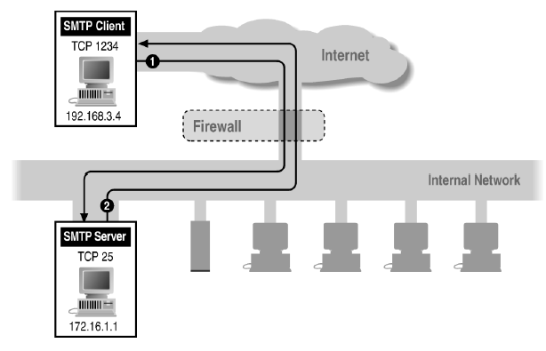
Filtering Example: Inbound SMTP
Assume we want to block internal server from external attack
Can block external request to internal server based on port number
Network Security Protocols

Slide 32
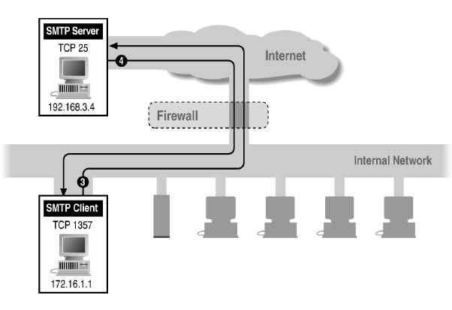
Filtering Example: Outbound SMTP
Assume we want to allow internal access to external server
Known low port out, arbitrary high port in
If firewall blocks incoming port 1357 traffic then connection fails
Network Security Protocols

Slide 33
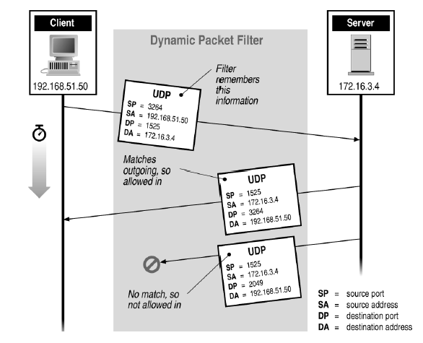
Stateful or Dynamic Packet Filtering
Assume we want to allow external UDP only if requested
Network Security Protocols

Slide 34
Telnet
How can stateful filtering identify legitimate session?
Telnet Server
Telnet Client
23
1234
◆ Client opens channel to server; tells server its port number. The ACK bit is not set while establishing the connection but will be set on the remaining packets
◆
“PORT 1234”
❖
“ACK”
❖ Server acknowledges
Stateful filtering can use this pattern to identify legitimate sessions
Network Security Protocols

Slide 35
FTP
How can stateful filtering identify legitimate session?
FTP Server
FTP Client
20
Data
21
Command
5150
5151
◆ Client opens command channel to server; tells server second port number
◆
“PORT 5151”
❖ Server acknowledges
❖
⬥
“OK”
⬥ Server opens data channel to client’s second port
DATA CHANNEL
 Client acknowledges

TCP ACK
Network Security Protocols
Notes:
From Zwicky, Building Internet Firewalls, second edition page 456

Slide 36
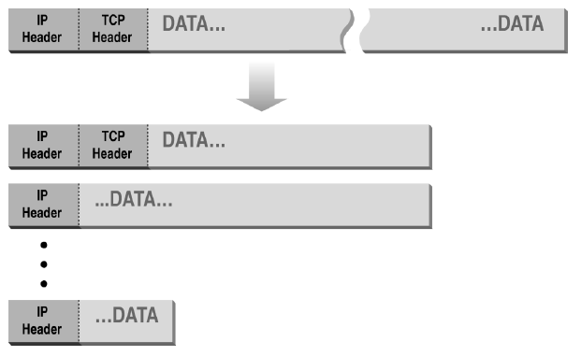
Normal IP Fragmentation
Complication for firewalls
Flags and offset inside IP header indicate packet fragmentation
Network Security Protocols

Slide 37
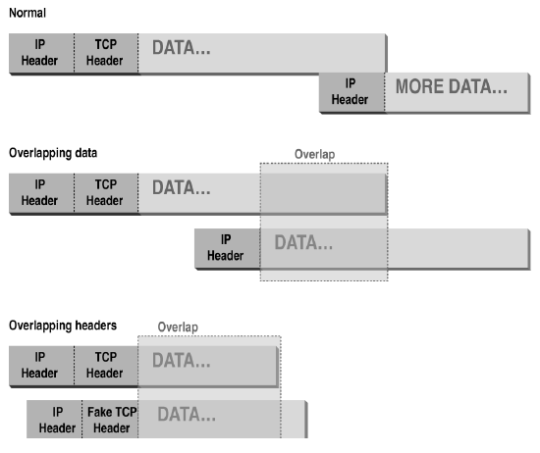
Abnormal Fragmentation
Low offset allows second packet to overwrite TCP header at receiving host
Network Security Protocols

Slide 38
Packet Fragmentation Attack
Firewall configuration
TCP port 23 is blocked but SMTP port 25 is allowed
First packet
Fragmentation Offset = 0.
DF bit = 0 : "May Fragment"
MF bit = 1 : "More Fragments"
Destination Port = 25. TCP port 25 is allowed, so firewall allows packet
Second packet
Fragmentation Offset = 1: second packet overwrites all but first 8 bits of the first packet
DF bit = 0 : "May Fragment"
MF bit = 0 : "Last Fragment."
Destination Port = 23. Normally be blocked, but sneaks by!
What happens
Firewall ignores second packet “TCP header” because it is fragment of first
At host, packet reassembled and received at port 23
Network Security Protocols

Slide 39
TCP Protocol Stack
Application protocol
Application
Application
Transport
TCP protocol
Transport
Network
IP protocol
IP
IP protocol
Network
Link
Data Link
Network Access
Data Link
Link
Network Security Protocols

Slide 40
Proxying Firewall
Beyond packet filtering
Application-level proxies
Tailored to http, ftp, smtp, etc.
Some protocols easier to proxy than others
Policy embedded in proxy programs
Proxies filter incoming, outgoing packets
Reconstruct application-layer messages
Can filter specific application-layer commands, etc.
Example: only allow specific ftp commands
Other examples: ?
Several network locations – see next slides
Network Security Protocols

Slide 41
Firewall with application proxies
FTP proxy
Telnet proxy
SMTP proxy
Telnet daemon
FTP daemon
SMTP daemon
Network Connection
Daemon spawns proxy when communication detected …
Network Security Protocols

Slide 42
Application-level proxies
Enforce policy for specific protocols
E.g., Virus scanning for SMTP
Need to understand MIME, encoding, Zip archives
Flexible approach, but may introduce network delays
“Batch” protocols are natural to proxy
SMTP (E-Mail) NNTP (Net news)
DNS (Domain Name System) NTP (Network Time Protocol)
Must protect host running protocol stack
Disable all non-required services; keep it simple
Install/modify services you want
Run security audit to establish baseline
Be prepared for the system to be compromised
Network Security Protocols

Slide 43
Web traffic scanning
Intercept and proxy web traffic
Can be host-based
Usually at enterprise gateway
Block known bad sites
Block pages with known attacks
Scan attachments
Virus, worm, malware, …
Network Security Protocols

Slide 44


Firewall references
Elizabeth D. Zwicky
Simon Cooper
D. Brent Chapman
William R Cheswick
Steven M Bellovin
Aviel D Rubin
Network Security Protocols

Slide 45
Intrusion detection
Many intrusion detection systems
Network-based, host-based, or combination
Two basic models
Misuse detection model
Maintain data on known attacks
Look for activity with corresponding signatures
Anomaly detection model
Try to figure out what is “normal”
Report anomalous behavior
Fundamental problem: too many false alarms
Network Security Protocols

Slide 46

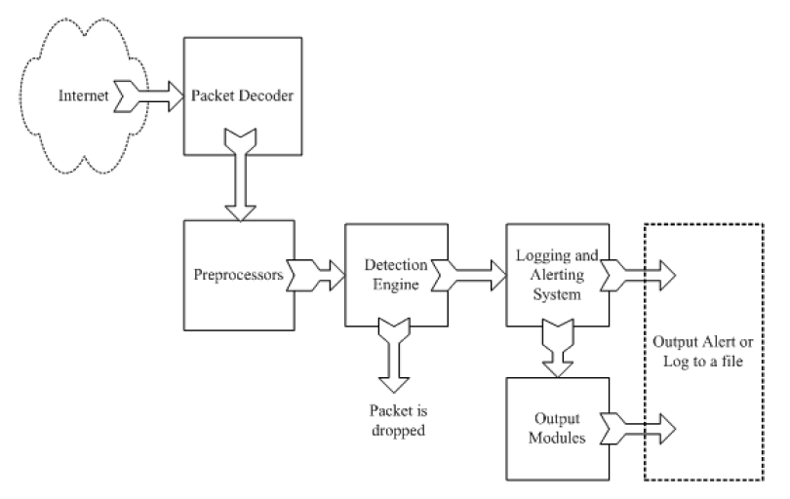
Example: Snort
http://www.snort.org/
From: Rafeeq Ur Rehman, Intrusion Detection Systems with Snort: Advanced IDS Techniques with Snort, Apache, MySQL, PHP, and ACID.
Network Security Protocols

Slide 47
Snort components
Packet Decoder
input from Ethernet, SLIP, PPP…
Preprocessor:
detect anomalies in packet headers
packet defragmentation
decode HTTP URI
reassemble TCP streams
Detection Engine: applies rules to packets
Logging and Alerting System
Output Modules: alerts, log, other output
Network Security Protocols

Slide 48
Snort detection rules
rule header
rule options
destination ip address
Apply to all ip packets
Destination port
Source ip address
Source port #
Rule options
Alert will be generated if criteria met
Network Security Protocols

Slide 49
Additional examples
alert tcp any any -> 192.168.1.0/24 111 (content:"|00 01 86 a5|"; msg: "mountd access";)
alert tcp !192.168.1.0/24 any -> 192.168.1.0/24 111 (content: "|00 01 86 a5|"; msg: "external mountd access";)
! = negation operator in address
content - match content in packet
192.168.1.0/24 - addr from 192.168.1.1 to 192.168.1.255
https://www.snort.org/documents/snort-users-manual
Network Security Protocols

Slide 50
Snort challenges
Misuse detection – avoid known intrusions
Database size continues to grow
Snort version 2.3.2 had 2,600 rules
Snort spends 80% of time doing string match
Anomaly detection – identify new attacks
Probability of detection is low
Network Security Protocols

Slide 51
Difficulties in anomaly detection
Lack of training data
Lots of “normal” network, system call data
Little data containing realistic attacks, anomalies
Data drift
Statistical methods detect changes in behavior
Attacker can attack gradually and incrementally
Main characteristics not well understood
By many measures, attack may be within bounds of “normal” range of activities
False identifications are very costly
Sys Admin spend many hours examining evidence
Network Security Protocols

Slide 52
Summary of this section
Perimeter defenses for local networks
Firewall
Packet filter (stateless, stateful), Application layer proxies
Intrusion detection
Anomaly and misuse detection
Network Security Protocols

Slide 53
Last section of today’s lecture
Network infrastructure protocols
BGP vulnerabilities and S-BGP
DNS security, cache poisoning and rebinding attacks
Network Security Protocols

Slide 54
Infrastructure protocols: BGP, DNS
Network Security Protocols

Slide 55
BGP example
1
3
3 2 7
4
2 7
2 6 5
2 6 5
3 2 6 5
5
8
2
2 7
6 5
7 2 6 5
7
2 7
7
6
6 2 7
5
7
2 6 5
5
Transit: 2 provides transit for 7
Algorithm seems to work OK in practice
BGP is does not respond well to frequent node outages
Figure: D. Wetherall
Network Security Protocols

Slide 56
BGP Security Issues
BGP is used for all inter-ISP routing
Benign configuration errors affect about 1% of all routing table entries at any time
Highly vulnerable to human errors, malicious attacks
Actual routing policies can be very complicated
MD5 MAC is rarely used, perhaps due to lack of automated key management, addresses only one class of attacks
Network Security Protocols

Slide 57
S-BGP Design Overview
IPsec: secure point-to-point router communication
Public Key Infrastructure: authorization for all S-BGP entities
Attestations: digitally-signed authorizations
Address: authorization to advertise specified address blocks
Route: Validation of UPDATEs based on a new path attribute, using PKI certificates and attestations
Repositories for distribution of certificates, CRLs, and address attestations
Tools for ISPs to manage address attestations, process certificates & CRLs, etc.
Slide: Steve Kent
Network Security Protocols

Slide 58
BGP example
1
3
4
2 7
8
2
2 7
7
2 7
7
6
5
7
AS
Host1
Host2
…
Hostn
Address blocks
Network Security Protocols

Slide 59
Address Attestation
Indicates that the final AS listed in the UPDATE is authorized by the owner of those address blocks
Includes identification of:
owner’s certificate
AS to be advertising the address blocks
address blocks
expiration date
Digitally signed by owner of the address blocks
Used to protect BGP from erroneous UPDATEs (authenticated but misbehaving or misconfigured BGP speakers)
Network Security Protocols

Slide 60
Route Attestation
Indicates that the speaker or its AS authorizes the listener’s AS to use the route in the UPDATE
Includes identification of:
AS’s or BGP speaker’s certificate issued by owner of the AS
the address blocks and the list of ASes in the UPDATE
the neighbor
expiration date
Digitally signed by owner of the AS (or BGP speaker) distributing the UPDATE, traceable to the IANA ...
Used to protect BGP from erroneous UPDATEs (authenticated but misbehaving or misconfigured BGP speakers)
Network Security Protocols

Slide 61
Validating a Route
To validate a route from AS_{n}, AS_{n+1} needs:
address attestation from each organization owning an address block(s) in the NLRI
address allocation certificate from each organization owning address blocks in the NLRI
route attestation from every AS along the path (AS₁ to AS_{n}), where the route attestation for AS_{k} specifies the NLRI and the path up to that point (AS₁ through AS_{k+1})
certificate for each AS or router along path (AS₁ to AS_{n}) to check signatures on the route attestations
and, of course, all the relevant CRLs must have been checked
Slide: Kent et al.
Network Security Protocols

Slide 62
Infrastructure protocols: BGP, DNS
Network Security Protocols

Slide 63
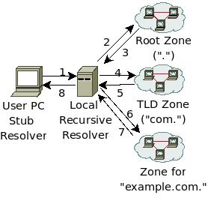
Recall: DNS Lookup
Query: "www.example.com A?"
Local recursive resolver caches these for TTL specified by RR
Reply
Resource Records in Reply
3
"com. NS a.gtld.net"
"a.gtld.net A 192.5.6.30"
5
"example.com. NS a.iana.net"
"a.iana.net A 192.0.34.43"
7
"www.example.com A 1.2.3.4"
8
"www.example.com A 1.2.3.4"
Network Security Protocols

Slide 64
DNS is Insecure
Packets sent over UDP, < 512 bytes
16-bit TXID, UDP Src port are only “security”
Resolver accepts packet if above match
Packet from whom? Was it manipulated?
Cache poisoning
Attacker forges record at resolver
Forged record cached, attacks future lookups
Kaminsky (BH USA08)
Attacks delegations with “birthday problem”
Network Security Protocols

Slide 65
DNSSEC Goal
“The Domain Name System (DNS) security extensions provide origin authentication and integrity assurance services for DNS data, including mechanisms for authenticated denial of existence of DNS data.”
-RFC 4033
Network Security Protocols

Slide 66
DNSSEC
Basically no change to packet format
Goal is security of DNS data, not channel security
New Resource Records (RRs)
RRSIG : signature of RR by private zone key
DNSKEY : public zone key
DS : crypto digest of child zone key
NSEC / NSEC3 authenticated denial of existence
Lookup referral chain (unsigned)
Origin attestation chain (PKI) (signed)
Start at pre-configured trust anchors
DS/DNSKEY of zone (should include root)
DS → DNSKEY → DS forms a link
Network Security Protocols
Notes:
Dan: How to distribute trust anchor?

Slide 67
DNSSEC Lookup
Query: "www.example.com A?"
Reply
RRs in DNS Reply
Added by DNSSEC
3
"com. NS a.gtld.net"
"a.gtld.net A 192.5.6.30"
"com. DS"
"RRSIG(DS) by ."
5
"example.com. NS a.iana.net"
"a.iana.net A 192.0.34.43"
"com. DNSKEY"
"RRSIG(DNSKEY) by com."
"example.com. DS"
"RRSIG(DS) by com."
7
"www.example.com A 1.2.3.4"
"example.com DNSKEY"
"RRSIG(DNSKEY) by example.com."
"RRSIG(A) by example.com."
8
"www.example.com A 1.2.3.4"
Last Hop?
Network Security Protocols
Notes:
Dan: Time constants

Slide 68
Authenticated Denial-of-Existence
Most DNS lookups result in denial-of-existence
NSEC (Next SECure)
Lists all extant RRs associated with an owner name
Easy zone enumeration
NSEC3
Hashes owner names
Public salt to prevent pre-computed dictionaries
NSEC3 chain in hashed order
Opt-out bit for TLDs to support incremental adoption
For TLD type zones to support incremental adoption
Non-DNSSEC children not in NSEC3 chain
Network Security Protocols

Slide 69
Insecure Sub-Namespace
NSEC3 Opt-out
"Does not assert the existence or non-existence of the insecure delegations that it may cover" (RFC 5155)
Only thing asserting this is insecure glue records
Property: Possible to insert bogus pre-pended name into otherwise secure zone. (RFC 5155)
Insecure delegation from secure zone
Spoofs possible for resultant lookup results
Acceptable for TLD, bad for enterprises
Network Security Protocols

Slide 70
DNS Rebinding Attack
[DWF’96, R’01]
<iframe src="http://www.evil.com">
DNSSEC cannot
stop this attack
Firewall
www.evil.com?
ns.evil.com
DNS server
171.64.7.115 TTL = 0
192.168.0.100
www.evil.com
web server
corporate
web server
171.64.7.115
192.168.0.100
Read permitted: it’s the “same origin”
Network Security Protocols

Slide 71
DNS Rebinding Defenses
Browser mitigation: DNS Pinning
Refuse to switch to a new IP
Interacts poorly with proxies, VPN, dynamic DNS, …
Not consistently implemented in any browser
Server-side defenses
Check Host header for unrecognized domains
Authenticate users with something other than IP
Firewall defenses
External names can’t resolve to internal addresses
Protects browsers inside the organization
Network Security Protocols

Slide 72
Summary of this section
Network infrastructure protocols
BGP vulnerabilities and S-BGP
Security can be achieved by applying cryptography and basic network connection security to every step
Heavyweight solution, but illustrates the ways BGP can be vulnerable
DNS security, rebinding attack
Domain-name security achieved by additional infrastructure
Most complicated part is addressing non-existence
Recommendation: do not allow opt out in enterprise networks
Network Security Protocols

Slide 73
Summary
Protecting network connections
Wireless security – 802.11i/WPA2
IPSEC
Perimeter network perimeter defenses
Firewall
Packet filter (stateless, stateful),
Application layer proxies
Intrusion detection
Anomaly and misuse detection
Network infrastructure security
BGP vulnerability and S-BGP
DNSSEC, DNS rebinding
Network Security Protocols

Slide 74

Thanks and any questions?
Network Security Protocols
The materials of this lecture are mostly from Stanford university

