Slide 1


Computer Security and Cryptography
Lecturer: Zhou Peng, Ph.D in Computer Network Security
pzhou@shu.edu.cn
Lecture 12

Slide 2

Computer Security and Cryptography
Lecture 12
Unwanted traffic: Denial of service attacks

Slide 3
What is network DoS?
Goal: take out a large site with little computing work
How: Amplification
Small number of packets ⇒ big effect
Two types of amplification attacks:
DoS bug:
Design flaw allowing one machine to disrupt a service
DoS flood:
Command bot-net to generate flood of requests
Denial of service attacks

Slide 4
DoS can happen at any layer
This lecture:
Sample Dos at different layers (by order):
Link
TCP/UDP
Application
Generic DoS solutions
Network DoS solutions
Sad truth:
Current Internet not designed to handle DDoS attacks
Denial of service attacks

Slide 5
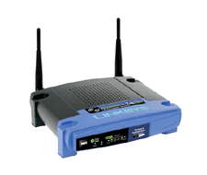
Warm up: 802.11b DoS bugs
Radio jamming attacks: trivial, not our focus.
Protocol DoS bugs: [Bellardo, Savage, ’03]
NAV (Network Allocation Vector):
15-bit field. Max value: 32767
Any node can reserve channel for NAV seconds
No one else should transmit during NAV period
… but not followed by most 802.11b cards
De-authentication bug:
Any node can send deauth packet to AP
Deauth packet unauthenticated
… attacker can repeatedly deauth anyone
Denial of service attacks

Slide 6
Smurf amplification DoS attack
1 ICMP Echo Req Src: Dos Target
Dest: brdct addr
3 ICMP Echo Reply Dest: Dos Target
Send ping request to broadcast addr (ICMP Echo Req)
Lots of responses:
Every host on target network generates a ping reply (ICMP Echo Reply) to victim
gateway
DoS Target
DoS Source
Prevention: reject external packets to broadcast address
Denial of service attacks

Slide 7
Modern day example (Mar ’13)
DNS Amplification attack: ( ×50 amplification )
DNS Query SrcIP: Dos Target
(60 bytes)
EDNS Reponse
(3000 bytes)
DoS Source
DNS Server
DoS Target
2006: 0.58M open resolvers on Internet (Kaminsky-Shiffman)
2014: 28M open resolvers (openresolverproject.org)
⇒ 3/2013: DDoS attack generating 309 Gbps for 28 mins.
Denial of service attacks
Notes:
http://blog.cloudflare.com/the-ddos-that-almost-broke-the-internet
3/2013 attack: 31,000 open DNS resolvers, each outputting 10Mbps. Source: 3 networks that allowed spoofing.
Attack on spamhouse protected by cloudflare.com

Slide 8
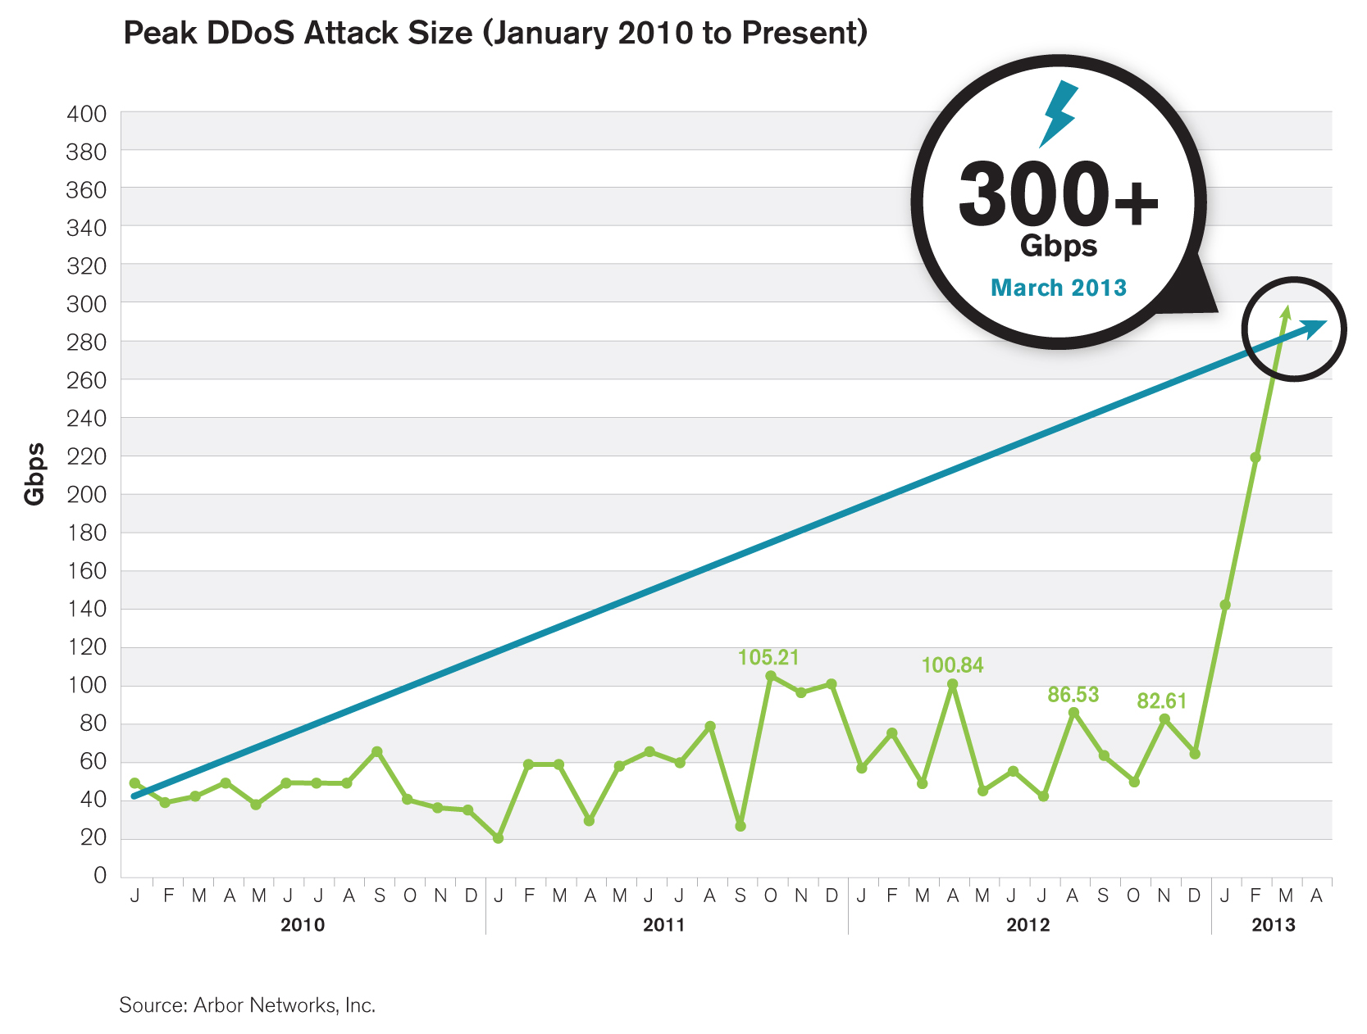
Feb. 2014: 400 Gbps via NTP amplification (4500 NTP servers)
Denial of service attacks
Notes:
In 2010 providers observed 100Gbps DNS reflection/amplification attack.
IMDDOS: botnet providing DDOS services for hire. 80$/24 hours.

Slide 9
Review: IP Header format
0
31
Connectionless
Unreliable
Best effort
Version
Header Length
Type of Service
Total Length
Identification
Flags
Fragment Offset
Time to Live
Protocol
Header Checksum
Source Address of Originating Host
Destination Address of Target Host
Options
Padding
IP Data
Denial of service attacks

Slide 10
Review: TCP Header format
TCP:
Session based
Congestion control
In order delivery
0
31
Source Port
Dest port
SEQ Number
ACK Number
U
R
G
A
C
K
P
S
H
P
S
R
S
Y
N
F
I
N
Other stuff
Denial of service attacks

Slide 11
Review: TCP Handshake
C
S
SYN:
SN_{C}⟵rand_{C}
AN_{C}⟵0
Listening
SN_{S}⟵rand_{S}
AN_{S}⟵SN_{C}
Store SN_{C} , SN_{S}
SYN/ACK:
Wait
SN⟵SN_{C}
AN⟵SN_{S}
ACK:
Established
Denial of service attacks

Slide 12
TCP SYN Flood I: low rate (DoS bug)
C
S
Single machine:
SYN Packets with random source IP addresses
Fills up backlog queue on server
No further connections possible
SYN_{C1}
SYN_{C2}
SYN_{C3}
SYN_{C4}
SYN_{C5}
Denial of service attacks

Slide 13
SYN Floods (phrack 48, no 13, 1996)
OS | Backlog queue size
Linux 1.2.x | 10
FreeBSD 2.1.5 | 128
WinNT 4.0 | 6
Backlog timeout: 3 minutes
Attacker needs only 128 SYN packets every 3 minutes
Low rate SYN flood
Denial of service attacks
Notes:
Number of packets depends on backlog queue eviction policy.

Slide 14
A classic SYN flood example
MS Blaster worm (2003)
Infected machines at noon on Aug 16th:
SYN flood on port 80 to windowsupdate.com
50 SYN packets every second.
each packet is 40 bytes.
Spoofed source IP: a.b.X.Y where X,Y random.
MS solution:
new name: windowsupdate.microsoft.com
Denial of service attacks
Notes:
Infected IP: a.b.c.d. a.b.X.Y avoids ingress filtering ISPs. Note: evades Savage’s /8 backscatter monitor.

Slide 15
Low rate SYN flood defenses
Non-solution:
Increase backlog queue size or decrease timeout
Correct solution (when under attack) :
Syncookies: remove state from server
Small performance overhead
Denial of service attacks
Notes:
Syncache: global hash table for all half open connections on all sockets.

Slide 16
Syncookies
[Bernstein, Schenk]
Idea: use secret key and data in packet to gen. server SN
Server responds to Client with SYN-ACK cookie:
T = 5-bit counter incremented every 64 secs.
L = MAC_{key} (SAddr, SPort, DAddr, DPort, SN_{C}, T) [24 bits]
key: picked at random during boot
SN_{S} = (T . mss . L) ( |L| = 24 bits )
Server does not save state (other TCP options are lost)
Honest client responds with ACK ( AN=SN_{S} , SN=SN_{C}+1 )
Server allocates space for socket only if valid SN_{S}
Denial of service attacks
Notes:
To check that SN_{S} is valid: server xors with SN_{C} and verifies that L is the correct value.
T guarantees that old SYN-ACK Cookies cannot be used
MSS: max segment size (TCP option), encoded as 3 bits.

Slide 17
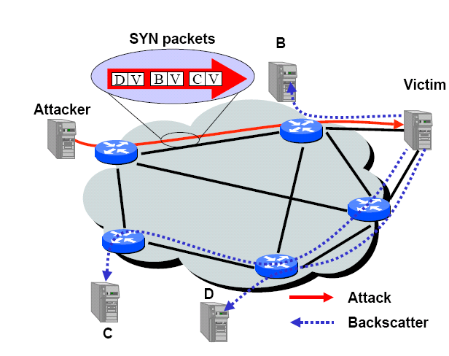
SYN floods: backscatter [MVS’01]
SYN with forged source IP ⇒ SYN/ACK to random host
Denial of service attacks

Slide 18
Backscatter measurement
Listen to unused IP addresss space (darknet)
Lonely SYN/ACK packet likely to be result of SYN attack
2001: 400 SYN attacks/week
2013: 773 SYN attacks/24 hours (arbor networks ATLAS)
Larger experiments: (monitor many ISP darknets)
Arbor networks
/8 network
0
monitor
2³²
Denial of service attacks
Notes:
Savage used /8 network: 44.x.y.z.
Arbor: measures *distinct* SYN attacks

Slide 19
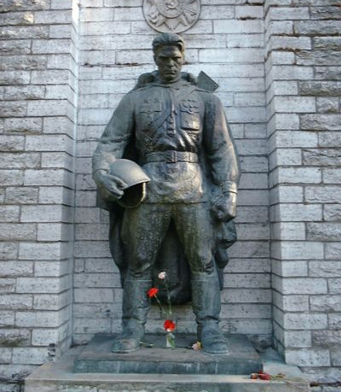
Estonia attack (ATLAS ‘07)
Attack types detected:
115 ICMP floods, 4 TCP SYN floods
Bandwidth:
12 attacks: 70-95 Mbps for over 10 hours
All attack traffic was coming from outside Estonia
Estonia’s solution:
Estonian ISPs blocked all foreign traffic until attacks stopped
⇒ DoS attack had little impact inside Estonia
Denial of service attacks
Notes:
Estonia moved statue away from city center to cemetery. Objections by ethnic Russian minority.
Targeted Estonian ministerial sites and businesses.

Slide 20
SYN Floods II: Massive flood (e.g BetCris.com)
Command bot army to flood specific target: (DDoS)
20,000 bots can generate 2Gb/sec of SYNs (2003)
At web site:
Saturates network uplink or network router
Random source IP ⇒ attack SYNs look the same as real SYNs
What to do ???
Denial of service attacks
Notes:
Gambling site in Costa Rica. Defended using PureGig ISP that has 10Gb/sec link.
Note: NetScalar boxes process SYN packets in HW.

Slide 21
Prolexic / CloudFlare
Idea: only forward established TCP connections to site
Lots-of-SYNs
Prolexic
Proxy
Lots-of-SYN/ACKs
Few ACKs
Web site
Forward
to site
Denial of service attacks
Notes:
Note: web site is only accessible through prolexic proxy via leased line

Slide 22
Other junk packets
Proxy must keep floods of these away from web site
Attack Packet | Victim Response | Rate: attk/day [ATLAS 2013]
TCP SYN to open port | TCP SYN/ACK | 773
TCP SYN to closed port | TCP RST
TCP ACK or TCP DATA | TCP RST
TCP RST | No response
TCP NULL | TCP RST
ICMP ECHO Request | ICMP ECHO Response | 50
UDP to closed port | ICMP Port unreachable | 387
Denial of service attacks
Notes:
Rate: #attacks detected per 24 hours
Filtering some of these, like TCP RST, requires Prolexic to maintain per-flow state.
Per-flow state is not easy to maintain.

Slide 23
Stronger attacks: TCP con flood
Command bot army to:
Complete TCP connection to web site
Send short HTTP HEAD request
Repeat
Will bypass SYN flood protection proxy
… but:
Attacker can no longer use random source IPs.
Reveals location of bot zombies
Proxy can now block or rate-limit bots.
Denial of service attacks

Slide 24


A real-world example: GitHub (3/2015)
popular server
Javascript-based DDoS:
honest
end user
inject
imageFlood.js
github.com
imageFlood.js
function imgflood() {
var TARGET = 'victim-website.com/index.php?’
var rand = Math.floor(Math.random() * 1000)
var pic = new Image()
pic.src = 'http://'+TARGET+rand+'=val'
}
setInterval(imgflood, 10)
Would HTTPS prevent this DDoS?
Denial of service attacks
Notes:
Would HTTPS prevent this? Not if attacker is trusted to issue certs for GitHub.

Slide 25
DNS DoS Attacks (e.g. bluesecurity ’06)
DNS runs on UDP port 53
DNS entry for victim.com hosted at victim_isp.com
DDoS attack:
flood victim_isp.com with requests for victim.com
Random source IP address in UDP packets
Takes out entire DNS server: (collateral damage)
bluesecurity DNS hosted at Tucows DNS server
DNS DDoS took out Tucows hosting many many sites
What to do ???
Denial of service attacks

Slide 26
DNS DoS solutions
Generic DDoS solutions:
Later on. Require major changes to DNS.
DoS resistant DNS design: (e.g. CloudFlare)
CoDoNS: [Sirer’04]
Cooperative Domain Name System
P2P design for DNS system:
DNS nodes share the load
Simple update of DNS entries
Backwards compatible with existing DNS
Denial of service attacks

Slide 27
DoS via route hijacking
YouTube is 208.65.152.0/22 (includes 2¹⁰ IP addr)
youtube.com is 208.65.153.238, …
Feb. 2008:
Pakistan telecom advertised a BGP path for
208.65.153.0/24 (includes 2⁸ IP addr)
Routing decisions use most specific prefix
The entire Internet now thinks
208.65.153.238 is in Pakistan
Outage resolved within two hours
… but demonstrates huge DoS vuln. with no solution!
Denial of service attacks
Notes:
YouTube was down for close to two hours.
More recent example: Apr, 8, 2010: for 18 minutes, China Telecom published BGP routes that cause .mil and .gov to route through China telecom.

Slide 28
DoS at higher layers
SSL/TLS handshake [SD’03]
RSA-encrypt speed ≈ 10 × RSA-decrypt speed
⇒ Single machine can bring down ten web servers
Similar problem with application DoS:
Send HTTP request for some large PDF file
Easy work for client, hard work for server.
Client Hello
Web
Server
Server Hello (pub-key)
RSA
Encrypt
Client key exchange
RSA
Decrypt
Denial of service attacks

Slide 29
DoS Mitigation
Denial of service attacks

Slide 30
1. Client puzzles
Idea: slow down attacker
Moderately hard problem:
Given challenge C find X such that
LSB_{n} ( SHA-1( C || X ) ) = 0^{n}
Assumption: takes expected 2^{n} time to solve
For n=16 takes about .3sec on 1GhZ machine
Main point: checking puzzle solution is easy.
During DoS attack:
Everyone must submit puzzle solution with requests
When no attack: do not require puzzle solution
Denial of service attacks

Slide 31
Examples
TCP connection floods (RSA ‘99)
Example challenge: C = TCP server-seq-num
First data packet must contain puzzle solution
Otherwise TCP connection is closed
SSL handshake DoS: (SD’03)
Challenge C based on TLS session ID
Server: check puzzle solution before RSA decrypt.
Same for application layer DoS and payment DoS.
Denial of service attacks
Notes:
For SYN floods: include puzzle solution in every SYN packet. Example: challenge C = source-IP.

Slide 32
Benefits and limitations
Hardness of challenge: n
Decided based on DoS attack volume.
Limitations:
Requires changes to both clients and servers
Hurts low power legitimate clients during attack:
Clients on cell phones and tablets cannot connect
Denial of service attacks

Slide 33
Memory-bound functions
CPU power ratio:
high end server / low end cell phone = 8000
⇒ Impossible to scale to hard puzzles
Interesting observation:
Main memory access time ratio:
high end server / low end cell phone = 2
Better puzzles:
Solution requires many main memory accesses
Dwork-Goldberg-Naor, Crypto ‘03
Abadi-Burrows-Manasse-Wobber, ACM ToIT ‘05
Denial of service attacks

Slide 34
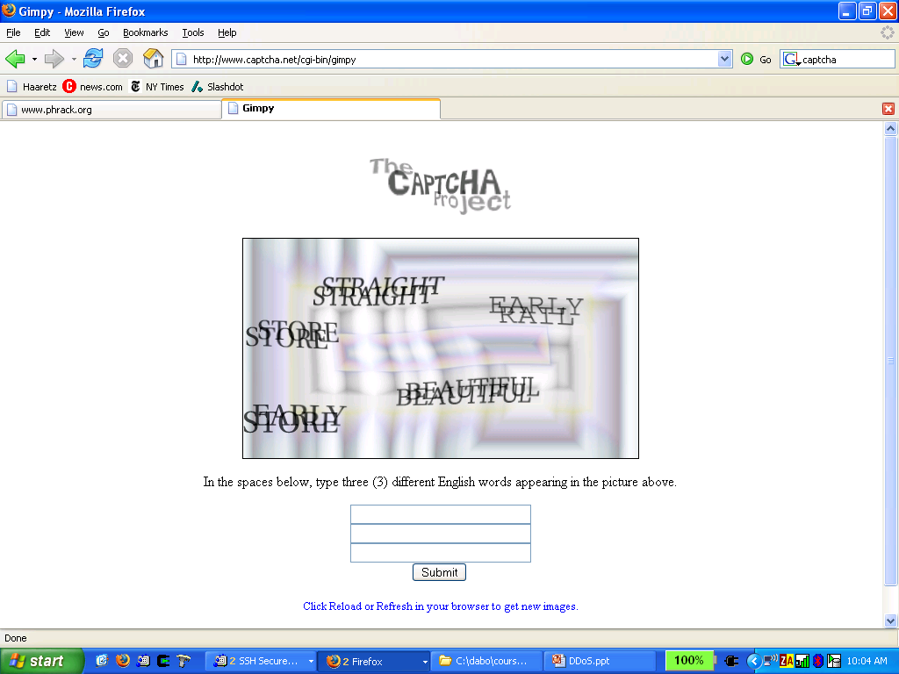
2. CAPTCHAs
Idea: verify that connection is from a human
Applies to application layer DDoS [Killbots ’05]
During attack: generate CAPTCHAs and process request only if valid solution
Present one CAPTCHA per source IP address.
Denial of service attacks

Slide 35
3. Source identification
Goal: identify packet source
Ultimate goal: block attack at the source
Denial of service attacks

Slide 36
1. Ingress filtering (RFC 2827, 3704)
Big problem: DDoS with spoofed source IPs
Ingress filtering policy: ISP only forwards packets with legitimate source IP (see also SAVE protocol)
ISP
Internet
Denial of service attacks
Notes:
Other methods to block spoofed source IP: SAVE (Infocomm’02)

Slide 37
Implementation problems
ALL ISPs must do this. Requires global trust.
If 10% of ISPs do not implement ⇒ no defense
No incentive for deployment
2014:
25% of Auto. Systems are fully spoofable (spoofer.cmand.org)
13% of announced IP address space is spoofable
Recall: 309 Gbps attack used only 3 networks (3/2013)
Denial of service attacks

Slide 38
2. Traceback [Savage et al. ’00]
Goal:
Given set of attack packets
Determine path to source
How: change routers to record info in packets
Assumptions:
Most routers remain uncompromised
Attacker sends many packets
Route from attacker to victim remains relatively stable
Denial of service attacks

Slide 39
Simple method
Write path into network packet
Each router adds its own IP address to packet
Victim reads path from packet
Problem:
Requires space in packet
Path can be long
No extra fields in current IP format
Changes to packet format too much to expect
Denial of service attacks

Slide 40
Better idea
DDoS involves many packets on same path
Store one link in each packet
Each router probabilistically stores own address
Fixed space regardless of path length
A₁
A₂
A₃
A₄
A₅
R₆
R₇
R₈
R₉
R₁₀
R₁₂
V
Denial of service attacks

Slide 41
Edge Sampling
Data fields written to packet:
Edge: start and end IP addresses
Distance: number of hops since edge stored
Marking procedure for router R
if coin turns up heads (with probability p) then
write R into start address
write 0 into distance field
else
if distance == 0 write R into end field
increment distance field
Denial of service attacks

Slide 42
Edge Sampling: picture
Packet received
R₁ receives packet from source or another router
Packet contains space for start, end, distance
packet
s
e
d
R₁
R₂
R₃
Denial of service attacks

Slide 43
Edge Sampling: picture
Begin writing edge
R₁ chooses to write start of edge
Sets distance to 0
packet
R₁
0
R₁
R₂
R₃
Denial of service attacks

Slide 44
Edge Sampling
Finish writing edge
R₂ chooses not to overwrite edge
Distance is 0
Write end of edge, increment distance to 1
packet
R₁
R₂
1
R₁
R₂
R₃
Denial of service attacks

Slide 45
Edge Sampling
Increment distance
R₃ chooses not to overwrite edge
Distance >0
Increment distance to 2
packet
R₁
R₂
2
R₁
R₂
R₃
Denial of service attacks

Slide 46
Path reconstruction
Extract information from attack packets
Build graph rooted at victim
Each (start,end,distance) tuple provides an edge
# packets needed to reconstruct path
E(X) <
where p is marking probability, d is length of path
ln(d)
p(1-p)^{d-1}
Denial of service attacks

Slide 47
Details: where to store edge
Identification field
Used for fragmentation
Fragmentation is rare
16 bits
Store edge in 16 bits?
Break into chunks
Store start + end
Version
Header Length
Type of Service
Total Length
Identification
Identification
Flags
Fragment Offset
offset
distance
edge chunk
Time to Live
Protocol
0 2 3 7 8 15
Header Checksum
Source Address of Originating Host
Destination Address of Target Host
Options
Padding
IP Data
Denial of service attacks

Slide 48
More traceback proposals
Advanced and Authenticated Marking Schemes for IP Traceback
Song, Perrig. IEEE Infocomm ’01
Reduces noisy data and time to reconstruct paths
An algebraic approach to IP traceback
Stubblefield, Dean, Franklin. NDSS ’02
Hash-Based IP Traceback
Snoeren, Partridge, Sanchez, Jones, Tchakountio, Kent, Strayer. SIGCOMM ‘01
Denial of service attacks

Slide 49
Problem: Reflector attacks [Paxson ’01]
Reflector:
A network component that responds to packets
Response sent to victim (spoofed source IP)
Examples:
DNS Resolvers: UDP 53 with victim.com source
At victim: DNS response
Web servers: TCP SYN 80 with victim.com source
At victim: TCP SYN ACK packet
Gnutella servers
Denial of service attacks

Slide 50
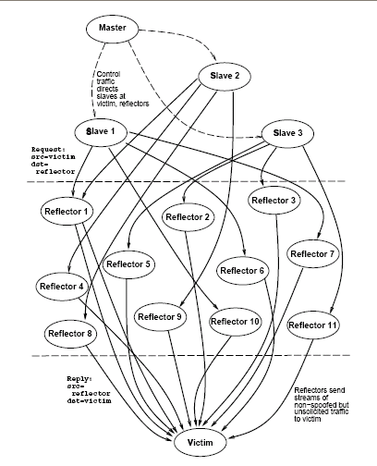
DoS Attack
Single Master
Many bots to generate flood
Zillions of reflectors to hide bots
Kills traceback and pushback methods
Denial of service attacks

Slide 51
Capability based defense
Denial of service attacks

Slide 52
Capability based defense
Anderson, Roscoe, Wetherall.
Preventing internet denial-of-service with capabilities. SIGCOMM ‘04.
Yaar, Perrig, and Song.
Siff: A stateless internet flow filter to mitigate DDoS flooding attacks. IEEE S&P ’04.
Yang, Wetherall, Anderson.
A DoS-limiting network architecture. SIGCOMM ’05
Denial of service attacks

Slide 53
Capability based defense
Basic idea:
Receivers can specify what packets they want
How:
Sender requests capability in SYN packet
Path identifier used to limit # reqs from one source
Receiver responds with capability
Sender includes capability in all future packets
Main point: Routers only forward:
Request packets, and
Packets with valid capability
Denial of service attacks
Notes:
Capabilities can be revoked in case of attack

Slide 54
Capability based defense
Capabilities can be revoked if source is attacking
Blocks attack packets close to source
R₁
R₃
dest
R₂
R₄
Source AS
Transit AS
Dest AS
Attack packets dropped
Denial of service attacks

Slide 55
Pushback Traffic Filtering
Denial of service attacks

Slide 56
Pushback filtering
Mahajan, Bellovin, Floyd, Ioannidis, Paxson, Shenker. Controlling High Bandwidth Aggregates in the Network. Computer Communications Review ‘02.
Ioannidis, Bellovin. Implementing Pushback: Router-Based Defense Against DoS Attacks. NDSS ’02
Argyraki, Cheriton. Active Internet Traffic Filtering: Real-Time Response to Denial-of-Service Attacks. USENIX ‘05.
Denial of service attacks

Slide 57
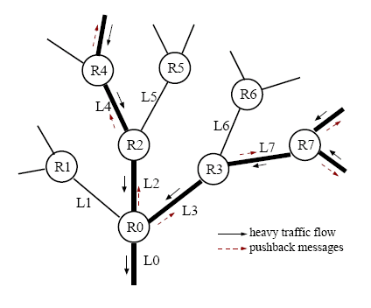
Pushback Traffic Filtering
Assumption: DoS attack from few sources
Iteratively block attacking network segments.
Denial of service attacks

Slide 58
Overlay filtering
Denial of service attacks

Slide 59
Overlay filtering
Keromytis, Misra, Rubenstein. SOS: Secure Overlay Services. SIGCOMM ‘02.
D. Andersen. Mayday. Distributed Filtering for Internet Services. Usenix USITS ‘03.
Lakshminarayanan, Adkins, Perrig, Stoica. Taming IP Packet Flooding Attacks. HotNets ’03.
Denial of service attacks

Slide 60
Take home message:
Denial of Service attacks are real. Must be considered at design time.
Sad truth:
Internet is ill-equipped to handle DDoS attacks
Commercial solutions: CloudFlare, Prolexic
Many good proposals for core redesign.
Denial of service attacks

Slide 61

Thanks and any questions?
Denial of service attacks
The materials of this lecture are mostly from Stanford university

