Slide 1
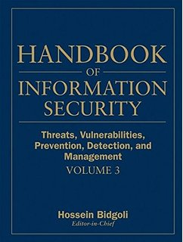
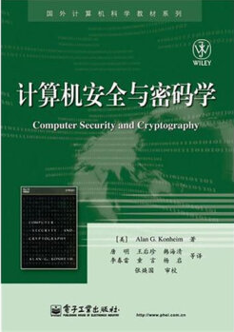
Computer Security and Cryptography
Lecturer: Zhou Peng, Ph.D in Computer Network Security
pzhou@shu.edu.cn
Lecture 2

Slide 2

Computer Security and Cryptography
Lecture 2
Principles of Secure Design

Slide 3
Today
Isolation and Least Privilege
Access Control Concepts
Operating Systems
Browser Isolation and Least Privilege
Principles of Secure Design

Slide 4
Principles of Secure Design
Compartmentalization
Isolation
Principle of least privilege
Defense in depth
Use more than one security mechanism
Secure the weakest link
Fail securely
Keep it simple
Principles of Secure Design

Slide 5
Principle of Least Privilege
What’s a privilege?
Ability to access or modify a resource
Assume compartmentalization and isolation
Separate the system into isolated compartments
Limit interaction between compartments
Principle of Least Privilege
A system module should only have the minimal privileges needed for its intended purposes
Principles of Secure Design

Slide 6
Principle of Least Privilege
What’s a privilege?
Ability to access or modify a resource
Assume compartmentalization and isolation
Separate the system into isolated compartments
Limit interaction between compartments
Principle of Least Privilege
A system module should only have the minimal privileges needed for its intended purposes
Principles of Secure Design

Slide 7
Monolithic design
System
Network
Network
User input
User device
File system
File system
Principles of Secure Design

Slide 8
Monolithic design
System
Network
Network
User input
User device
File system
File system
Principles of Secure Design

Slide 9
Monolithic design
System
Network
Network
User input
User display
File system
File system
Principles of Secure Design

Slide 10
Component design
Network
Network
User input
User display
File system
File system
Principles of Secure Design

Slide 11
Component design
Network
Network
User input
User device
File system
File system
Principles of Secure Design

Slide 12
Component design
Network
Network
User input
User device
File system
File system
Principles of Secure Design

Slide 13
Principle of Least Privilege
What’s a privilege?
Ability to access or modify a resource
Assume compartmentalization and isolation
Separate the system into isolated compartments
Limit interaction between compartments
Principle of Least Privilege
A system module should only have the minimal privileges needed for its intended purposes
Principles of Secure Design

Slide 14
Example: Mail Agent
Requirements
Receive and send email over external network
Place incoming email into local user inbox files
Sendmail
Traditional Unix
Monolithic design
Historical source of many vulnerabilities
Qmail
Compartmentalized design
Principles of Secure Design

Slide 15
OS Basics (before examples)
Isolation between processes
Each process has a UID
Two processes with same UID have same permissions
A process may access files, network sockets, ….
Permission granted according to UID
Relation to previous terminology
Compartment defined by UID
Privileges defined by actions allowed on system resources
Principles of Secure Design

Slide 16
Qmail design
Isolation based on OS isolation
Separate modules run as separate “users”
Each user only has access to specific resources
Least privilege
Minimal privileges for each UID
Only one “setuid” program
setuid allows a program to run as different users
Only one “root” program
root program has all privileges
Principles of Secure Design

Slide 17
Structure of qmail
qmail-smtpd
qmail-inject
qmail-queue
Incoming external mail
Incoming internal mail
qmail-send
qmail-rspawn
qmail-lspawn
qmail-remote
qmail-local
Principles of Secure Design

Slide 18
Isolation by Unix UIDs
qmailq – user who is allowed to read/write mail queue
qmaild
qmail-smtpd
qmail-inject
user
qmailq
qmail-queue
qmail-send
qmailr
qmails
root
qmail-rspawn
qmail-lspawn
setuid user
qmailr
user
qmail-remote
qmail-local
Principles of Secure Design

Slide 19
Structure of qmail
qmail-smtpd
qmail-inject
qmail-queue
Reads incoming mail directories
Splits message into header, body
Signals qmail-send
qmail-send
qmail-rspawn
qmail-lspawn
qmail-remote
qmail-local
Principles of Secure Design

Slide 20
Structure of qmail
qmail-smtpd
qmail-inject
qmail-queue
qmail-send signals
qmail-lspawn if local
qmail-remote if remote
qmail-send
qmail-rspawn
qmail-lspawn
qmail-remote
qmail-local
Principles of Secure Design

Slide 21
Structure of qmail
qmail-smtpd
qmail-inject
qmail-queue
qmail-send
qmail-lspawn
qmail-lspawn
Spawns qmail-local
qmail-local runs with ID of user receiving local mail
qmail-local
Principles of Secure Design

Slide 22
Structure of qmail
qmail-smtpd
qmail-inject
qmail-queue
qmail-send
qmail-lspawn
qmail-local
Handles alias expansion
Delivers local mail
Calls qmail-queue if needed
qmail-local
Principles of Secure Design

Slide 23
Structure of qmail
qmail-smtpd
qmail-inject
qmail-queue
qmail-send
qmail-rspawn
qmail-remote
Delivers message to remote MTA
qmail-remote
Principles of Secure Design

Slide 24
Isolation by Unix UIDs
qmailq – user who is allowed to read/write mail queue
qmaild
qmail-smtpd
qmail-inject
user
qmailq
qmail-queue
setuid
qmail-send
qmailr
qmails
root
qmail-rspawn
qmail-lspawn
root
setuid user
qmailr
user
qmail-remote
qmail-local
Principles of Secure Design

Slide 25
Least privilege
qmail-smtpd
qmail-inject
qmail-queue
setuid
qmail-send
qmail-rspawn
qmail-lspawn
root
qmail-remote
qmail-local
Principles of Secure Design

Slide 26
Android process isolation
Android application sandbox
Isolation: Each application runs with its own UID in own VM
Provides memory protection
Communication limited to using Unix domain sockets
Only ping, zygote (spawn another process) run as root
Interaction: reference monitor checks permissions on inter-component communication
Least Privilege: Applications announces permission
User grants access at install time
Principles of Secure Design

Slide 27
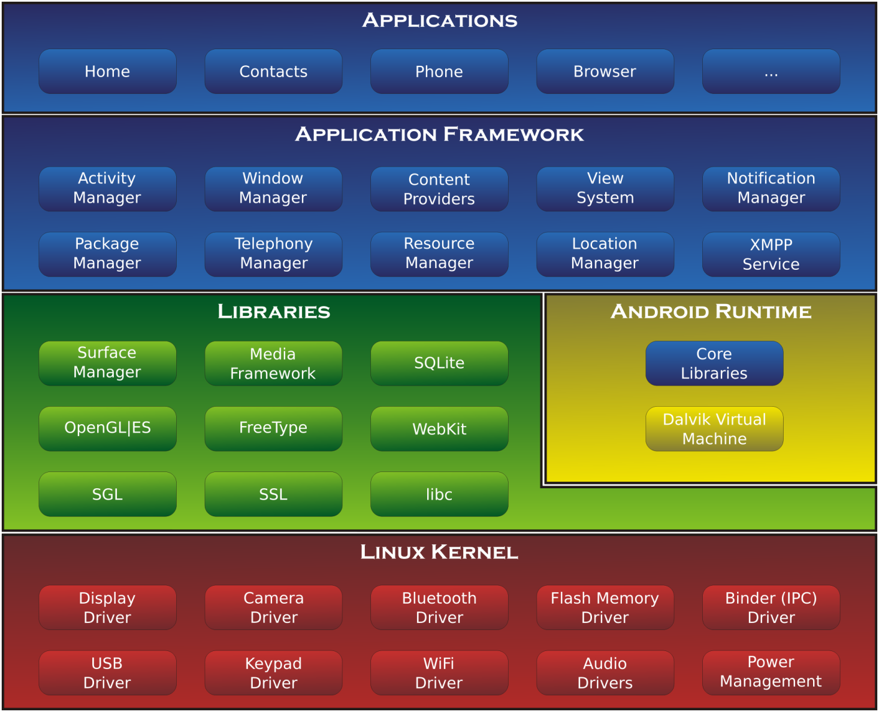
Principles of Secure Design

Slide 28

App
Principles of Secure Design

Slide 29
Discussion?
Principle of Least Privilege
Qmail example
Android app sandbox example
Principles of Secure Design

Slide 30
Today
Isolation and Least Privilege
Access Control Concepts
Operating Systems
Browser Isolation and Least Privilege
Principles of Secure Design

Slide 31
Access control
Assumptions
System knows who the user is
Authentication via name and password, other credential
Access requests pass through gatekeeper (reference monitor)
System must not allow monitor to be bypassed
Reference
monitor
?
Resource
User process
access request
policy
Principles of Secure Design

Slide 32
Access control matrix [Lampson]
Objects
 | File 1 | File 2 | File 3 | … | File n
User 1 | read | write | - | - | read
User 2 | write | write | write | - | -
User 3 | - | - | - | read | read
…
User m | read | write | read | write | read
Subjects
Principles of Secure Design

Slide 33
Implementation concepts
 | File 1 | File 2 | …
User 1 | read | write | -
User 2 | write | write | -
User 3 | - | - | read
…
User m | Read | write | write
Access control list (ACL)
Store column of matrix
with the resource
Capability
User holds a “ticket” for
each resource
Two variations
store row of matrix with user, under OS control
unforgeable ticket in user space
Access control lists are widely used, often with groups
Some aspects of capability concept are used in many systems
Principles of Secure Design

Slide 34
ACL vs Capabilities
Access control list
Associate list with each object
Check user/group against list
Relies on authentication: need to know user
Capabilities
Capability is unforgeable ticket
Random bit sequence, or managed by OS
Can be passed from one process to another
Reference monitor checks ticket
Does not need to know identify of user/process
Principles of Secure Design

Slide 35
ACL vs Capabilities
Process P
User U
Process P
Capabilty c,d,e
Process Q
User U
Process Q
Capabilty c,e
Process R
User U
Process R
Capabilty c
Principles of Secure Design

Slide 36
ACL vs Capabilities
Delegation
Cap: Process can pass capability at run time
ACL: Try to get owner to add permission to list?
More common: let other process act under current user
Revocation
ACL: Remove user or group from list
Cap: Try to get capability back from process?
Possible in some systems if appropriate bookkeeping
OS knows which data is capability
If capability is used for multiple resources, have to revoke all or none …
Indirection: capability points to pointer to resource
If C → P → R, then revoke capability C by setting P=0
Principles of Secure Design

Slide 37
Roles (aka Groups)
Role = set of users
Administrator, PowerUser, User, Guest
Assign permissions to roles; each user gets permission
Role hierarchy
Partial order of roles
Each role gets
permissions of roles below
List only new permissions
given to each role
Administrator
PowerUser
User
Guest
Principles of Secure Design

Slide 38
Role-Based Access Control
Individuals
Roles
Resources
engineering
Server 1
marketing
Server 2
Server 3
human res
Advantage: users change more frequently than roles
Principles of Secure Design

Slide 39
Access control summary
Access control involves reference monitor
Check permissions: ⟨user info, action⟩→ yes/no
Important: no way around this check
Access control matrix
Access control lists vs capabilities
Advantages and disadvantages of each
Role-based access control
Use group as “user info”; use group hierarchies
Principles of Secure Design

Slide 40
Discussion?
Access control matrix
Access control list (ACL)
Capabilities
Role-based access control
Principles of Secure Design

Slide 41
Today
Isolation and Least Privilege
Access Control Concepts
Operating Systems
Browser Isolation and Least Privilege
Principles of Secure Design

Slide 42
Unix access control
 | File 1 | File 2 | …
User 1 | read | write | -
User 2 | write | write | -
User 3 | - | - | read
…
User m | Read | write | write
Process has user id
Inherit from creating process
Process can change id
Restricted set of options
Special “root” id
All access allowed
File has access control list (ACL)
Grants permission to user ids
Owner, group, other
Principles of Secure Design

Slide 43
Unix file access control list
Each file has owner and group
Permissions set by owner
Read, write, execute
Owner, group, other
Represented by vector of
four octal values
Only owner, root can change permissions
This privilege cannot be delegated or shared
Setid bits – Discuss in a few slides
setid
-
rwx
rwx
rwx
ownr
grp
othr
Principles of Secure Design

Slide 44
Question
Owner can have fewer privileges than other
What happens?
Owner gets access?
Owner does not?
Prioritized resolution of differences
if user = owner then owner permission
else if user in group then group permission
else other permission
Principles of Secure Design

Slide 45
Process effective user id (EUID)
Each process has three Ids (+ more under Linux)
Real user ID (RUID)
same as the user ID of parent (unless changed)
used to determine which user started the process
Effective user ID (EUID)
from set user ID bit on the file being executed, or sys call
determines the permissions for process
file access and port binding
Saved user ID (SUID)
So previous EUID can be restored
Real group ID, effective group ID, used similarly
Principles of Secure Design

Slide 46
Process Operations and IDs
Root
ID=0 for superuser root; can access any file
Fork and Exec
Inherit three IDs, except exec of file with setuid bit
Setuid system call
seteuid(newid) can set EUID to
Real ID or saved ID, regardless of current EUID
Any ID, if EUID=0
Details are actually more complicated
Several different calls: setuid, seteuid, setreuid
Principles of Secure Design

Slide 47
Setid bits on executable Unix file
Three setid bits
Setuid – set EUID of process to ID of file owner
Setgid – set EGID of process to GID of file
Sticky
Off: if user has write permission on directory, can rename or remove files, even if not owner
On: only file owner, directory owner, and root can rename or remove file in the directory
Principles of Secure Design

Slide 48
Example
Owner 18
RUID 25
SetUID
…;
…;
exec( );
program
Owner 18
…;
…;
i=getruid()
setuid(i);
…;
…;
-rw-r--r--
file
read/write
RUID 25
EUID 18
Owner 25
RUID 25
-rw-r--r--
read/write
EUID 25
file
Principles of Secure Design

Slide 49
Unix summary
Good things
Some protection from most users
Flexible enough to make things possible
Main limitation
Too tempting to use root privileges
No way to assume some root privileges without all root privileges
Principles of Secure Design

Slide 50
Weakness in isolation, privileges
Network-facing Daemons
Root processes with network ports open to all remote parties, e.g., sshd, ftpd, sendmail, …
Rootkits
System extension via dynamically loaded kernel modules
Environment Variables
System variables such as LIBPATH that are shared state across applications. An attacker can change LIBPATH to load an attacker-provided file as a dynamic library
Principles of Secure Design

Slide 51
Weakness in isolation, privileges
Shared Resources
Since any process can create files in /tmp directory, an untrusted process may create files that are used by arbitrary system processes
Time-of-Check-to-Time-of-Use (TOCTTOU)
Typically, a root process uses system call to determine if initiating user has permission to a particular file, e.g. /tmp/X.
After access is authorized and before the file open, user may change the file /tmp/X to a symbolic link to a target file /etc/shadow.
Principles of Secure Design

Slide 52
Access control in Windows
Some basic functionality similar to Unix
Specify access for groups and users
Read, modify, change owner, delete
Some additional concepts
Tokens
Security attributes
Generally
More flexible than Unix
Can define new permissions
Can transfer some but not all privileges (cf. capabilities)
Principles of Secure Design

Slide 53
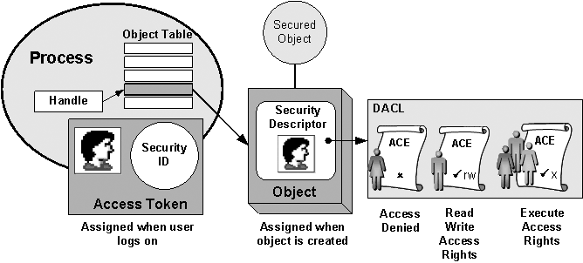
Principles of Secure Design

Slide 54
Process has set of tokens
Security context
Privileges, accounts, and groups associated with the process or thread
Presented as set of tokens
Impersonation token
Used temporarily to adopt a different security context, usually of another user
Principles of Secure Design

Slide 55
Object has security descriptor
Specifies who can perform what actions on the object
Header (revision number, control flags, …)
SID of the object's owner
SID of the primary group of the object
Two attached optional lists:
Discretionary Access Control List (DACL) – users, groups, …
System Access Control List (SACL) – system logs, ..
Principles of Secure Design

Slide 56
Example access request
Access token
User: Mark
Group1: Administrators
Access request: write
Action: denied
Group2: Writers
Revision Number
User Mark requests write permission
Descriptor denies permission to group
Reference Monitor denies request
(DACL for access, SACL for audit and logging)
Control flags
Owner SID
Group SID
DACL Pointer
Security descriptor
SACL Pointer
Deny
Priority:
Explicit Deny Explicit Allow Inherited Deny Inherited Allow
Writers
Read, Write
Allow
Mark
Read, Write
Principles of Secure Design

Slide 57
Impersonation Tokens (compare to setuid)
Process adopts security attributes of another
Client passes impersonation token to server
Client specifies impersonation level of server
Anonymous
Token has no information about the client
Identification
Obtain the SIDs of client and client's privileges, but server cannot impersonate the client
Impersonation
Impersonate the client
Delegation
Lets server impersonate client on local, remote systems
Principles of Secure Design

Slide 58
Weakness in isolation, privileges
Similar problems to Unix
E.g., Rootkits leveraging dynamically loaded kernel modules
Windows Registry
Global hierarchical database to store data for all programs
Registry entry can be associated with a security context that limits access; common to be able to write sensitive entry
Enabled By Default
Historically, many Windows deployments also came with full permissions and functionality enabled
Principles of Secure Design

Slide 59
Discussion?
Unix access control
What information is associated with a process?
What information is associated with a resource (file)?
How are they compared?
What form of delegation or authority is possible?
Windows access control
What information is associated with a process?
What information is associated with a resource (file)?
How are they compared?
What form of delegation or authority is possible?
Comparison, pros and cons?
Principles of Secure Design

Slide 60
Today
Isolation and Least Privilege
Access Control Concepts
Operating Systems
Browser Isolation and Least Privilege
Principles of Secure Design

Slide 61
Web browser: an analogy
Operating system
Web browser
Subject: Processes
Has User ID (UID, SID)
Discretionary access control
Objects
File
Network
…
Vulnerabilities
Untrusted programs
Buffer overflow
…
Subject: web content (JavaScript)
Has “Origin”
Mandatory access control
Objects
Document object model
Frames
Cookies / localStorage
Vulnerabilities
Cross-site scripting
Implementation bugs
…
The web browser enforces its own internal policy. If the browser implementation is corrupted, this mechanism becomes unreliable.
Principles of Secure Design

Slide 62
Components of security policy
Frame-Frame relationships
canScript(A,B)
Can Frame A execute a script that manipulates arbitrary/nontrivial DOM elements of Frame B?
canNavigate(A,B)
Can Frame A change the origin of content for Frame B?
Frame-principal relationships
readCookie(A,S), writeCookie(A,S)
Can Frame A read/write cookies from site S?
Principles of Secure Design

Slide 63
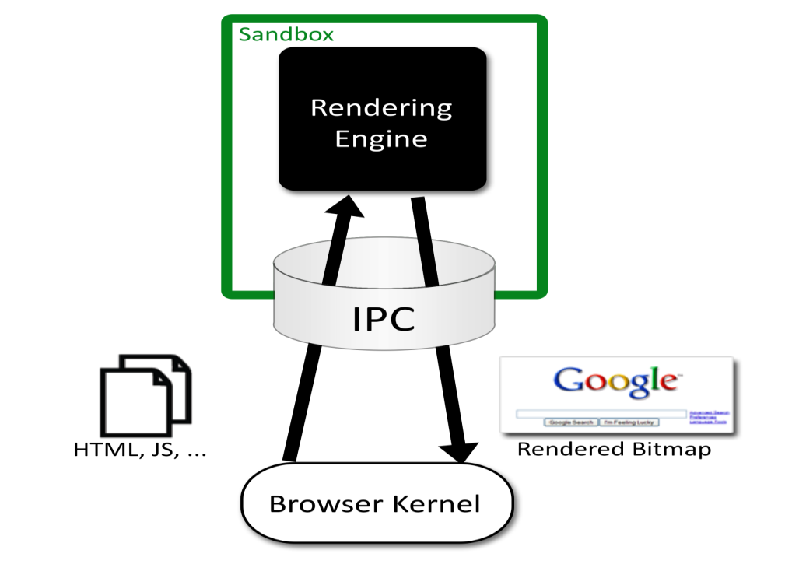

Chromium Security Architecture
Browser ("kernel")
Full privileges (file system, networking)
Rendering engine
Up to 20 processes
Sandboxed
One process per plugin
Full privileges of browser
Principles of Secure Design

Slide 64
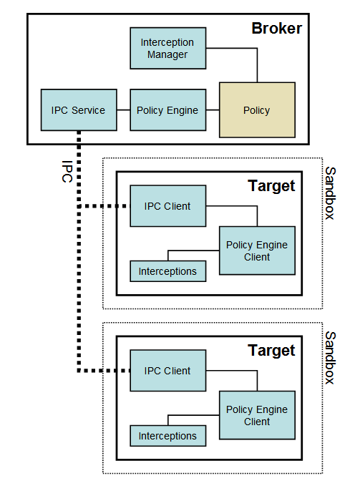
Chromium
Communicating sandboxed components
See: http://dev.chromium.org/developers/design-documents/sandbox/
Principles of Secure Design

Slide 65
Design Decisions
Compatibility
Sites rely on the existing browser security policy
Browser is only as useful as the sites it can render
Rules out more “clean slate” approaches
Black Box
Only renderer may parse HTML, JavaScript, etc.
Kernel enforces coarse-grained security policy
Renderer to enforces finer-grained policy decisions
Minimize User Decisions
Principles of Secure Design

Slide 66
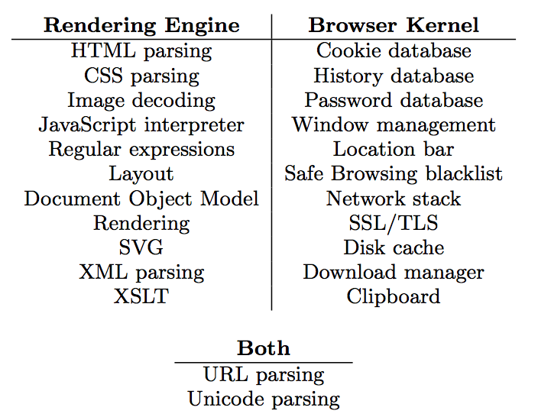
Task Allocation
Principles of Secure Design

Slide 67
Leverage OS Isolation
Sandbox based on four OS mechanisms
A restricted token
The Windows job object
The Windows desktop object
Windows integrity levels
Specifically, the rendering engine
adjusts security token by converting SIDS to DENY_ONLY, adding restricted SID, and calling AdjustTokenPrivileges
runs in a Windows Job Object, restricting ability to create new processes, read or write clipboard, ..
runs on a separate desktop, mitigating lax security checking of some Windows APIs
See: http://dev.chromium.org/developers/design-documents/sandbox/
Principles of Secure Design

Slide 68
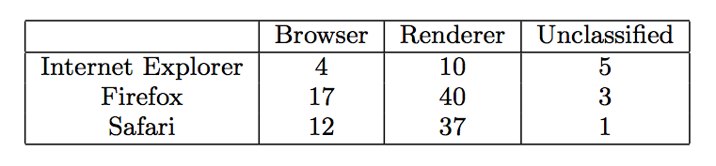
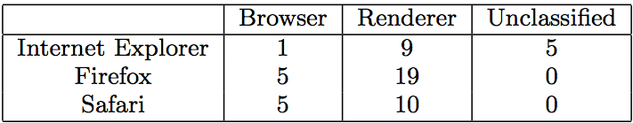
Evaluation: CVE count
Total CVEs:
Arbitrary code execution vulnerabilities:
Principles of Secure Design

Slide 69
Discussion?
How does Chrome architecture use principle of least privilege?
What are the isolated modules?
Which privileges are given to each module?
Why is this effective?
Are there other ways you could use operating system features to improve isolation and least privilege?
Principles of Secure Design

Slide 70
Summary
Security principles
Isolation
Principle of Least Privilege
Qmail example
Access Control Concepts
Matrix, ACL, Capabilities
OS Mechanisms
Unix: UID, ACL, Setuid
Windows: SID, Tokens, Security Descriptor, Impersonation
Browser security architecture
Isolation and least privilege example
Principles of Secure Design

Slide 71

Thanks and any questions?
Principles of Secure Design
The materials of this lecture are mostly from Stanford university

