Slide 1

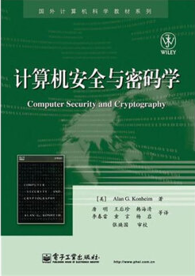
Computer Security and Cryptography
Lecturer: Zhou Peng, Ph.D in Computer Network Security
pzhou@shu.edu.cn
Lecture 4

Slide 2

Computer Security and Cryptography
Lecture 4
Modern Cryptography

Slide 3
Today
Some loose ends on WWII
Maurice Burnett
Modern Cryptography
Modern symmetric ciphers
Public-key cryptosystems
Modern Cryptography

Slide 4
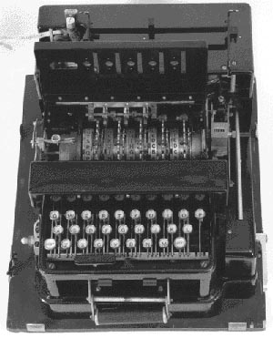
British Cipher Machine
Design based on commercial Enigma
5 rotor wheels (instead of 3 in Enigma)
Multiple rings per rotor
Last 2 rotor wheels didn’t rotate
British attempted to break it (without success)
Typex Machine
Modern Cryptography

Slide 5
German Code-Breaking Efforts
About 6,000 people (compare to 12,000 working at Bletchley Park)
Decentralized: each military branch had their own, didn’t share what they learned
Effective against manual codes: broke about 50% of manually coded messages
Didn’t attempt to break rotor-based ciphers – so confident Enigma was unbreakable, didn’t try to Typex and similar machines
Modern Cryptography

Slide 6
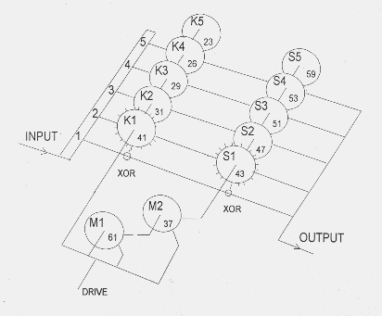
Lorenz Cipher
From http://www.codesandciphers.org.uk/lorenz/fish.htm
Modern Cryptography

Slide 7
Modern Symmetric Ciphers
A billion billion is a large number, but it's not that large a number. Whitfield Diffie
Same idea but:
Use digital logic instead of mechanical rotors
Larger keys (random bits, not rotor alignments)
Lorenz ≈ 5¹² < 10⁹
Modern ≥ 128 bits > 10³⁷
Encrypt blocks of letters at a time
Modern Cryptography

Slide 8
Modern Ciphers
AES (Rijndael) successor to DES selected 2001
128-bit keys, encrypt 128-bit blocks
Brute force attack (around 10³⁰ times harder than Lorenz)
Try 1 Trillion keys per second
Would take 10790283070806000000 years to try all keys!
If that’s not enough, can use 256-bit key
No known techniques that do better than brute force search
Modern Cryptography

Slide 9
Login Process
Terminal
Login: alyssa
Password: fido
login sends
<“alyssa”, “fido”>
Trusted Subsystem
Eve
Modern Cryptography

Slide 10
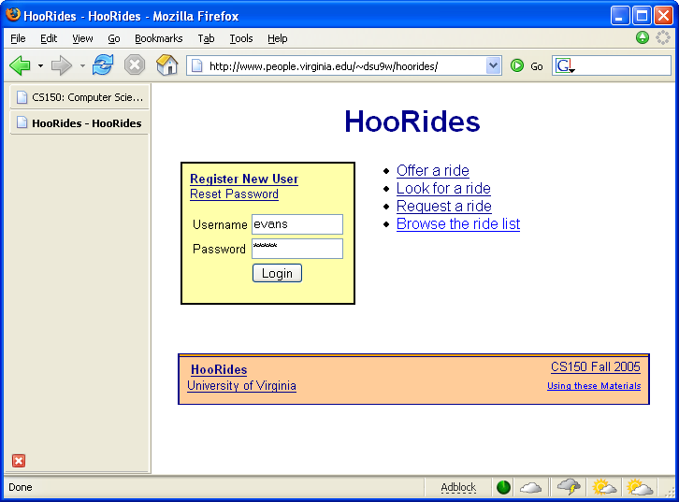
Sending Passwords
Encrypt
The Internet
User
Server
Modern Cryptography

Slide 11
The Internet
Ciphertext
Encrypt
Decrypt
Plaintext
Plaintext
K
K
User
C = Encrypt_{K} (P)
P = Decrypt_{K} (C)
Server
Modern Cryptography

Slide 12
Private-Key Cryptography
traditional private/secret/single key cryptography uses one key
shared by both sender and receiver
if this key is disclosed communications are compromised
also is symmetric, parties are equal
hence does not protect sender from receiver forging a message & claiming is sent by sender
Modern Cryptography
Notes:
So far all the cryptosystems discussed have been private/secret/single key (symmetric) systems. All classical, and modern block and stream ciphers are of this form.

Slide 13
Public-Key Cryptography
probably most significant advance in the 3000 year history of cryptography
uses two keys – a public & a private key
asymmetric since parties are not equal
uses clever application of number theoretic concepts to function
complements rather than replaces private key crypto
Modern Cryptography
Notes:
Will now discuss the radically different public key systems, in which two keys are used. Anyone knowing the public key can encrypt messages or verify signatures, but cannot decrypt messages or create signatures, counter-intuitive though this may seem. It works by the clever use of number theory problems that are easy one way but hard the other. Note that public key schemes are neither more secure than private key (security depends on the key size for both), nor do they replace private key schemes (they are too slow to do so), rather they complement them.

Slide 14
Public-Key Cryptography
public-key/two-key/asymmetric cryptography involves the use of two keys:
a public-key, which may be known by anybody, and can be used to encrypt messages, and verify signatures
a private-key, known only to the recipient, used to decrypt messages, and sign (create) signatures
is asymmetric because
those who encrypt messages or verify signatures cannot decrypt messages or create signatures
Modern Cryptography

Slide 15
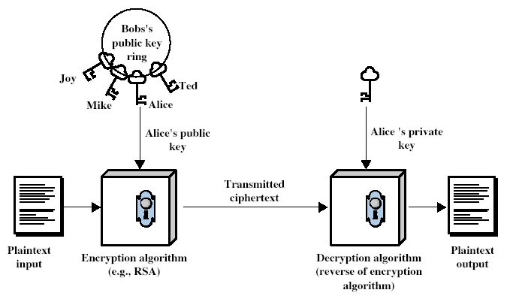
Public-Key Cryptography
Modern Cryptography
Notes:
Stallings Fig 9-1.

Slide 16
Public-Key Characteristics
Public-Key algorithms rely on two keys with the characteristics that it is:
computationally infeasible to find decryption key knowing only algorithm & encryption key
computationally easy to en/decrypt messages when the relevant (en/decrypt) key is known
either of the two related keys can be used for encryption, with the other used for decryption (in some schemes)
Modern Cryptography
Notes:
Public key schemes utilise problems that are easy (P type) one way but hard (NP type) the other way, eg exponentiation vs logs, multiplication vs factoring. Consider the following analogy using padlocked boxes: traditional schemes involve the sender putting a message in a box and locking it, sending that to the receiver, and somehow securely also sending them the key to unlock the box. The radical advance in public key schemes was to turn this around, the receiver sends an unlocked box to the sender, who puts the message in the box and locks it (easy - and having locked it cannot get at the message), and sends the locked box to the receiver who can unlock it (also easy), having the key. An attacker would have to pick the lock on the box (hard).

Slide 17
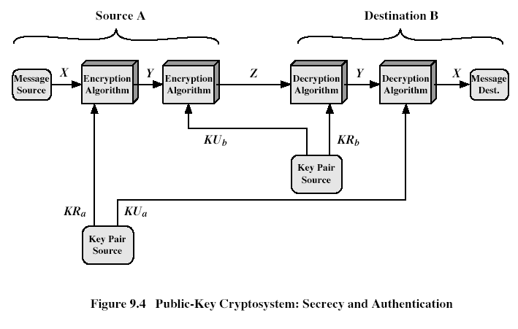
Public-Key Cryptosystems
Modern Cryptography
Notes:
Stallings Fig 9-4.
Here see various components of public-key schemes used for both secrecy and authentication. Note that separate key pairs are used for each of these – receiver owns and creates secrecy keys, sender owns and creates authentication keys.

Slide 18
Public-Key Applications
can classify uses into 3 categories:
encryption/decryption (provide secrecy)
digital signatures (provide authentication)
key exchange (of session keys)
some algorithms are suitable for all uses, others are specific to one
Modern Cryptography

Slide 19
Security of Public Key Schemes
like private key schemes brute force exhaustive search attack is always theoretically possible
but keys used are too large (>512bits)
security relies on a large enough difference in difficulty between easy (en/decrypt) and hard (cryptanalysis) problems
more generally the hard problem is known, its just made too hard to do in practise
requires the use of very large numbers
hence is slow compared to secret key schemes
Modern Cryptography
Notes:
Public key schemes are no more or less secure than private key schemes - in both cases the size of the key determines the security. Note also that you can't compare key sizes - a 64-bit private key scheme has very roughly similar security to a 512-bit RSA - both could be broken given sufficient resources. But with public key schemes at least there's usually a firmer theoretical basis for determining the security since its based on well-known and well studied number theory problems.

Slide 20
Public key encryption algorithms
Requirements:
.
.
+
-
1
need K ( ) and K ( ) such that
B
B
-
+
K (K (m)) = m
B
B
2
+
given public key K , it should be impossible to compute private key K
B
-
B
RSA: Rivest, Shamir, Adelson algorithm
Modern Cryptography

Slide 21
RSA: Choosing keys
1. Choose two large prime numbers p, q.
(e.g., 1024 bits each)
2. Compute n = pq, z = (p-1)(q-1)
3. Choose e (with e<n) that has no common factors
with z. (e, z are “relatively prime”).
4. Choose d such that ed-1 is exactly divisible by z.
(in other words: ed mod z = 1 ).
5. Public key is (n,e). Private key is (n,d).
+
-
K
K
B
B
Modern Cryptography

Slide 22
RSA: Encryption, decryption
0. Given (n,e) and (n,d) as computed above
1. To encrypt bit pattern, m, compute
e
e
c = m mod n
(i.e., remainder when m is divided by n)
2. To decrypt received bit pattern, c, compute
d
d
m = c mod n
(i.e., remainder when c is divided by n)
Magic
happens!
e
d
m = (m mod n)
mod n
c
Modern Cryptography

Slide 23
RSA example:
Bob chooses p=5, q=7. Then n=35, z=24.
e=5 (so e, z relatively prime).
d=29 (so ed-1 exactly divisible by z.
m
e
e
letter
m
c = m mod n
encrypt:
l
12
1524832
17
d
d
c
c
m = c mod n
letter
decrypt:
17
481968572106750915091411825223071697
12
l
Modern Cryptography

Slide 24
RSA: Why is that
e
d
m = (m mod n)
mod n
Useful number theory result: If p,q prime and
n = pq, then:
y
y mod (p-1)(q-1)
x mod n = x mod n
e
d
ed
(m mod n)
mod n = m mod n
ed mod (p-1)(q-1)
= m mod n
(using number theory result above)
1
= m mod n
(since we chose ed to be divisible by
(p-1)(q-1) with remainder 1 )
= m
Modern Cryptography

Slide 25
RSA: another important property
The following property will be very useful later:
-
+
+
-
K (K (m)) = m
=
K (K (m))
B
B
B
B
use public key first, followed by private key
use private key first, followed by public key
Result is the same!
Modern Cryptography

Slide 26
Digital Signatures
Cryptographic technique analogous to hand-written signatures.
sender (Bob) digitally signs document, establishing he is document owner/creator.
verifiable, nonforgeable: recipient (Alice) can prove to someone that Bob, and no one else (including Alice), must have signed document
Modern Cryptography

Slide 27
Digital Signatures
Simple digital signature for message m:
Bob signs m by encrypting with his private key K_{B}, creating “signed” message, K_{B}(m)
-
-
Bob’s message, m
-
Bob’s private
key
-
K
K
(m)
B
B
Dear Alice
Oh, how I have missed you. I think of you all the time! …(blah blah blah)
Bob
Bob’s message, m, signed (encrypted) with his private key
Public key
encryption
algorithm
Modern Cryptography

Slide 28
Digital Signatures (more)
-
Suppose Alice receives msg m, digital signature K_{B}(m)
Alice verifies m signed by Bob by applying Bob’s public key K_{B} to K_{B}(m) then checks K_{B}(K_{B}(m) ) = m.
If K_{B}(K_{B}(m) ) = m, whoever signed m must have used Bob’s private key.
+
-
+
-
+
-
Alice thus verifies that:
Bob signed m.
No one else signed m.
Bob signed m and not m’.
Non-repudiation:
Alice can take m, and signature K_{B}(m) to court and prove that Bob signed m.
-
Modern Cryptography

Slide 29
Internet checksum: poor crypto hash function
Internet checksum has some properties of hash function:
produces fixed length digest (16-bit sum) of message
is many-to-one
But given message with given hash value, it is easy to find another message with same hash value:
message
ASCII format
message
ASCII format
I O U 1
0 0 . 9
9 B O B
49 4F 55 31
30 30 2E 39
39 42 D2 42
I O U 9
0 0 . 1
9 B O B
49 4F 55 39
30 30 2E 31
39 42 D2 42
B2 C1 D2 AC
different messages
but identical checksums!
B2 C1 D2 AC
Modern Cryptography

Slide 30
Message Digests
large
message
m
H: Hash
Function
Computationally expensive to public-key-encrypt long messages
Goal: fixed-length, easy- to-compute digital “fingerprint”
apply hash function H to m, get fixed size message digest, H(m).
H(m)
Hash function properties:
many-to-1
produces fixed-size msg digest (fingerprint)
given message digest x, computationally infeasible to find m such that x = H(m)
Modern Cryptography

Slide 31
Digital signature = signed message digest
Alice verifies signature and integrity of digitally signed message:
Bob sends digitally signed message:
large
message
m
H: Hash
function
encrypted
msg digest
H(m)
-
K_{B}(H(m))
Bob’s
private
key
digital
signature
(encrypt)
large
message
m
-
Bob’s
public
key
digital
signature
(decrypt)
K
B
+
H: Hash
function
K
encrypted
msg digest
B
+
-
K_{B}(H(m))
H(m)
H(m)
equal
?
Modern Cryptography

Slide 32
Digital Envelopes -- Symmetric + Asymmetric
Generate a secret key (session key) at random.
Encrypt the message using the session key and symmetric algorithm.
Encrypt the session key with the recipient’s public key. This becomes the “digital envelope”.
Send the encrypted message and the digital envelope to the recipient.
Figure …
Modern Cryptography

Slide 33
Key Distribution
symmetric schemes require both parties to share a common secret key
issue is how to securely distribute this key
often secure system failure due to a break in the key distribution scheme
Modern Cryptography
Notes:
This is one of the most critical areas in security systems - on many occasions systems have been broken, not because of a poor encryption algorithm, but because of poor key selection or management. It is absolutely critical to get this right!

Slide 34
Key Distribution
given parties A and B have various key distribution alternatives:
A can select key and physically deliver to B
third party can select & deliver key to A & B
if A & B have communicated previously can use previous key to encrypt a new key
if A & B have secure communications with a third party C, C can relay key between A & B
Modern Cryptography
Notes:
Physical delivery (1 & 2) is simplest - but only applicable when there is personal contact between recipient and key issuer. Is fine for link encryption where devices & keys occur in pairs, but does not scale as number of parties who wish to communicate grows.
A third party is a trusted intermediary, whom all parties trust, to mediate the establishment of secure communications between them. Must trust intermediary not to abuse the knowledge of all session keys.
As number of parties grow, some variant of 4 is only practical solution.

Slide 35
Trusted Intermediaries
Symmetric key problem:
How do two entities establish shared secret key over network?
Solution:
trusted key distribution center (KDC) acting as intermediary between entities
Public key problem:
When Alice obtains Bob’s public key (from web site, e-mail, diskette), how does she know it is Bob’s public key, not Trudy’s?
Solution:
trusted certification authority (CA)
Modern Cryptography

Slide 36



Key Distribution Center (KDC)
Alice, Bob need shared symmetric key.
KDC: server shares different secret key with each registered user (many users)
Alice, Bob know own symmetric keys, K_{A-KDC} K_{B-KDC} , for communicating with KDC.
KDC
K_{A-KDC}
K_{P-KDC}
K_{X-KDC}
K_{P-KDC}
K_{B-KDC}
K_{Y-KDC}
K_{Z-KDC}
K_{A-KDC}
K_{B-KDC}
Modern Cryptography

Slide 37
Key Distribution Center (KDC)
Q: How does KDC allow Bob, Alice to determine shared symmetric secret key to communicate with each other?
KDC generates R1
K_{A-KDC}(A,B)
Alice
knows R1
K_{A-KDC}(R1, K_{B-KDC}(A,R1) )
Bob knows to use R1 to communicate with Alice
K_{B-KDC}(A,R1)
Alice and Bob communicate: using R1 as
session key for shared symmetric encryption
Modern Cryptography

Slide 38
Key Management (public)
public-key encryption helps address key distribution problems
have two aspects of this:
distribution of public keys
use of public-key encryption to distribute secret keys
Modern Cryptography

Slide 39
Distribution of Public Keys
can be considered as using one of:
Public announcement
Publicly available directory
Public-key authority
Public-key certificates
Modern Cryptography

Slide 40
Public Announcement
users distribute public keys to recipients or broadcast to community at large
eg. append PGP keys to email messages or post to news groups or email list
major weakness is forgery
anyone can create a key claiming to be someone else and broadcast it
until forgery is discovered can masquerade as claimed user
Modern Cryptography

Slide 41
Certification Authorities
Certification authority (CA): binds public key to particular entity, E.
E (person, router) registers its public key with CA.
E provides “proof of identity” to CA.
CA creates certificate binding E to its public key.
certificate containing E’s public key digitally signed by CA – CA says “this is E’s public key”
Bob’s
public
key
digital
signature
(encrypt)
+
K
+
B
K
B
CA
private
key
certificate for Bob’s public key, signed by CA
Bob’s
identifying information
-
K
CA
Modern Cryptography

Slide 42
Certification Authorities
When Alice wants Bob’s public key:
gets Bob’s certificate (Bob or elsewhere).
apply CA’s public key to Bob’s certificate, get Bob’s public key
+
digital
signature
(decrypt)
Bob’s
public
key
K
B
+
K
B
CA
public
key
+
K
CA
Modern Cryptography

Slide 43
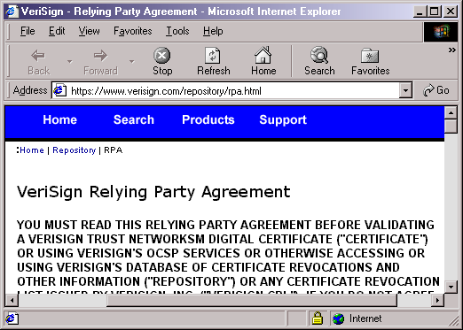
Data encrypted using secret key
exchanged using some public key
associated with some certificate.
Modern Cryptography

Slide 44
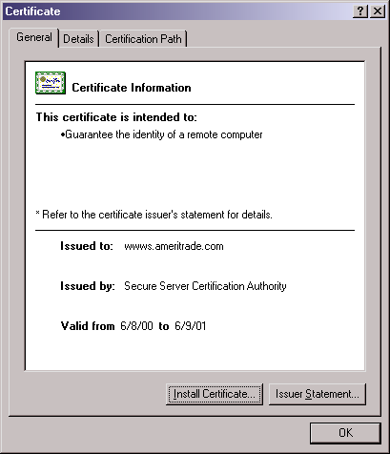
Modern Cryptography

Slide 45
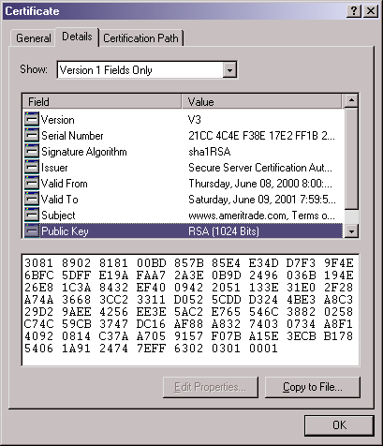
Modern Cryptography

Slide 46
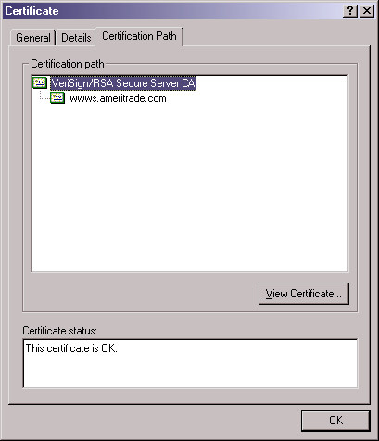
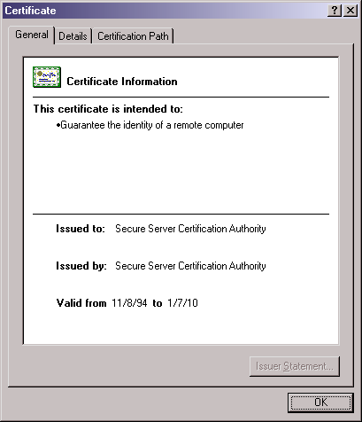
Modern Cryptography

Slide 47
SSL Recap
Browser
Server
Hello
KR_{CA}[Server Identity, KU_{S}]
Check Certificate using KU_{CA}
Pick random K
KU_{S}[K]
Find K using KR_{S}
Note: This is slightly simplified from the actual SSL protocol. This version
is vulnerable to a person-in-the-middle attack!
Secure channel using K
Modern Cryptography

Slide 48
Thanks and any questions?
Modern Cryptography

Slide 49
Animated version of Asymmetric Cryptography Demo
Modern Cryptography

Slide 50
Padlocked Boxes
Hi!
Alice
Modern Cryptography

Slide 51
Padlocked Boxes
Alice’s Padlock
Hi!
Alice
Alice’s Padlock Key
Modern Cryptography

Slide 52
Padlocked Boxes
Shady
Sammy’s
Slimy
Shipping
Service
Alice
Alice’s Padlock Key
Modern Cryptography

Slide 53
Padlocked Boxes
Bob’s Padlock
Alice
Hi!
Alice’s Padlock Key
Bob
Bob’s Padlock Key
Modern Cryptography

Slide 54
Padlocked Boxes
Hi!
Alice
Alice’s Padlock Key
Bob
Bob’s Padlock Key
Modern Cryptography

Slide 55
Padlocked Boxes
Hi!
Alice
Alice’s Padlock Key
Bob
Bob’s Padlock Key
Modern Cryptography

Slide 56
Padlocked Boxes
Alice
Hi!
Bob
Bob’s Padlock Key
Modern Cryptography

Slide 57
Padlocked Boxes
Hi!
Alice
Hi!
Bob
Bob’s Padlock Key
Modern Cryptography

Slide 58

The end and questions?
Modern Cryptography
The materials of this lecture are mostly from Washington university

