Slide 1

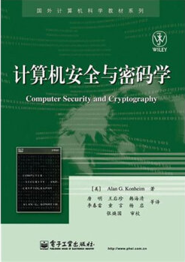
Computer Security and Cryptography
Lecturer: Zhou Peng, Ph.D in Computer Network Security
pzhou@shu.edu.cn
Lecture 8

Slide 2
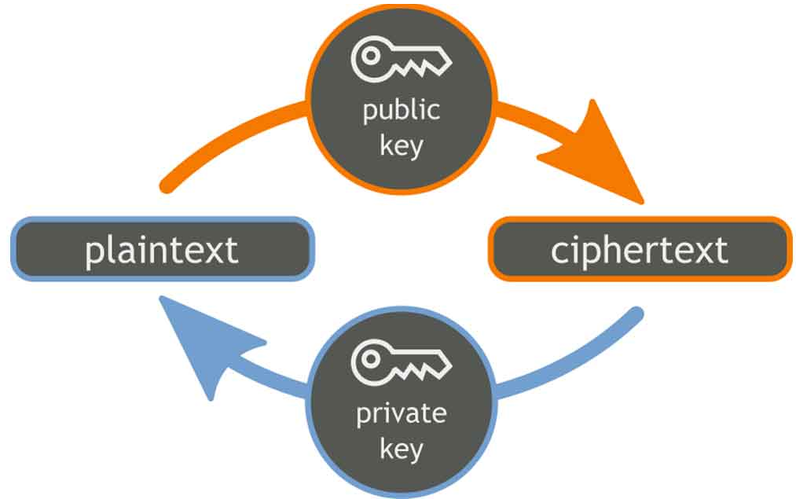
Computer Security and Cryptography
Lecture 8
Cryptography Review

Slide 3
Cryptography
Is
A tremendous tool
The basis for many security mechanisms
Is not
The solution to all security problems
Reliable unless implemented properly
Reliable unless used properly
Something you should try to invent or implement yourself
Cryptography Review

Slide 4
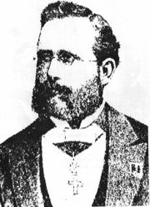
Kerckhoff’s principle
A cryptosystem should be secure even if everything about the system, except the secret key, is public knowledge.
Cryptography Review

Slide 5
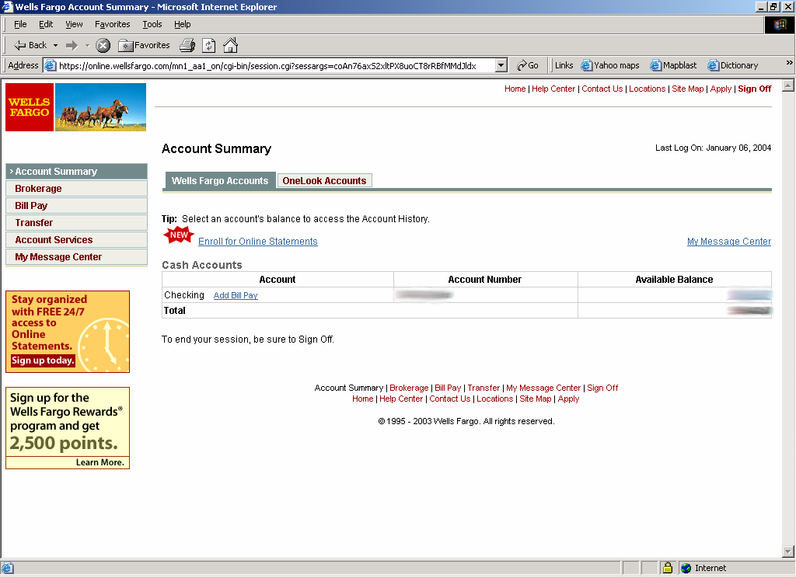
Goal 1:secure communication
Step 1: Session setup to exchange key
Step 2: encrypt data
HTTPS
Cryptography Review

Slide 6
Goal 2: Protected files
Disk
File 1
Alice
Alice
No eavesdropping
No tampering
File 2
Analogous to secure communication:
Alice today sends a message to Alice tomorrow
Cryptography Review

Slide 7
Symmetric Cryptography
Assumes parties already share a secret key
Cryptography Review

Slide 8
Building block: sym. encryption
E, D: cipher k: secret key (e.g. 128 bits)
m, c: plaintext, ciphertext n: nonce (aka IV)
Encryption algorithm is publicly known
Never use a proprietary cipher
nonce
Alice
Bob
m, n
E
E(k,m,n)=c
c, n
D
D(k,c,n)=m
k
k
Cryptography Review

Slide 9
Use Cases
Single use key: (one time key)
Key is only used to encrypt one message
encrypted email: new key generated for every email
No need for nonce (set to 0)
Multi use key: (many time key)
Key used to encrypt multiple messages
files: same key used to encrypt many files
Cryptography Review

Slide 10
First example: One Time Pad (single use key)
Vernam (1917)
Shannon ‘49:
OTP is “secure” against ciphertext-only attacks
Key:
0
1
0
1
1
1
0
0
1
0
⊕
Plaintext:
1
1
0
0
0
1
1
0
0
0
Ciphertext:
1
0
0
1
1
0
1
0
1
0
Cryptography Review

Slide 11
Stream ciphers (single use key)
Problem: OTP key is as long the message
Solution: Pseudo random key -- stream ciphers
Stream ciphers: RC4 (126 MB/sec) , Salsa20/12 (643 MB/sec)
key
c ← PRG(k) ⊕ m
PRG
⊕
message
ciphertext
Cryptography Review
Notes:
Pentium 4, 2.1GhZ

Slide 12
Dangers in using stream ciphers
One time key !! “Two time pad” is insecure:
C₁ ← m₁ ⊕ PRG(k)
C₂ ← m₂ ⊕ PRG(k)
Eavesdropper does:
C₁ ⊕ C₂ → m₁ ⊕ m₂
Enough redundant information in English that:
m₁ ⊕ m₂ → m₁ , m₂
Cryptography Review

Slide 13
Block ciphers: crypto work horse
n Bits
E, D
n Bits
PT Block
CT Block
Key
k Bits
Canonical examples:
3DES: n= 64 bits, k = 168 bits
AES: n=128 bits, k = 128, 192, 256 bits
IV handled as part of PT block
Cryptography Review

Slide 14
Building a block cipher
Input: (m, k)
Repeat simple “mixing” operation several times
• DES: Repeat 16 times:
• AES-128: Mixing step repeated 10 times
Difficult to design: must resist subtle attacks
• differential attacks, linear attacks, brute-force, …
m_{L} ← m_{R}
m_{R} ← m_{L}⊕F(k,m_{R})
Cryptography Review

Slide 15
Block Ciphers Built by Iteration
key k
key expansion
k₁
k₂
k₃
k_{n}
m
R(k₁, ⋅)
R(k₂, ⋅)
R(k₃, ⋅)
R(k_{n}, ⋅)
c
R(k,m): round function
for DES (n=16), for AES-128 (n=10)
Cryptography Review

Slide 16
Incorrect use of block ciphers
Electronic Code Book (ECB):
Problem:
if m₁=m₂ then c₁=c₂
PT:
m₁
m₂
CT:
c₁
c₂
Cryptography Review

Slide 17
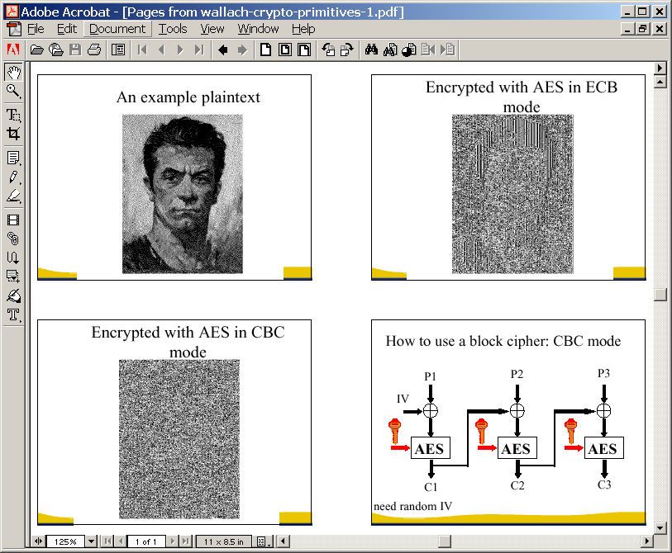
In pictures
Cryptography Review

Slide 18
Correct use of block ciphers I: CBC mode
E a secure PRP. Cipher Block Chaining with random IV:
IV
m[0]
m[1]
m[2]
m[3]
⊕
⊕
⊕
⊕
E(k,⋅)
E(k,⋅)
E(k,⋅)
E(k,⋅)
IV
c[0]
c[1]
c[2]
c[3]
ciphertext
Q: how to do decryption?
Cryptography Review

Slide 19
Use cases: how to choose an IV
Single use key: no IV needed (IV=0)
Multi use key: (CPA Security)
Best: use a fresh random IV for every message
Can use unique IV (e.g counter)
but then first step in CBC must be IV’ ← E(k₁,IV)
benefit: may save transmitting IV with ciphertext
Cryptography Review

Slide 20
CBC with Unique IVs
unique IV means: (k,IV) pair is used for only one message.
generate unpredictable IV’ as E(k₁,IV)
IV
m[0]
m[1]
m[2]
m[3]
IV′
⊕
⊕
⊕
⊕
E(k₁,⋅)
E(k,⋅)
E(k,⋅)
E(k,⋅)
E(k,⋅)
IV
c[0]
c[1]
c[2]
c[3]
ciphertext
Cryptography Review

Slide 21
In pictures
Cryptography Review

Slide 22
Correct use of block ciphers II: CTR mode
Counter mode with a random IV: (parallel encryption)
IV
m[0]
m[1]
…
m[L]
⊕
E(k,IV)
E(k,IV+1)
…
E(k,IV+L)
IV
c[0]
c[1]
…
c[L]
ciphertext
Why are these modes secure? not today.
Cryptography Review

Slide 23
Performance: Crypto++ 5.6.0 [ Wei Dai ]
Intel Core 2 (on Windows Vista)
Cipher Block/key size Speed (MB/sec)
RC4 126
Salsa20/12 643
3DES 64/168 10
AES/GCM 128/128 102
AES is about 8x faster with AES-NI : Intel Westmere and onwards
Cryptography Review

Slide 24
Data integrity
Cryptography Review

Slide 25
Message Integrity: MACs
Goal: message integrity. No confidentiality.
ex: Protecting public binaries on disk.
k
Message m
tag
k
Alice
Bob
Generate tag:
tag ← S(k, m)
Verify tag:
V(k, m, tag) = `yes’
?
note: non-keyed checksum (CRC) is an insecure MAC !!
Cryptography Review

Slide 26
Secure MACs
Attacker information: chosen message attack
for m₁,m₂,…,m_{q} attacker is given t_{i} ← S(k,m_{i})
Attacker’s goal: existential forgery.
produce some new valid message/tag pair (m,t).
(m,t) ∉ { (m₁,t₁) , … , (m_{q},t_{q}) }
A secure PRF gives a secure MAC:
S(k,m) = F(k,m)
V(k,m,t): `yes’ if t = F(k,m) and `no’ otherwise.
Cryptography Review

Slide 27
Construction 1: ECBC
m[0]
m[1]
m[2]
m[3]
⊕
⊕
⊕
E(k,⋅)
E(k,⋅)
E(k,⋅)
E(k,⋅)
Raw CBC
E(k₁,⋅)
tag
key = (k, k₁)
Cryptography Review

Slide 28
Construction 2: HMAC (Hash-MAC)
Most widely used MAC on the Internet.
H: hash function.
example: SHA-256 ; output is 256 bits
Building a MAC out of a hash function:
Standardized method: HMAC
S( k, m ) = H( k⊕opad || H( k⊕ipad || m ))
Cryptography Review

Slide 29
SHA-256: Merkle-Damgard
m[0]
m[1]
m[2]
m[3]
IV
h
h
h
h
H(m)
h(t, m[i]): compression function
Thm 1: if h is collision resistant then so is H
“Thm 2”: if h is a PRF then HMAC is a PRF
Cryptography Review

Slide 30
Construction 3: PMAC – parallel MAC
ECBC and HMAC are sequential. PMAC:
m[0]
m[1]
m[2]
m[3]
P(k,0)
⊕
P(k,1)
⊕
P(k,2)
⊕
P(k,3)
⊕
F(k,⋅)
F(k,⋅)
F(k,⋅)
F(k,⋅)
⊕
F(k₁,⋅)
tag
Cryptography Review

Slide 31
Why are these MAC constructions secure?
… not today – take CS255
Why the last encryption step in ECBC?
CBC (aka Raw-CBC) is not a secure MAC:
Given tag on a message m, attacker can deduce tag for some other message m’
How: good crypto exercise …
Cryptography Review

Slide 32
Authenticated Encryption: Encryption + MAC
Cryptography Review

Slide 33
Combining MAC and ENC (CCA)
Encryption key K_{E} MAC key = K_{I}
Option 1: MAC-then-Encrypt (SSL)
Option 2: Encrypt-then-MAC (IPsec)
Option 3: Encrypt-and-MAC (SSH)
MAC(M,K_{I})
Enc K_{E}
Msg M
Msg M
MAC
Enc K_{E}
MAC(C, K_{I})
Secure for all secure primitives
Msg M
MAC
Enc K_{E}
MAC(M, K_{I})
Msg M
MAC
Cryptography Review

Slide 34
OCB
offset codebook mode
More efficient authenticated encryption
m[0]
m[1]
m[2]
m[3]
checksum
P(N,k,0)
⊕
P(N,k,1)
⊕
P(N,k,2)
⊕
P(N,k,3)
⊕
P(N,k,0)
⊕
E(k,⋅)
E(k,⋅)
E(k,⋅)
E(k,⋅)
E(k,⋅)
P(N,k,0)
⊕
P(N,k,1)
⊕
P(N,k,2)
⊕
P(N,k,3)
⊕
auth
⊕
c[0]
c[1]
c[2]
c[3]
c[4]
Rogaway, …
Cryptography Review

Slide 35
Public-key Cryptography
Cryptography Review

Slide 36
Public key encryption: (Gen, E, D)
Gen
pk
sk
E
D
m
c
c
m
Cryptography Review
Notes:
Note: asymmetric keys

Slide 37
Applications
Session setup (for now, only eavesdropping security)
Non-interactive applications: (e.g. Email)
Bob sends email to Alice encrypted using pk_{alice}
Note: Bob needs pk_{alice} (public key management)
Alice
pk
Bob
Generate (pk, sk)
choose random x
(e.g. 48 bytes)
E(pk, x)
x
Cryptography Review

Slide 38


Applications
Encryption in non-interactive settings:
Encrypted File Systems
sk_{A}
read
Alice
write
E(pk_{A}, K_{F})
Bob
File
E(k_{F}, File)
E(pk_{B}, K_{F})
Cryptography Review

Slide 39
Applications
Encryption in non-interactive settings:
Key escrow: data recovery without Bob’s key
Escrow
Service
write
sk_{escrow}
E(pk_{escrow}, K_{F})
Bob
E(k_{F}, File)
E(pk_{B}, K_{F})
Cryptography Review
Notes:
Describe this in corporate settings. Bob’s key is no longer available, but need access to his files.
Escrow service is offline until needed.

Slide 40
Trapdoor functions (TDF)
Def: a trapdoor func. X⟶Y is a triple of efficient algs. (G, F, F⁻¹)
G(): randomized alg. outputs key pair (pk, sk)
F(pk,⋅): det. alg. that defines a func. X ⟶ Y
F⁻¹(sk,⋅): defines a func. Y ⟶ X that inverts F(pk,⋅)
Security: F(pk, ⋅) is one-way without sk
Cryptography Review

Slide 41
Public-key encryption from TDFs
(G, F, F⁻¹): secure TDF X ⟶ Y
(E_{s}, D_{s}) : symm. auth. encryption with keys in K
H: X ⟶ K a hash function
We construct a pub-key enc. system (G, E, D):
Key generation G: same as G for TDF
Cryptography Review

Slide 42
Public-key encryption from TDFs
(G, F, F⁻¹): secure TDF X ⟶ Y
(E_{s}, D_{s}) : symm. auth. encryption with keys in K
H: X ⟶ K a hash function
E( pk, m) :
x ⟵ X, y ⟵ F(pk, x)
k ⟵ H(x), c ⟵ E_{s}(k, m)
output (y, c)
D( sk, (y,c) ) :
x ⟵ F⁻¹(sk, y),
k ⟵ H(x), m ⟵ D_{s}(k, c)
output m
R
Cryptography Review

Slide 43
In pictures:
Security Theorem:
If (G, F, F⁻¹) is a secure TDF,
(E_{s}, D_{s}) provides auth. enc. and H: X ⟶ K is a “random oracle” then (G,E,D) is CCA^{ro} secure.
F(pk, x)
E_{s}( H(x), m )
header
body
Cryptography Review
Notes:
Need to explain what is a random oracle. NEVER encrypt m directly with RSA.

Slide 44
Digital Signatures
Public-key encryption
Alice publishes encryption key
Anyone can send encrypted message
Only Alice can decrypt messages with this key
Digital signature scheme
Alice publishes key for verifying signatures
Anyone can check a message signed by Alice
Only Alice can send signed messages
Cryptography Review

Slide 45
Digital Signatures from TDPs
(G, F, F⁻¹): secure TDP X ⟶ X
H: M ⟶ X a hash function
Security: existential unforgeability under a chosen message attack (in the random oracle model)
Sign( sk, m∈X) :
output
sig = F⁻¹(sk, H(m) )
Verify( pk, m, sig) :
output
1 if H(m) = F(pk, sig)
0 otherwise
Cryptography Review

Slide 46
Public-Key Infrastructure (PKI)
Anyone can send Bob a secret message
Provided they know Bob’s public key
How do we know a key belongs to Bob?
If imposter substitutes another key, can read Bob’s mail
One solution: PKI
Trusted root Certificate Authority (e.g. Symantec)
Everyone must know the verification key of root CA
Check your browser; there are hundreds!!
Root authority signs intermediate CA
Results in a certificate chain
Cryptography Review

Slide 47
Back to SSL/TLS
Version, Crypto choice, nonce
S
C
Version, Choice, nonce,
Signed certificate
containing server’s
public key Ks
Secret key K
encrypted with
server’s key Ks
switch to negotiated cipher
Hash of sequence of messages
Hash of sequence of messages
data transmission
Cryptography Review

Slide 48
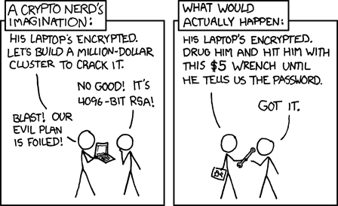
Limitations of cryptography
Cryptography works when used correctly !!
… but is not the solution to all security problems
XKCD 538
Cryptography Review

Slide 49

Thanks and any questions?
Cryptography Review
The materials of this lecture are mostly from Stanford university

